Slide 1
The Business Card
A lasting impression

Slide 2
Design
  White stock, dark ink (for easy reading and scanning into address books)
  Non-glossy surface – to make it easy to write on
  Standard size 2” x 3.5”
  Simple, easy to read type
  Clean crisp design
  No butterflies or unicorns – it’s a BUSINESS card

Slide 3
Printing
  Don’t money for offset printing, or engraving
  Don’t print 1000 (start with 50) – you’ll probably make changes soon
  Print on a laser printer.
    Use Avery ten-up, micro-perforated sheets
    for laser printers
    # 5871 (white) or 5876 (ivory)

Slide 4
Content
Employee or Entrepreneur
  Name
  Company
  Permanent address
  Phone
  Email
  Company URL
  Photo or sketch of product (optional)

Slide 5
Content
Student
  Name
  School,
      Major
      Graduation year
  Permanent address (minimum: city /state;
  or country if international student)
  Phone
  Email

Slide 6
Content
Job Seeker
  Name
  Field or Expertise
  (e.g. - Attorney, Designer, Accountant)
  Permanent address
  Phone (with answering machine)
  Personal Email

Slide 7
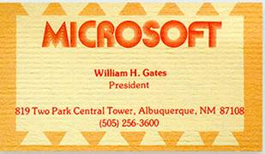
Sample Business Card 1

Slide 8
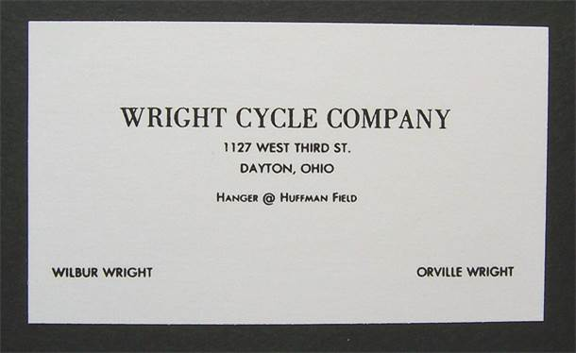
Sample Business Card 2

Slide 9
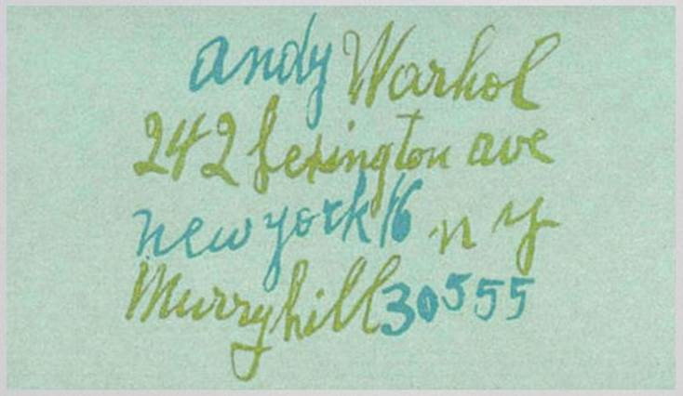
Sample Business Card 3

Slide 10
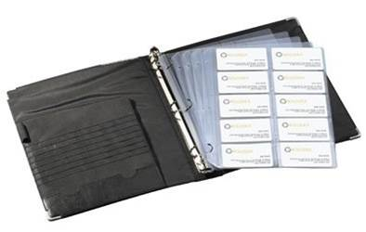
The Card Game
The one who collects the most cards wins
Rolodex Business Card Binder Kit
Fits 3-ring binder
Holds 100
business cards

Slide 11
Blank Slide

