Slide 1
Social Media Marketing

Slide 2
Popular Social Media Sites
  LinkedIn business networking, job changes
  Facebook and MySpace® friends/family
  Twitter users broadcast short messages
  YouTube users post videos to their “channel”
  Instagram bulletin board for photographs
  Snapchat like Instagram but pics last only seconds
  Pinterest subject-oriented photo sharing site

Slide 3
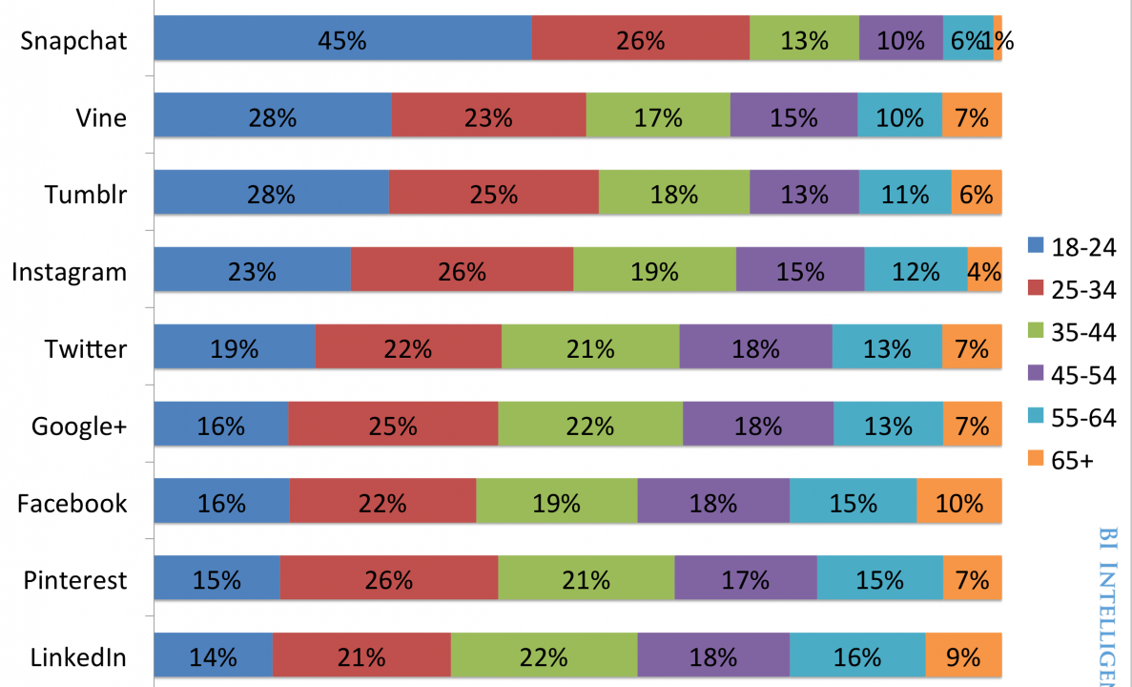
Age Distribution
U.S. Aged 18 and up. December 2014

Slide 4
Social Media is Pervasive
  More than 1 in 3 Americans have Facebook pages
  Facebook is the largest country in the world (1.44 billion “monthly active” users)
  Twitter has roughly 236 million active users
  MySpace still has roughly 50 million users
  Virtually every American between the ages of 10 and 25 is active on social media

Slide 5
Implications for Your Business
  58% of small business marketers spend 10 minutes on social media per day (46% more than one hour/day)*
  Businesses gain a 185% lift in in Web traffic after achieving 1,000 Facebook “likes”*
  Businesses with 51 to 100 Twitter followers generate 106% more traffic than those with 25 or fewer followers
  Many businesses see an increase in their search engine rankings if they are active on social media*
  57% of businesses have generated customers via LinkedIn
    48% Twitter
    42% Facebook *
Notes:
Source: http://localvox.com/resources/marketing-statistics/#social-media
November 2016

Slide 6
Impact of Social Media Ads
  An online display ad has an average click-through rate of 0.06%.
  A rich media ad has an average click-through rate of 0.27%
  Rich media is digital advertising that includes advanced features like video, audio, or other elements that encourage viewers to interact and engage with the content.
Notes:
Source: Smart Insights

Slide 7
You Still Need a Website
  Customers assume that you have one
  You can keep 100% of the profits you make and not have to share with the social media platform
  If you are selling creative works, you avoid some SM sites’ policy of “owning all rights” to images posted on the site

Slide 8
Social Media Marketing Tips
Share “cool, compelling content” to your target audience
  Must be entertaining AND informative
  How-to articles and video tutorials
  Interviews
  Webinars and Podcasts

Slide 9
Share content when traffic is at its peak
  Facebook®: 1 pm to 4 pm EST
  Twitter®: 1 pm to 3 pm EST
  LinkedIn®: 7 am to 9 am, 5 pm to 6 pm EST
  Google+®: 9 am to 11 am EST
  Pinterest®: 2 pm to 4 pm, 8 pm to 1 am EST*
Notes:
*source: www.marketmesuite.com

Slide 10
To start discussions and keep the
“buzz” going, ask questions
  Ask “open-ended” questions
  Ask questions about your industry or niche
  DON’T ask “yes or no” questions
  DON’T make every question about your products or services

Slide 11
Use Social Media for customer support and feedback collection
  50% of online buyers expect small businesses to provide customer support on Facebook
  56% of customer “tweets” to SMBs are ignored
Notes:
*source: www.marketmesuite.com

Slide 12
Choose the Right Social Media Platform
  B2C businesses: Facebook
  B2B and professional services: LinkedIn
  Impulse buys: Pinterest and Instagram
  Entertainment: Myspace
  Celebrities and personal brands: Twitter
Notes:
* source: www.myaffordablemarketing.com

Slide 13
Don’t Spread Yourself Too Thin ...
  30% of SMBs find LinkedIn® helpful
  22% of SMBs find Facebook® helpful
  14% of SMBs find Twitter® helpful
  13% of SMBs find YouTube® helpful
  7% of SMBs find Google+® helpful
  2% of SMBs find Pinterest® helpful*
... But don’t overlook “Microsites” for niche markets.
Notes:
*source: Wall Street Journal

Slide 14
Legal Issues
Advertising “tweets” may violate anti-spam laws
  You must give followers the chance to stop following
  You cannot send “tweets” to people who have not registered as a follower
  Must include a physical mailing address in all tweets
  Header must be honest and not misleading

Slide 15
Disclaimer
Legal information presented in this program SHOULD NOT be relied upon as legal or tax advice, which can only be given by a lawyer or other professional licensed to practice in your state.
Source: Cliff Ennico http://www.cliffennico.com

Slide 16
Blank slide

