Slide 1
Equity Capitalization Schedule (Cap Table)
Allowing for Enough Rounds of Financing to Achieve Profitability

Slide 2
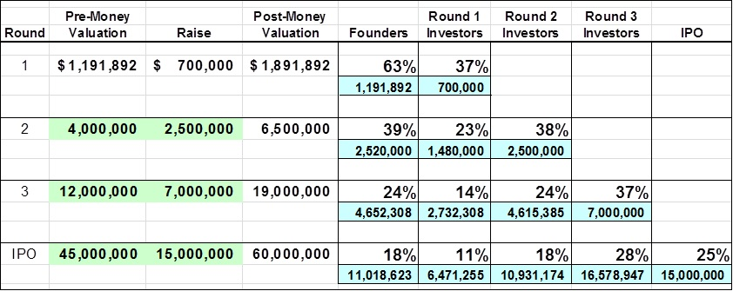
Cap Table Valuation vs. Dilution Analysis
Set aside equity to recruit key executives.
Identify capital needs for each round.
Determine valuation for each round.
  Identify comparables for exit (IPO or sale to larger firm).

Slide 3
Blank Slide

