Slide 1
Protecting Intellectual Property
    Patents
    Trade secrets

Slide 2
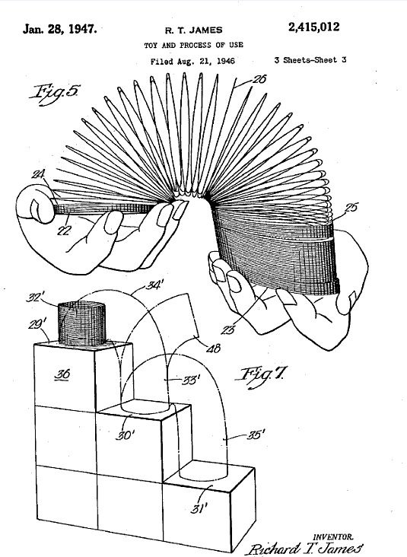
Patent
An intellectual property right granted by the government to an inventor to exclude others from making, using, selling or importing the invention for a limited time, in exchange for public disclosure of the invention. See www.USPTO.gov.

Slide 3
  Patents are assigned for 20 years
  To be granted, the product, process or software
  “Must be sufficiently different from what has been used or described before that it may be said to be non-obvious to a person having ordinary skill in the area of technology related to the invention.”
Notes:
For example, the substitution of one color for another, or changes in size, are ordinarily not patentable.

Slide 4
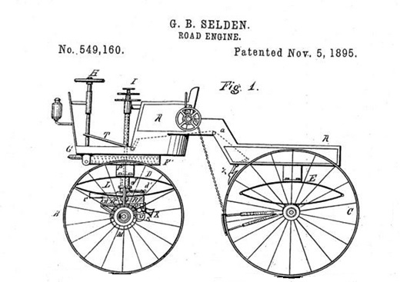
Law changed in 2013
As of 2013, patents are now granted to the
“first to file” for a patent (not the first to invent).

Slide 5
Protecting your idea prior to patenting
Limit exposure
Do not divulge secret sauce – discuss benefits, not the “how”
Use NDAs when possible
Ask employees and contractors to assign all rights to you
Notes:
NDA = Non Disclosure Agreement.
PROVISIONAL PATENT requires less paperwork than a full patent and allows inventor a year to refine the final product, but still establishes your precedence as the first to file.
You will be able to use the term “patent pending” in conjunction with the product during the 12-month “pendency” period.
Note: you must file for a full (non-provisional) patent within 12 months or risk losing the right to patent.

Slide 6
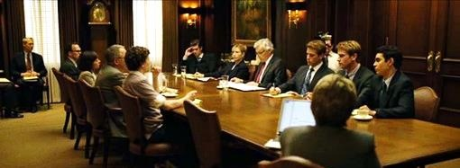
What is this a dramatization of ?
Who is the character seated second from right on the near side?
What should the Winklevoss twins have done to protect their idea?
Notes:
1. Lawsuit by Winklevoss twins against Facebook for stealing idea
Actor Jesse Eisenberg portraying Facebook founder Mark Zuckerberg
Asked Zuckerberg to sign and NDA and document granting all rights to software developed by him to the Winklevosses (seated 2nd and 3rd from right on far side of the table).

Slide 7
To Patent or Not to Patent
REASONS TO PATENT
Build investor confidence
Discourage knock-offs
Prevent someone else from patenting product – and then precluding you from making or selling it
Notes:
1. Investors are reluctant to lay out funds for an idea that can easily be copied.

Slide 8
REASONS NOT TO PATENT
A “First-Mover Advantage” may be just as effective in discouraging copycats; and less expensive.
Your product has a “secret sauce” that is easier to protect by just keeping it hidden
The product’s marketable lifespan is less than the time it takes to obtain a patent
If someone violates your patent it could cost $500,000 or more to try to defend it in court.
Notes:
A patent can cost $10,000 to 20,000 or more, depending on complexity of invention.
Coca-Cola uses the Secret Sauce strategy and the formula has never been patented.
A patent requires typically 2 or more years to obtain; and applicants are not always successful.
... And after spending years of your life and all your money, you might lose the patent suit.
The court could decide that your product wasn’t unique enough and you should not have been awarded a patent in the first place.
The patent game is for well-healed players.

Slide 9
Slide title
“Intellectual Property has the
shelf life of a banana.”
-- Bill Gates

Slide 10
Where to Start
Make sure the idea is not already patented
(you have the right to make it).
Search www.Patents.Google.com
Obtain quotes from attorneys.
Decide if it is worth the time, effort and
expense to attempt to obtain a patent
Select the type of patent to file (there are 3)
Notes:
1. If idea is already patented, can you alter or improve upon it in such a way as to obtain a patent. Over 1000 patents have issued for better mousetraps.
If there is no way around the patent, consider acquiring a license that would allow you to manufacture and sell the item.
3. Discussions with reputable attorneys will give you an inkling as to the probability of obtaining a patent.
4. [Go to next slide]

Slide 11
Types of Patents
  a. Provisional. A temporary patent. A standard utility patent must be filed within 12 months.
b. Utility (Non-Provisional). A “full patent.” Granted for 20 years.
c. Design (for a new, original, and ornamental design for an article of manufacture).
Notes:
a. Provisional. A preliminary and relatively easy application process to establish
precedence. A standard non-provisional utility patent must be filed within 12 months.
b. Utility (Non-Provisional). Granted for new and useful process, machine, article of manufacture, or composition of matter, or any new and useful improvement thereof.
c. Design (for a new, original, and ornamental design for an article of manufacture).
For example, Apple’s iPhone has rounded corners. When Samsung introduced its smartphone, with rounded corners, Apple sued for violation of a design patent.

Slide 12
Trade Secret
An alternative to a Patent.
Information about the product or process is NOT filed with the government, as then it would be available to the public and, well, then no longer a secret.
The common law behind the concept is that if you literally had a secret sauce, you could take legal action against someone who sells the identical sauce if you can prove they would have had to obtain the information illegally.

Slide 13
Proving secret could have been obtained only surreptitiously
Document that you had a formal procedure to prevent disclosure of the trade secret. Proof of your safeguarding procedures might include:
Security at business office and manufacturing location
Procedures to keep vital information under lock and key
Non-disclosure agreements with employees and suppliers
A patent is more expensive, but as a government document it is easier to defend in court than a Trade Secret claim.

Slide 14
Blank slide

