Slide 1
Protecting Intellectual Property
    Trademarks
    Copyrights

Slide 2
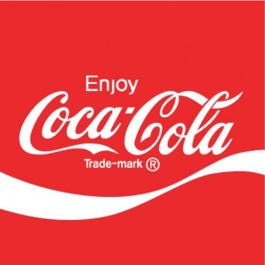
Trademark
Protects a brand name, product logo or other feature that distinguishes one company’s products from its competitors.

Slide 3
Types of Trademarks
Type | Examples
Word | McDonalds, Tesla
Color | Coca-Cola red, Kodak yellow
Design or Logo | Nike swoosh, Coke swoosh
Sound | NBC chime (G-E-C)
Notes:
The NBC chime notes stand for General Electric Corporation

Slide 4
What makes for a strong mark?
FANCIFUL MARK
Easiest to register and defend, as they are made up words with no meaning– other than what you give to them.
Examples:
EXXON
XEROX

Slide 5
ARBITRARY MARK
An existing word but that has no relation to the product.
This is the second strongest type of mark.
Examples:
APPLE for computer
PANDORA for streaming music

Slide 6
DESCRIPTIVE MARK
The weakest as it may be difficult to prove that it is unique to your brand. It may be possible to show that the word has acquired secondary meaning through its association with your brand – but this is costly; not recommended for startups.
Examples:
PURE for bottled water
AIRBUS for airplane
COPPERTONE for sun tan lotion

Slide 7
Before adopting a trade name ...
…for your product or company, make sure it isn’t already registered for your class of product or service.
For a quick search see www.KnowEm.com
Or search www.uspto.gov/trademark

Slide 8
Before adopting a trade name ...continued
Check to see if the "Live/Dead Indicator" shows the mark to be "live."
A "dead" mark cannot be used to block your application.

Slide 9
It is not necessary to register a mark in order to use it
You can simply add a small TM to your product name or logo (SM for services).
Product NameTM

Slide 10
Advantages of
Registering a Trademark
  The ability to sue for infringement
  To obtain registration in other countries
  To prevent importation of infringing goods
  The right to use the federal registration symbol ®
  Listing in the US PTO database so other entrepreneurs will see that the mark is registered
Notes:
Registering a trademark will cost approximately $300 in filing fees, plus legal expenses.

Slide 11
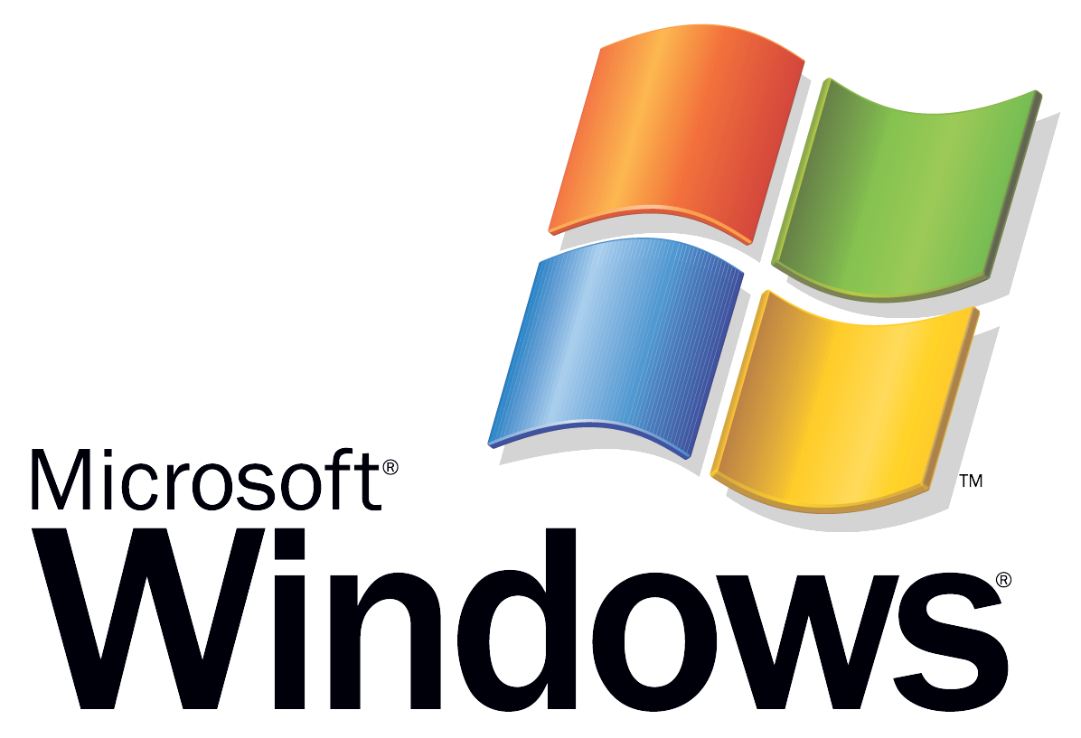
Examples of Use of ® and TM
Notes:
Note that Microsoft uses a registration mark on the word “Windows,” but a TM on the symbol for “Windows.”

Slide 12
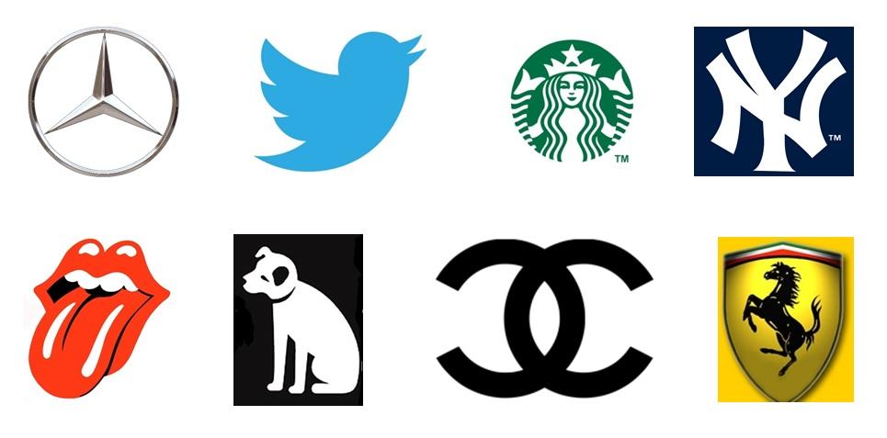
Can you name these companies just by their symbols?

Slide 13
Copyright
Protects original works of authorship including books, scripts, music, art and design, and computer software.

Slide 14
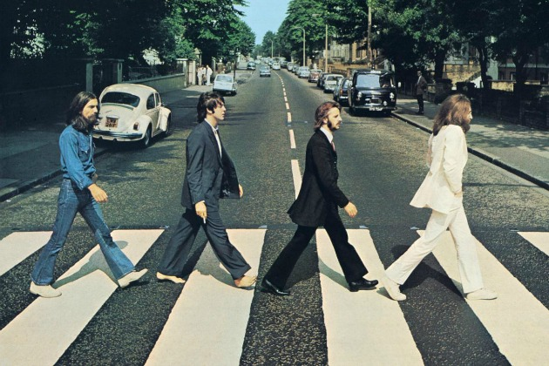
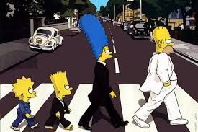
The Original (Copyrighted)
Abbey Roads album cover
M-m-m, no.
Notes:
The Beatles Abbey Road album cover

Slide 15
The process is now automatic
  Before 1989, US copyright law required creators to publish works with a copyright notice printed within the work.
  Now a copyright is automatic. An author owns a copyright from the moment it is created.
  A copyright lasts for the life of the author plus 70 years.

Slide 16
However ... if you wish to bring a lawsuit
  for infringement of your work, you will have to produce a copyright registration certificate.
  The fee is $35. Register online at
  U.S. Copyright Office https://eco.copyright.gov

Slide 17
Blank slide

