Slide 1
Alternative Business Structures
    Sole Proprietorship
    Limited Liability Company (LLC)
    Corporation (C Corp)
    Benefit Corporation

Slide 2
Sole Proprietorship
  If you do nothing, you are by default a Sole Proprietorship.
  You and the business are the same entity.
  You are responsible for all obligations, debts, and fines incurred by the business.
  Business income is reported on your personal income tax returns.
  You do not have to file or pay a separate tax on the business.

Slide 3
    Limited Liability Company (LLC)
  Allows for multiple owners, but with limited personal financial.
  Not subject to the requirements to elect a board and hold regular meetings with minutes, as required under the Corporation structure.

Slide 4
Corporation
  A traditional corporation; also called a “C Corp”.
  Managed by a Board of Directors that is elected by the shareholders.
  The shareholders and Board must meet at least annually and keep minutes of important decisions.
  Profits are taxed by the IRS and the states.
  Dividends (which can only be distributed from after-tax profits) are reported on the individual tax returns of the shareholders. Owners are therefore “double-taxed” on income from the company.

Slide 5
LLC vs. C-Corp Fundraising Implications
Investors will want you to be a C-Corp because it is much easier to distribute shares of equity. (Unlike Corporations, LLCs do not have stockholders.)
Also, venture capital funds are not structured to be flow-through tax entities. For an LLC profits and losses flow through to the VC fund, creating a tax paperwork burden for the fund and its investors. To prevent this problem, VCs invest only in C-corps.
However, you can start as an LLC, then convert to a C Corp when you are ready for professional equity financing.

Slide 6
    Benefit Corporation
  A class of C Corporation legally obligated to make a material positive impact on society and the environment.
  Boards of directors are required to consider the consequences of key actions as they affect all society stakeholders, not just shareholders.
  For more information http://benefitcorp.net

Slide 7
    Analysis of Benefit Corporation
ADVANTAGES
PR value in attracting and retaining employees and socially conscious investors
Differentiation with competitors
Alternative to a
non-profit structure
DISADVANTAGES
Additional paperwork to set up and more detailed annual reports
Must incur the annual paperwork and fees associated with a C Corp.

Slide 8
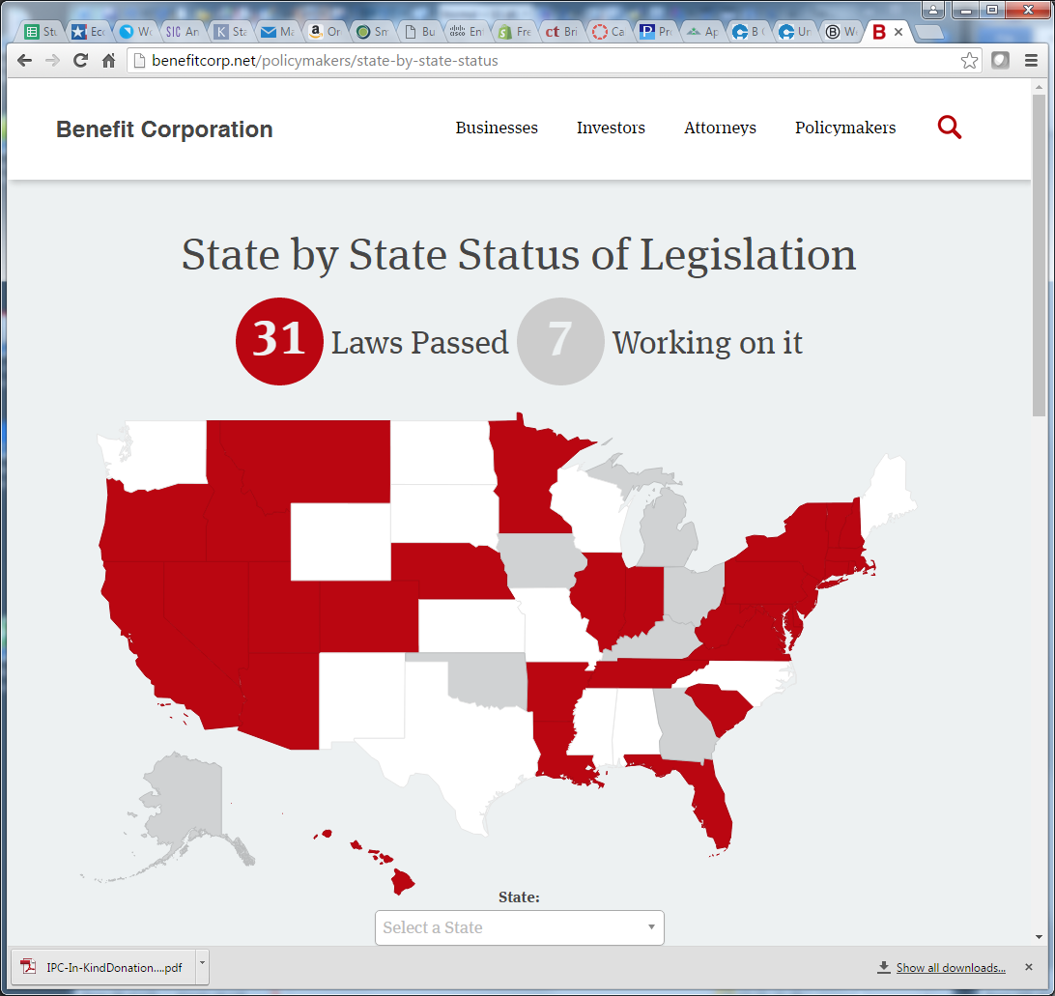
States That Allow Benefit Corporations
Notes:
States that allow Benefit Corporations. If your state is shaded white or gray, and you want to see if it passed legislation allowing for Benefit Corporations since this map was prepared (June 2016), go to http://benefitcorp.net/policymakers/state-by-state-status

Slide 9
The B Corp
Sometimes confused with Benefit Corporation
  A “B Corp” is a certified Benefit Corporation that pays a fee to B Lab, a non-profit that confirms that the company has met its legal obligations as to Measurable Social Performance, Accountability, Transparency, and Measurable Environmental Performance.
  Certification fees range from $500 to $500,000 per year, depending on the size of the company.
Notes:
To learn more about B Corp certification, visit www.bcorporation.net

Slide 10
Steps to Setting up An LLC
  Confirm company name is not already registered in your state and is available as a trademark and URL.
  Arrive at an agreement among the founders as to what percentage each of you will own. (You can form an LLC with a sole member.)
  Prepare an “LLC Operating Agreement” Template: http://www.legalcontract.com/contracts/llc-operating-agreement
  File Articles of Organization with Secretary of State
  Register company with your Town Clerk
  Obtain a Sales Tax License (to collect sales taxes)
Notes:
Prepare an “LLC Operating Agreement”. A boilerplate example appears in the Launching a Venture text. We recommend that you review the document with a business attorney, but you will save the lawyer time (and you money) by considering issues of governance in advance and preparing a draft document.
A nifty online template that will guide you through each legal twist and turn may be found at
http://www.legalcontract.com/contracts/llc-operating-agreement/.
The cost is $24.50 for the one form. There is also a “free” option (assuming you remember and figure out how to cancel the $33/ month contract that kicks in with the free download.
Obtain a Sales Tax License through your state department of revenue services. (Google “Sales taxes” and the name of your state.) Some municipalities, like New York City, also require you to collect sales taxes on their behalf, so also check with the city administration in the town where your business is headquartered.

Slide 11
Blank slide

