Slide 1

Crowdfunding
© Copyright Entrepreneurship Foundation Inc.

Slide 2
Strategy
A thoughtful, well-planned and professionally-executed crowdfunding campaign can serve to provide the critical startup and early-stage growth capital for student ventures.

Slide 3
Crowdfunding Hierarchy
Category Supporter Motivation Potential
DONOR Help member of alma mater $200 - $2000
REWARD Price discount for advance $5000 - $100,000
purchase of new products
DEBT Better than average return $2500 - $10,000
ROYALTY Safer, faster return than equity $5000 - $10,000
EQUITY Potentially very high return $50,000 and up
(In early on next Google)

Slide 4
Donor Crowdfunding

Slide 5
What Results Can Students Expect?
Assume you will raise $200-$500
The higher the Funding goal, the less likely a project will succeed.
Crowdfunders often choose companies to invest in based on the percentage of goal attained.
The lower the goal, the easier it is to show significant progress early on.

Slide 6
Suggested Use of Grants
Proof-of-concept: determine if the concept is technically feasible (it will work), a market demand exists, and product is not already patented:
Creating an MVP (Minimum Viable Product)
Lab testing the MVP
Patent search
Provisional patent to launch on Kickstarter

Slide 7
Donor Acknowledgements (Rewards)
REWARD THRESHOLD. $20 for intangibles;
For a tangible reward (coffee cup, CD), add
at least cost of reward.
OFFER LEVELS to elicit larger donations.
EARLY-BIRD SPECIALS for early momentum
EXAMPLES
  $ 20 = Listing on web site
  $ 30 = Signed photo postcard from team
  $ 40 = T-Shirt with your logo and “Sponsor”
  $ 100 = Invite to product launch party

Slide 8
Crowdfunding – General

Slide 9
Promotion: Marketing the Campaign
  PREPARE THE GROUND. 90% of the work of a successful campaign takes place before it launches.
  PEOPLE GIVE TO PEOPLE. Team members should have personal pages connected to the project.
  ENGAGE AUDIENCE. Create a 1 question survey around alternative product features.
  POST FLYERS AROUND SCHOOL just prior to launch of campaign

Slide 10
PR (Advertising you don’t pay for)
Find bloggers, reporters who cover your industry – or town.
Send Press Releases . Use a service like MarketWired.com to get instant SEO boost as 200+ other websites will link back to your site.
Have a media kit ready for journalists
  Bio and inspiring personal stories
  Professional pics
  Info about your industry
  Social mission, how you benefit society

Slide 11
Building the Prospect List
  Start NOW to build your list of
    friends
    alumni
    local entrepreneurs
    parents
    bloggers and journalists
  If students and faculty reach out to the people they know, those people will each know 3 .......
  LinkedIn is searchable by alma mater

Slide 12
  Hype Via Social Media
Focus on engagement, not broadcasting. Converse with potential customers about everyday issues. Be a personality not a spammer.
  Optimizing Social Media Affect
    Start publicizing before start of campaign
    Consider a Social Media Aggregator like www.Hootsuite.com
    Leverage with Thunderclap.it >>

Slide 13

The All-Important Video
Must tell a compelling story
You, your team, and your business
Why should anyone care? Exude passion.
Amount of raise, and how it will enable startup
Video Production
Share draft for feedback on your video and rewards
Length: 30-60 sec. Capture attention in 10 seconds
The following video raised $13 million on Kickstarter
https://d2pq0u4uni88oo.cloudfront.net/projects/730019/video-414581-h264_high.mp4

Slide 14
Timetable
  Don’t underestimate time and energy required for a SUCCESSFUL campaign.
  Develop a cadre of volunteers to help promote
  The team should raise 30% of goal prior to the official start of campaign.
  Launch all projects at your school on same day to maximize buzz and coordinate promotion.
  Do NOT launch entrepreneurship projects at same time of year as other university campaigns
  Set a consistent deadline for giving: 30 days

Slide 16
TheFollowing slides contain information intended for professors only

Slide 17
Donor Crowdfunding
The Entrepreneurship Foundation has a Donor Crowdfunding platform: www.EF.Hubbub.net that is available to schools for student businesses to raise Proof-of-Concept funds.
The Foundation retains 8% of successful campaigns (same as Kickstarter) to cover site maintenance and payment processing.
Contact Roer@EntrepreneurshipFoundation.org to set up a custom page on the platform.

Slide 18
Donor Crowdfunding Site
Limited to entrepreneurial projects
Only students and recent grads may be “Project Creators”
Projects must attain minimum goal for “Sponsor” donations to be earned. (Otherwise pledges returned to donors.)

Slide 19
How Schools Can Help
  Consider offering bonus points for every $100 contributed, redeemable for ...
    privileged parking spaces on campus
    tickets to athletic or entertainment event
    lunch with dean
Provide a match to all contributions, up to a specified total per project.

Slide 20
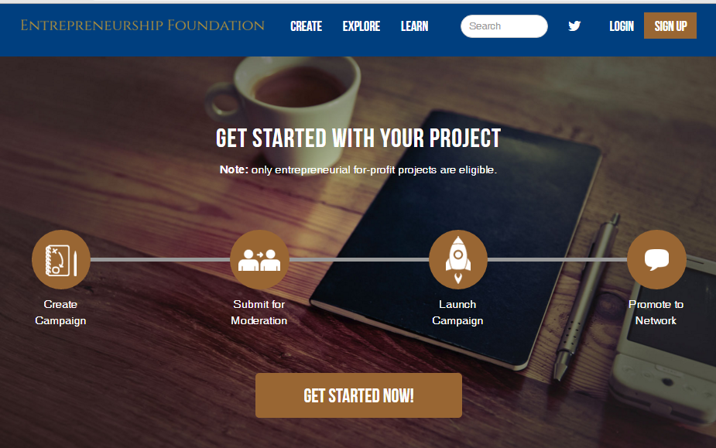
EF.Hubbub.net

Slide 21
Patent
Note: a patent may not be necessary for the donor (pre-seed) stage. The details of the innovation can be vague enough not to enable someone to file a pre-emptive patent.
“We’re working on a method to produce biodegradable fast-food serving containers”
does not reveal the all-important how.

Slide 22
Blank Slide

