Slide 1
Allocating Shares to Investors Based on Rules of Thumb

Slide 2
Mark Cuban does not whip out a financial calculator during negotiations on Shark Tank.
When making a quick analysis, most angel investors use a personal rule of thumb for the percentage ownership they need from each investment to meet their ROI goal, averaging their home runs with the singles and strike-outs.

Slide 3
The Following are Rules-of Thumb Used by Investors to Calculate the Ownership Percentage Needed to meet their ROI objectives

Slide 4
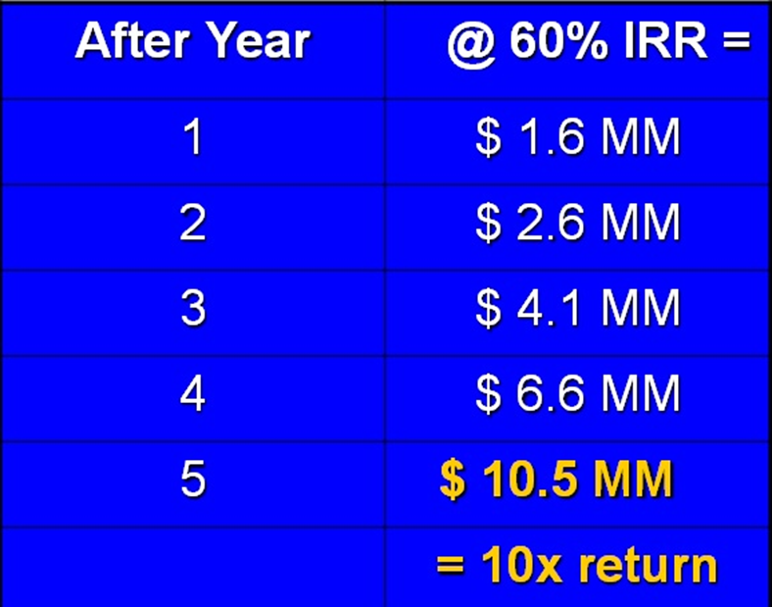
1. The “X” Return on Investment in 5 Years. Most serial investors will expect a deal that offers a 10x to 20x return in 5 years— assuming all goes according to your business plan.
Example of a $1 Million Investment achieving a 10x return in 5 years.

Slide 5
Reality Check
So does that mean an investor whose deals always allows for a 10x ROI (if sales and profit goals are met) will actually earn ten times his or her money back over a typical 5-year horizon (an average annual compounded ROI of 40%)?

Slide 6
No. Assume a $1 Million Investment in each of 10 startups ($10m total), with terms that provide a 10x on each investment, IF the profit goals are met. How did we do? What was our actual I/Y? PV= N= FV= PMT = 0 CMT I/Y = __ %

Slide 7
So how do we structure an offering calculated to provide a 10X return?

Slide 8
“X” Return on Investment Method Made Easy
Determine the potential value of company at exit (“terminal value” AKA FV) for example, $ 20 million
Determine the return on investment required: e.g. 10X
Calculate PV (Post-Money val): $ 20m /10X = $ 2 m Why should PV be “Post”?
If size of investment is $ 1 m then fair ownership for investors is ______ %
Notes:
50%
$2 million current Post-Money Valuation / $1 million of valuation represented by investment

Slide 9
2. Rule of Thumb Based on Investor’s Experience
Many angel investors feel that based on their track record they need a Y% stake in every portfolio company in order for them to meet their ROI goal; And to own enough of company to have some influence over decisions.
You can see this rule of thumb at play on Shark Tank.

Slide 10
EFFECT OF SUPPLY AND DEMAND on Average Percentage Allocation to Investors
Investor shares usually range between 10% and 50%,
but most deals are done for approximately a 30-33% stake to investors:
Not so a percentage little that investors don’t have a significant stake
Nor so much that entrepreneurs lose control or motivation
Notes:
Contrary to popular belief, investors do NOT want to take control (and all the headaches that come with it).
They want to provide capital, connections and advice, but leave the responsibility with the entrepreneur.

Slide 11
Effect of Market Equilibrium
Because so many deals have now been done, investor know they can find a better deal if an entrepreneur insists on giving up more than a few percentage points.
Likewise, knowledgeable entrepreneurs know that if an investor demands much more than 50%, he or she can probably find a more reasonable capital provider.

Slide 12
When Markets Are Out of Equilibrium
During the dot-com bubble, when investors were chasing deals, presumed valuations were high and many deals netted investors only a 10% stake.
Moral: As in other forms of investment, emotion often plays an outsize role in equity financing deals.

Slide 13
3. Valuation Based on Risk
Investors will also look at the risk inherent in a venture and adjust their requested reward accordingly.
Note: this is a factor in all deals. Entrepreneurs should hold off raising capital for as long as possible, to squeeze as much risk out of the deal for investors as is possible.

Slide 14
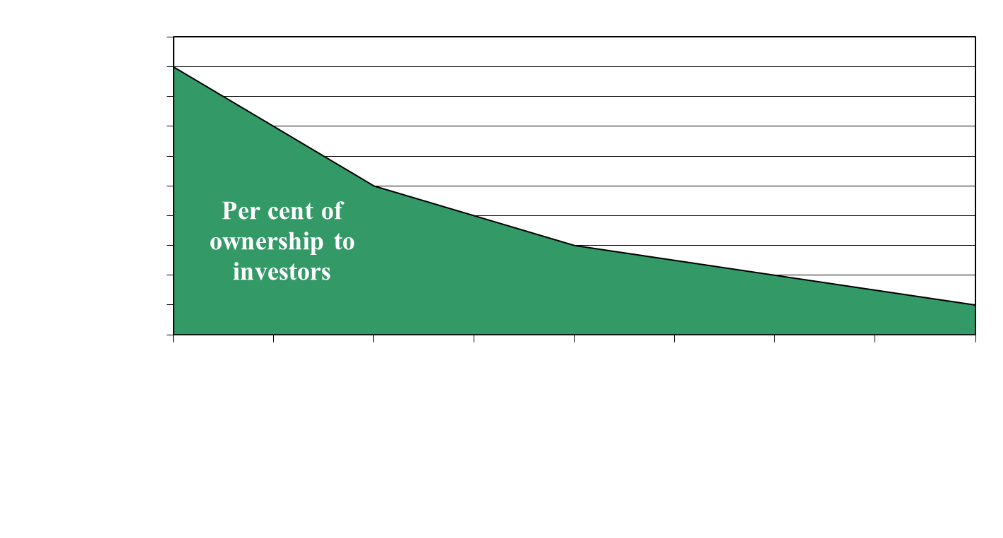
Sample Investor Allocation Based on Perceived Risk
External factors: Economy – Capital available – Confidence – Competition Internal Factors: Hot New Tech – Serial Entrepreneur – Mega Potential

Slide 15
Blank Slide

