Slide 1
What’s the Big Idea?

Slide 2
Concept Development Process
A. IDEATION. Generating ideas for new businesses/products
EVALUATION. Filtering concepts to arrive at the most promising

Slide 3
Sources of Inspiration
Bookstores – Best Nonfiction sellers
Wired.com
Facebook / Twitter / YouTube (What’s trending?)

Slide 4
Research - 1
Look for problems lacking adequate solutions--
where the problem causes real pain.
What do you find annoying?
Talk to other consumers.
Talk to people in your industry. What are their pain points?

Slide 5
Research - 2
Look for new niches (customer segments not now adequately served)
Skate like Wayne Gretsky
Find a product or service that needs improvement
Lower manufacturing cost of an existing product

Slide 6
Research - 3
Research emerging trends. Make sure to catch the start of the wave so you don’t get wiped out. Don’t be a me, too.
Sometimes a new product creates a demand for a related product line, as cell phones led to demand for protective cases.
Think like Bobby Fisher

Slide 7
Trends
The "One Word: Plastics" scene from The Graduate
https://www.youtube.com/watch?v=PSxihhBzCjk

Slide 8
Trends -2
Indiegogo.com
Feb 2019

Slide 9
Trends - 3
iGen teens—those who were born in 1995 and later, grew up with cell phones—spend 7 fewer hours a week socializing with their friends.
They are replacing human time with screen time. Wired

Slide 10
Trends - 4
A Google Home device is sold every second.
So what?

Slide 11
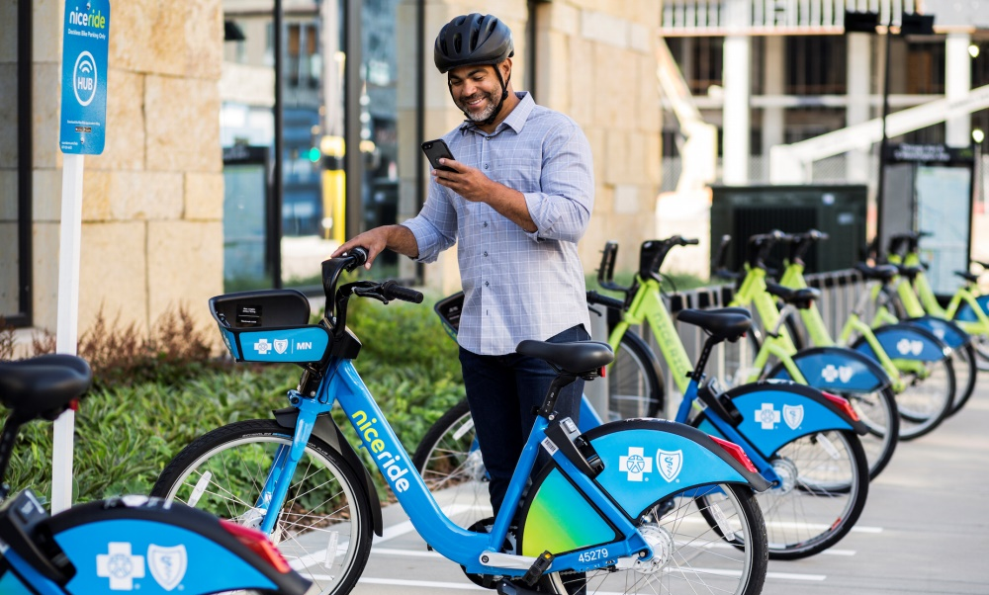
Trends - 5
Millennials want to live in cities.
What opportunities will this create for resourceful entrepreneurs?

Slide 12
Trends - 6
China is buying less of our recycled plastic and cardboard. It is pilling up.
-- Newsday, Sep 2, 2018
Amazon and Walmart shipping boxes.
What opportunities does this offer?

Slide 13
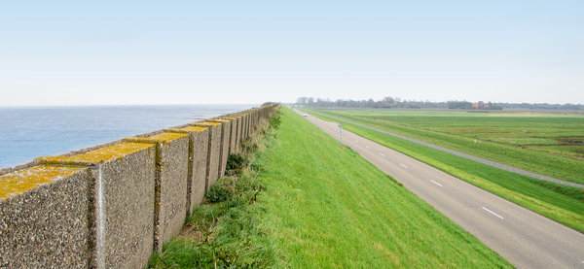
Trends - 7
Global warming
What problems will this create?
Solutions?

Slide 14
Trends - 8
Banned in Washington D.C.
-- The Atlantic, April 2019

Slide 15
Trends - 9
Self-Driving Cars
What opportunities will this create?
Video showing unnerving effect of driverless cars on fast-food drive-up window servers
https://www.youtube.com/watch?v=lN85JXpV69A
Self-driving trucks?

Slide 16
Trends - 10
Block chain
AI
Robotics
VR, AR

Slide 17
What is the problem each of the following products solve?
Is the pain intense enough to cause customers to break old habits and try the new solution?
Rate each: Cool or Dumb?

Slide 18
Food Products

Slide 19
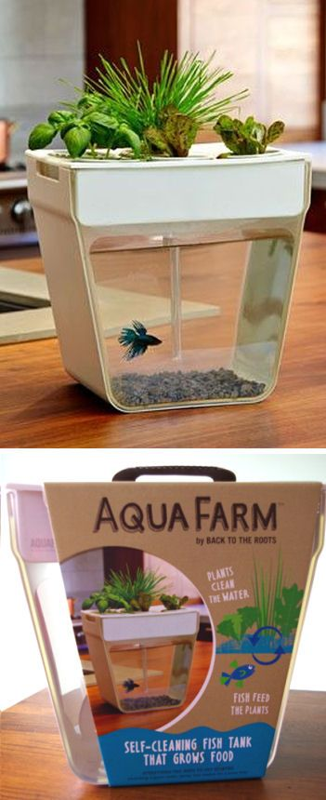
Food Products - 2

Slide 20
Food Product – 3 (Fictitious, right?)

Slide 21
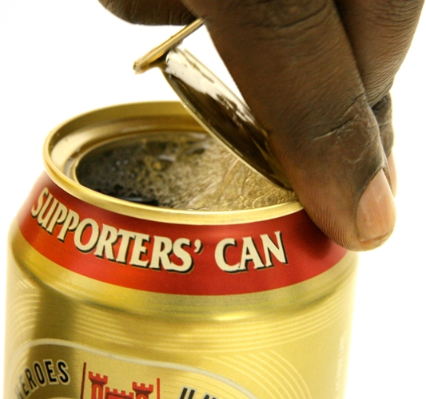
Perhaps no so far-fetched

Slide 22
Kitchen Gadgets

Slide 23
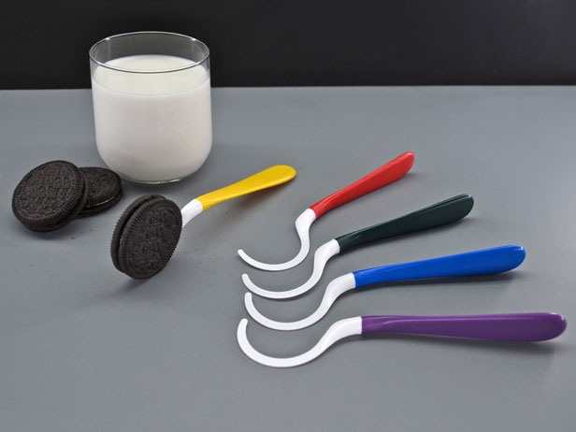
Kitchen Gadgets - 1

Slide 24
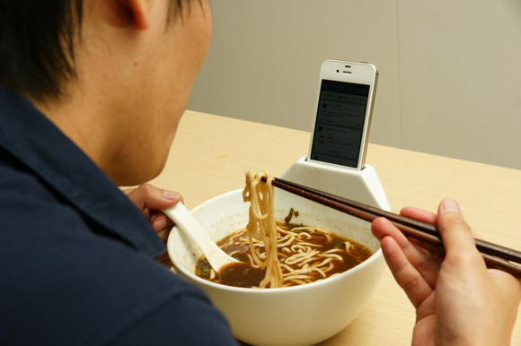
Kitchen Gadgets - 2

Slide 25
Work-Related Aids

Slide 26
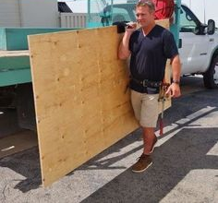
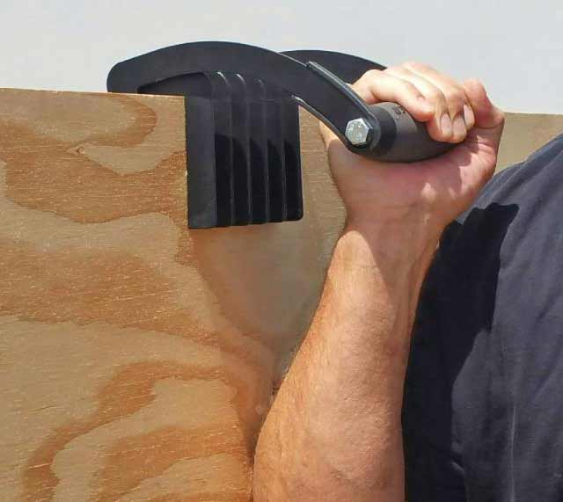
Work-Related Aids - 1

Slide 27
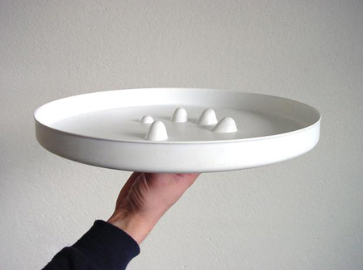
Work-Related Aids - 2

Slide 28
Household Products

Slide 29
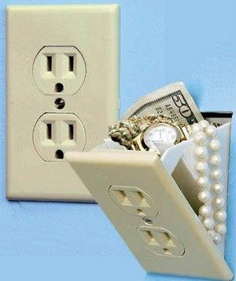
Household Products - 1

Slide 30
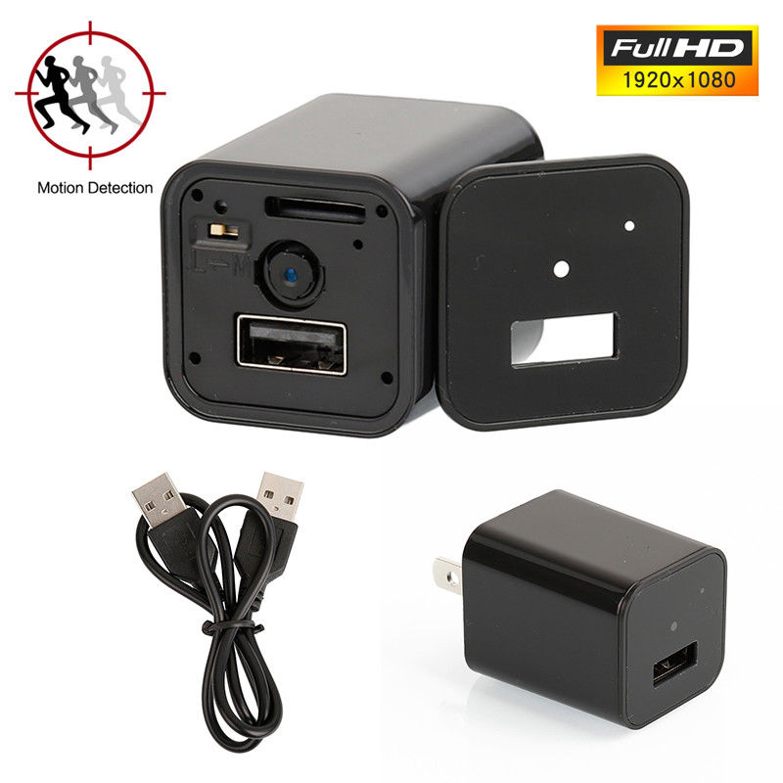
Household Products - 2
Nanny Cam built into a phone Charger

Slide 31
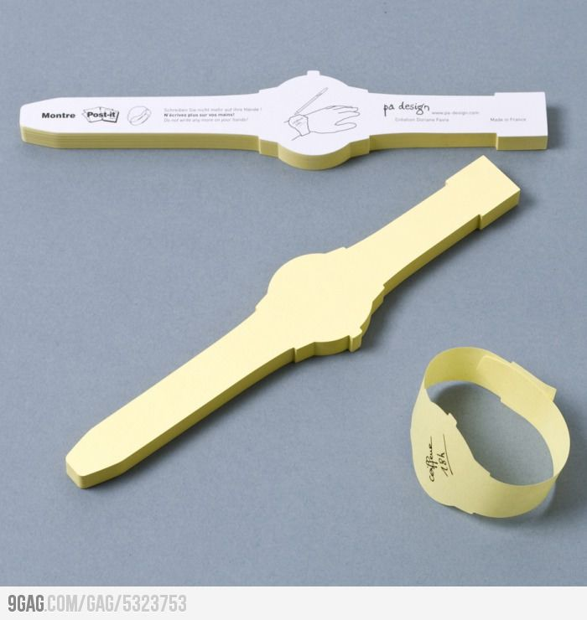
Personal Products
Replaces the string-around-the-finger reminder

Slide 32
Electronics

Slide 33
Filtering and Validating Ideas
Do what you know
Do what you are passionate about
Do you have the right to make it? Search Patents.Google.com
Do you have the necessary capital or access to it?
Evaluate ideas as if you were the investor

Slide 34
Blank slide

