Slide 1
Competitive Positioning
Researching Competition

Slide 2
Competitive Intelligence
Google search: geographic area +type of business
Massachusetts printers
Des Moines restaurants
BizBuySell.com
Hoovers Database http://www.Hoovers.com/mktsem/access-all-businesses.html
With 2 day free trial
Industry Journals and Blogs
App stores

Slide 3
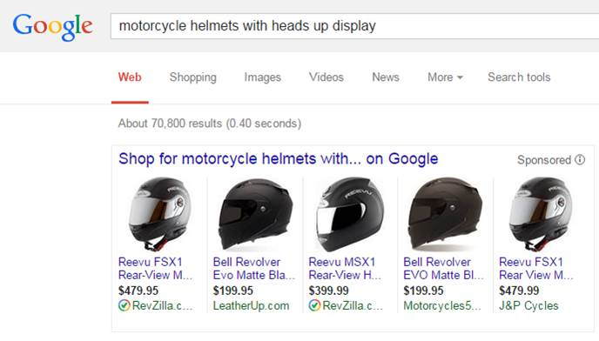
Google Competitive Search Example

Slide 4
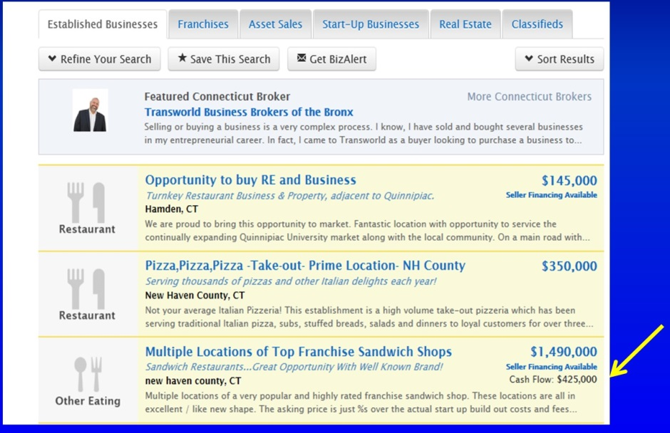
Researching Industry Profitability
Consult www.BizBuySell.com
for businesses like the one you want to start.
What is typical cash flow (annual cash profit)?

Slide 5
Hoover’s Database of Businesses
Fee-based, but free through college library and some town libraries.

Slide 6
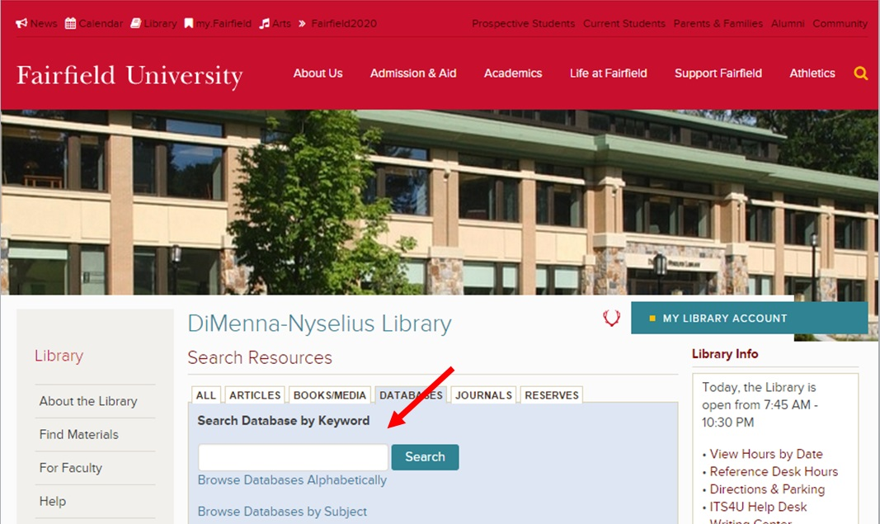
Searching University Library of Databases

Slide 7
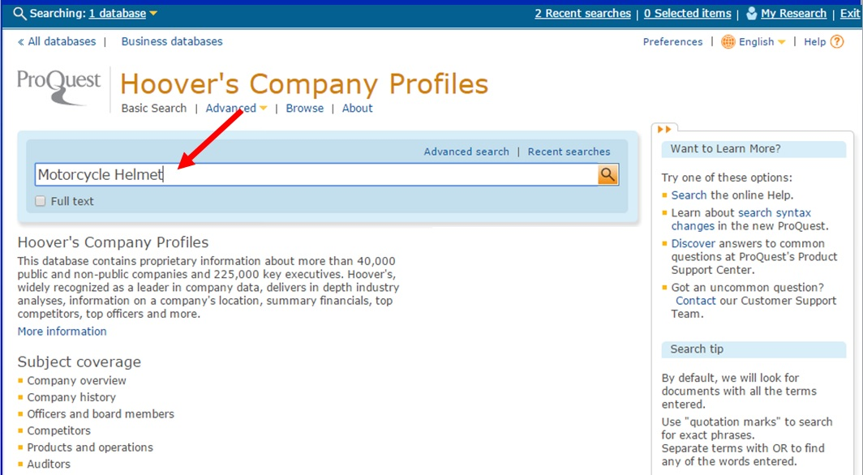
How to Search Hoover’s for Competitors or Suppliers in an Industry

Slide 8
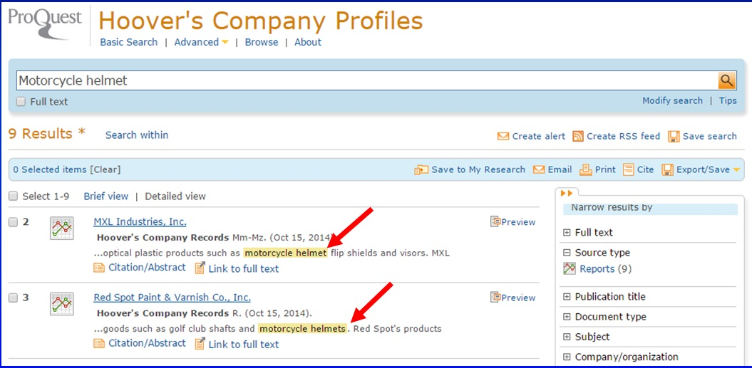
Sample Search Results on Hoover’s

Slide 9
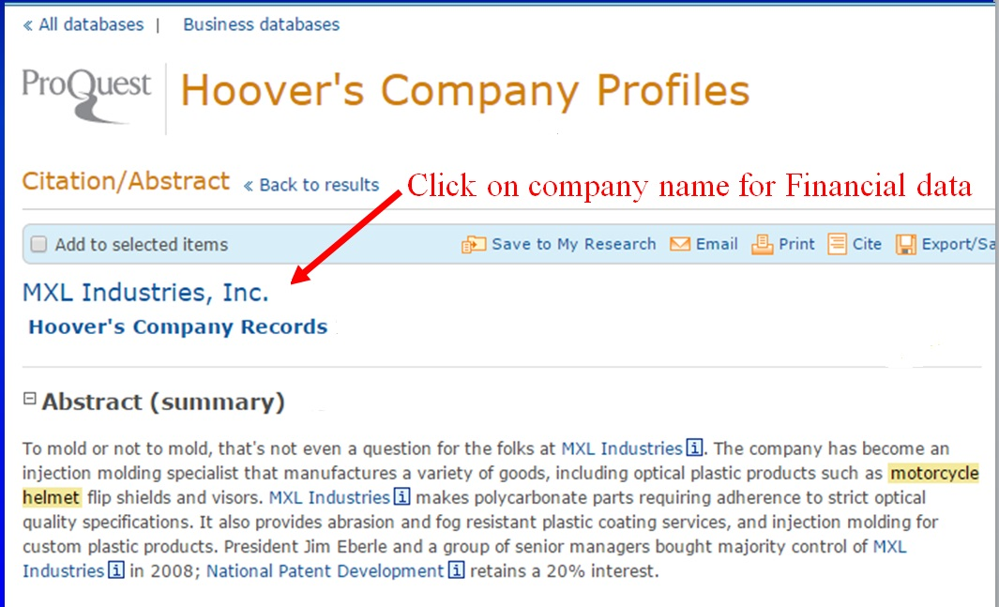
Sample Hoover’s Company Profile

Slide 10
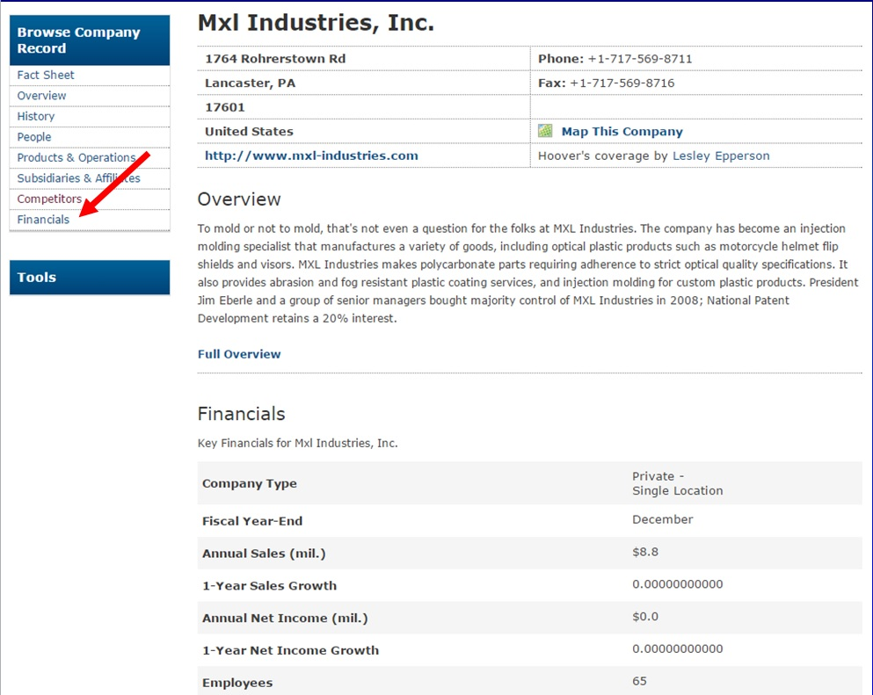
Expanded Company Profile

Slide 11
Industry Journals and Blogs
Search for industry trade journals at: MediaFinder.com
TechCrunch.com
Startups profiles, Internet product reviews and breaking tech news

Slide 12
App Stores
To search for competing apps
Apple iTunes
www.apple.com/itunes
Google app store:
Google Store https://play.google.com/store/apps/category

Slide 13
Blank Slide

