Slide 1
Business Modeling

Slide 2
Business Modeling Assumptions
A startup is a temporary organization designed to search for a profitable business model
  Start with a business model (the strategy you think will lead to a sustainable venture), not a business plan (how you will operate)
A business model is only a series of hypotheses that need to be validated outside the building with Experiments
  Failure is a normal Part of the Process

Slide 3
The BMC Helps You
  Quickly explain your idea to others
  Identify who has the problem that you are trying to solve
  Get to Product Market fit by...Asking, Listening and Learning

Slide 4
There are Two Versions of the Business Model Canvas (BMC)
  Osterwalder for high-growth, high-valuation startups or established companies re-evaluating their business model strategy
  Lean Canvas, developed by Ash Maurya, for first-time entrepreneurs, students, and most startup situations.

Slide 5
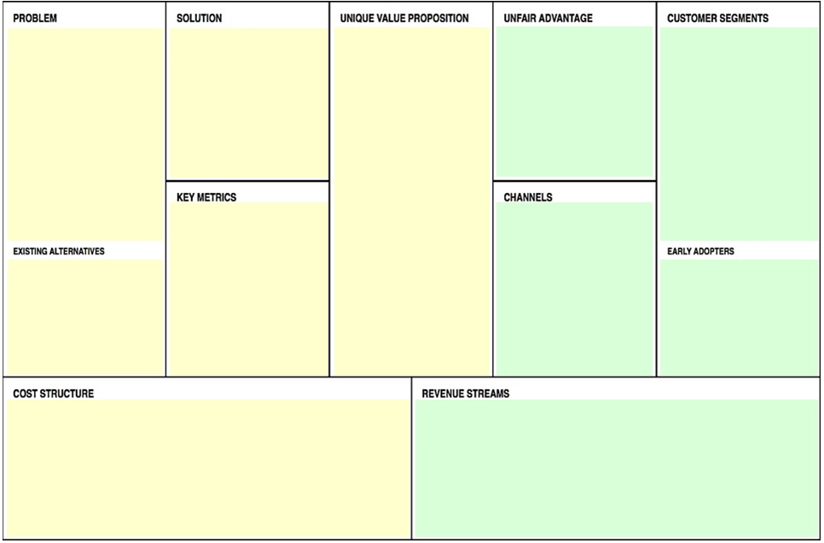
Lean BMC
Notes:
Lean Business Model Canvas as it appears in accompanying textbook.
In the Word version of the textbook, the reader can click on a colored section to add text; or slide color block to the side to see explanation of section.
For more on the Lean Canvas see
http://www.slideshare.net/ashmaurya/running-lean-canvas

Slide 6
The 9 Main Sections of the Lean Business Model Canvas (BMC)
Problem. Most startups fail because they lack thorough and accurate understanding of the problem faced by their market niche.
Solution. Test hypotheses with potential customers.
Value Proposition. What customer receives from you and how much you receive in return.
Unfair Advantage. Another name for competitive advantage or barriers to entry. (Some startups may not have any “unfair advantages” or at most a first-mover (first to market) advantage.

Slide 7
Lean BMC (Continuation 1)
Key Metrics to evaluate testing and market trials.
Customer Segments. Who is the ultimate user? The decision maker?
Demographics of Market Niche:
  Age
  Gender
  Where they live, work
  Educational level
  Income level
  Other (e.g. - home ownership.)
  What are their Buying Habits?
  Who do they buy from now? Why?
Notes:
Customer Segments. The user of Cocoa Puffs are children, but are they the customers? How many people have to be sold in order to sell one box of cereal?

Slide 8
Lean BMC (Continuation 2)
Channels
  How will the product or service, and value be delivered to the customer?
  How will the user become aware of the product?
  How will customers be supported after purchasing and delivery?

Slide 9
Lean BMC (Continuation 3)
Cost Structure
a) How much it will cost you to provide product
b) Pricing Model (e.g. – low-volume, high margin)
Revenue Streams
a) Who will pay you (distributor, wholesaler, end user)?
b) How will you collect the money?
Notes:
Customer Segments. The user of Cocoa Puffs are children, but are they the customers? How many people have to be sold in order to sell one box of cereal?

Slide 10
Blank Slide

Slide 11
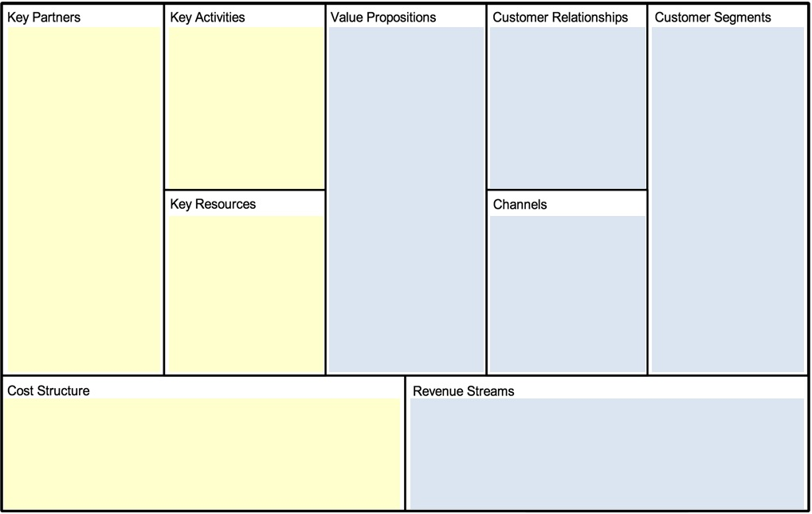
Alternative Osterwalder BMC
Notes:
Osterwalder Business Model Canvas as it appears in accompanying textbook.
In the Word version of the textbook, the reader can click on a colored section to add text; or slide color block to the side to see explanation of section.

