Slide 1
Designing the Product or Service Product Costing and Sourcing Components
Minimum viable product or service
Physical product prototyping
Resources for prototyping and production
Software and mobile app prototyping

Slide 2
Minimum Viable Product (MVP)
The fewest set of features to test basic functionality, measure customer acceptance, and determine investor interest.
Notes:
MVPs can be counter-intuitive since fully-featured products are considered easier to sell: something for everyone.
However, building more features than necessary risks wasting time on functionality no one wants. It also compromises experimental designs, because it can be difficult to determine why a customer rejected an iteration that incorporated many simultaneous changes.
In the R&D phase, founders rapidly evolve the MVP based on customer feedback obtained through interviews, focus groups, and customer tests.

Slide 3
Resources for Physical Product Prototyping and Manufacturing
METALS. “Any size, any quantity, anywhere” Metal sources http://www.metalsdepot.com/index.php
Metals Depot will also fabricate parts.
FASTENERS AND OTHER METAL PARTS. Metal parts source www.McMaster.com
550,000 items in stock for prototyping and initial short runs for market testing.

Slide 4
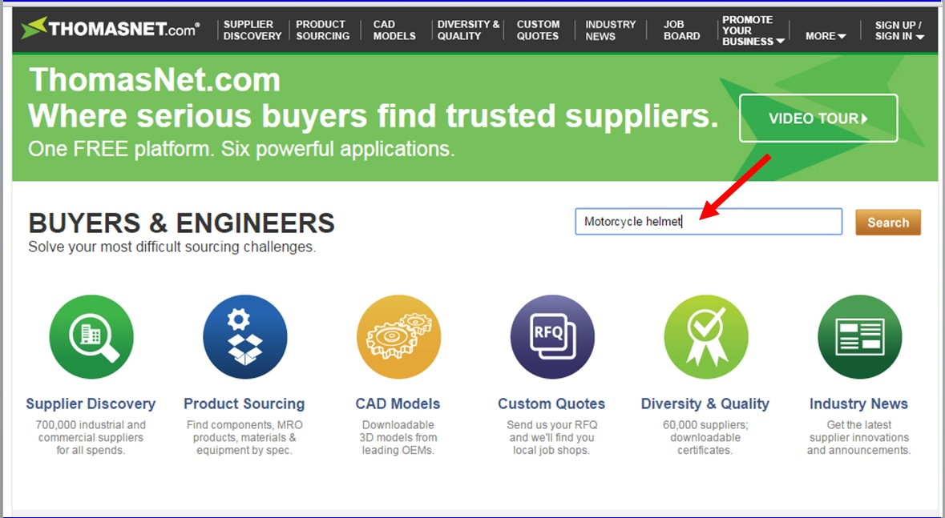
ThomasNet.com

Slide 5
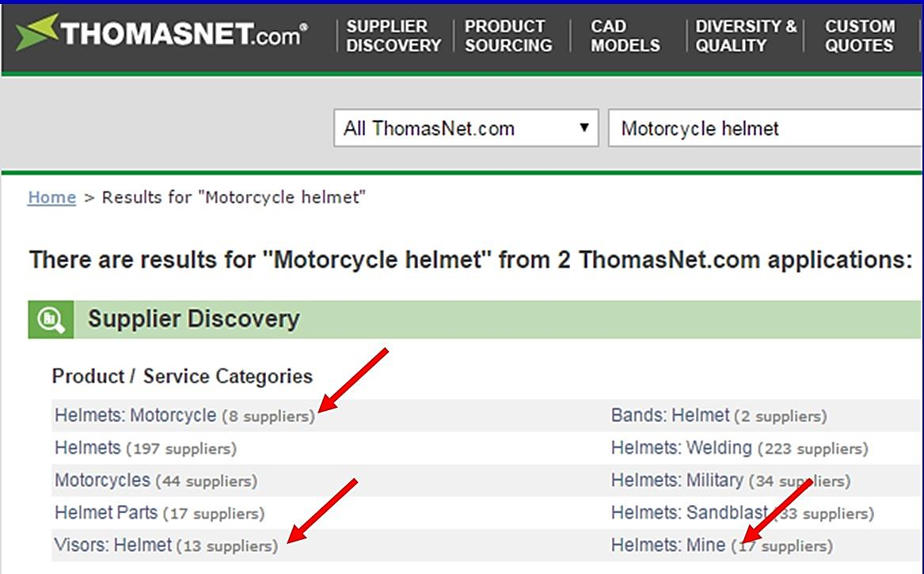
ThomasNet.com Sample Search Results

Slide 6
Web-Based Services Rapid Prototyping For Testing and Feedback
POWERPOINT AND APPLE KEYNOTE Support clickable links to jump to other slides (posing as web pages).
PowerPoint tutorial www.boxesandarrows.com/view/interactive
Notes:
For Keynote documentation, see http://www.apple.com/iwork/keynote. Keynotopia.com provides templates for rapid application prototyping in PowerPoint or Keynote.
For sample website created in PowerPoint, see companion PowerPoint presentation:
“Designing the Product or Service - Sample Website Rapid Prototype Created in PPT”

Slide 7
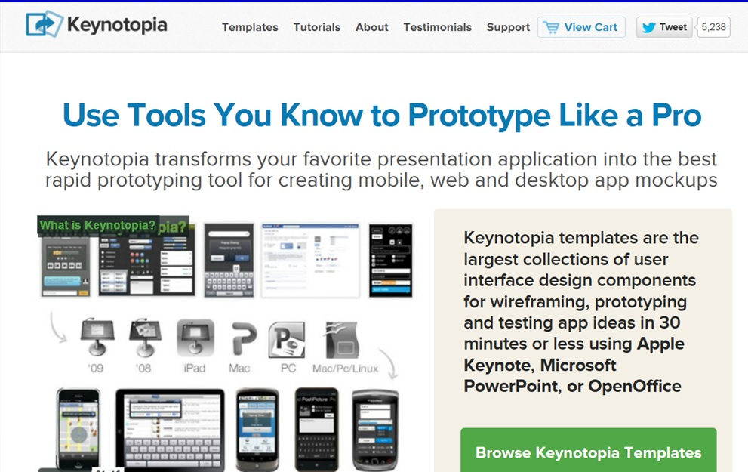
Apple’s Keynotopia Website

Slide 8
Mobile App Rapid Prototyping Sites For Testing and Feedback
KEYNOTE.COM templates run $50 to $150.
PROTO.IO iPhone and Android Apps. Free for 15 days, then $12/mo for students.
FLINTO.COM. iPhone or Android. Free for 30 days, then $20 per month.
Notes:
For Keynote documentation, see http://www.apple.com/iwork/keynote. Keynotopia.com provides templates for rapid application prototyping in PowerPoint or Keynote.
For sample website created in PowerPoint, see companion PowerPoint presentation:
“Designing the Product or Service - Sample Website Rapid Prototype Created in PPT”

Slide 9
Blank Slide

