Slide 1
Ownership Retention When Raising Equity Capital

Slide 2
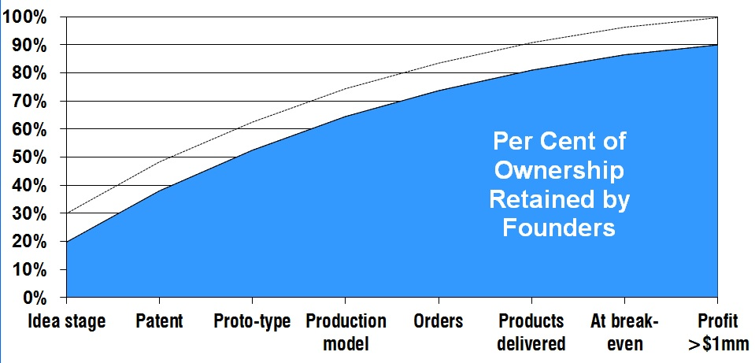
The more advanced the business development, the less execution risk for the investor, and therefor the greater percentage founders might expect to retain.
Notes:
There are additional factors that may affect the percentages in the preceding chart. These variables may exert an upward pull on the percentage of ownership the entrepreneur might retain (dotted line); or they may lower the ownership percentage the entrepreneur should expect to retain.
External factors (variables not within your control):
The Economy
Amount of Capital Available
Investor Confidence
Total amount of capital available in the investment market
Internal Factors (variables under your control):
Newness or uniqueness of product or service
Experience (Serial entrepreneurs can retain a larger share of ownership)
Profit potential

Slide 3
Blank Slide

Slide 4
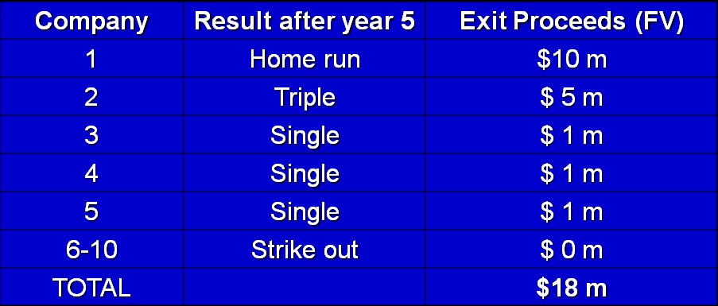
No. Assume a $1 Million Investment in each of 10 startups ($10m total), with terms that provide a 10x on each investment, IF the profit goals are met.
How did we do? What was our actual I/Y?
PV= N= FV= PMT = 0 CMT I/Y = __ %
Notes:
For online calculator, see www.financialmentor.com/calculator/present-value-calculator

Slide 5
So how do we structure an offering calculated to provide a 10X return?

Slide 6
“X” Return on Investment Method Made Easy
Determine the potential value of company at exit
(“terminal value” AKA FV) for example, $ 20 million
Determine the return on investment required: e.g. 10X
Calculate PV (Post-Money val): $ 20m /10X = $ 2 m
Why should PV be “Post”?
If size of investment is $ 1 m
then fair ownership for investors is ______ %
Notes:
50%
$2 million current Post-Money Valuation / $1 million of valuation represented by investment

Slide 7
2. Rule of Thumb Based on Investor’s Experience
Many angel investors feel that based on their track record they need a Y% stake in every portfolio company in order for them to meet their ROI goal; And to own enough of company to have some influence over decisions.
You can see this rule of thumb at play on Shark Tank.

Slide 8
EFFECT OF SUPPLY AND DEMAND on Average Percentage Allocation to Investors
Investor shares usually range between 10% and 50%,
but most deals are done for approximately a 30-33% stake to investors:
Not so a percentage little that investors don’t have a significant stake
Nor so much that entrepreneurs lose control or motivation
Notes:
Contrary to popular belief, investors do NOT want to take control (and all the headaches that come with it).
They want to provide capital, connections and advice, but leave the responsibility with the entrepreneur.

Slide 9
Effect of Market Equilibrium
Because so many deals have now been done, investor know they can find a better deal if an entrepreneur insists on giving up no more than a few percentage points.
Likewise, knowledgeable entrepreneurs know that if an investor demands much more than 50%, he or she can probably find a more reasonable capital provider.

Slide 10
When Markets Are Out of Equilibrium
During the dot-com bubble, when investors were chasing deals, presumed valuations were high and many deals netted investors only a 10% stake.
Moral: As in other forms of investment, emotion often plays an outsize role in equity financing deals.

Slide 11
3. Valuation Based on Risk
Investors will also look at the risk inherent in a venture and adjust their requested reward accordingly.
Note: this is a factor in all deals. Entrepreneurs should hold off raising capital for as long as possible, to squeeze as much risk out of the deal for investors as is possible.

Slide 12
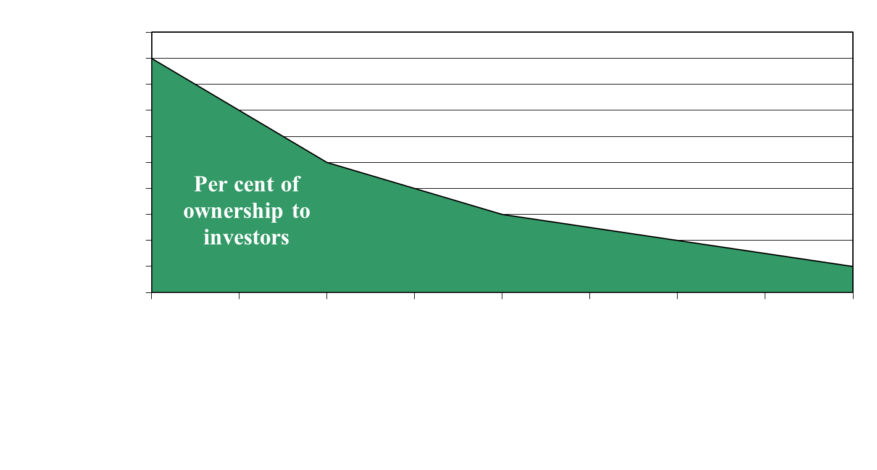
Sample Investor Allocation Based on Perceived Risk
External factors: Economy – Capital available – Confidence – Competition Internal Factors: Hot New Tech – Serial Entrepreneur – Mega Potential

Slide 13
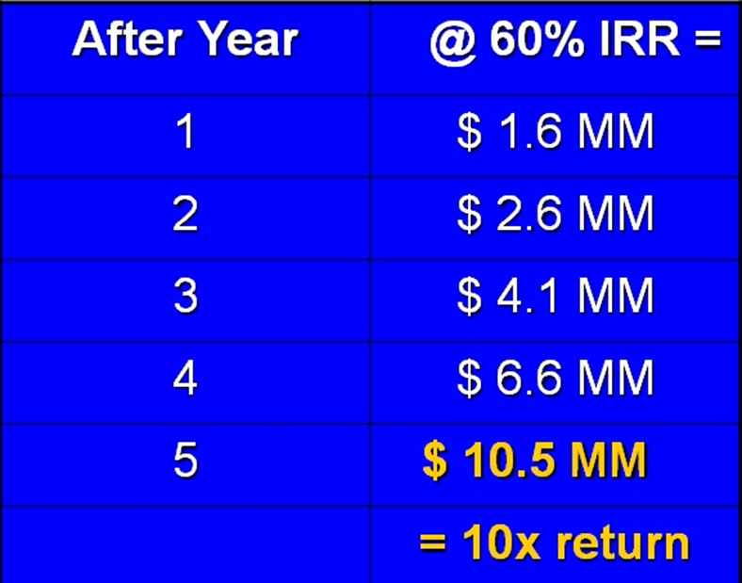
1. The “X” Return on Investment in 5 Years.
Most serial investors will expect a deal that offers a
10x to 20x return in 5 years— assuming all goes according to your business plan.
Example of a $1 Million Investment achieving a 10x return in 5 years.

Slide 14
Reality Check
So does that mean an investor whose deals always allows for a 10x ROI (if sales and profit goals are met) will actually earn ten times his or her money back over a typical 5-year horizon (an average annual compounded ROI of 60%)?

