Slide 1
Ash Theology
灰神学
金京來博士 Kyungrae Kim, Ph.D.

Slide 2
Ash Theology (灰神学)
-Galatians 6:14.
但我斷不以別的誇口，只誇我們主耶穌基督的
十字架；因這十字架，就我而論，世界已經釘
在十字架上；就世界而論，我已經釘在十字架上。
There is a place outside the camp, where the ashes removed from the altar are collected. It is called ‘a clean place.’ This place is so important that it refers to the place of crucifixion of Jesus Christ. Those who serve the Lord have to keep pouring out the ‘ashes’ (results, fruits, accomplishments) of their service/ministry onto the cross.

Slide 3
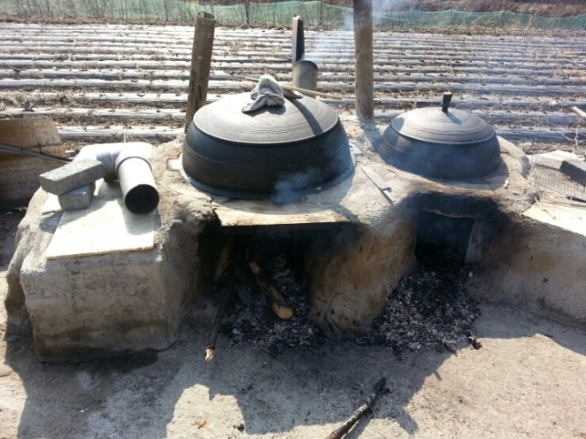
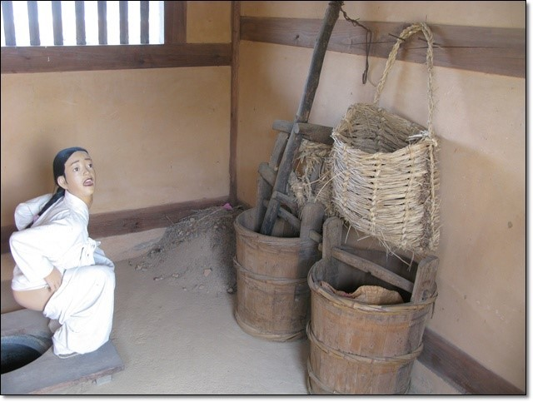
Ash 灰

Slide 4
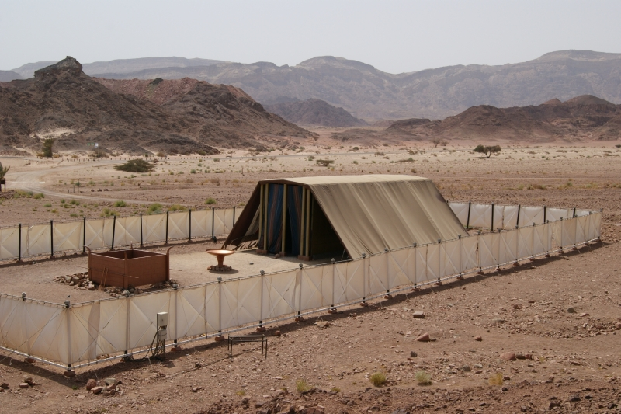
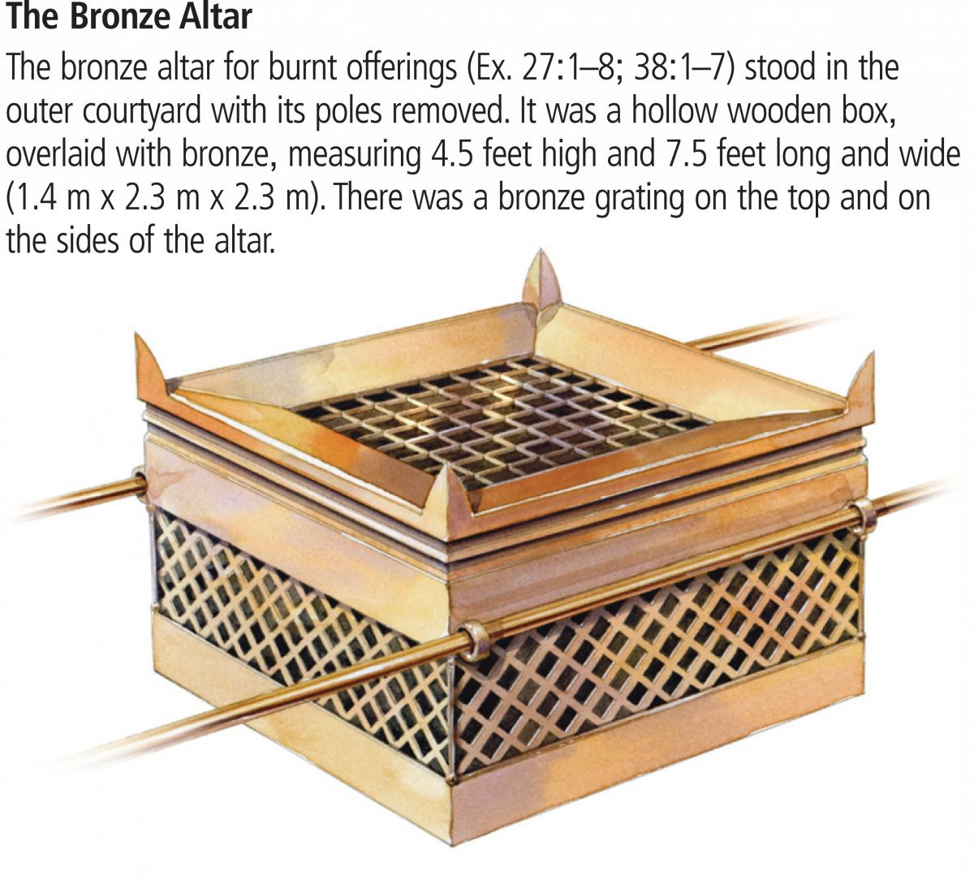
Model of the tabernacle
in Timna Valley Park, Israel
Model of the Bronze Altar
Notes:
Exodus 40:2 "Set up the tabernacle, the Tent of Meeting, on the first day of the first month.
Exodus 40:17 So the tabernacle was set up on the first day of the first month in the second year.
Leviticus 1:1 The LORD called to Moses and spoke to him from the Tent of Meeting. He said,

Slide 5
Let the Fire keep Burning! How about Ash?
讓祭壇的火繼續燃燒！那麼灰怎麼樣？
Leviticus 6:12-13[6:5-6] (also Leviticus 6:9, 13) ^{NIV} 12 The fire on
the altar must be kept burning; it must not go out. Every morning the priest is to add firewood and arrange the burnt offering on the fire and burn the fat of the fellowship offerings on it. 13 The fire must be kept burning on the altar continuously; it must not go out. / 壇上的火要在其上常常燒著，不可熄滅。祭司要每日早晨在上面燒柴，並要把燔祭擺在壇上，在其上燒平安祭牲的脂油。在壇上必有常常燒著的火,不可熄滅.
1 Thessalonians 5:19. to. pneu/ma mh. sbe,nnute
不要消滅聖靈的感動.
NIV：Do not put out the Spirit's fire. / KJV：Quench not the Spirit.

Slide 6
1) The Sin (Purification) Offering
–all the rest of the bull- of the high priest and the congregation
of Israel was burned on the ash heap (Leviticus 4:12, 21).
-Leviticus 4:12 ^{NIV} that is, all the rest of the bull-- he must take outside the camp to a place ceremonially clean, where the ashes are thrown, and burn it in a wood fire on the ash heap. / 就是全公牛，要搬到營外潔淨之地、倒灰之所，用火燒在柴上。
-Leviticus 4:21 ^{NIV} Then he shall take the bull outside the camp and burn it as he burned the first bull. This is the sin offering for the community. / 他要把牛搬到營外燒了,像燒頭一個牛一樣;這是會眾的贖罪祭.

Slide 7
The Sin (Purification) Offering
-Exodus 29:14 ^{NIV} But burn the bull's flesh and its hide and its
intestines outside the camp. It is a sin offering. / 只是公牛的皮、
肉、糞、都要用火燒在營外．這牛是贖罪祭。(on priest ordination)
-Leviticus 8:17 ^{NKJ} But the bull, its hide, its flesh, and its offal, he burned with fire outside the camp, as the LORD had commanded Moses. / 惟有公牛、連皮帶肉、並糞、用火燒在營外．都是照耶和華所吩咐摩西的。(on priest ordination)
-Leviticus 9:11 ^{NKJ} The flesh and the hide he burned with fire outside the camp. / 又用火將肉和皮燒在營外。
-Ezekiel 43:21 ^{ESV} You shall also take the bull of the sin offering, and it shall be burned in the appointed place belonging to the temple, outside the sacred area. / 你又要將那作贖罪祭的公牛犢燒在殿外、聖地之外預定之處.

Slide 8
2) The Ashes of the Burnt Offering
were brought outside the camp probably to the same place.
-Leviticus 6:11 ^{NKJ} Then he shall take off his garments, put on other garments, and carry the ashes outside the camp to a clean place.
10. 祭司要穿上細麻布衣服,又要把細麻布褲子穿在身上,把壇上所燒的燔祭灰收起來,倒在壇的旁邊.
隨後要脫去這衣服,穿上別的衣服,把灰拿到營外潔淨之處.

Slide 9
3) In the Day of Atonement
the flesh and offal of the sin offerings were burned
outside the camp.
-Leviticus 16:27 ^{NIV} The bull and the goat for the sin offerings, whose blood was brought into the Most Holy Place to make atonement, must be taken outside the camp; their hides, flesh and offal are to be burned up.
作贖罪祭的公牛和公山羊的血既帶入聖所贖罪，這牛羊就要搬到營外,將皮,肉,糞用火焚燒.

Slide 10
4) The ashes of the red heifer for cleansing
were kept probably at the same place outside the camp.
-Numbers 19:3 ^{NKJ} You shall give it to Eleazar the priest,
that he may take it outside the camp, and it shall be slaughtered before him;
交給祭司以利亞撒,他必牽到營外,人就把牛宰在他面前。
-Numbers 19:9 ^{NIV} A man who is clean shall gather up the ashes of the heifer and put them in a ceremonially clean place outside the camp. They shall be kept by the Israelite community for use in the water of cleansing; it is for purification from sin.
有一個潔淨的人收起母牛的灰,存在營外潔淨的地方,為以色列會眾調做除污穢的水.這本是除罪的.

Slide 11
5) The author of Hebrews
alludes to this place when mentioning the crucifixion of Jesus.
-Hebrews 13:11-13. ^{NIV} 11 The high priest carries the
blood of animals into the Most Holy Place as a sin offering, but the bodies are burned outside the camp. 12 And so Jesus also suffered outside the city gate to make the people holy through his own blood.
11 原來牲畜的血,被大祭司帶入聖所作贖罪祭,牲畜的身子,被燒在營外。12 所以耶穌,要用自己的血叫百姓成聖,也就在城門外受苦。13 這樣,我們也當出到營外就了他去,忍受他所受的凌辱.
*This important passages allude to some passages of the Old Testament, such as Leviticus 4:12, 21; 16:27; Exodus 29:14. There is a place outside the camp, where the ashes removed from the altar are collected. It is called ‘a clean place.’ This place is quite symbolic and very important, because it refers to the place of crucifixion of Jesus Christ.

Slide 12
Ash & the Cross: Spiritual Funeral / Galatians 6:14
灰與十字架:屬靈的葬禮 / 加拉太書6:14
Galatians 6:14 ^{ESV} But far be it from me to boast except
in the cross of our Lord Jesus Christ, by which the world
has been crucified to me, and I to the world.
但我斷不以別的誇口,只誇我們主耶穌基督的十字架.因這十字架,就我而論,世界已經釘在十字架上.就世界而論,我已經釘在十字架上.
*For Paul, his only boast was of ‘the cross of Christ.’ See also 1 Corinthians 1:17, 18; 2:2 (因為我曾定了主意、在你們中間不知道別的、只知道耶穌基督、並他釘十字架); Galatians 5:11; 6:12-14; Ephesians 2:16 (既在十字架上滅了冤仇、便藉這十字架、使兩下歸為一體、與神和好了); Philippians 2:8; 3:18; Colossians 1:20; 2:14-15. Cf. Hebrews 12:2; 1 Peter 2:24.

Slide 13
民數記 6:24-26
願耶和華賜福給你,保護你. 願耶和華使他的臉
光照你,賜恩給你.願耶和華向你仰臉,賜你平安.
‎ יְבָרֶכְךָ יְהוָה וְיִשְׁמְרֶךָ׃ Numbers 6:24-26
יָאֵר יְהוָה פָּנָיו אֵלֶיךָ וִיחֻנֶּךָּ׃
‎יִשָּׂא יְהוָה פָּנָיו אֵלֶיךָ וְיָשֵׂם לְךָ שָׁלוֹם׃

