Slide 1
人若回轉 神也回轉
(約拿書 第三章)
If Man Returns, God Returns
(Jonah Chapter 3)
金京來博士 Kyungrae Kim, Ph.D.

Slide 2
神第二次的指示，先知約拿的順服
Jonah 3:1-3. 1 耶和華的話二次臨到約拿說： 2 「你起來！
往尼尼微大城去，向其中的居民宣告我所吩咐你的話。」 3 約拿便照耶和華的話起來，往尼尼微去。這尼尼微是極大的城，有三日的路程。
-神的第一次指示:
Jonah 1:2 你起來往尼尼微大城去，向其中的居民呼喊，因為他們的惡達到我面前。
-約拿的不順服:
Jonah 1:3 約拿卻起來，逃往他施去躲避耶和華；下到約帕，遇見一隻船，要往他施去。他就給了船價，上了船，要與船上的人同往他施去躲避耶和華。

Slide 3
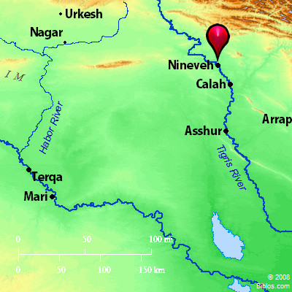
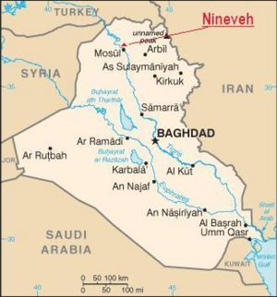
Nineveh is located in the east bank of Tigris River. Nimrod founded the city in the beginning (Genesis 10:8-12).
Today, Mosul is located in the west bank of Tigris River in Nineveh’s opposite. Nimrod founded the city in the beginning (Genesis 10:8-12).

Slide 4
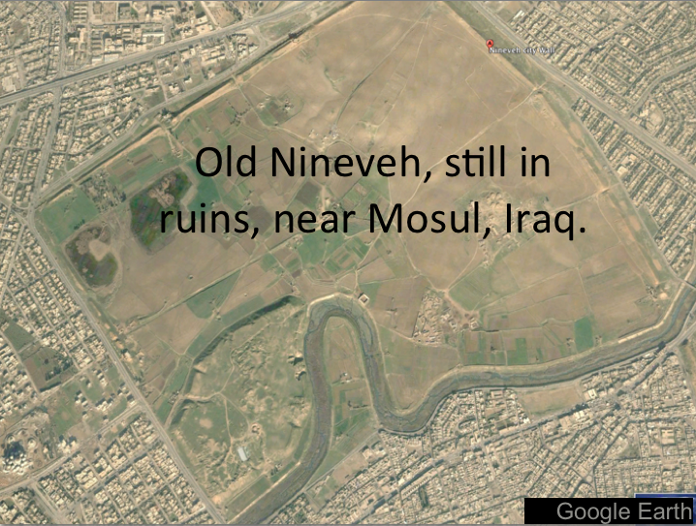
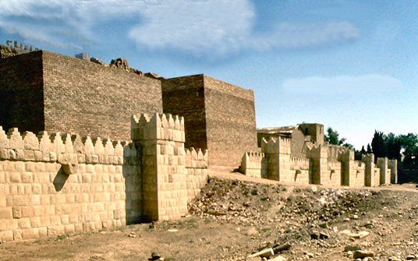
Nineveh
The Great City
In Ruins

Slide 5
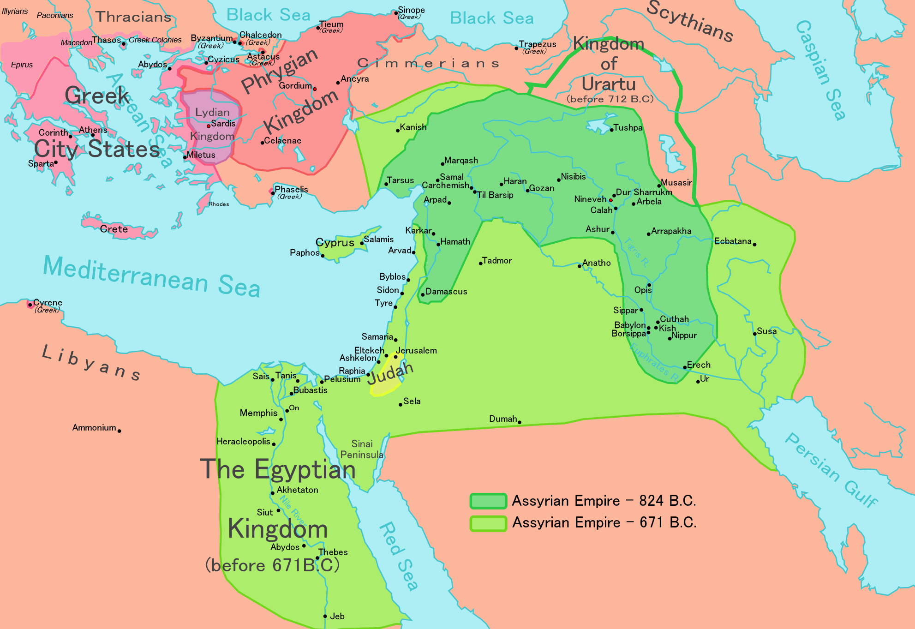
Assyrian Empire
-824 BC
Before Jonah
-671 BC
After Jonah

Slide 6
約拿向尼尼微宣告神的話
Jonah 3:4. 約拿進城走了一日，宣告說：
「再等四十日，尼尼微必傾覆了！」 (נֶהְפָּכֶת)
*約拿不是外國傳教士，而是討厭亞述的先知
*The Hebrew מַהְפֵּכָה "overthrow" (a noun from the verb here הפך) occurs 6 times in the Hebrew Old Testament (Deuteronomy 29:22; Isaiah 1:7; 13:19; Jeremiah 49:18; 50:40; Amos 4:11), and is always related to ‘Sodom and Gommorah’.
-Amos 4:11 ^{NIV} “I overthrew some of you as I overthrew Sodom and Gomorrah. You were like a burning stick snatched from the fire, yet you have not returned to me,” declares the LORD. / 我傾覆 (הָפַכְתִּי) 你們中間的城邑，如同我從前傾覆 (מַהְפֵּכַת) 所多瑪、蛾摩拉一樣，使你們好像從火中抽出來的一根柴；你們仍不歸向我。這是耶和華說的。

Slide 7
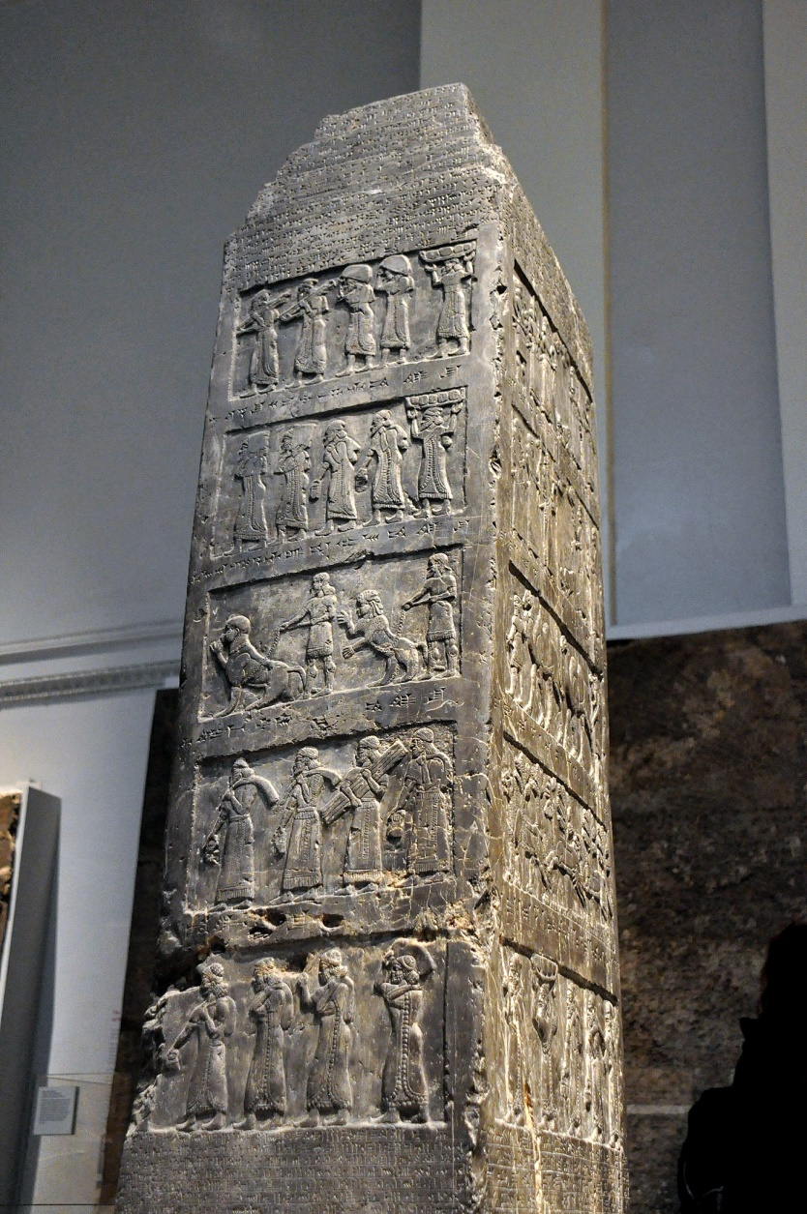
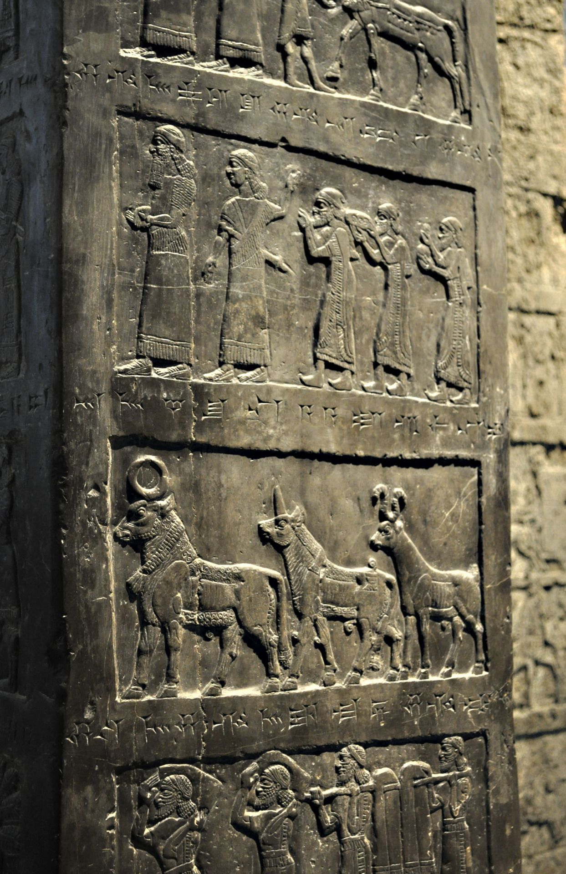
Black Obelisk (方尖碑)
of Shalmaneser III
The Black Obelisk of Shalmaneser III (859-824 BC) shows Jehu (856-830 BC) (2 Kings 9-10) actually kneeling before the Assyrian emperor to whom he paid tribute (841 BC). Jehu is the only king in either Israel or Judah, of whom we have a picture today. / British Museum (1.98 meters high, 45 cm wide), Discovers in Nimrud, Iraq

Slide 8
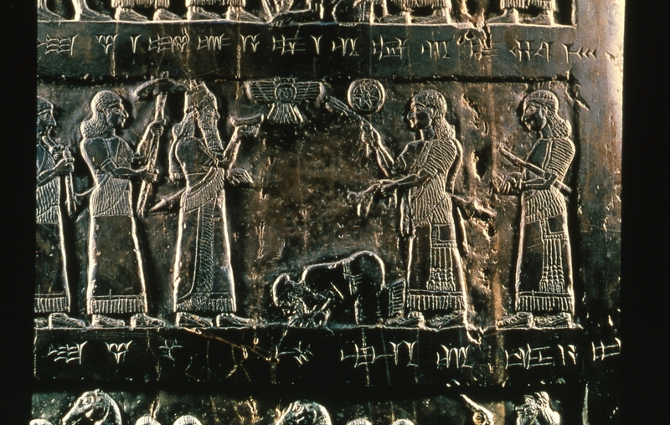
Shalmaneser III
(859-824 BC)
and
Jehu
(856-830 BC)

Slide 9
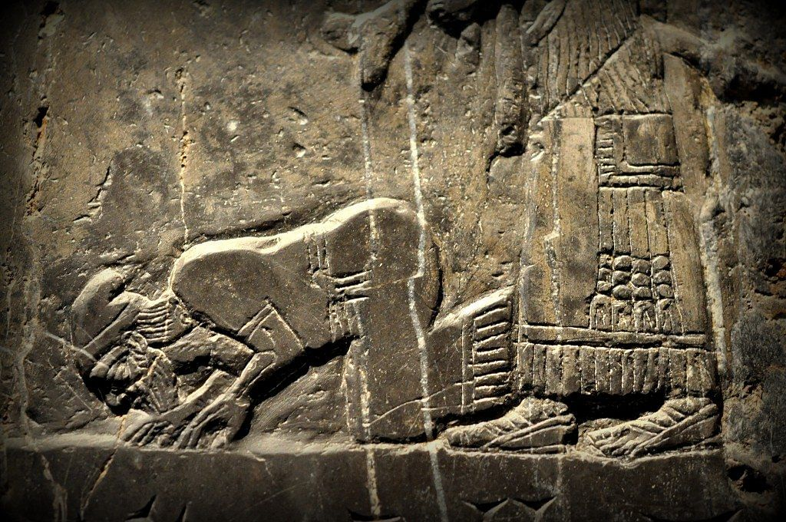
Jehu (856-830 BC) kneeling before the Assyrian emperor to whom he paid tribute (841 BC). Jehu is the only king in either Israel or Judah, of whom we have a picture today.

Slide 10
尼尼微人徹底和真誠的悔改
尼尼微人信服神，便宣告禁食 (Jonah 3:5-7)
5 尼尼微人信服神，便宣告禁食，從最大的到至小的都穿麻衣。 6 這信息傳到尼尼微王的耳中，他就下了寶座，脫下朝服，披上麻布，坐在灰中。 7 他又使人遍告尼尼微通城，說：「王和大臣有令，人不可嘗什麼，牲畜、牛羊不可吃草，也不可喝水。
*The impact of the message was so great that even the king humiliated himself. According to the edict, a total and overall fast was forced upon not only human beings but also animals. (the only case in the Bible)
2) 求告神，回頭離開惡道和強暴 (Jonah 3:8)
人與牲畜都當披上麻布；人要切切求告神. 各人回頭離開所行的惡道，丟棄手中的強暴. (וְיָשֻׁבוּ) / ^{ESV} Jonah 3:8 ……. Let everyone turn from his evil way and from the violence that is in his hands.
*Real repentance should be proved by ‘turning away from evil deeds’.

Slide 11
How could the people of Nineveh so quickly repent?
See the following remarkable explanation of Eugene W. Faulstich.
*The eponym, Bur-Sagale of 763 BC, tells of a solar eclipse in Assyria,
which is astronomically verified as June 7, 763 BC (= Sivan 29).
Jonah probably began preaching on Sunday, 28 Sivan. The people no doubt fasted for the full forty days so that they could see if they were going to be destroyed. Since the primary god of Assyria, Ashur, was represented by the sun disc, and if an eclipse should occur, it would seem that the chief god had taken his eyes off the Assyrian people for a moment and certainly would be interpreted as a bad omen. Pul = Ashur-dan III (773-755 BC), the uncle of Tiglath-pileser III, repented at the preaching of Jonah. The end of the forty days fell on the ninth of Ab, a day of repeated disaster in Hebrew history. The Israelites worshipped the golden calf on that day, and their Temple was destroyed twice on that day. ….… Samarian fell to the Assyrian army of Shalmaneser V after 40 years (763 BC + 40 = 723 BC).
*In a solar eclipse the sun is darkened as the moon passes between it and the earth. This can only occur at the phase of the new moon.

Slide 12
Assyrian King List by Eugene W. Faulstich
Assyrian King Duration Accession Year BC
Shamash-adad V 13 years 824
Adad-nirari III 28 years 811
Shalmaneser IV 10 years 783
Ashur-dan III (Pul) 18 years 773
*ECLIPSE of June 7th (Sivan 29) 763 (Jonah)
Ashur-nirari V 10 years 755
Tiglath-pileser III 18 years 745
Shalmaneser V 5 years 727
Sargon II 17 years 722
Sennacherib 24 years 705

Slide 13
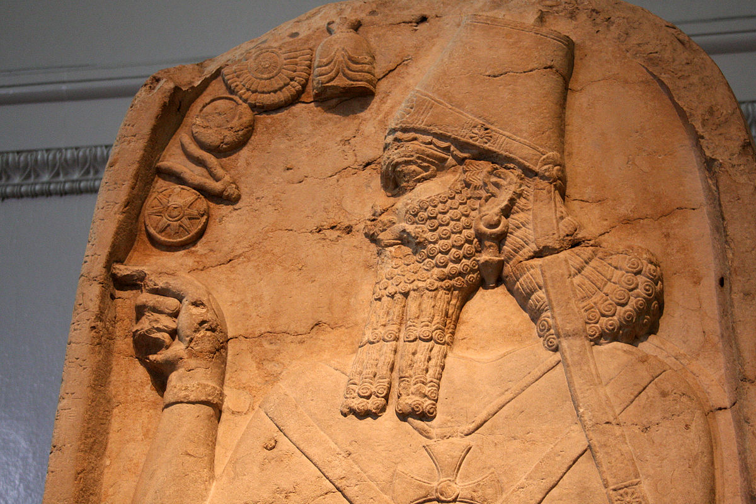
Pul 普勒 = Ashur-dan III (773-755 BC)
Notes:
2 Kings 15:19 亞述王普勒來攻擊以色列國．米拿現給他一千他連得銀子、請普勒幫助他堅定國位.

Slide 14
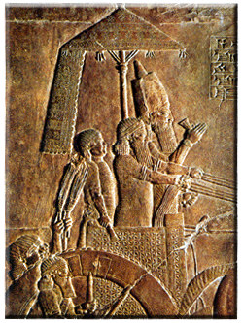
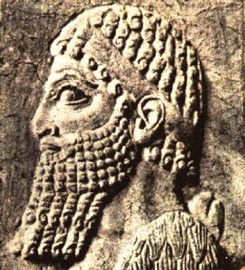
Pul =
Ashur-dan III
(773-755 BC)
2 Kings 15:19
亞述王普勒來攻擊以色列國，米拿現給他一千他連得銀子，請普勒幫助他堅定國位。
(755 BC)

Slide 15
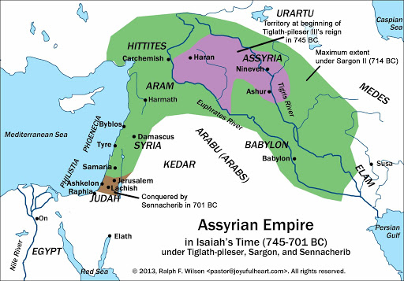
Assyrian Empire
-Around 715 BC
About 40 Years
after Jonah

Slide 16
論人與神的“返回”
Jonah 3:8-9. 8 人與牲畜都當披上麻布；人要切切求告神。
各人回頭 (וְיָשֻׁבוּ) 離開所行的惡道，丟棄手中的強暴.
9 或者神轉意後悔 (וְשָׁב יָשׁוּב)， 不發烈怒，使我們不至滅亡，也未可知。
^{ESV} Jonah 3:8 ……. Let everyone turn from his evil way and from the violence that is in his hands. 3:9 Who knows? God may turn and relent and turn from his fierce anger, so that we may not perish.
*The same verbשׁוב (shuv = turn, return, repent), which is applied to man (verse 8), is also applied twice to God (verse 9). They expect that their change can also bring the change in God’s side. See also Malachi 3:7 ^{NKJ} Yet from the days of your fathers You have gone away from My ordinances And have not kept them. Return to Me, and I will return to you," Says the LORD of hosts. "But you said,`In what way shall we return?' / 萬軍之耶和華說：從你們列祖的日子以來，你們常常偏離我的典章而不遵守。現在你們要轉向我，我就轉向你們。你們卻問說：『我們如何才是轉向呢？』

Slide 17
看到人們悔改 神就轉變意志
Jonah 3:10 於是神察看他們的行為，見他們離開惡道， (שָׁבוּ)
他就後悔，不把所說的災禍降與他們了。 (וַיִּנָּחֶם)
^{NIV}When God saw what they did and how they turned (שָׁבוּ) from their evil ways, he relented (וַיִּנָּחֶם) and did not bring on them the destruction he had threatened.
*The Hebrew נִחָם simply means ‘to change the mind,’ or ‘to change the plan.’ See also Jonah 4:2 (……… 我知道你是有恩典、有憐憫的神、不輕易發怒、有豐盛的慈愛、並且後悔不降所說的災．所以我急速逃往他施去).

Slide 18
先知約拿的順服帶來的巨大後果
Jonah 3:1-3. 1 耶和華的話二次臨到約拿說： 2 「你起來！
往尼尼微大城去，向其中的居民宣告我所吩咐你的話。」 3 約拿便照耶和華的話起來，往尼尼微去。這尼尼微是極大的城，有三日的路程。
*Romans 11:11-12. 11 我且說、他們失腳是要他們跌倒麼．斷乎不是．反倒因他們的過失、救恩便臨到外邦人、要激動他們發憤。 12 若他們的過失、為天下的富足、他們的缺乏、為外邦人的富足．何況他們的豐滿呢。
-(11節) 神善用約拿(以色列/猶太人)的不順服
-(12節) 神更善用約拿(以色列/猶太人)的順服
*順服: 打開悔改之門的鑰匙

Slide 19
民數記 6:24-26
願耶和華賜福給你,保護你.
願耶和華使他的臉光照你,賜恩給你.
願耶和華向你仰臉,賜你平安.
‎ יְבָרֶכְךָ יְהוָה וְיִשְׁמְרֶךָ׃ Numbers 6:24-26
יָאֵר יְהוָה פָּנָיו אֵלֶיךָ וִיחֻנֶּךָּ׃
‎יִשָּׂא יְהוָה פָּנָיו אֵלֶיךָ וְיָשֵׂם לְךָ שָׁלוֹם׃

