Slide 1
公義的老師 耶穌
Jesus, Teacher of Righteousness
金京來博士 Kyungrae Kim, Ph.D.

Slide 2
古代以色列與農業 Ancient Israel & Agriculture
Genesis 43:11 他們的父親以色列說,若必須如此,你們就當這樣行,可以將這地,土產中最好的乳香,蜂蜜,香料,沒藥,榧子,杏仁,都取一點收在器具裡,帶下去送給那人作禮物. / Ezekiel 27:17 猶大和以色列地的人,都與你交易.他們用米匿的麥子,餅,蜜,油,乳香,兌換你的貨物

Slide 3
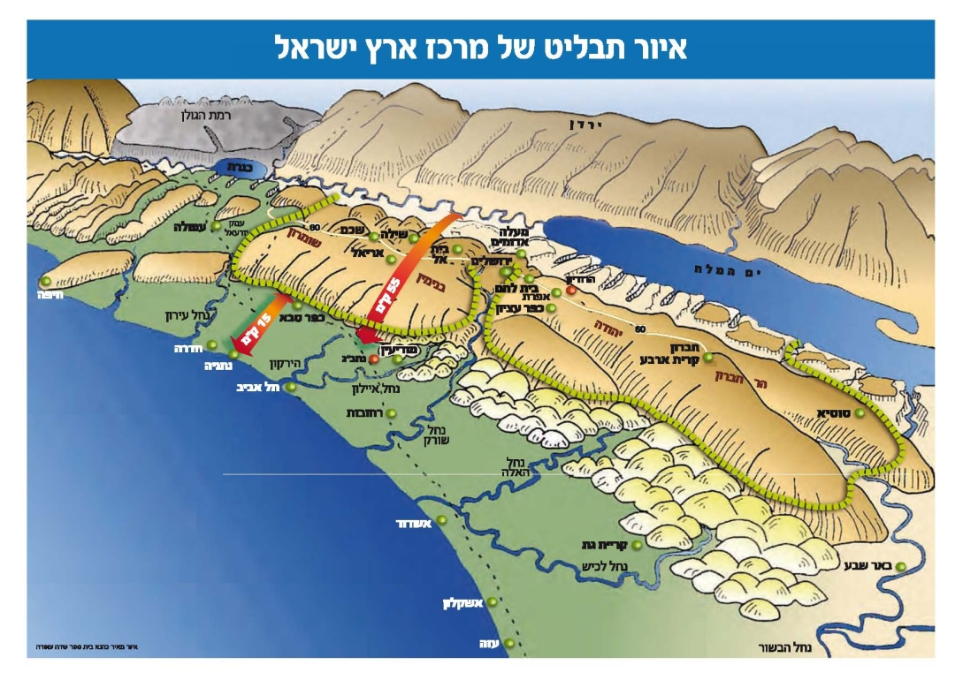
以色列的地形
Topography of Israel

Slide 4
古代以色列的主要農業產品
Deuteronomy 8:8 那地有小麥、大麥、葡萄樹、無花果樹、
石榴樹、橄欖樹、和蜜 / ^{NIV} a land with wheat and barley,
vines and fig trees, pomegranates, olive oil and honey.
*Many scholars understand ‘honey’ here as ‘the honey of palm date’ or ‘palm date’ itself. These seven agricultural species can be categorized into three groups: 1) grain/bread (wheat, barley); 2) wine (vine, fig, pomegranates); 3) oil (olive oil, honey).
Month | March-April | May-June | July-August | October | November | Nov.-March
Products | Barley | Wheat | Grape | Olive | Ingathering | Rainy Season
*Exodus 23:16. 又要守收割節、所收的是你田間所種勞碌得來初熟之物．並在年底收藏、要守收藏節. / ^{ESV} You shall keep the Feast of Harvest, of the firstfruits of your labor, of what you sow in the field. You shall keep the Feast of Ingathering at the end of the year, when you gather in from the field the fruit of your labor.

Slide 5
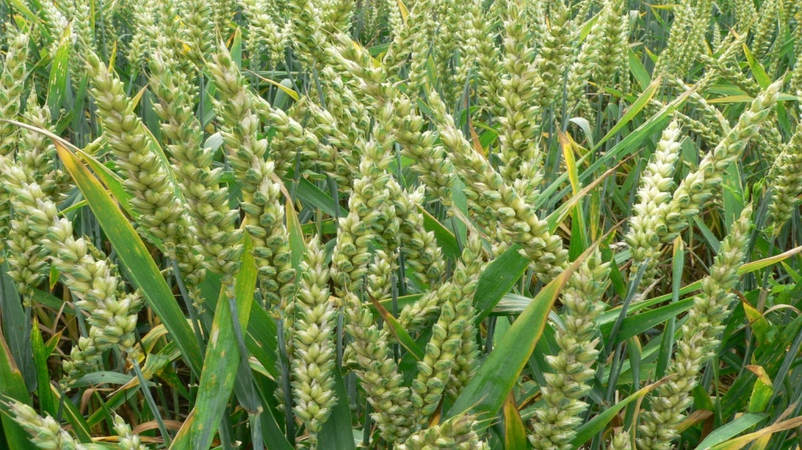
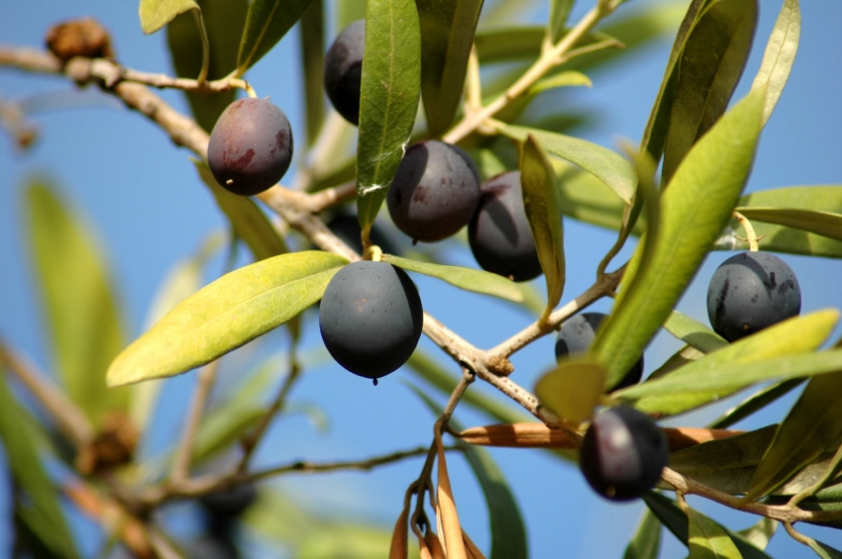
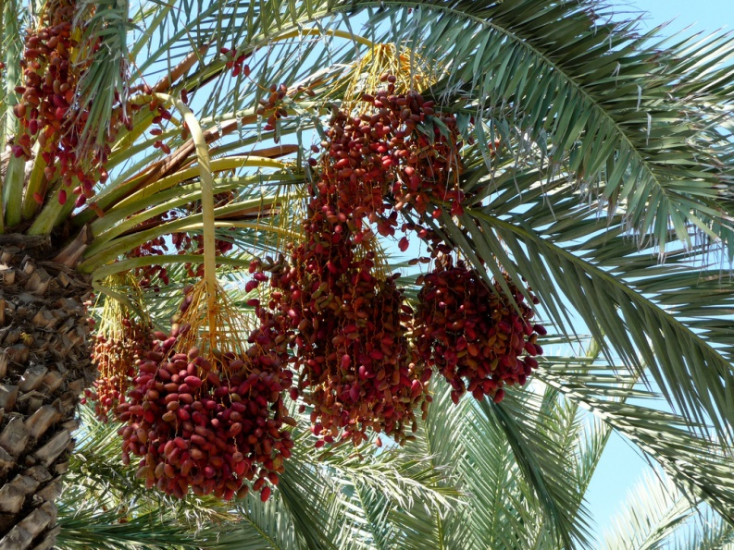
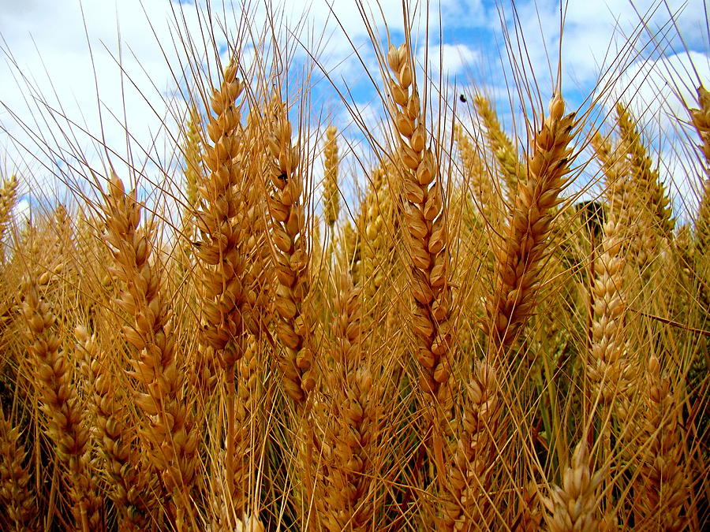
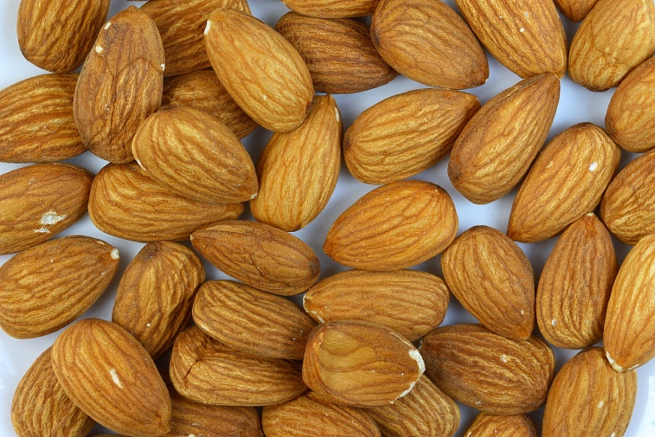
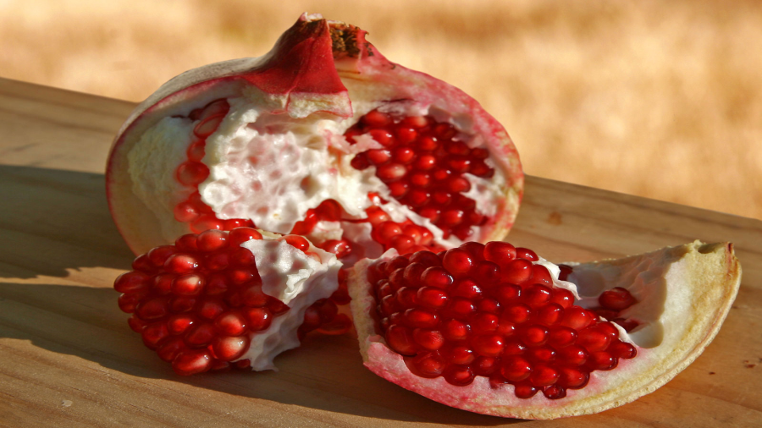
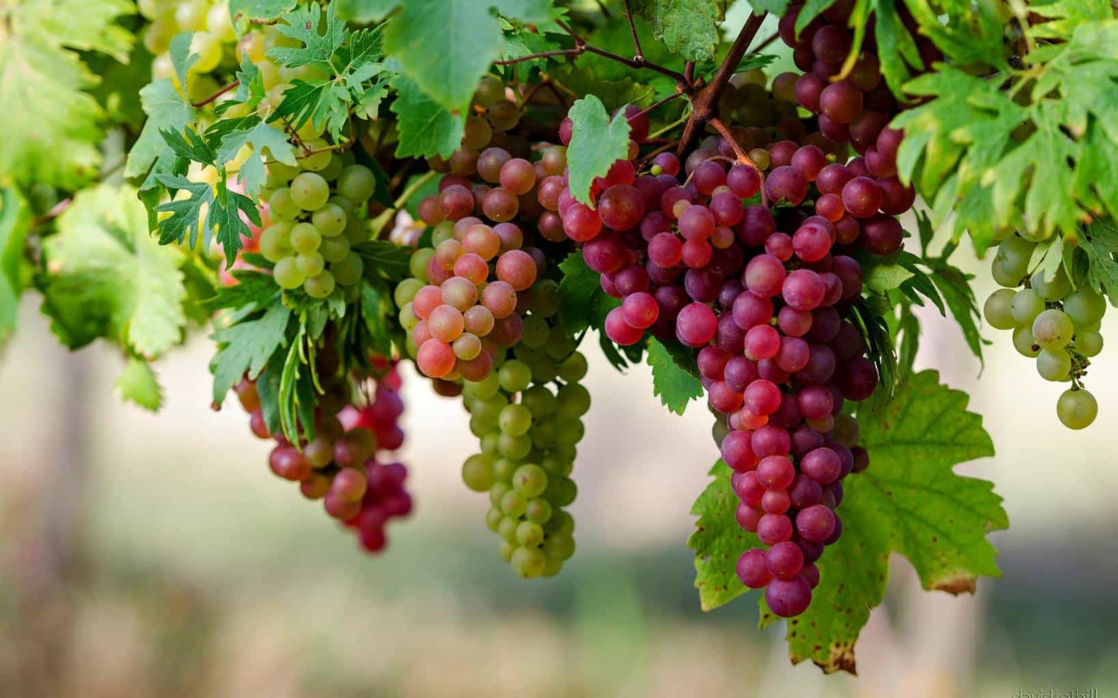
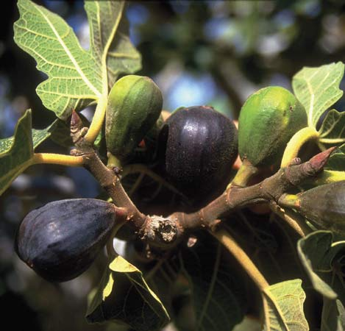

Slide 6
聖經中的修辭法 Figure of Speech in the Bible
修辭法: 單一字匯或一組字匯可以表達其字面意義，亦可表達
象征意義。修辭法就是用單一字匯或一組字匯將某一想法和觀點
加以特殊強調。這種特殊強調經常是以演講者將嚴格的字面意義特意轉變下達成的。
-A word or words can be expressed either in literal sense or in figurative sense. Figure of Speech is a word or a group of words used to give particular emphasis to an idea or sentiment. The special emphasis is typically accomplished by the user's conscious deviation from the strict literal sense of a word.
耶穌使用比喻來幫助聽他講論的人來了解神國；耶穌使用日常生活中(特別是與農業有關) 的影像和人物來使他的信息更加生動，這就是耶穌最常用的教導方式。
-Jesus used parables to help his listeners understand what the Kingdom of God is like. Jesus used images and characters taken from everyday life (especially, related to agriculture) to illustrate his messages. This was Jesus’ most common way of teaching.

Slide 7
聖經中與農業有關的修辭法
• Of a vine of Egypt 埃及的葡萄樹 (詩篇 80:8-16)
• Of the vineyard 葡萄園的比喻 (以賽亞書 5:1-7; 27:2, 3)
• Of the husbandman 農夫的比喻 (以賽亞書 28:23-29)
• Of the vine 葡萄樹的比喻 (以西結書 15:1 ... 17:5-10; 19:10-14)
• The farmer 農夫的比喻 (提摩太後書 2:6)
The Parables of Jesus 耶穌的比喻
• The barren fig tree 無花果樹的比喻 (Luke 13:6-9)
• The four soils 四種土地的比喻 (Matthew 13:3-9,18-23; Mark 4:1-9,14-20; Luke 8:5-8,11-15)
• The wheat and weeds 麥子和稗子的比喻 (Matthew 13:24-30, 36-43)
• The seed growing secretly 種子發芽漸長 (Mark 4:26-29)
• The mustard seed 芥菜種的比喻 (Matthew 13:31, 32; Mark 4:30-32; Luke 13:18, 19)
• The leaven (yeast) 酵的比喻 (Matthew 13:33; Luke 13:20, 21)
• The laborers in the vineyard 葡萄園的工人 (Matthew 20:1-16)
• The wicked vinedressers 惡園戶的比喻 (Matthew 21:33-44; Mark 12:1-12; Luke 20:9-18)
• The fig tree leafing 無花果樹發芽的比喻 (Matthew 24:32-33; Mark 13:28-29; Luke 21:29-31)

Slide 8
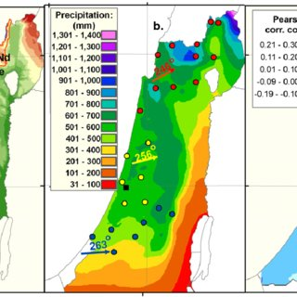
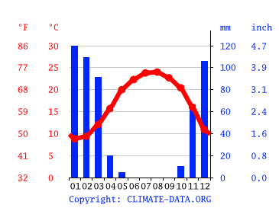
在以色列非常重要的“雨”
-Deuteronomy 11:14 ……..וְנָתַתִּ֧י מְטַֽר־אַרְצְכֶ֛ם בְּעִתּ֖וֹ יוֹרֶ֣ה וּמַלְק֑וֹשׁ
^{RSV} he will give the rain for your land in its season, the early rain
and the later rain, that you may gather in your grain and your wine
and your oil. (^{NKJ} ……. the rain ……. the early rain and the latter rain)
^{CUV} 他[原文作我]必按時降秋雨春雨、在你們的地上、使你們可以收藏五穀、新酒、和油．
^{LZZ} 他就按时将你们的地所需要的雨水就是秋霖春雨赐下来使你们可以收藏五谷新酒和新油。
^{CNV} 他必按時降雨在你們的地上，就是降秋雨和春雨，使你們可以豐收五穀、新酒和新油。
平均 降雨
與溫度
在耶路撒冷
Average
Rainfall & Temperature
in Jerusalem
以色列各
地區的降水Precipitation by region
in Israel

Slide 9
聖經修辭法中的“雨”(申32:2;賽45:8)
Deuteronomy 32:2 我的教訓要淋漓如雨；我的言語要滴落如露，
如細雨降在嫩草上，如甘霖降在菜蔬中.
^{NIV} Let my teaching fall like rain and my words descend like dew,
like showers on new grass, like abundant rain on tender plants.
Isaiah 45:8 ‎諸天哪，自上而滴，穹蒼降下公義；地面開裂，產出救恩，
使公義一同發生；這都是我耶和華所造的. / ^{NIV} You heavens above, rain down righteousness; let the clouds shower it down. Let the earth open wide, let salvation spring up, let righteousness grow with it; I, the LORD, have created it.
*In the Bible, expressions related to rain are used to refer to spiritual matters such as righteousness, justice, teaching and the Lord’s coming. 在聖經中，與雨有關的表述用於指代諸如公義，公平，教導和主的降臨之類屬靈的事。

Slide 10
“雨”和 主的降臨 (何西阿 6:3)
Hosea 6:3 ‎וְיָב֤וֹא כַגֶּ֙שֶׁם֙ לָ֔נוּ כְּמַלְק֖וֹשׁ י֥וֹרֶה אָֽרֶץ׃ ..……….
我們務要認識耶和華,竭力追求認識他.他出現確如晨光; 他必臨到
我們像甘雨,像滋潤田地的春雨. / ^{NKJ} Let us know, Let us pursue the knowledge of the LORD. His going forth is established as the morning; He will come to us like the rain, Like the latter and former rain to the earth.
^{ESV} …..… he will come to us as the showers, as the spring rains that water the earth.
*The Hebrewמַלְקוֹשׁ occurs 8 times in the OT (Deuteronomy 11:14; Job 29:23; Proverbs 16:15; Jeremiah 3:3; 5:24; Hosea 6:3; Joel 2:23; Zechariah 10:1). There is similarity between the coming of the Lord and rain-coming. Cf. Joel 2:23; Hosea 10:12; 2 Samuel 23:3-4 (以色列的神、以色列的磐石曉諭我說：那以公義治理人民的，敬畏神執掌權柄，他必像日出的晨光，如無雲的清晨，雨後的晴光，使地發生嫩草 / ^{ESV}….... like rain that makes grass to sprout from the earth)

Slide 11
“雨”和 公義 (何西阿 10:12)
Hosea 10:12 ‎וְעֵת֙ לִדְר֣וֹשׁ אֶת־יְהוָ֔ה עַד־יָב֕וֹא וְיֹרֶ֥ה צֶ֖דֶק לָכֶֽם׃ ..……….
‎你們要為自己栽種公義，就能收割慈愛。現今正是尋求耶和華
的時候；你們要開墾荒地，等他臨到，使公義如雨降在你們身上。
^{NKJ} Sow for yourselves righteousness; Reap in mercy; Break up your fallow ground,
For it is time to seek the LORD, Till He comes and rains righteousness on you.
^{RSV} ..………. that he may come and rain salvation upon you.
^{NIV} ..………. until he comes and showers righteousness on you.
^{TNK} ..………. Break for yourselves betimes fresh ground Of seeking the LORD, So that you may obtain a teacher of righteousness."
*The Hebrew יֹרֶה perhaps should be considered a verb here (hiphil imperfect 3rd person masculine singular), derived from the root ירה (to throw, shoot; to point, direct; teach). TNK’s ‘a teacher of righteousness’ could be the right translation. / Cf. “並且他會教你們公義”.

Slide 12
“雨”和 “公義的老師”(約珥 2:23)
2:23 錫安的民哪,你們要快樂,為耶和華你們的神歡喜．因他賜給
你們合宜的秋雨,為你們降下甘霖,就是秋雨,春雨、和先前一樣。
^{RSV} "Be glad, O sons of Zion, and rejoice in the LORD, your God; for he has given
the early rain for your vindication, he has poured down for you abundant rain, the early and the latter rain, as before. / ^{NIV} … for he has given you the autumn rains in righteousness. He sends you abundant showers, both autumn and spring rains, as before. / ^{YLT} And ye sons of Zion, joy and rejoice, In Jehovah your God, For He hath given to you the Teacher for righteousness, …
אֶת־הַמּוֹרֶ֖ה לִצְדָקָ֑ה ‎וּבְנֵ֣י צִיּ֗וֹן גִּ֤ילוּ וְשִׂמְחוּ֙ בַּיהוָ֣ה אֱלֹֽהֵיכֶ֔ם כִּֽי־נָתַ֥ן לָכֶ֛ם
וַיּ֣וֹרֶד לָכֶ֗ם גֶּ֛שֶׁם מוֹרֶ֥ה וּמַלְק֖וֹשׁ בָּרִאשֽׁוֹן׃
*希伯來文“moreh”(מוֹרֶה)的意思: 1) 早期的雨 (= 秋雨); 2)老師. 這裏的第一個“moreh”有冠詞(הַמּוֹרֶ֖ה“ha-moreh”),後面出現的“秋雨,春雨”(מוֹרֶ֥ה וּמַלְק֖וֹשׁ “moreh u-malkosh”)都沒有冠詞,所以第一個“ha-moreh”是有特定的意義, 比較理想的翻譯可以為：“公義的老師＂.這裏正確的翻譯是“錫安的民哪,你們要快樂,在耶和華你們的神裡頭歡喜．因他賜給你們公義的老師, 為你們降下甘霖,秋雨,春雨,和先前一樣”.

Slide 13
死海古卷中“公義的老師”(מוֹרֶה צֶדֶק Moreh Tsedek)
<Source> https://www.jewishvirtuallibrary.org/teacher-of-righteousness
TEACHER OF RIGHTEOUSNESS (Heb. מוֹרֶה צֶדֶק moreh ẓedek),
the organizer of the *Qumran community or *Yaḥad . His designation may have been derived from such biblical passages as Hosea 10:12, "it is time to seek the Lord, till He come and cause righteousness to rain [yoreh ẓedek] upon you," or Joel 2:23, "rejoice in the Lord, your God; for He giveth you the former rain in just measure" – et ha-moreh li-ẓedakah, which has sometimes been translated "teacher of righteousness" (see AV margin). He is never indicated by his personal name, so far as can be told from surviving records; it has been suggested that his name was Zadok, and that it was for this reason that his followers were called *Zadokites (so H.J. Schoeps, Urgemeinde, Judenchristentum, Gnosis (1956), 74); but this is uncertain. Knowledge of him is derived from two principal sources – the Zadokite Fragments (or Book of the Covenant of *Damascus ) and various Qumran commentaries on books or sections of the Bible.

Slide 14
“公義的老師”耶穌
Matthew 7:28-29. 耶穌講完了這些話，眾人都希奇他的教訓；
因為他教訓他們，正像有權柄的人，不像他們的文士。
John 3:2 這人夜裡來見耶穌、說、拉比、我們知道你是由神那裡來作師傅的．因為你所行的神蹟、若沒有神同在、無人能行。
John 13:13-14 你們稱呼我夫子、稱呼我主、你們說的不錯．我本來是。我是你們的主、你們的夫子、尚且洗你們的腳、你們也當彼此洗腳。
Matthew 23:8 但你們不要受拉比的稱呼．因為只有一位是你們的夫子．你們都是弟兄。
*Jesus was frequently called ‘teacher’ (διδάσκαλος 夫子, 師傅). See Matthew 8:19; 9:11; 10:24-25, 38; 17:24; 19:16; 22:16, 24, 36; 23:8, 10; 26:18; Mark 4:38; 5:35; 9:17, 38; 10:17, etc.

Slide 15
最棒的老師 耶穌
Isaiah 50:4 主耶和華賜我受教者的舌頭、使我知道怎樣
用言語扶助疲乏的人．主每早晨提醒、提醒我的耳朵、
使我能聽、像受教者一樣。
^{NKJ} The Lord GOD has given Me The tongue of the learned, That I should know how to speak A word in season to him who is weary. He awakens Me morning by morning, He awakens My ear To hear as the learned.
Matthew 11:28-30. 28 凡勞苦擔重擔的人可以到我這裡來，我就使你們得安息。 29 我心裡柔和謙卑，你們當負我的軛，學我的樣式；這樣，你們心裡就必得享安息。 30 因為我的軛是容易的，我的擔子是輕省的。

Slide 16
民數記 6:24-26
願耶和華賜福給你,保護你.
願耶和華使他的臉光照你,賜恩給你.
願耶和華向你仰臉,賜你平安.
‎ יְבָרֶכְךָ יְהוָה וְיִשְׁמְרֶךָ׃ Numbers 6:24-26
יָאֵר יְהוָה פָּנָיו אֵלֶיךָ וִיחֻנֶּךָּ׃
‎יִשָּׂא יְהוָה פָּנָיו אֵלֶיךָ וְיָשֵׂם לְךָ שָׁלוֹם׃

