Slide 1
以賽亞書中的
文字遊戲
Wordplay in the Book of Isaiah
金京來博士 Kyungrae Kim, Ph.D.

Slide 2
聖經中的文字遊戲 Wordplay in the Bible
文字遊戲是一種運用機智和幽默的文學技巧，
以有效表達信息。在聖經原文（主要是希伯來語）中
文字遊戲的效果在譯本中幾乎完全消失。以賽亞書提供研究聖經文字遊戲的最佳資源。從原文找出文字遊戲,並簡要加以銓釋將對聖經信息有更好的理解。
Wordplay (or word play, or play-on-words) is a literary technique that uses wit and humor, mainly to convey an effective message. The effects of wordplay almost always disappear in the Versions (translations). They can be found only in the original text of the Bible, mainly Hebrew. The Book of Isaiah is the best source for studying wordplay in the Bible. Finding out wordplays and briefly explaining them will be very helpful for a better understanding of the Biblical message.

Slide 3
以賽亞書 Isaiah 5:7
וַיְקַו לְמִשְׁפָּט וְהִנֵּה מִשְׂפָּח לִצְדָקָה וְהִנֵּה צְעָקָה׃ …...
萬軍之耶和華的葡萄園就是以色列家；他所喜愛的樹
就是猶大人。他指望的是公平，誰知倒有暴虐(或作:倒流人血)；
指望的是公義，誰知倒有冤聲。
^{NIV} …... And he looked for justice, but saw bloodshed; for righteousness, but heard cries of distress. / ^{NKJ} …... He looked for justice, but behold, oppression; For righteousness, but behold, a cry for help.
*The Hebrew מִשְׂפָּח occurs only here in the OT. Cf. the verbספח (Isaiah 14:1; 1 Samuel 2:36; 26:19; Job 30:7; Habakkuk 2:15).
-Habakkuk 2:15 ‎給人酒喝、又加上毒物、使他喝醉、好看見他下體的、有禍了。 / ^{ESV} ……. you pour out your wrath and make them drunk ……. (מְסַפֵּ֥חַ)

Slide 4
以賽亞書 Isaiah 7:9
‎ אִם לֹא תַאֲמִינוּ כִּי לֹא תֵאָמֵנוּ׃ ……..
以法蓮的首城是撒瑪利亞；撒瑪利亞的首領是
利瑪利的兒子。你們若是不信，定然不得立穩。
^{ESV} ….. If you are not firm in faith, you will not be firm at all.
^{NKJ} ….. If you will not believe, Surely you shall not be established.
^{NIV} …….. If you do not stand firm in your faith, you will not stand at all.'"
*The same root (אמן) occurs first in hiphil pattern, and then in niphal. The same wordplay occurs in 2 Chronicles 20:20 (‎הַאֲמִינוּ בַּיהוָ֤ה אֱלֹהֵיכֶם֙ וְתֵאָמֵנוּ / 次日清早眾人起來、往提哥亞的曠野去．出去的時候、約沙法站著說、猶大人和耶路撒冷的居民哪、要聽我說、信耶和華你們的神、就必立穩．信他的先知就必亨通。/ ^{ESV} …… Believe in the LORD your God, and you will be established; ……).
).

Slide 5
以賽亞兒子的名字: 預兆先知的信息
以賽亞書 Isaiah 7:3
耶和華對以賽亞說:你和你的兒子施亞雅述出去,
到上池的水溝頭,在漂布地的大路上,去迎接亞哈斯.(שְׁאָר יָשׁוּב)
-10:21-22 ‎所剩下的，就是雅各家所剩下的，必歸回全能的神.以色列阿,你的百姓,雖多如海沙,惟有剩下的歸回.原來滅絕的事已定.必有公義施行,如水漲溢.
^{NIV} A remnant will return, a remnant of Jacob will return to the Mighty God. For though your people Israel be as the sand of the sea, only a remnant of them will return. Destruction is decreed, overflowing with righteousness. (שְׁאָר יָשׁוּב)
).

Slide 6
以賽亞兒子的名字: 預兆先知的信息
以賽亞書 Isaiah 8:1, 3
8:1 וּכְתֹ֤ב עָלָיו֙ בְּחֶ֣רֶט אֱנ֔וֹשׁ לְמַהֵר שָׁלָל חָשׁ בַּז׃ ‎ …….
耶和華對我說：「你取一個大牌，拿人所用的筆，
寫上『瑪黑珥沙拉勒哈施罷斯』(就是擄掠速臨、搶奪快到的意思).
^{NIV} …… scroll and write on it with an ordinary pen: Maher-Shalal-Hash-Baz.
8:3 我以賽亞與妻子(原文作女先知)同室;他懷孕生子,耶和華就對我說:給他起名叫瑪黑珥沙拉勒哈施罷斯 / ^{NIV} Then I went to the prophetess, …….. Name him Maher-Shalal-Hash-Baz. (מַהֵר שָׁלָל חָשׁ בַּז)
*8:4 因為在這小孩子不曉得叫父叫母之先、大馬色的財寶、和撒瑪利亞的擄物、必在亞述王面前搬了去. / 10:6 我要打發他攻擊褻瀆的國民、吩咐他攻擊我所惱怒的百姓、搶財為擄物、奪貨為掠物、將他們踐踏 ……

Slide 7
以賽亞書 Isaiah 12:2 & 13:6
12:2 …….. ‎הִנֵּ֙ה אֵ֧ל יְשׁוּעָתִ֛י אֶבְטַח וְלֹ֣א אֶפְחָד
看哪!神是我的拯救;我要倚靠他,並不懼怕.
因為主耶和華是我的力量,是我的詩歌,他也成了我的拯救.
^{NIV} Surely God is my salvation; I will trust and not be afraid. The LORD, the LORD, is my strength and my song; he has become my salvation.
13:6 ‎הֵילִ֕ילוּ כִּ֥י קָר֖וֹב י֣וֹם יְהוָ֑ה כְּשֹׁד מִשַּׁדַּי יָבֽוֹא׃
你們要哀號，因為耶和華的日子臨近了！這日來到，
好像毀滅從全能者來到。/ ^{NIV} ……. like destruction from the Almighty.
*Also Joel 1:15 (‎קָרוֹב֙ י֣וֹם יְהוָ֔ה וּכְשֹׁד מִשַׁדַּי יָבֽוֹא׃ / 哀哉!耶和華的日子臨近了。這日來到，好像毀滅從全能者來到。
).

Slide 8
以賽亞書 Isaiah 19:18
‎ וְנִשְׁבָּע֖וֹת לַיהוָ֣ה צְבָא֑וֹת עִיר הַהֶרֶס יֵאָמֵ֖ר לְאֶחָֽת׃ ……
^{LXX} πόλις-ασεδεκ (the city of Asedec / עִיר הַצֶּדֶק 公義之城）
當那日,埃及地必有五城的人說迦南的方言,又指著
萬軍之耶和華起誓。有一城必稱為「滅亡城」. / ^{NIV} In that day five cities in Egypt will speak the language of Canaan and swear allegiance to the LORD Almighty. One of them will be called the City of Destruction.
^{TNK} Town of Heres / ^{NKJ} the City of Destruction / ^{RSV} the City of the Sun (太陽城)
*When Isaiah used the term ‘City of Destruction’ (עִיר הַהֶרֶס), by the wordplay, he may have meant to refer to the ‘City of the Sun’ (עִיר הַחֶרֶס).
חֶרֶס (cheres) the Sun (太陽): Job 9:7; Judges 14:18
הֶרֶס (heres) overthrow, destruction (毀壞, 毀滅, 滅亡)
‘City of the Sun’ (太陽城): allusion to On-Heliopolis (Ἡλιούπολις)
).

Slide 9
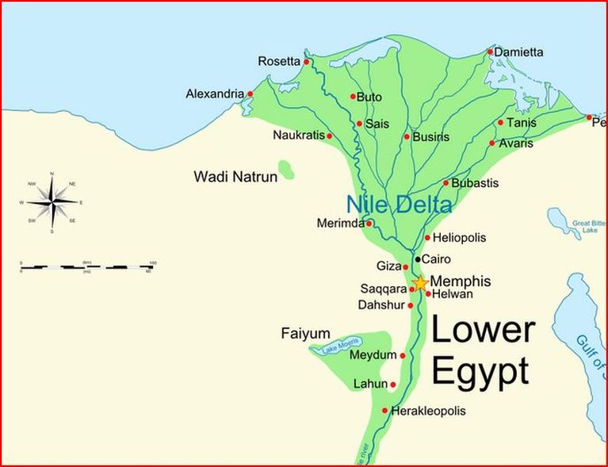
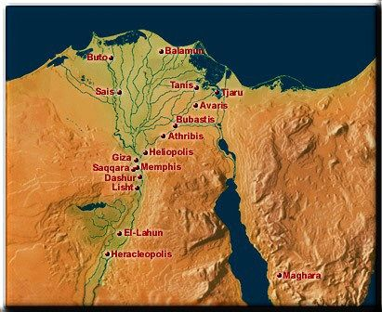
太陽城
On-Heliopolis
(Worship center of the sun god Re/Ra)

Slide 10
以賽亞書 Isaiah 24:17-18
17פַּחַד וָפַחַת וָפָח עָלֶ֖יךָ יוֹשֵׁ֥ב הָאָֽרֶץ׃
וְֽ֠הָיָה הַנָּ֞ס מִקּ֤וֹל הַפַּחַד יִפֹּ֣ל אֶל־הַפַּחַת 18
……… ‎‎ וְהָֽעוֹלֶה֙ מִתּ֣וֹךְ הַפַּחַת יִלָּכֵ֖ד בַּפָּח
17 地上的居民哪,恐懼,陷坑,網羅都臨近你.18 躲避恐懼聲音的必墜入陷坑;從陷坑上來的必被網羅纏住;因為天上的窗戶都開了,地的根基也震動了.
^{NIV} Terror and pit and snare await you, …….. Whoever flees at the sound of terror will fall into a pit; whoever climbs out of the pit will be caught in a snare. ……..
*Also in Jeremiah 48:43-44 (耶和華說:摩押的居民哪,恐懼,陷坑,網羅都臨近你。躲避恐懼的必墜入陷坑;從陷坑上來的必被網羅纏住;因我必 ……).
-Lamentations 3:47 ‎恐懼和陷坑,殘害和毀滅,都臨近我們 (פַּחַד וָפַחַת )
-Job 22:10 因此、有網羅環繞你、有恐懼忽然使你驚惶 (פַחִים וִֽ֜יבַהֶלְךָ פַּחַד )
).

Slide 11
以賽亞書 Isaiah 30:16 & 61:3
30:16 וַתֹּ֙אמְר֥וּ לֹא־כִ֛י עַל־סוּס נָנוּס עַל־כֵּ֣ן תְּנוּסוּן
וְעַל־קַל נִרְכָּ֔ב עַל־כֵּ֖ן יִקַּלּוּ רֹדְפֵיכֶֽם׃
你們卻說,不然,我們要騎馬奔走.所以你們必然奔走.
又說,我們要騎飛快的牲口.所以追趕你們的,也必飛快.
^{NKJ} And you said, "No, for we will flee on horses "-- Therefore you shall flee! And, "We will ride on swift horses"-- Therefore those who pursue you shall be swift!
61:3 …… לָשׂ֣וּם לַאֲבֵלֵ֣י צִיּ֗וֹן לָתֵת֩ לָהֶ֙ם פְּאֵר תַּ֣חַת אֵפֶר
賜華冠與錫安悲哀的人,代替灰塵,喜樂油,代替悲哀,讚美衣,
代替憂傷之靈.使他們稱為公義樹,是耶和華所栽的,叫他得榮耀.
^{NIV} and provide for those who grieve in Zion-- to bestow on them
a crown of beauty instead of ashes, the oil of joy instead of mourning, …..
).

Slide 12
馬太使用以賽亞書中的彌賽亞預言作為文字遊戲
以賽亞書 Isaiah 11:1 (馬太福音 2:23)
‎וְיָצָ֥א חֹ֖טֶר מִגֵּ֣זַע יִשָׁ֑י וְנֵצֶר מִשָּׁרָשָׁ֥יו יִפְרֶֽה׃
從耶西的本必發一條；從他根生的枝子必結果實。
^{NIV} A shoot ……. from the stump of Jesse; from his roots a Branch will bear fruit.
-Matthew 2:23 到了一座城,名叫拿撒勒(Ναζαρέτ),就住在那裡.
這是要應驗先知所說,他將稱為拿撒勒人的話了.
*拿撒勒人 (Ναζωραῖος): נָצְרִי ‘notzri ’ (Modern Hebrew)
*拿撒勒 (Ναζαρέτ): The village is not known in the OT. It is pronounced ‘natzrat’ (נָצְרַת) or ‘natzeret’ in Hebrew. One of the Messianic names in the OT is ‘netzer’ (נֵצֶר ‘branch’ 枝子) (Isaiah 11:1). It is probable that Matthew mentioned this by means of wordplay, a technique very common in Jewish writing.

Slide 13
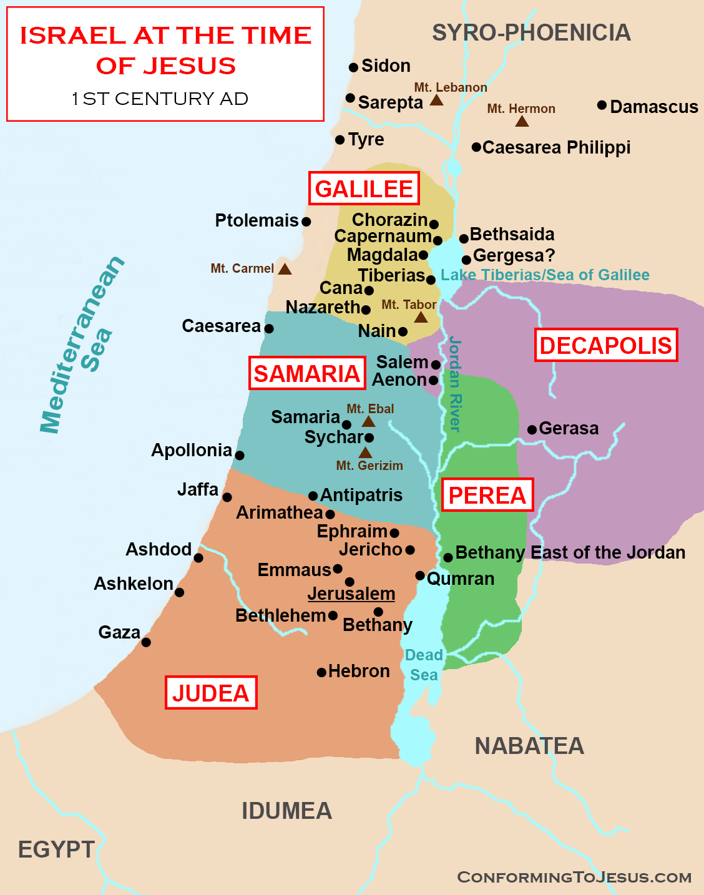
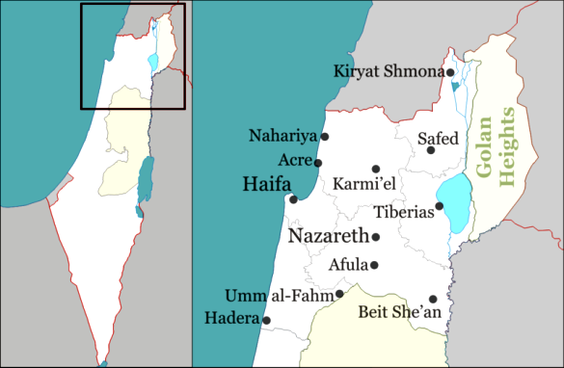
拿撒勒
Nazareth
נָצְרַת

Slide 14
民數記 6:24-26
願耶和華賜福給你,保護你.
願耶和華使他的臉光照你,賜恩給你.
願耶和華向你仰臉,賜你平安.
‎ יְבָרֶכְךָ יְהוָה וְיִשְׁמְרֶךָ׃ Numbers 6:24-26
יָאֵר יְהוָה פָּנָיו אֵלֶיךָ וִיחֻנֶּךָּ׃
‎יִשָּׂא יְהוָה פָּנָיו אֵלֶיךָ וְיָשֵׂם לְךָ שָׁלוֹם׃

