Slide 1
耶利米書和以西結書中的
文 字 遊 戲
Wordplay in Jeremiah & Ezekiel
金京來博士 Kyungrae Kim, Ph.D.

Slide 2
聖經中的文字遊戲 Wordplay in the Bible
文字遊戲是一種運用機智和幽默的文學技巧，
以有效表達信息。 希伯來聖經的讀者可能會
發現一些文字遊戲。但是，沒有翻譯可以用
與希伯來語相同的方式表達希伯來語聖經中的文字遊戲。從原文找出文字遊戲,並簡要加以銓釋將對聖經信息有更好的理解。
Wordplay (or word play, or play-on-words) is a literary technique that uses wit and humor, mainly to convey an effective message. Readers of the Hebrew Bible may locate many cases of wordplay. There is no translation, however, which can express the wordplays of the Hebrew Bible in the same way as they appear in the Hebrew language. Finding out wordplays and briefly explaining them will be very helpful for a better understanding of the Biblical message.

Slide 3
耶利米書 Jeremiah 1:11-12
‎ וַיֹּ֧אמֶר יְהוָ֛ה אֵלַ֖י וָאֹמַ֕ר מַקֵּ֥ל שָׁקֵ֖ד אֲנִ֥י רֹאֶֽה׃ …….
הֵיטַ֣בְתָּ לִרְא֑וֹת כִּֽי־שֹׁקֵ֥ד אֲנִ֛י עַל־דְּבָרִ֖י לַעֲשֹׂתֽוֹ׃
11 ……. 「耶利米,你看見什麼?」我說:「我看見一根杏樹枝.」
12 耶和華對我說:「你看得不錯;因為我留意保守我的話,使得成就.」
^{NIV} 11 ……. "I see the branch of an almond tree," I replied. 12 The LORD said to me, "You have seen correctly, for I am watching to see that my word is fulfilled."
*‘an almond tree’ (שָׁקֵד shaqed) & ‘watching to see’ (שֹׁקֵד shoqed)
*The Hebrew verb שָׁקַד occurs 12 times in the OT (Ezra 8:29; Psalm 102:7[8]; 127:1; Proverbs 8:34; Isaiah 29:20; Jeremiah 1:12; 5:6; 31:28<2x>; 44:27; Daniel 9:14). Cf. Jeremiah 31:28. (我先前怎樣留意將他們拔出,拆毀,毀壞,傾覆,苦害，也必照樣留意將他們建立,栽植.這是耶和華說的./ ^{NIV} watch over ); 44:27 (我向他們留意降禍不降福、在埃及地的一切猶大人必因刀劍飢荒所滅、直到滅盡./ ^{NIV} watching).

Slide 4
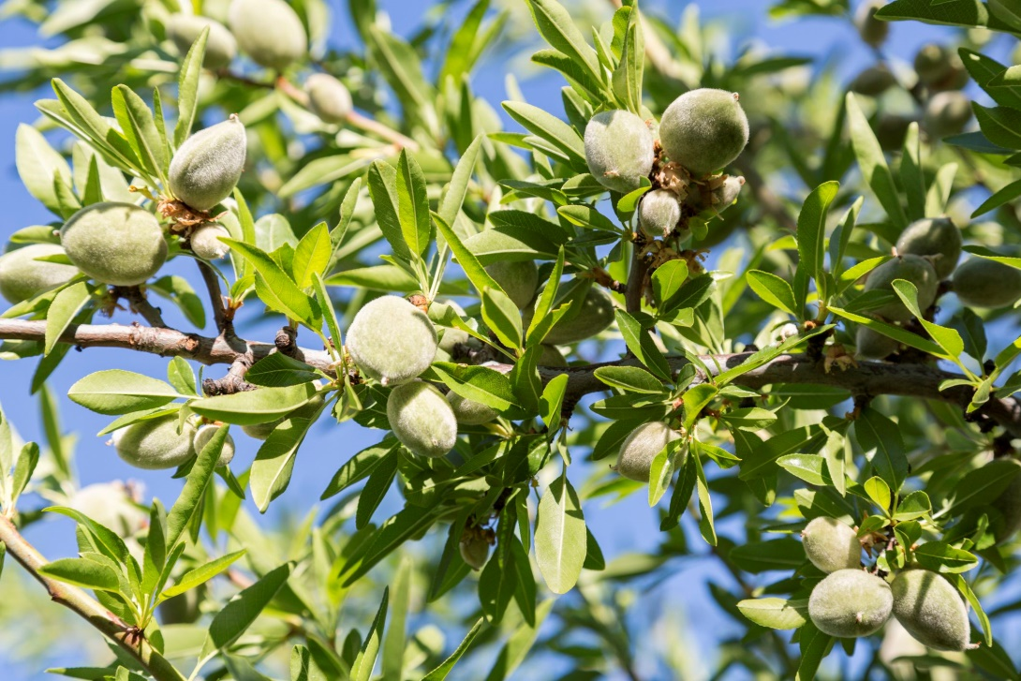
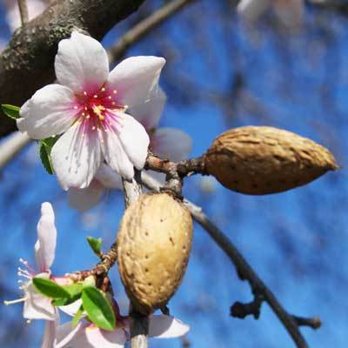
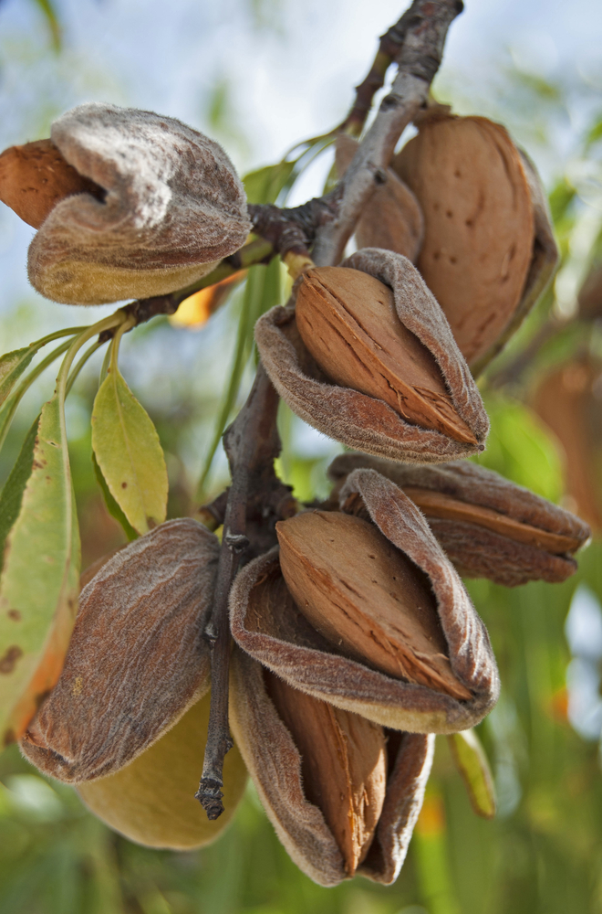
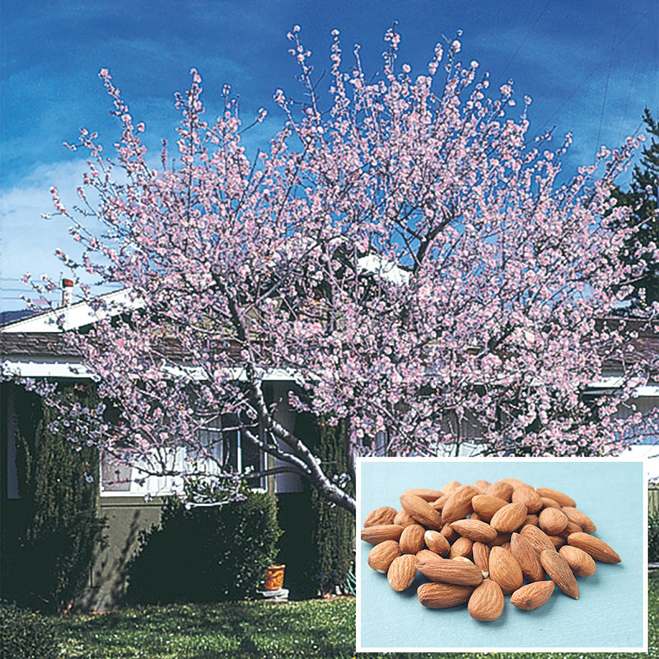
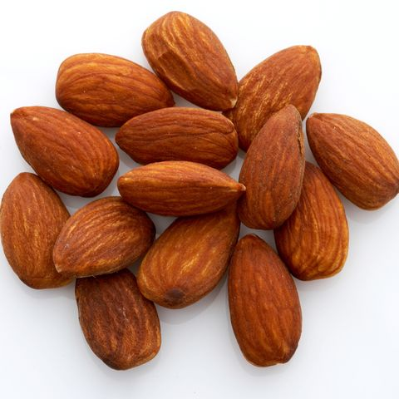
Almond Tree שָׁקֵד
(shaqed)
杏仁樹

Slide 5
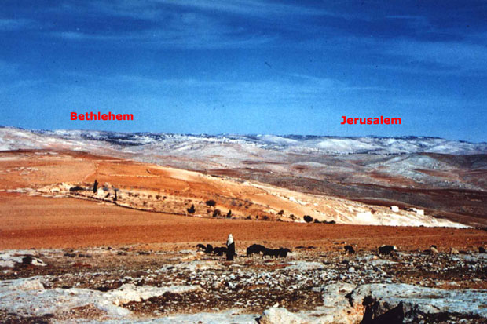
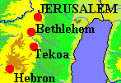
耶利米書 Jeremiah 6:1
……. ‎וּבִתְקוֹ֙עַ֙ תִּקְע֣וּ שׁוֹפָ֔ר …….
便雅憫人哪,你們要逃出耶路撒冷,在提哥亞吹角,
在伯哈基琳立號旗;因為有災禍與大毀滅從北方張望.
^{NIV} Flee for safety, people of Benjamin! Flee from Jerusalem!
Sound (תִּקְעוּ) the trumpet in Tekoa (תְקוֹע)! Raise the signal over …….
Tekoa (תְקוֹע 提哥亞)
8 km South
from Bethlehem
16 km South
from Jerusalem

Slide 6
耶利米書 Jeremiah 20:3
לֹ֤א פַשְׁחוּר֙ קָרָ֤א יְהוָה֙ שְׁמֶ֔ךָ כִּ֖י אִם־מָגוֹר מִסָּבִיב׃
次日,巴施戶珥將耶利米開枷釋放.於是耶利米對他說:
耶和華不是叫你的名為巴施戶珥,乃是叫你瑪歌珥米撒畢.
^{NIV} …….. The LORD's name for you is not Pashhur, but Magor-Missabib.
*The name signifies ‘Terror on every side’ (四面驚嚇), with a prophetic message in it. See Jeremiah 20:10 (我聽見了許多人的讒謗，四圍都是驚嚇；就是我知己的朋友也都窺探我，願我跌倒，說：告他吧，我們也要告他！或者他被引誘，我們就能勝他，在他身上報仇 / מָגוֹר מִסָּבִיב). And the first word (מָגוֹר terror 驚嚇) alone occurs in Jeremiah 20:4 (因耶和華如此說、我必使你自覺驚嚇 …….你也必親眼看見、我必將猶大人全交在巴比倫王的手中、他要將他們擄到巴比倫去、也要用刀將他們殺戮). Cf. Jeremiah 6:25; 46:5; 49:29.

Slide 7
耶利米書 Jeremiah 25:26 & 51:41
……. עַל־פְּנֵ֣י הָאֲדָמָ֑ה וּמֶ֥לֶךְ שֵׁשַׁךְ יִשְׁתֶּ֥ה אַחֲרֵיהֶֽם׃ 25:26
北方遠近的諸王,以及天下地上的萬國喝了.
以後示沙克[就是巴比倫]王也要喝.
^{NIV} ……. And after all of them, the king of Sheshak will drink it too.
51:41אֵ֚יךְ נִלְכְּדָ֣ה שֵׁשַׁךְ וַתִּתָּפֵ֖שׂ תְּהִלַּ֣ת כָּל־הָאָ֑רֶץ אֵ֣יךְ הָיְתָ֧ה לְשַׁמָּ֛ה בָּבֶל בַּגּוֹיִֽם׃
示沙克何竟被攻取.天下所稱讚的,何竟被佔據.巴比倫在列國中,
何竟變為荒場. / ^{NIV} How Sheshak will be captured, the boast of the whole
earth seized! How desolate Babylon will be among the nations!
*The Hebrew שֵׁשַׁךְ occurs only twice in the Hebrew OT. It is a name for Babylon (Jeremiah 51:41). The name is formed in the way which the letters of the alphabet were put one for the other in the inverse order (ת for א, שׁ for ב, etc.); thus שׁ would correspond to ב and כ to ל. See also Jeremiah 51:1.
א ב ג ד ה ו ז ח ט י כ ל מ נ ס ע פ צ ק ר ש ת

Slide 8
耶利米書 Jeremiah 51:1
הִנְנִי֙ מֵעִ֣יר עַל־בָּבֶ֔ל וְאֶל־יֹשְׁבֵ֖י לֵב קָמָי ר֖וּחַ מַשְׁחִֽית׃ …….
^{LXX} ……. Βαβυλῶνα καὶ ἐπὶ τοὺς κατοικοῦντας Χαλδαίους
ἄνεμον καύσωνα διαφθείροντα (the Chaldeans 迦勒底人)
耶和華如此說,我必使毀滅的風颳起,攻擊巴比倫,和住在立加米的人。
^{NIV} This is what the LORD says: "See, I will stir up the spirit of a destroyer against Babylon and the people of Leb Kamai.
*As in Jeremiah 25:25; 51:41, the Hebrew word לֵב קָמָי is formed in the way which the letters of the alphabet were put one for the other in the inverse order (ת for א, שׁ for ב, etc.). Thus the Hebrew word כַּשְׂדִּים (the Chaldeans) is represented by לֵב קָמַי (lev kamai), whose meaning is dubious. It is a wordplay by a transposition of the letters so as to gain a significant meaning.
א ב ג ד ה ו ז ח ט י כ ל מ נ ס ע פ צ ק ר ש ת

Slide 9
耶利米書 Jeremiah 48:2, 9
אֵ֣ין עוֹד֘ תְּהִלַּ֣ת מוֹאָב֒ בְּחֶשְׁבּ֗וֹן חָשְׁב֤וּ עָלֶ֙יהָ֙ רָעָ֔ה48:2
לְכ֖וּ וְנַכְרִיתֶ֣נָּה מִגּ֑וֹי גַּם־מַדְמֵ֣ן תִּדֹּ֔מִּי אַחֲרַ֖יִךְ תֵּ֥לֶךְ חָֽרֶב׃
摩押不再被稱讚．有人在希實本設計謀害他、說、來罷、
我們將他剪除、不再成國。瑪得緬哪、你也必默默無聲．刀劍必追趕你。
^{NKJ} No more praise of Moab. In Heshbon they have devised evil against her:`Come, and let us cut her off as a nation.' You also shall be cut down, O Madmen! ……
48:9 …… ‎ תְּנוּ־צִ֣יץ לְמוֹאָ֔ב כִּ֥י נָצֹ֖א תֵּצֵ֑א וְעָרֶ֙יהָ֙ לְשַׁמָּ֣ה תִֽהְיֶ֔ינָה
要將翅膀給摩押、使他可以飛去．他的城邑必至荒涼、無人居住。
^{ESV} "Give wings to Moab, for she would fly away; her cities shall become a desolation, with no inhabitant in them. / ^{NIV} Put salt on Moab, for she will be laid waste; her towns will become desolate, with no one to live in them.
*The meaning ofצִיץ (usually, blossom; flower) is not clear in this context.

Slide 10
耶利米書 Jeremiah 48:43-44
פַּ֥חַד וָפַ֖חַת וָפָ֑ח עָלֶ֛יךָ יוֹשֵׁ֥ב מוֹאָ֖ב נְאֻם־יְהוָֽה׃
(הַנִּיס) [הַנָּ֞ס] מִפְּנֵ֤י הַפַּ֙חַד֙ יִפֹּ֣ל אֶל־הַפַּ֔חַת
וְהָֽעֹלֶה֙ מִן־הַפַּ֔חַת יִלָּכֵ֖ד בַּפָּ֑ח …….
耶和華說:摩押的居民哪,恐懼,陷坑,網羅都臨近你。躲避恐懼的必墜入陷坑;從陷坑上來的必被網羅纏住;因我必使追討之年臨到摩押.這是耶和華說的。/ ^{NIV} Terror and pit and snare await you, …… Whoever flees from the terror will fall into a pit, whoever climbs out of the pit will be caught in a snare; ……
*Also in Isaiah 24:17-18 (地上的居民哪,恐懼,陷坑,網羅都臨近你.躲避恐懼聲音的必墜入陷坑;從陷坑上來的必被網羅纏住 ……).
-Lamentations 3:47 ‎恐懼和陷坑,殘害和毀滅,都臨近我們 (פַּחַד וָפַחַת )
-Job 22:10 因此、有網羅環繞你、有恐懼忽然使你驚惶 (פַחִים וִֽ֜יבַהֶלְךָ פַּחַד )
).

Slide 11
以西結書 Ezekiel 7:11 & 9:4
7:11‎ לֹא־מֵהֶ֞ם וְלֹ֧א מֵהֲמוֹנָ֛ם וְלֹ֥א מֶהֱמֵהֶ֖ם וְלֹא־נֹ֥הַּ בָּהֶֽם׃ ……
強暴興起、成了罰惡的杖．以色列人、或是他們的群眾、
或是他們的財寶、無一存留、他們中間也沒有得尊榮的。
^{NKJ} Violence has risen up into a rod of wickedness; None of them shall remain, None of their multitude, None of them; Nor shall there be wailing for them. / ^{NIV} …… None of the people will be left, none of that crowd-- none of their wealth, nothing of value.
*The meaning of this Hebrew passage is obscure.
9:4הָאֲנָשִׁ֗ים הַנֶּֽאֱנָחִים֙ וְהַנֶּ֣אֱנָקִ֔ים עַ֚ל כָּל־הַתּ֣וֹעֵב֔וֹת הַֽנַּעֲשׂ֖וֹת בְּתוֹכָֽהּ׃ ..…
耶和華對他說,你去走遍耶路撒冷全城,那些因城中所行可憎之事歎息哀哭的人,畫記號在額上。
^{NKJ} and the LORD said to him, "Go through the midst of the city,
以西結書 Ezekiel 7:11 & 9:4
7:11‎ לֹא־מֵהֶ֞ם וְלֹ֧א מֵהֲמוֹנָ֛ם וְלֹ֥א מֶהֱמֵהֶ֖ם וְלֹא־נֹ֥הַּ בָּהֶֽם׃ ……
強暴興起、成了罰惡的杖．以色列人、或是他們的群眾、
或是他們的財寶、無一存留、他們中間也沒有得尊榮的。
^{NKJ} Violence has risen up into a rod of wickedness; None of them shall remain, None of their multitude, None of them; Nor shall there be wailing for them. / ^{NIV} …… None of the people will be left, none of that crowd-- none of their wealth, nothing of value.
*The meaning of this Hebrew passage is obscure.
9:4הָאֲנָשִׁ֗ים הַנֶּֽאֱנָחִים֙ וְהַנֶּ֣אֱנָקִ֔ים עַ֚ל כָּל־הַתּ֣וֹעֵב֔וֹת הַֽנַּעֲשׂ֖וֹת בְּתוֹכָֽהּ׃ ..…
耶和華對他說,你去走遍耶路撒冷全城,那些因城中所行可憎之事歎息哀哭的人,畫記號在額上./ ^{NKJ} …… who sigh and cry over all the abominations ……
אנח (sigh, groan): 13 times, always in niphal pattern
אנק (groan, be in mourning): 4 times (Jeremiah 51:52; Ezekiel 9:4; 24:17; 26:15)

Slide 12
以西結書 Ezekiel 12:10, 12
12:10 ….… הַנָּשִׂ֞יא הַמַּשָּׂ֤א הַזֶּה֙ בִּיר֣וּשָׁלִַ֔ם
你要對他們說,主耶和華如此說,這是關乎耶路撒冷
的君王,和他周圍以色列全家的預表.[原文作擔子]
^{ESV} ……. This oracle concerns the prince in Jerusalem and all the house of Israel who are in it. / ^{NIV} ……. This prophecy concerns the prince in Jerusalem …….
*The Hebrewמַשָּׂא (literally: load, bearing, tribute, burden, lifting) occurs 69 times in the OT. In 29 cases, the word signifies ‘prophecy, utterance, oracle’. The Hebrew מַשָּׂא and נָשִׂיא (chief, minor king, leader) share the same root נשׂא (to lift, raise; bear, carry).
12:12 ……. ‎וְהַנָּשִׂ֙יא אֲשֶׁר־בְּתוֹכָ֜ם אֶל־כָּתֵ֤ף יִשָּׂא֙ בָּעֲלָטָ֣ה וְיֵצֵ֔א
他們中間的君王、也必在天黑的時候將物件搭在肩頭上帶出去．他們要挖通了牆、從其中帶出去．他必蒙住臉、眼看不見地。
^{ESV} And the prince who is among them shall lift his baggage upon his shoulder ……

Slide 13
以西結書 Ezekiel 12:16 & 20:37-38
12:16 ‎וְהוֹתַרְתִּ֤י מֵהֶם֙ אַנְשֵׁ֣י מִסְפָּ֔ר מֵחֶ֖רֶב מֵרָעָ֣ב וּמִדָּ֑בֶר
לְמַ֙עַן יְסַפְּר֜וּ אֶת־כָּל־תּוֹעֲבֽוֹתֵיהֶ֗ם בַּגּוֹיִם֙ ….…
我卻要留下他們幾個人得免刀劍,飢荒,瘟疫,使他們
在所到的各國中,述說他們一切可憎的事.人就知道我是耶和華.
^{ESV} But I will let a few of them escape from the sword, from famine and pestilence, that they may declare all their abominations among the nations where they go, and may know that I am the LORD.
20:37-38. …... וּבָרוֹתִ֣י מִכֶּ֗ם הַמֹּרְדִ֤ים 38 וְהֵבֵאתִ֥י אֶתְכֶ֖ם בְּמָסֹ֥רֶת הַבְּרִֽית׃ …... 37
37 我必使你們從杖下經過、使你們被約拘束．38 我必從你們中間除淨叛逆和得罪我的人、將他們從所寄居的地方領出來、他們卻不得入以色列地．你們就知道我是耶和華。/ ^{ESV} 37 I will make you pass under the rod, and I will bring you into the bond of the covenant. 38 I will purge out the rebels from among you, …….
).

Slide 14
以西結書 Ezekiel 20:29
וָאֹמַ֣ר אֲלֵהֶ֔ם מָ֣ה הַבָּמָ֔ה אֲשֶׁר־אַתֶּ֥ם הַבָּאִ֖ים שָׁ֑ם
וַיִּקָּרֵ֤א שְׁמָהּ֙ בָּמָ֔ה עַ֖ד הַיּ֥וֹם הַזֶּֽה׃
我就對他們說、你們所上的那高處叫甚麼呢．
那高處的名字叫巴麻直到今日。
^{ESV} I said to them, What is the high place to which you go?
So its name is called Bamah to this day.
*See the similarity between הַבָּמָה (the high place)
and הַבָּאִים …… מָה (What is …... go).
).

Slide 15
以西結書 Ezekiel 23:4
‎וּשְׁמוֹתָ֗ן אָהֳלָ֤ה הַגְּדוֹלָה֙ וְאָהֳלִיבָ֣ה אֲחוֹתָ֔הּ
וַתִּֽהְיֶ֣ינָה לִ֔י וַתֵּלַ֖דְנָה בָּנִ֣ים וּבָנ֑וֹת
וּשְׁמוֹתָ֕ן שֹׁמְר֣וֹן אָהֳלָ֔ה וִירוּשָׁלִַ֖ם אָהֳלִיבָֽה׃
他們的名字,姐姐名叫阿荷拉,妹妹名叫阿荷利巴.他們都歸於我,生了兒女.論到他們的名字,阿荷拉就是撒瑪利亞,阿荷利巴就是耶路撒冷.
^{NIV} The older was named Oholah, and her sister was Oholibah.
They were mine and gave birth to sons and daughters.
Oholah is Samaria, and Oholibah is Jerusalem.
‘Oholah’ אָהֳלָה – her tent
‘Oholibah’ אָהֳלִיבָה – My tent is in her.
*Also Ezekiel 23:5, 11, 22, 36, 44.
).

Slide 16
以西結書 Ezekiel 24:21 & 25:16
24:21 …… מַחְמַ֥ד עֵֽינֵיכֶ֖ם וּמַחְמַ֣ל נַפְשְׁכֶ֑ם ……
你告訴以色列家、主耶和華如此說、我必使我的聖所、
就是你們勢力所誇耀、眼裡所喜愛、心中所愛惜的被褻瀆、
並且你們所遺留的兒女、必倒在刀下。/ ^{ESV} 'Say to the house of Israel, Thus says the Lord GOD: Behold, I will profane my sanctuary, the pride of your power, the delight of your eyes, and the yearning of your soul, …….
25:16 וְהִכְרַתִּ֖י אֶת־כְּרֵתִ֑ים וְהַ֣אֲבַדְתִּ֔י אֶת־שְׁאֵרִ֖ית ח֥וֹף הַיָּֽם׃ ……
所以主耶和華如此說、我必伸手攻擊非利士人、剪除基利提人、滅絕沿海剩下的居民. / ^{ESV} therefore thus says the Lord GOD, Behold, I will stretch out my hand against the Philistines, and I will cut off the Cherethites and destroy the rest of the seacoast.
).

Slide 17
以西結書 Ezekiel 33:27 & 37:28
33:27 ……. ‎חַי־אָנִי֒ אִם־לֹ֞א אֲשֶׁ֤ר בֶּֽחֳרָבוֹת֙ בַּחֶ֣רֶב יִפֹּ֔לוּ …….
你要對他們這樣說、主耶和華如此說、我指著我的
永生起誓、在荒場中的必倒在刀下．在田野間的
必交給野獸吞喫．在保障和洞裡的必遭瘟疫而死。
^{ESV} Say this to them, Thus says the Lord GOD: As I live, surely those who are in the waste places shall fall by the sword, and whoever is in the open field …….
37:28 ‎וְיָֽדְעוּ֙ הַגּוֹיִ֔ם כִּ֚י אֲנִ֣י יְהוָ֔ה מְקַדֵּ֖שׁ אֶת־יִשְׂרָאֵ֑ל בִּהְי֧וֹת מִקְדָּשִׁ֛י בְּתוֹכָ֖ם לְעוֹלָֽם׃
我的聖所在以色列人中間、直到永遠、外邦人就必知道我是叫以色列成為聖的耶和華。/ ^{ESV} Then the nations will know that I am the LORD who sanctifies Israel, when my sanctuary is in their midst forevermore.

Slide 18
以西結書 Ezekiel 37:8-10
‎ וַיִּקְרַ֧ם עֲלֵיהֶ֛ם ע֖וֹר מִלְמָ֑עְלָה וְר֖וּחַ אֵ֥ין בָּהֶֽם׃ ……..
וַיֹּ֣אמֶר אֵלַ֔י הִנָּבֵ֖א אֶל־הָר֑וּחַ הִנָּבֵ֣א בֶן־אָ֠דָם וְאָמַרְתָּ֙ אֶל־הָר֜וּחַ
כֹּֽה־אָמַ֣ר אֲדֹנָ֣י יְהוִ֗ה מֵאַרְבַּ֤ע רוּחוֹת֙ בֹּ֣אִי הָר֔וּחַ וּפְחִ֛י בַּהֲרוּגִ֥ים…..
‎וְהִנַּבֵּ֖אתִי כַּאֲשֶׁ֣ר צִוָּ֑נִי וַתָּבוֹא֩ בָהֶ֙ם הָר֜וּחַ וַיִּֽחְי֗וּ וַיַּֽעַמְדוּ֙ עַל־רַגְלֵיהֶ֔ם…….
8 我觀看,見骸骨上有筋,也長了肉,又有皮遮蔽其上.只是還沒有氣息.9 主對我說,人子阿,你要發預言,向風發預言,說,主耶和華如此說,氣息阿,要從四方而來,吹在這些被殺的人身上,使他們活了.10 於是我遵命說預言,氣息就進入骸骨,骸骨便活了,並且站起來,成為極大的軍隊.
^{ESV} 8 And I looked, …….. But there was no breath in them. 9 Then he said to me, "Prophesy to the breath; prophesy, son of man, and say to the breath, Thus says the Lord GOD: Come from the four winds, O breath, and breathe on these slain, that they may live." 10 So I prophesied as he commanded me, and the breath came into them, ……..
*The three Chinese nouns are renderings of the same Hebrew word (רוּחַ).
.

Slide 19
以西結書 Ezekiel 39:15-16
עַ֣ד קָבְר֤וּ אֹתוֹ֙ הַֽמְקַבְּרִ֔ים אֶל־גֵּ֖יא הֲמ֥וֹן גּֽוֹג׃ ……..
וְגַ֥ם שֶׁם־עִ֛יר הֲמוֹנָ֖ה וְטִהֲר֥וּ הָאָֽרֶץ׃
15 巡查遍地的人,要經過全地．見有人的骸骨,就在旁邊
立一標記,等葬埋的人來將骸骨葬在哈們歌革谷。
16 他們必這樣潔淨那地．並有一城名叫哈摩那。
^{ESV} 15 And when these travel through the land and anyone sees a human bone, then he shall set up a sign by it, till the buriers have buried it in the Valley of Hamon-gog. 16 (Hamonah is also the name of the city.) Thus shall they cleanse the land. / ^{TNK} 15 …….. any one of them who sees a human bone shall erect a marker beside it, until the buriers have interred them in the Valley of Gog's Multitude. 16 There shall also be a city named Multitude. And thus the land shall be cleansed.
*The Hebrewהֲמוֹן (Hamon) or הֲמוֹנָה (Hamonah) means ‘multitude’ (TNK).

Slide 20
以西結書 Ezekiel 48:35
סָבִ֕יב שְׁמֹנָ֥ה עָשָׂ֖ר אָ֑לֶף וְשֵׁם־הָעִ֥יר מִיּ֖וֹם יְהוָ֥ה שָֽׁמָּה׃
城四圍共一萬八千肘.從此以後,這城的名字,必稱為
耶和華的所在。/ ^{ESV} The circumference of the city shall be
……. And the name of the city from that time on shall be, The LORD Is There.
*A similar phrase is found in Ezekiel 35:10.因為你曾說、這二國這二邦必歸於我、我必得為業．其實耶和華仍在那裡.
^{NIV} "'Because you have said, "These two nations and countries will be ours and we will take possession of them," even though I the LORD was there. (‎‎וַֽיהוָ֖ה שָׁ֥ם הָיָֽה )

Slide 21
民數記 6:24-26
願耶和華賜福給你,保護你.
願耶和華使他的臉光照你,賜恩給你.
願耶和華向你仰臉,賜你平安.
‎ יְבָרֶכְךָ יְהוָה וְיִשְׁמְרֶךָ׃ Numbers 6:24-26
יָאֵר יְהוָה פָּנָיו אֵלֶיךָ וִיחֻנֶּךָּ׃
‎יִשָּׂא יְהוָה פָּנָיו אֵלֶיךָ וְיָשֵׂם לְךָ שָׁלוֹם׃

