Slide 1
死海古卷中的
以賽亞書卷
Isaiah Scrolls from Qumran
金京來博士 Kyungrae Kim, Ph.D.

Slide 2
死海古卷的發現
The Discovery of Dead Sea Scrolls
數以萬計的書卷片段/近1000份文件
-Tens of thousands of scroll fragments / almost 1000 documents
在1947年至1979年之間發現/在Qumran谷周圍的十一個山洞裡
-Discovered between 1947 and 1979 in eleven caves in and around
the Wadi Qumran
寫於公元前2世紀中期至 公元一世紀
-Written between the middle of the 2nd century BC and the 1st century AD

Slide 3
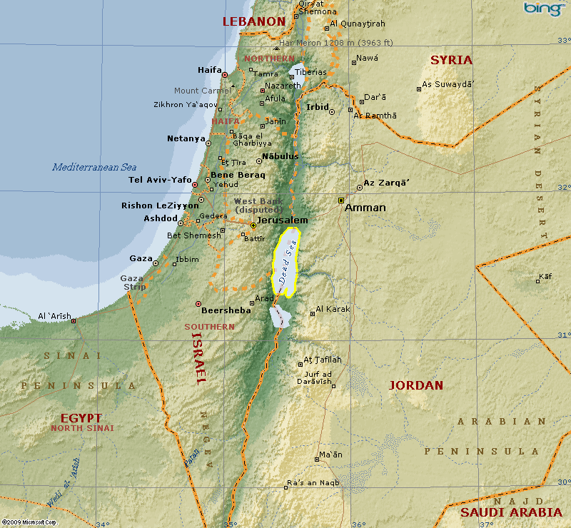
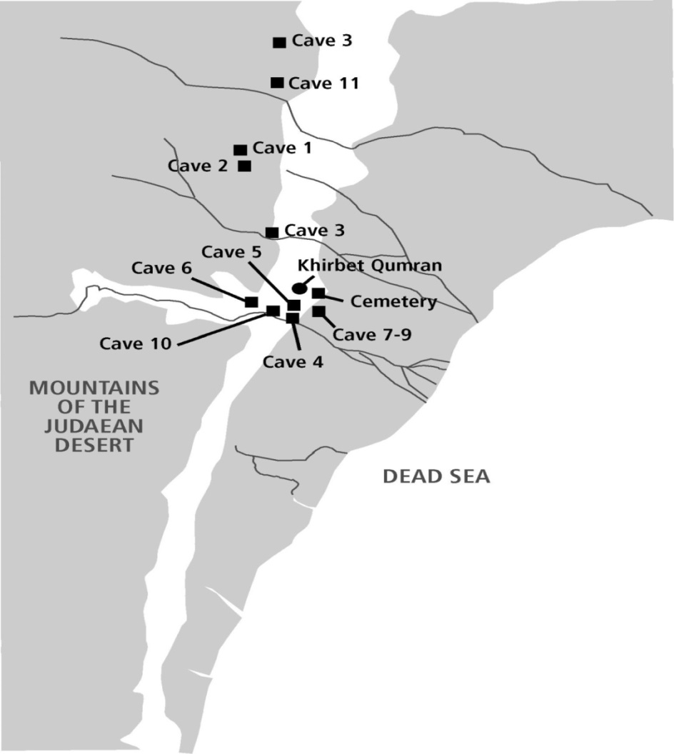
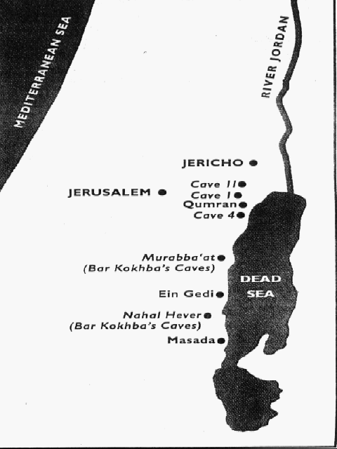
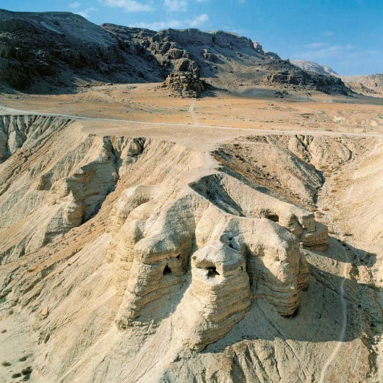
Aerial view of Qumran Caves

Slide 4
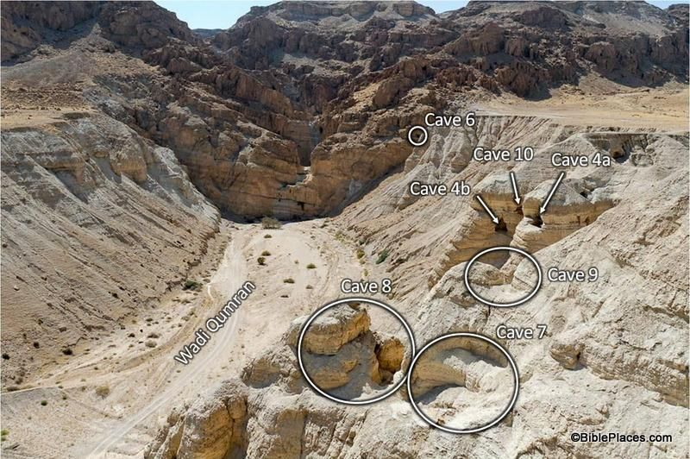
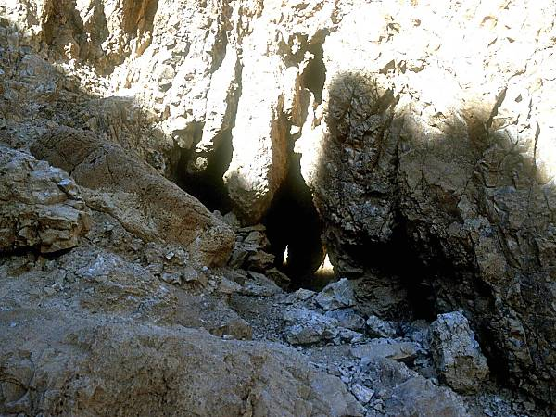
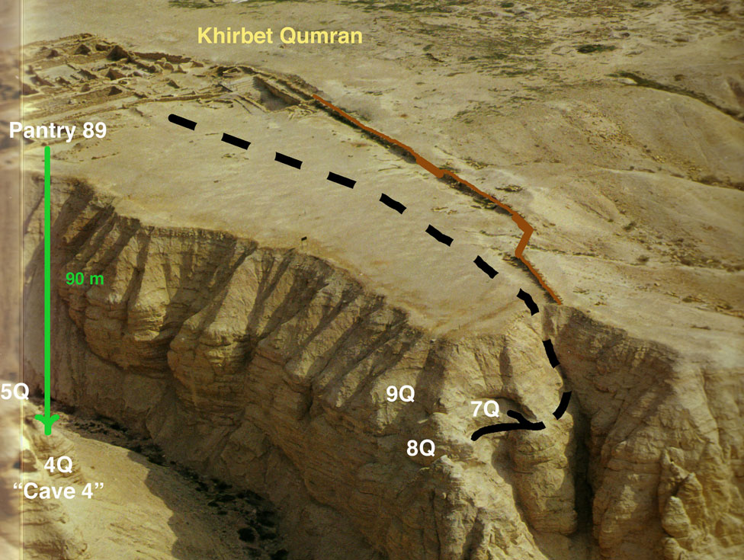
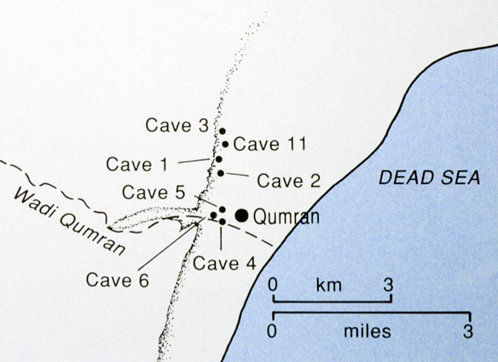
Qumran Cave 1
Qumran
Caves

Slide 5
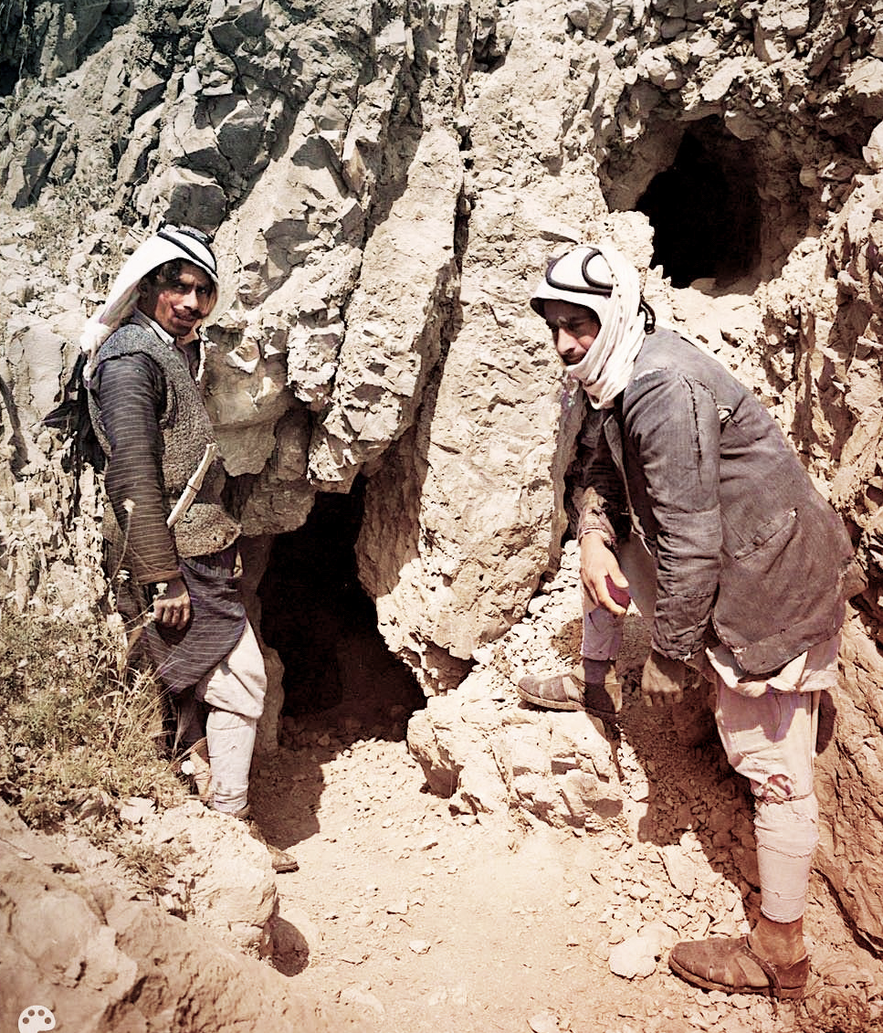
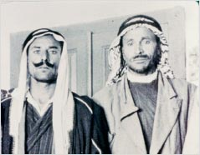
Bedouin Shepherds Jum'a and
Muhammed ed-Dib (left to right)

Slide 6
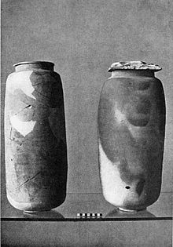
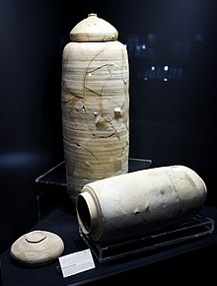
Two Dead Sea Scrolls jars at the Jordan Museum, Amman
Pottery jars that held some of the Dead Sea Scrolls found at Qumran

Slide 7
根據發現的抄本數量排名的書（前15名）
Books Ranked According to Number of
Manuscripts found (top 15)
Books | INo. found | Books | No. found | Books | No. found
Psalms | 39 | Jubilees | 21 | Daniel | 8
Deuteronomy | 33 | Exodus | 18 | Jeremiah | 6
1 Enoch | 25 | Leviticus | 17 | Ezekiel | 6
Genesis | 24 | Numbers | 11 | Job | 6
Isaiah | 22 | Minor Prophets | 10 | 1 & 2 Samuel | 4

Slide 8
死海古卷中的以賽亞書卷: 一共22卷 (1-6)
Isaiah Scrolls from Qumran: total 22 copies (1-6)
 | Scroll | Isaiah Passages
1 | 1QIsª | 1:1-31; 2:1-22; 3:1-5:30; 6:1-13; 7:1-25; 8:1-23; 9:1-20; 10:1-34; 11:1-45:25; 46:1-66:24 (complete)
2 | 1QIs^{b} (1Q8) | 7:22-25; 8:1; 10:17-19; 12:3-6; 13:1-8, 16-19; 15:3-9; 16:1-2, 7-11; 19:7-17, 20-25; 20:1; 22:11-18, 24-25; 23:1-4; 24:18-23; 25:1-8; 26:1-5; 28:15-20; 29:1-8; 30:10-14, 21-26; 35:4-5; 37:8-12; 38:12-22; 39:1-8; 40:2-3; 41:3-23; 43:1-13, 23-27; 44:21-28; 45:1-13; 46:3-13; 47:1-14; 48:17-22; 49:1-15; 50:7-11; 51:1-10; 52:7-15; 53:1-12; 54:1-6; 55:2-13; 56:1-12; 57:1-4, 17-21; 58:1-14; 59:1-8, 20-21; 60:1-22; 61:1-2; 62:2-12; 63:1-19; 64:1, 6-8; 65:17-25; 66:1-24 (about 75% complete)
3 | 4QIsaª (4Q55) | 1:1-3; 2:7-10; 4:5-6; 6:4-7; 11:12-15; 12:4-6; 13:4-6; 17:9-14; 19:9-14; 20:1-6; 21:1-2,4-16; 22:13-25; 23:1-12
4 | 4QIsa^{b} (4Q56) | 1:1-6; 2:3-16; 3:14-22; 5:15-28; 9:10-11; 11:7-9; 12:2; 13:3-18; 17:8-14; 18:1,5-7; 19:1-25; 20:1-4; 21:11-14; 22:24-25; 24:2; 26:1-5,7-19; 35:9-10; 36:1-2; 37:2932; 39:1-8; 40:1-4,22-26; 41:8-11; 43:12-15; 44:19-28; 45:20-25; 46:1-3; 49:21-23; 51:14-16; 52:2,7; 53:11-12; 61:1-3; 64:5-11; 65:1; 66:24
5 | 4QIsa^{c} (4Q57) | 9:3-12; 10:23-32; 11:4-11,15-16; 12:1; 14:1-5,13; 22:10-14; 23:8-18; 24:1-15,19-23; 25:1-2,8-12; 30:8-17; 33:2-8,16-23; 45:1-4,6-13; 48:10-13,17-19; 50:7-11; 51:1-16; 52:10-15; 53:1-3,6-8; 54:3-17; 55:1-6; 66:20-24
6 | 4QIsa^{d}(4Q58) | 46:10-13; 47:1-6,8-9; 48:8-22; 49:1-15; 52:4-7; 53:8-12; 54:1-11; 57:9-21; 58:1-3,5-7

Slide 9
死海古卷中的以賽亞書卷: 一共22卷 (7-22)
Isaiah Scrolls from Qumran: total 22 copies (7-22)
7 | 4QIsa^{e} (4Q59) | 2:1-4; 7:17-20; 8:2-14; 9:17-20; 10:1-10; 11:14-15; 12:1-6; 13:1-4; 14:1-13,20-24; 59:15-16
8 | 4QIsa^{f} (4Q60) | 1:10-16,18-31; 2:1-3; 5:13-14, 25; 6:3-8,10-13; 7:16-18,23-25; 8:1,4-11; 20:4-6; 22:14-22,25; 24:1-3; 27:1,5-6,8-12; 28:6-9,16-18,22,24; 29:8
9 | 4QIsa^{g} (4Q61) | 42:14-25; 43:1-4,17-24
10 | 4QIsa^{h} (4Q61) | 42:4-11
11 | 4QIsa^{i} (4Q62) | 56:7-8; 57:5-8
12 | 4QIsa^{j} (4Q63) | 1:1-6
13 | 4QIsa^{k} (4Q64) | 28:26-29:9
14 | 4QIsa^{l} (4Q65) | 7:14-15; 8:11-14
15 | 4QIsa^{m} (4Q66) | 60:20-61:1,3-6
16 | 4QIsa^{n} (4Q67) | 58:13-14
17 | 4QIsaº (4Q68) | 14:28-15:2
18 | 4QIsa^{p} (4Q69) | 5:28-30
19 | 4QIsa^{q} (4Q69a) | 54:10-13
20 | 4QIsa^{r} (4Q69b) | 30:23
21 | 5QIsa | 40:16,18-19
22 | MurIsa (Mur3) |  | Wadi Muraba’at (= Nahal Darga)

Slide 10
死海古卷中的以賽亞書的解經書卷
(一共6卷)
Pesher (Commentary) Isaiah from Qumran
(total 6 copies)
3QpIsa (3Q4)
4QpIsaiahª (4Q161)
4QpIsaiah^{b} (4Q162)
4QpIsaiah^{c} (4Q163)
4QpIsaiah^{d} (4Q164)
4QpIsaiah^{e} (4Q165)

Slide 11
以賽亞書卷 The Great Isaiah Scroll (1QIsª)
-One of the seven Dead Sea Scrolls, discovered by Bedouin
between late 1946 and mid-1947 from Qumran Cave 1
-Brought to Israel in 1954
-The largest and best preserved of all the biblical scrolls, and the
only one that is almost complete, apart from a few small damaged portions
-Written on 17 sheets of parchment, being about 734 cm (24 feet) long and ranges from 25.3 to 27 cm high (10 to 10.6 inches) with 54 columns of text
-Divided into two halves, each with 27 columns and 33 chapters
-Approximately 1000 years older than the oldest Hebrew manuscripts (Aleppo Codex & Codex Leningrad) known before the scrolls' discovery
-Date: between 356 and 103 BCE and 150-100 BCE respectively (using both radiocarbon dating and palaeographic/scribal dating)
-The text is close to the fixed Masoretic text of medieval codices

Slide 12
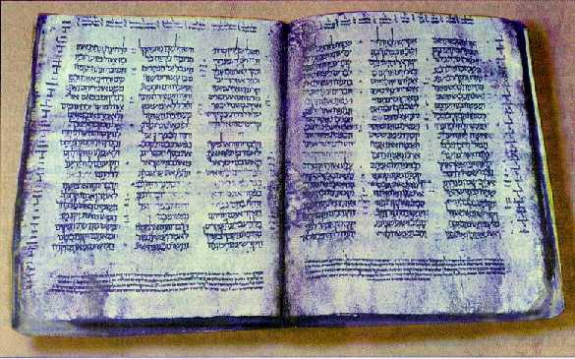
Codex Cairensis (ca AD 895)
Reached Israel in 1985 / Contents: Neviim (Joshua, Judges, Samuel, Kings, Isaiah, Jeremiah, Ezekiel, Minor Prophets)

Slide 13
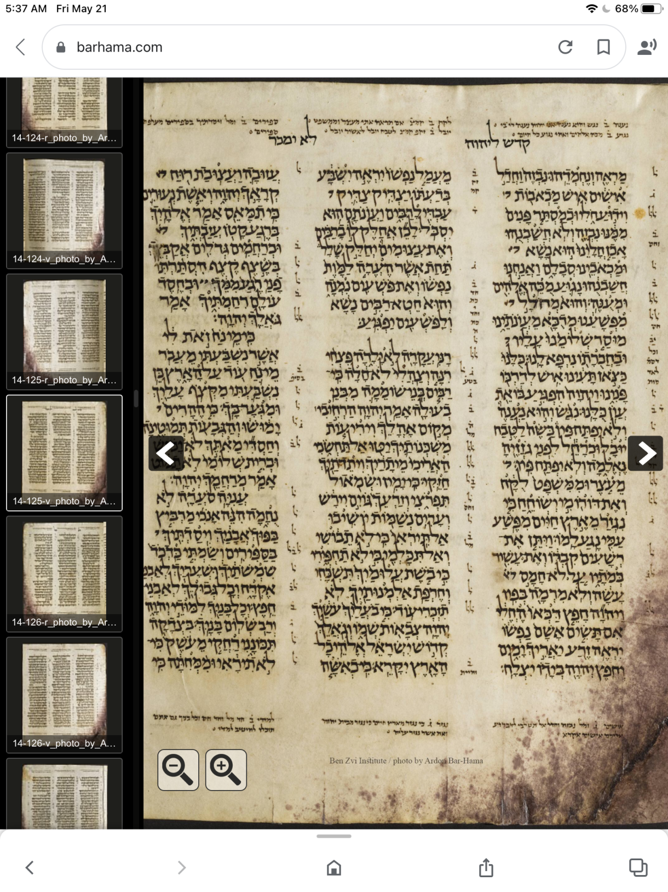
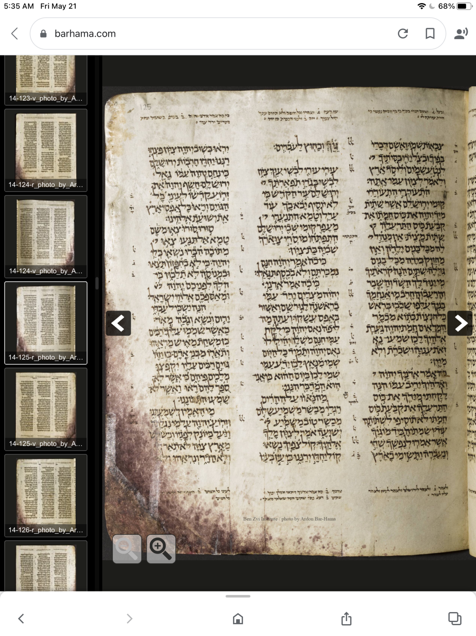
Aleppo Codex
(ca AD 930)
These pages include Isaiah 52:13-53:12.
Originally 487 pages, extant 294 pages Smuggled to Israel in 1958, now in Israel Museum, Jerusalem

Slide 14
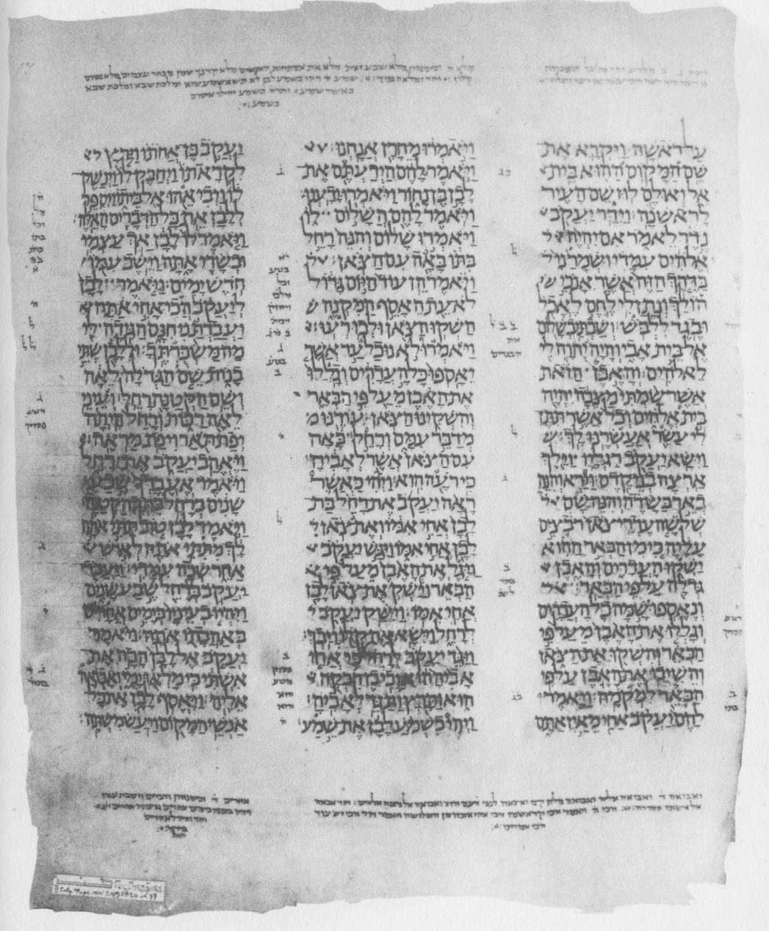
Masoretic Text – Leningrad Codex (ca AD 1008)
Leningrad Codex
-Written in Cairo
-The oldest complete Hebrew Bible still preserved
-In the Russian National Library,
St. Petersburg, Russia

Slide 15
Isaiah Scroll
Found: 1947, Cave 1
Brought to Israel in 1954

Slide 16
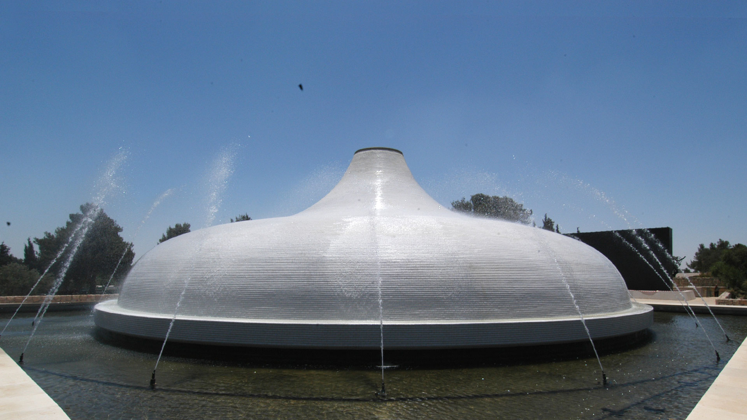
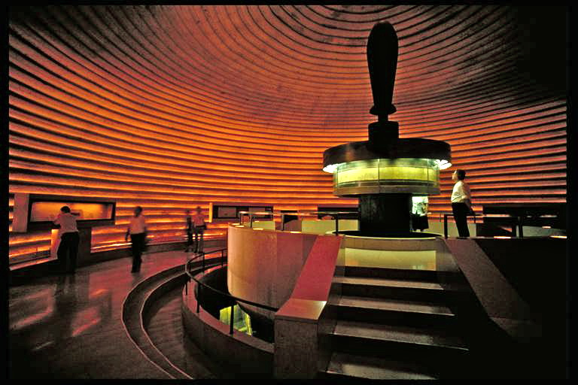
The Shrine of the Book Complex
The Israel Museum, Jerusalem
(The unique white dome embodies the lids of the jars in which the first scrolls were found.)

Slide 17
Isaiah Scroll (Photocopy)

Slide 18
Isaiah Scroll (1QIsª) Written in Hebrew, Qumran, Cave 1. / Ca. 120 BCE / Parchment

Slide 19
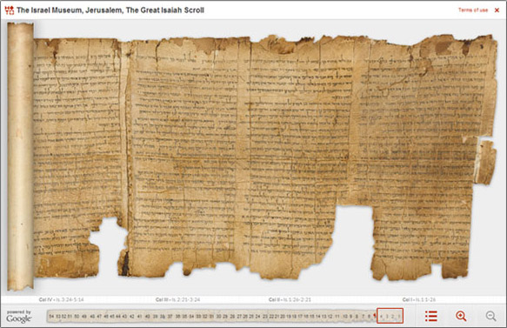
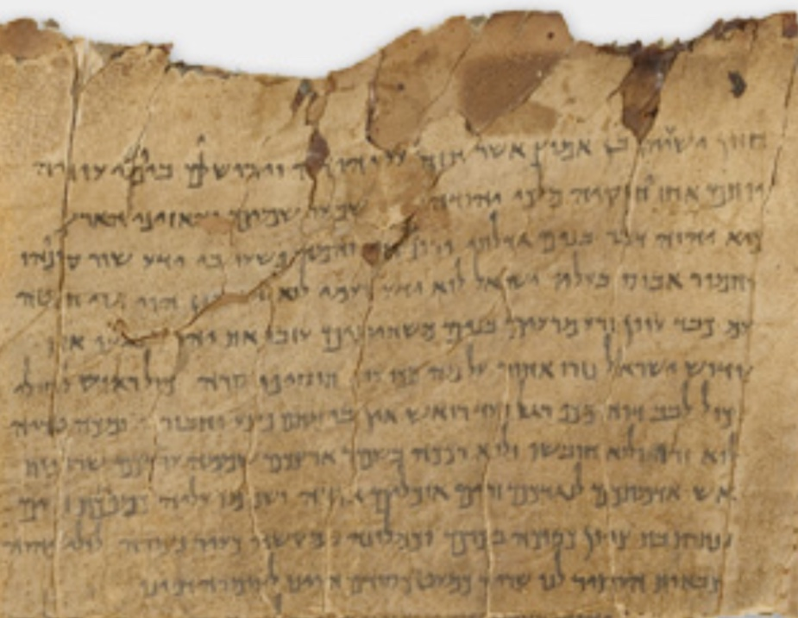
Isaiah Scroll (1QIsª)
Isaiah 1:1-9
Isaiah Scroll (1QIsa-a)
The Beginning Columns from Isaiah 1:1
http://dss.collections.imj.org.il/isaiah

Slide 20
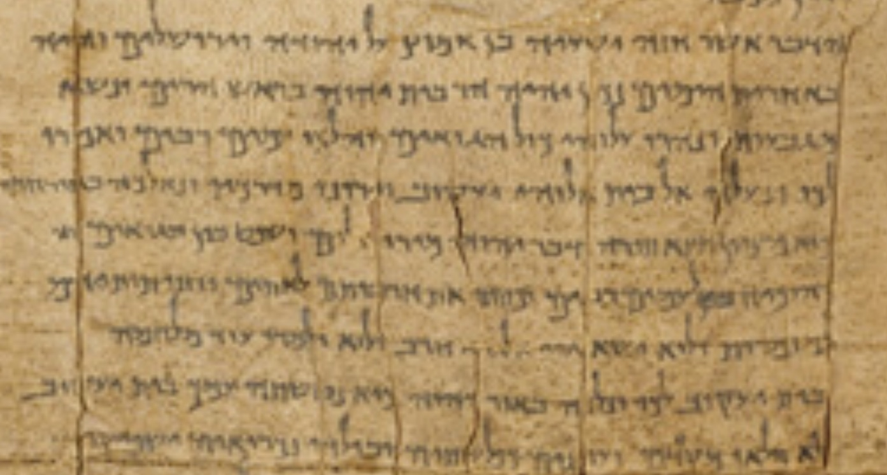
The Digital Dead Sea Scrolls: the Great Isaiah Scroll
http://dss.collections.imj.org.il/isaiah
Isaiah Scroll (1QIsª)
A Part of Column II
Isaiah 2:1-6

Slide 21
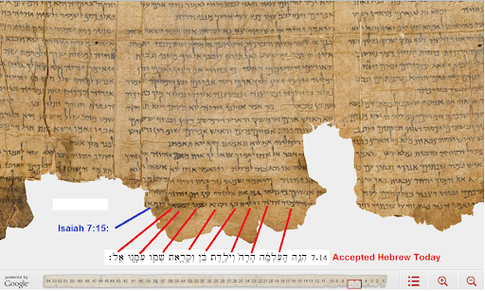
Isaiah Scroll (1QIsª)
A Part of Column VI
Isaiah 7:13-14

Slide 22
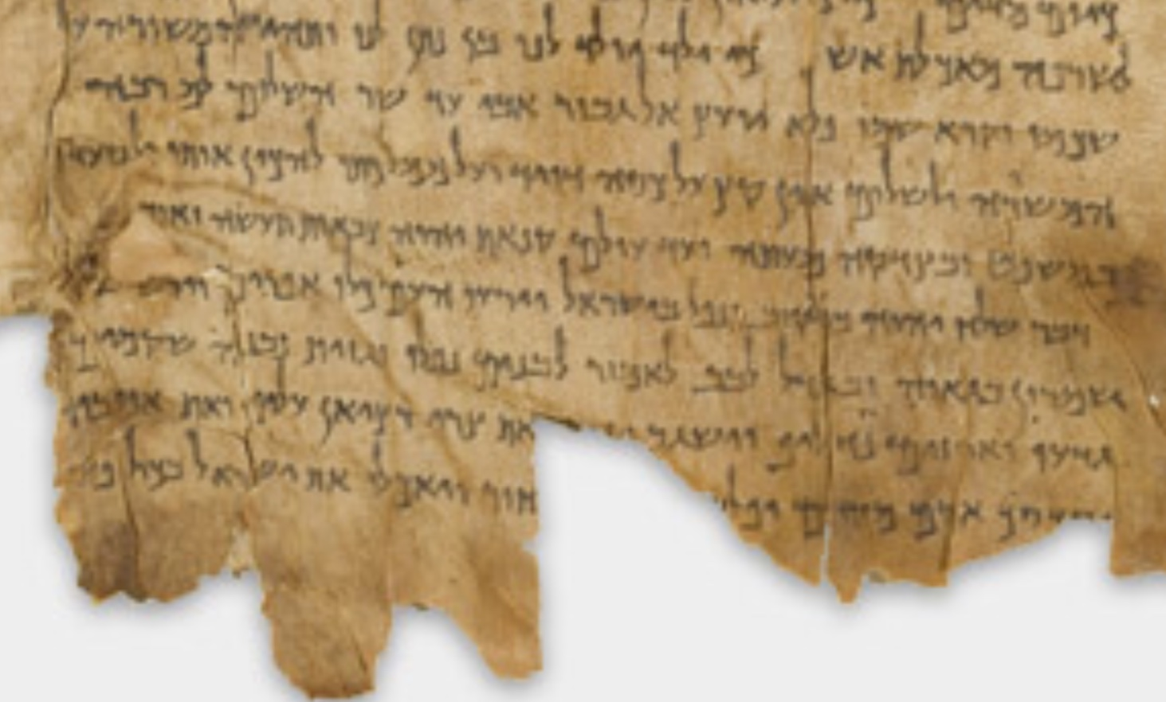
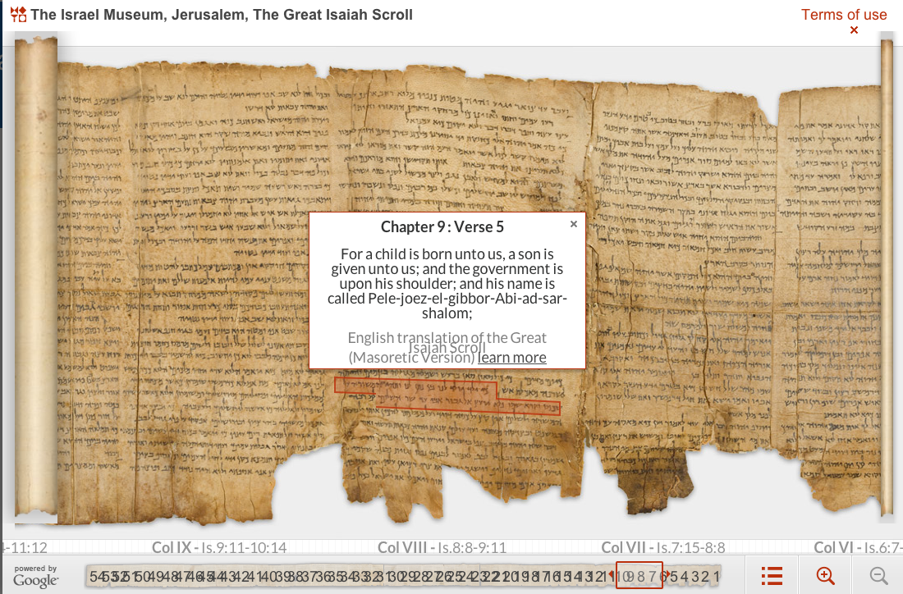
‎כִּי־יֶ֣לֶד יֻלַּד־לָ֗נוּ בֵּ֚ן נִתַּן־לָ֔נוּ וַתְּהִ֥י הַמִּשְׂרָ֖ה עַל־שִׁכְמ֑וֹ
וַיִּקְרָ֙א שְׁמ֜וֹ פֶּ֠לֶא יוֹעֵץ֙ אֵ֣ל גִּבּ֔וֹר אֲבִיעַ֖ד שַׂר־שָׁלֽוֹם׃
Column VIII Isaiah 9:6[Heb. 9:5]
因有一嬰孩為我們而生、有一子賜給我們．政權必擔在他的肩頭上．他名稱為奇妙、策士、全能的 神、永在的父、和平的君。

Slide 23
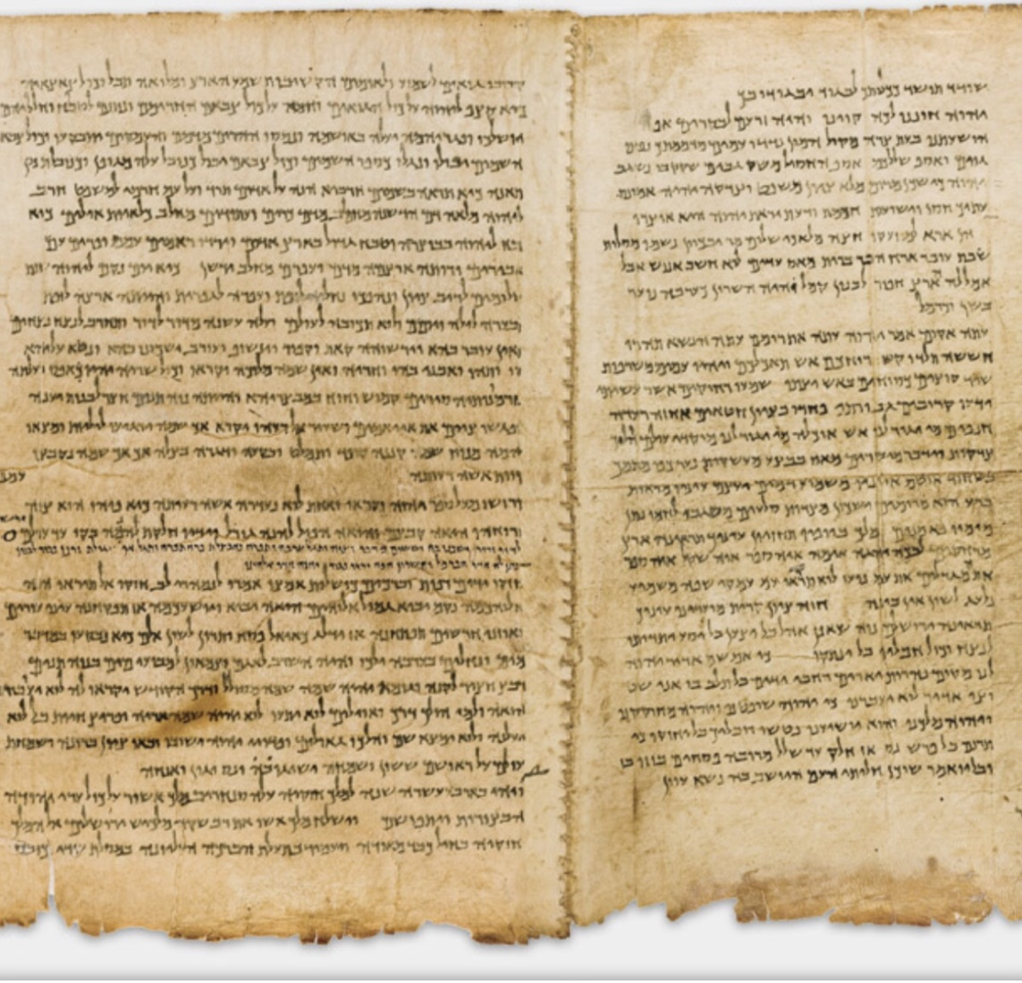
Column XXVII (Right) & XXVIII
Isaiah 33:1 to 33:24 (Column XXVII)
-The Scroll is clearly divided into two halves, each with 27 columns and 33 chapters.
-This is the last column of the 1st half.
-See the enough margin at the bottom of the column XXVII.

Slide 24
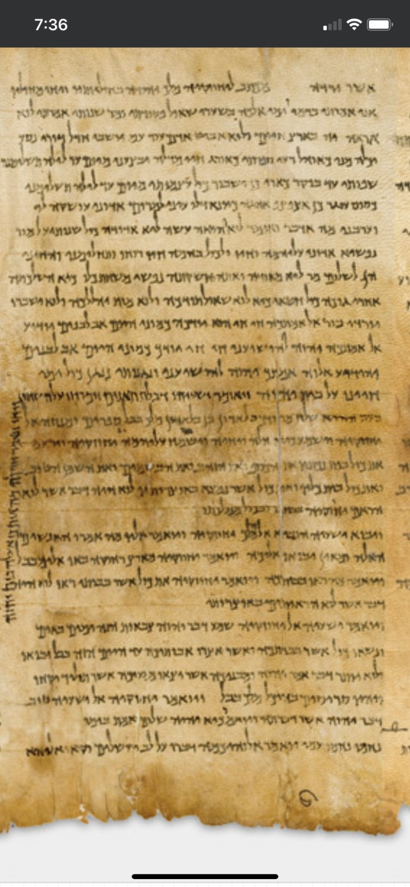
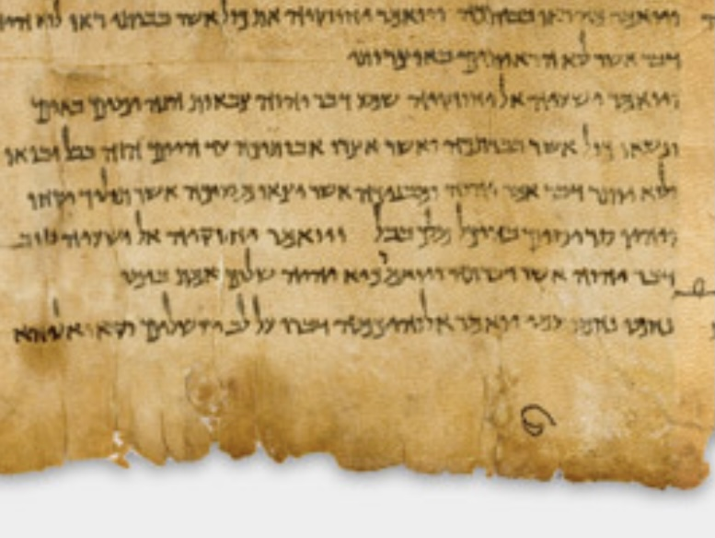
Column XXXII
(Isaiah 38:8 to 40:2)
(Isaiah 40:1 starts with the last line)

Slide 25
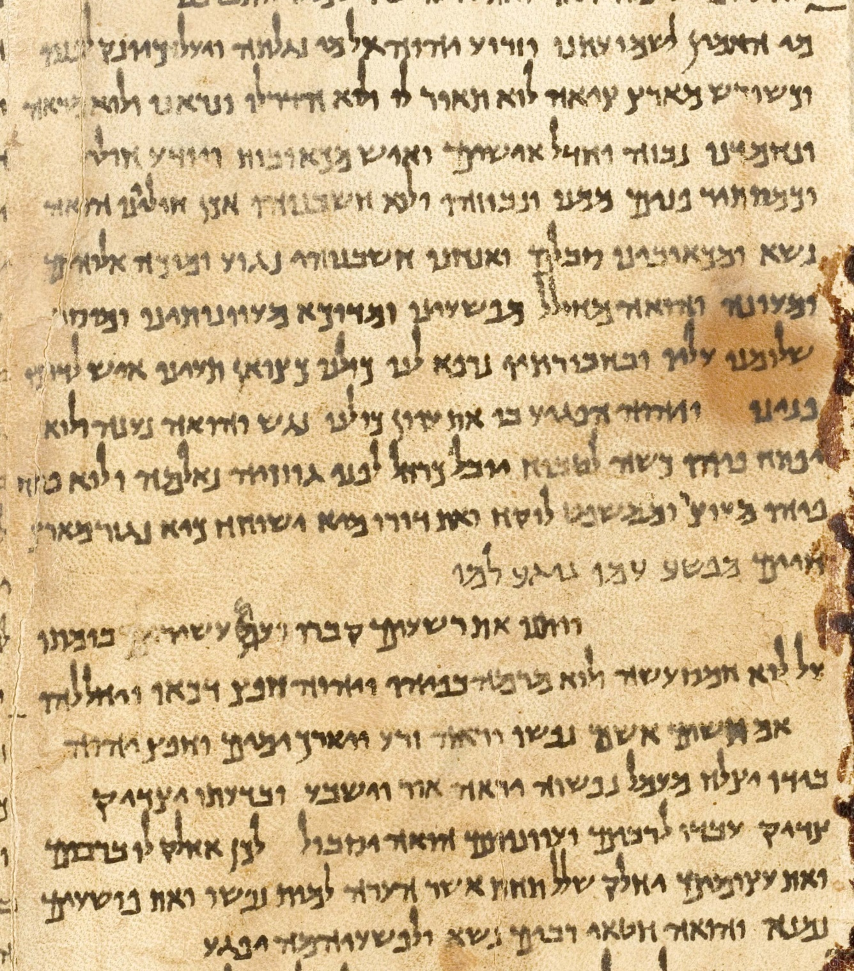
Column XLIV
Isaiah 52:13 to 54:4
(from Line 5: Isaiah 53)
‎ ¹מִ֥י הֶאֱמִ֖ין לִשְׁמֻעָתֵ֑נוּ וּזְר֥וֹעַ יְהוָ֖ה עַל־מִ֥י נִגְלָֽתָה׃² וַיַּ֙עַל כַּיּוֹנֵ֜ק לְפָנָ֗יו וְכַשֹּׁ֙רֶשׁ֙ מֵאֶ֣רֶץ צִיָּ֔ה לֹא־תֹ֥אַר ל֖וֹ וְלֹ֣א הָדָ֑ר וְנִרְאֵ֥הוּ וְלֹֽא־מַרְאֶ֖ה וְנֶחְמְדֵֽהוּ׃
³ נִבְזֶה֙ וַחֲדַ֣ל אִישִׁ֔ים אִ֥ישׁ מַכְאֹב֖וֹת וִיד֣וּעַ חֹ֑לִי וּכְמַסְתֵּ֤ר פָּנִים֙ מִמֶּ֔נּוּ נִבְזֶ֖ה וְלֹ֥א חֲשַׁבְנֻֽהוּ׃

Slide 26
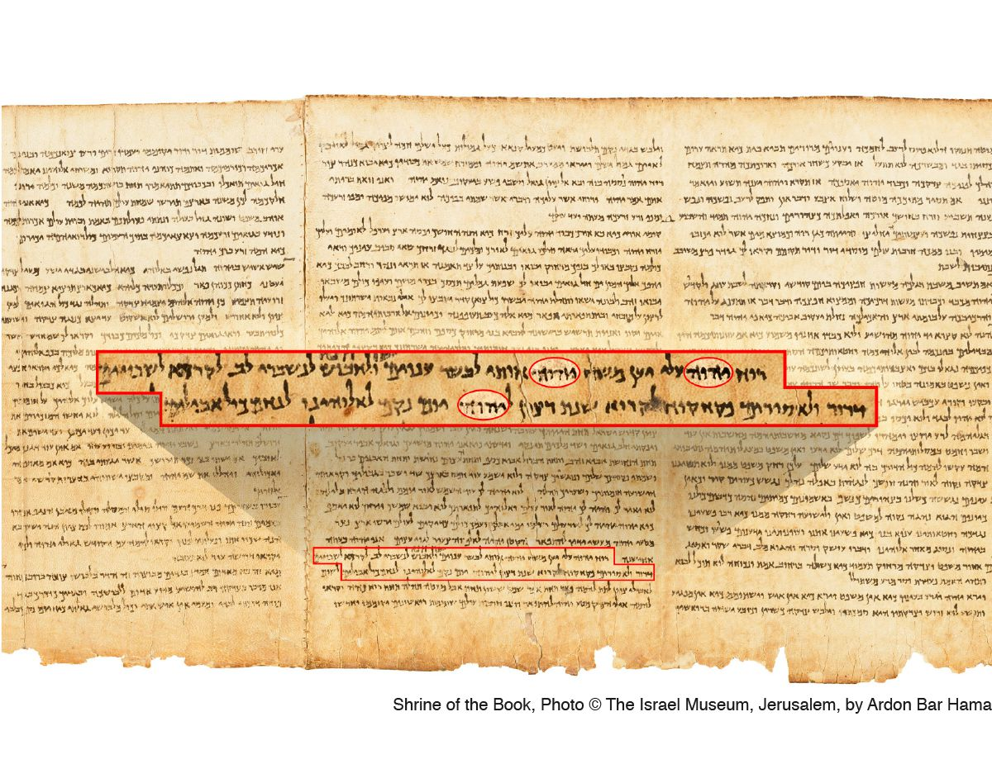
‎ Is 61:1 ר֛וּחַ אֲדֹנָ֥י יְהוִ֖ה עָלָ֑י יַ֡עַן מָשַׁח֩ יְהוָ֙ה אֹתִ֜י לְבַשֵּׂ֣ר עֲנָוִ֗ים שְׁלָחַ֙נִי֙ לַחֲבֹ֣שׁ לְנִשְׁבְּרֵי־לֵ֔ב לִקְרֹ֤א לִשְׁבוּיִם֙ דְּר֔וֹר וְלַאֲסוּרִ֖ים פְּקַח־קֽוֹחַ׃
‎ Is 61:2 לִקְרֹ֤א שְׁנַת־רָצוֹן֙ לַֽיהוָ֔ה וְי֥וֹם נָקָ֖ם לֵאלֹהֵ֑ינוּ לְנַחֵ֖ם כָּל־אֲבֵלִֽים׃
61:1 主耶和華的靈在我身上．因為耶和華用膏膏我、叫我傳好信息給謙卑的人、差遣我醫好傷心的人、報告被擄的得釋放、被囚的出監牢．61:2 報告耶和華的恩年、和我們 神報仇的日子、安慰一切悲哀的人．

Slide 27
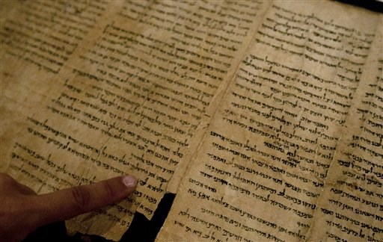
The finger points at the word "Jerusalem"
(ירושׁלים)
written in a part of the Isaiah Scroll.

Slide 28
以賽亞書卷 (1QIs^{b} = 1Q8)
-One of the seven Dead Sea Scrolls, discovered by Bedouin
between late 1946 and mid-1947 from Qumran Cave 1
-Prof. Eleazar Sukenik of the Hebrew University of Jerusalem purchased the scroll from an antiquities dealer in Bethlehem, on December 21, 1947
-Additional fragments of the scroll were found scattered in the same cave 1 in the excavations conducted in 1949
-Written in a Herodian (from 30 B.C.E. to 70 C.E.) Hebrew script and dated to the first century C.E / Four sheets found
-The text is close to the fixed Masoretic text of medieval codices

Slide 29
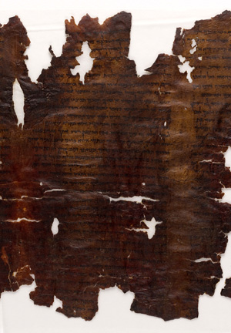
Photo showing part of 1QIsa^{b}, Isaiah 57:17–59:9
Isaiah Scroll, Manuscript B (1QIsa^{b} = 1Q8) Jerusalem, The Shrine of the Book, The Hebrew University of Jerusalem (owner)
Ink on leather; 1 leaf (part of a scroll)
22 x 43 cm Bible (fragment); Hebrew Judaean Desert, Israel

Slide 30
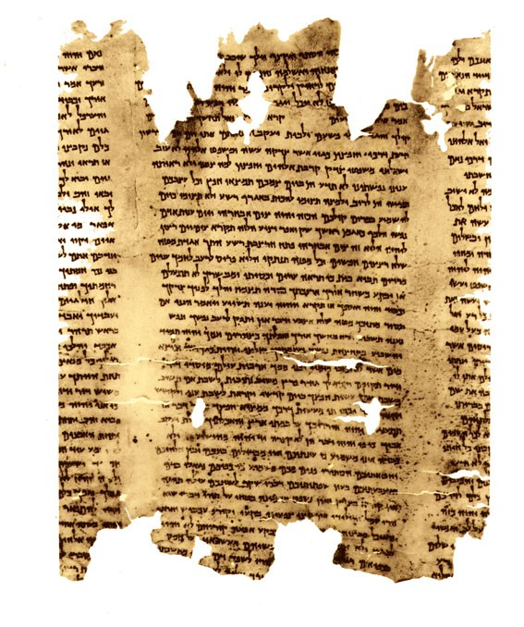
Photo showing part of 1QIsa^{b}, Is 57:17–59:9

Slide 31
Part of 1QIsa^{b} (Isaiah 57-59)

Slide 32
民數記 6:24-26
願耶和華賜福給你,保護你.
願耶和華使他的臉光照你,賜恩給你.
願耶和華向你仰臉,賜你平安.
‎ יְבָרֶכְךָ יְהוָה וְיִשְׁמְרֶךָ׃ Numbers 6:24-26
יָאֵר יְהוָה פָּנָיו אֵלֶיךָ וִיחֻנֶּךָּ׃
‎יִשָּׂא יְהוָה פָּנָיו אֵלֶיךָ וְיָשֵׂם לְךָ שָׁלוֹם׃

