Slide 1
死海古卷中的
但以理書卷
Daniel Scrolls from Qumran
金京來博士 Kyungrae Kim, Ph.D.

Slide 2
聖經中亞蘭文經文 Aramaic Passages in the OT
-創世記 Genesis 31:47 (兩個字 2 words)
-耶利米 Jeremiah 10:11 (一節 1 verse)
-但以理 Daniel 2:4-7:28 (兩百節 200 verses)
-以斯拉 Ezra 4:8-6:18; 7:12-26 (六十七節 67 verses)
https://www.youtube.com/watch?v=bcrkmuoleqI
聖經中亞蘭文經文 (二)
Aramaic Passages in the Hebrew Bible (II)
但以理書 2:4-13
Daniel 2:4-13 (Aramaic)
聖經中亞蘭文經文 (一)
Aramaic Passages in the Hebrew Bible (I)
舊約中的 亞蘭文
Aramaic in the Old Testament
https://www.youtube.com/watch?v=FqZ-WcgxAPI

Slide 3
舊約中的亞蘭文/亞蘭語 אֲרָמִית Aramaic (language)
-2 Kings 18:26 ……求你用亞蘭言語和僕人說話 ……
-Isaiah 36:11 ……求你用亞蘭言語和僕人說話 ……
-Daniel 2:4 ‎וַֽיְדַבְּר֧וּ הַכַּשְׂדִּ֛ים לַמֶּ֖לֶךְ אֲרָמִ֑ית מַלְכָּא֙ לְעָלְמִ֣ין חֱיִ֔י
אֱמַ֥ר חֶלְמָ֛א לְעַבְדָ֖ךְ וּפִשְׁרָ֥א נְחַוֵּֽא׃
迦勒底人用亞蘭的言語對王說：願王萬歲！
請將那夢告訴僕人，僕人就可以講解。
-Ezra 4:7 וּבִימֵ֣י אַרְתַּחְשַׁ֗שְׂתָּא כָּתַ֙ב בִּשְׁלָ֜ם מִתְרְדָ֤ת טָֽבְאֵל֙ וּשְׁאָ֣ר כְּנָוֹתָ֔יו
עַל־אַרְתַּחְשַׁ֖שְׂתְּ מֶ֣לֶךְ פָּרָ֑ס וּכְתָב֙ הַֽנִּשְׁתְּוָ֔ן כָּת֥וּב אֲרָמִ֖ית וּמְתֻרְגָּ֥ם אֲרָמִֽית׃
亞達薛西年間、比施蘭、米特利達、他別、和他們的同黨、
上本奏告波斯王亞達薛西．本章是用亞蘭文字、亞蘭方言。

Slide 4
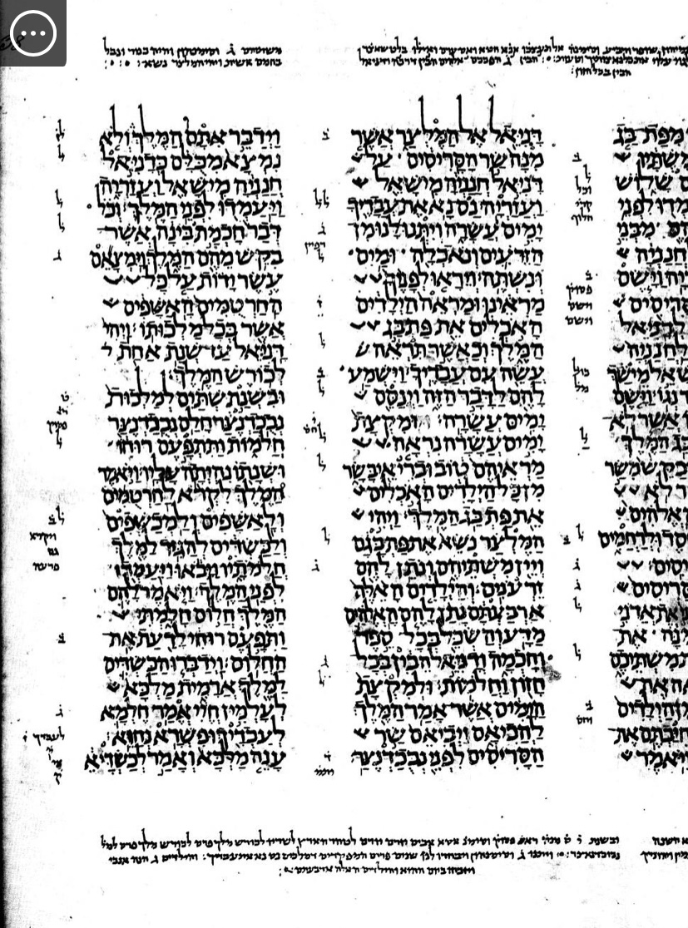
The shift of language from Hebrew to Aramaic (Daniel 2:4) is noticed in the left column, line 4 from the bottom.
Leningrad Codex
-Written in Cairo (ca AD 1008)
-The oldest complete Hebrew Bible still preserved
-In the Russian National Library,
St. Petersburg, Russia

Slide 5
但以理書的補充經文與兩個希臘文譯本
Additions & Two Greek Texts of the Book of Daniel
-The Greek Bibles have additions to the Book of Daniel.
1) The Prayer of Azariah and Song of the Three Holy Children:
Daniel 3:24–90 inserted between verses 23 and 24 (v. 24 becomes v. 91)
2) Susanna and the Elders:
before Daniel 1:1, a prologue in early Greek manuscripts.
3) Bel and the Dragon: after Daniel 12:13 in Greek, an epilogue.
-七十士譯本 & Theodotion (Θεοδοτίων / c. 150 AD):
Theodotion's translation, which is closer to the Masoretic text, was so widely copied in the early Christian church that his version of the Book of Daniel virtually superseded the Septuagint.

Slide 6
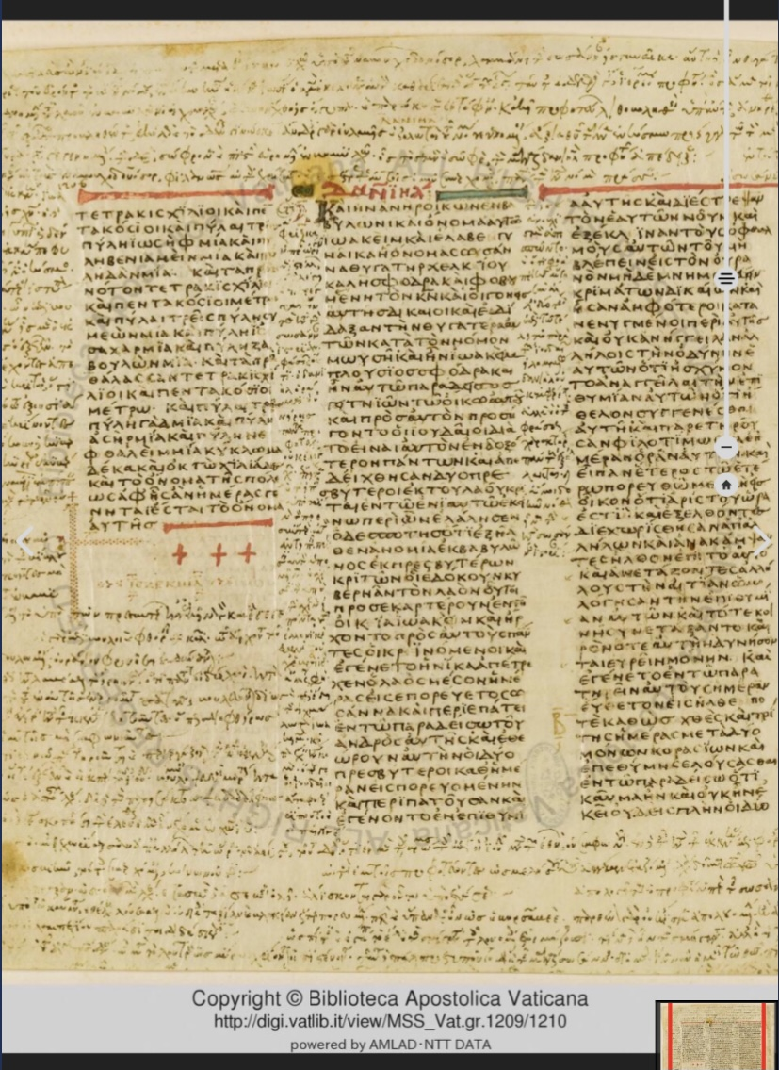
Codex Vaticanus (4 C. AD)
Book of Daniel
Page 1206
Susanna and the Elders
Susanna (TH) 1:1 καὶ ἦν ἀνὴρ οἰκῶν ἐν Βαβυλῶνι καὶ ὄνομα αὐτῷ Ιωακιμ ² καὶ ἔλαβεν γυναῖκα ᾗ ὄνομα Σουσαννα θυγάτηρ Χελκιου καλὴ σφόδρα καὶ φοβουμένη τὸν κύριον ³ καὶ οἱ γονεῖς αὐτῆς δίκαιοι καὶ ἐδίδαξαν τὴν θυγατέρα αὐτῶν κατὰ τὸν νόμον Μωυσῆ ⁴ καὶ ἦν Ιωακιμ πλούσιος σφόδρα καὶ ἦν αὐτῷ παράδεισος γειτνιῶν τῷ οἴκῳ αὐτοῦ καὶ πρὸς αὐτὸν προσήγοντο οἱ Ιουδαῖοι διὰ τὸ εἶναι αὐτὸν ἐνδοξότερον πάντων …….

Slide 7
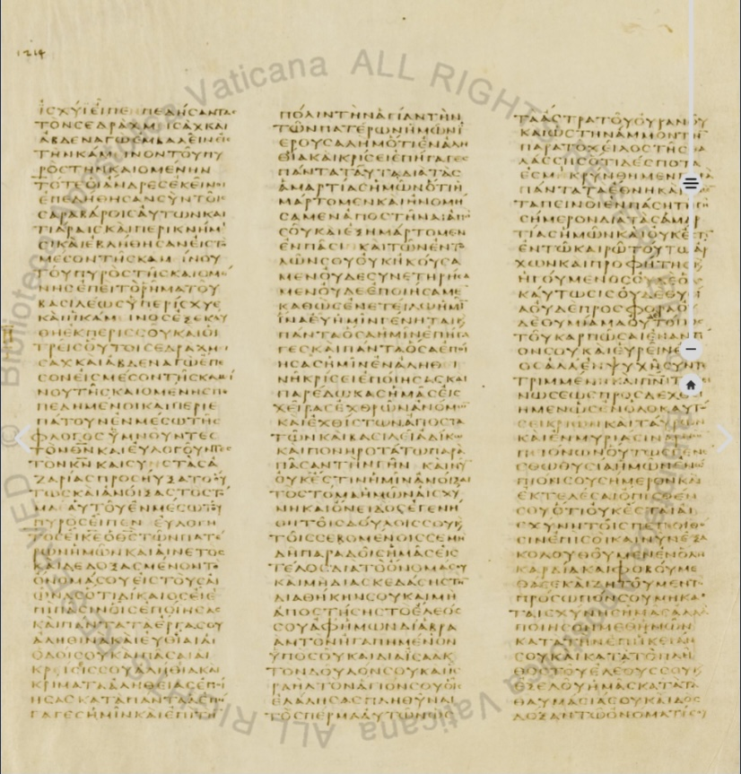
Codex Vaticanus (4 C. AD) Daniel 3 (Pages 1214-1215)
The Prayer of Azariah and Song of the Three Holy Children

Slide 8
根據發現的抄本數量排名的書（前15名）
Books Ranked According to Number of
Manuscripts found (top 15)
Books | No. found | Books | No. found | Books | No. found
Psalms | 39 | Jubilees | 21 | Daniel | 8
Deuteronomy | 33 | Exodus | 18 | Jeremiah | 6
1 Enoch | 25 | Leviticus | 17 | Ezekiel | 6
Genesis | 24 | Numbers | 11 | Job | 6
Isaiah | 22 | Minor Prophets | 10 | 1 & 2 Samuel | 4

Slide 9
死海古卷中的但以理書卷: 一共8卷 Daniel Scrolls (8 copies)
Name | Contents | Date Copied
1QDanª (1Q71) | 1:10–17; 2:2–6 / the shift of language from Hebrew to Aramaic, the phrase ‘in Aramaic’ (אֲרָמִית) at 2:4 missing | 50–68 A.D.
1QDan^{b} (1Q72) | 3:22–30 / Four fragments on vellum, the absence of the apocryphal “Prayer of Azariah and Song of the Three Men” | 50–68 A.D. or earlier
4QDanª (4Q112) | 1:16–20; 2:9–11, 19–49; 3:1–2; 4:29–30; 5:5–7, 12–14, 16–19; 7:5–7, 25–28; 8:1–5; 10:16–20; 11:13–16 / the shift of language from Aramaic to Hebrew, a blank line between the end of the Aramaic section and beginning of the Hebrew |  | Hasmonean
4QDan^{b} (4Q113) | 5:10–12, 14–16, 19–22; 6:8–22, 27–29; 7:1–6, 11?, 26–28; 8:1–8, 13–16 / the shift of language from Aramaic to Hebrew. |  | Herodian
4QDan^{c} (4Q114) | 10:5–9, 11–16, 21; 11:1–2, 13–17, 25–29 / the oldest known text of Daniel |  | 2nd century B.C.
4QDan^{d} (4Q115) | 3:8–10?, 23–25; 4:5–9, 12–16; 7:15–23 / Fragments, the largest of which contains five partial lines in severe decay. |  | Herodian
4QDan^{e} | 9:12–17 / Five tiny fragments from chapter nine (4Q116) |  | Hasmonean
6QDanª (6Q7) | 8:20-21; 10:8–16, 11:33–36, 38; 8:16-17 / Papyrus manuscripts rather than leather parchment (6QpapDan) |  | Herodian

Slide 10
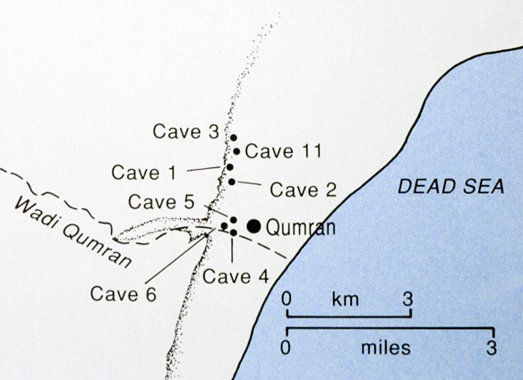
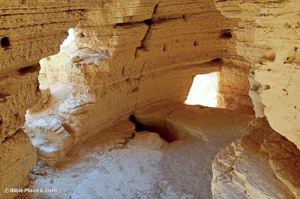
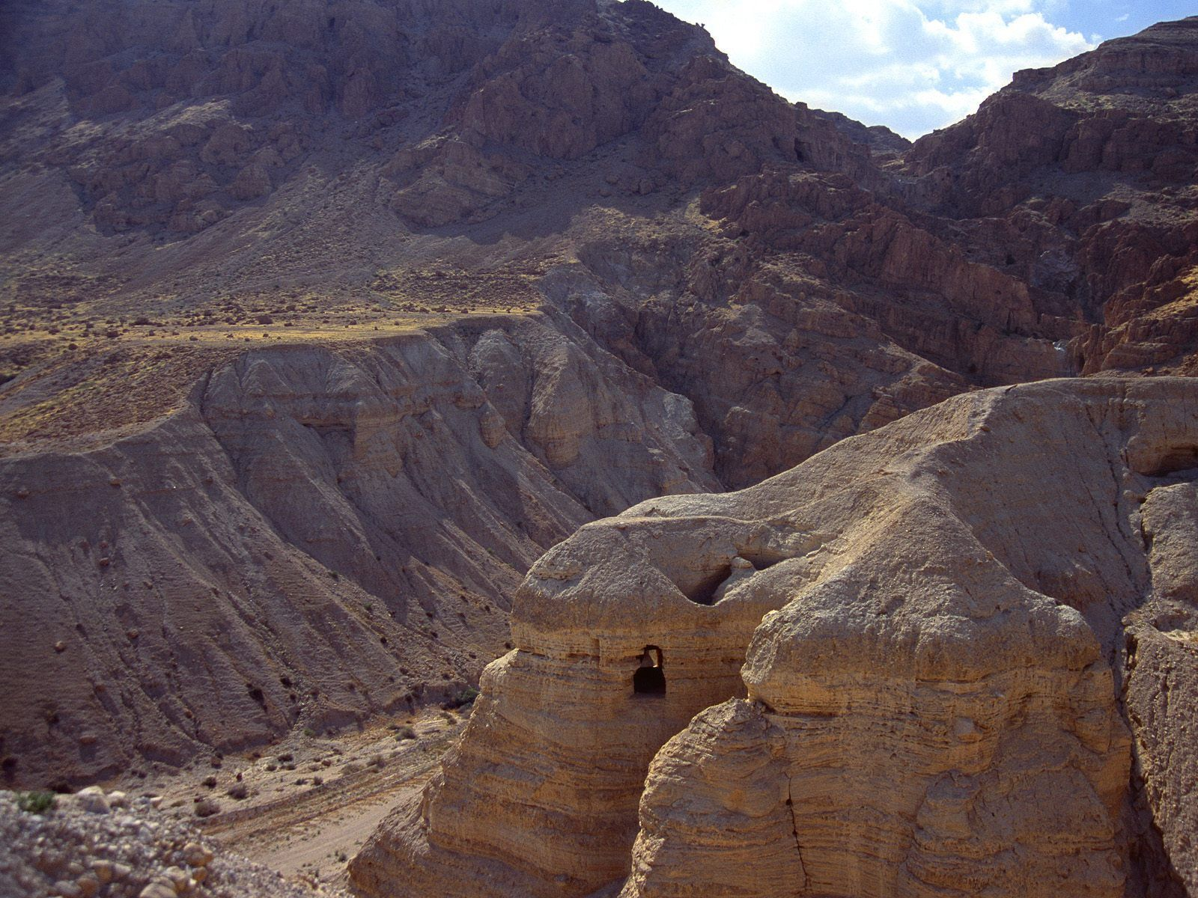
Qumran Caves
Cave 4 Interior
Qumran Cave 4
(Most famous and the most significant in terms of finds) More than 15,000 fragments from over 200 books were found in this cave, nearly all by Bedouin thieves. One hundred and twenty-two biblical scrolls (or fragments) were found in this cave. The scrolls found in this cave were poorly preserved because they were not stored in jars.

Slide 11
提及但以理或包括但以理相關故事的死海古卷
Scrolls that Mention Daniel or include Daniel-Related Story
-4Q174 (the Florilegium, 4QFlor) quotes Daniel 12:10 as
'written in the book of Daniel, the Prophet' (frgs. 1-3 ii 3-4a).
-11QMelch (= 11Q13):15ff: "This is the day of peace about which God spoke of old through the words of Isaiah the prophet, who said: How beautiful upon the mountains are the feet of the messenger who announces peace, of the messenger of good who announces salvation, saying to Zion: 'your God reigns'. Its interpretation: the mountains are the prophets...And the messenger is the anointed of the spirit about whom Daniel spoke...and the messenger of good who announces salvation is the one about whom it is written that he will send him to comfort the afflicted, to watch over the afflicted ones of Zion"
-The Pseudo-Danielic manuscripts (4Q242-244): These documents look like a re-telling and large-scale expansion of the biblical Daniel motif.
-4Q246 (the Daniel Apocryphon / the Son of God Text): Written in Aramaic. Daniel is actually not mentioned, but some commentators see 'similarities' between this and Daniel.

Slide 12
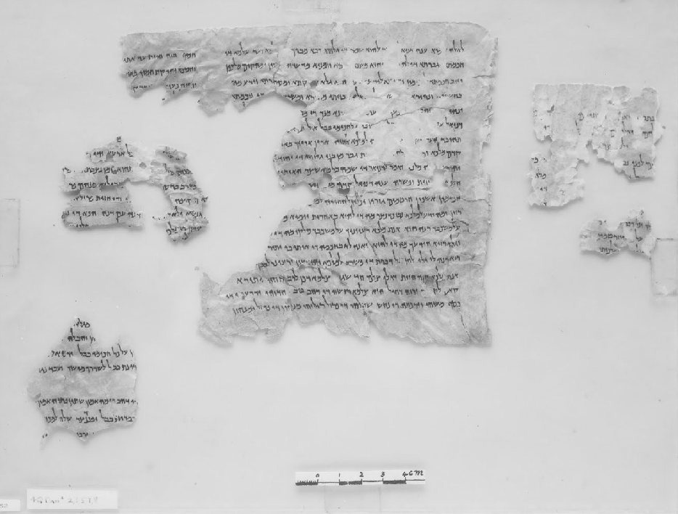
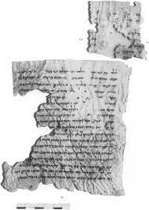
4QDanª (4Q112)
4QDanª includes portions from Daniel chapters 1-11 (image from the Leon Levy Dead Sea Scrolls Digital Library).

Slide 13
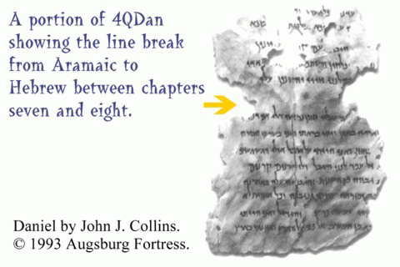
4QDanª
(4Q112)
‎ 7:28 עַד־כָּ֖ה סוֹפָ֣א דִֽי־מִלְּתָ֑א אֲנָ֙ה דָֽנִיֵּ֜אל שַׂגִּ֣יא׀ רַעְיוֹנַ֣י יְבַהֲלֻנַּ֗נִי וְזִיוַי֙ יִשְׁתַּנּ֣וֹן עֲלַ֔י וּמִלְּתָ֖א בְּלִבִּ֥י נִטְרֵֽת׃
‎ 8:1 בִּשְׁנַ֣ת שָׁל֔וֹשׁ לְמַלְכ֖וּת בֵּלְאשַׁצַּ֣ר הַמֶּ֑לֶךְ חָז֞וֹן נִרְאָ֤ה אֵלַי֙ אֲנִ֣י דָנִיֵּ֔אל אַחֲרֵ֛י הַנִּרְאָ֥ה אֵלַ֖י בַּתְּחִלָּֽה׃

Slide 14
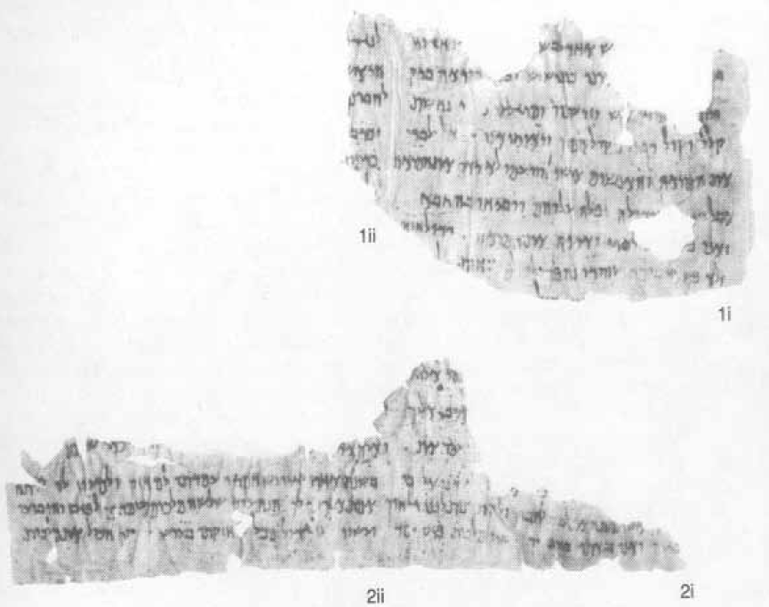
4QDan^{c}
Fragments 1 and 2
Daniel 10:5–11:12
4QDan^{c} Fragment 3 Daniel 11:13–17, 25–29

Slide 15
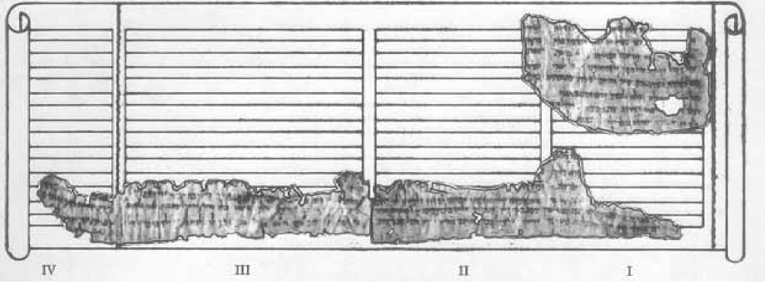
A reconstruction of 4QDan^{c}, the oldest manuscript of the book of Daniel (the second century BC). Shown are the positions of the fragments of 4QDanc across four columns of the original scroll (reading was from right to left). Linda Manies

Slide 16
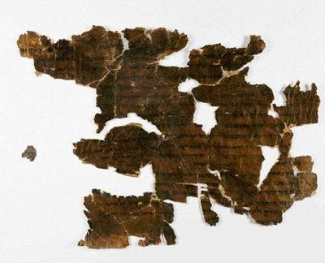
Florilegium Scroll
(4Q174 = 4QFlor)
Below: Dead Sea Scrolls
Electronic Library
‎(‎4Q‎174 Fragment ‎1, Column ii, 3‎)‎ “…… written in the Book of Daniel the prophet….”
1 היאה עת המצרף הב[אה על בית י]ה֯ודה להתם[‏ ]
2 בלי על ונשאר שא֯ר֯‏ [הע]ם‏ [ישר]אל ועשו את כול התורה֯[‏ ]
3 מושה הואה ה֯[דבר אש]ר‏ כתוב בספר דניאל הנביא להרשי֯[ע רשעים ולוא יבינו‏]
4a וצדיקים‏ י֯ת֯[בררו‏ ויתלב]נו‏ ויצטרפו‏ ועם‏ יודעי‏ אלוה‏ יחזיקו‏ המ֯[ה‏ ]
4 ה֯׺׺׺‏[ ]א֯ח֯רי ה̇‏[ ]אשר אליהמה יור֯[ד‏ ]
5‏ [ ]ה֯ ברדתו מ‏[ ]
6‏ [ ] א֯׺׺׺׺׺‏[ ]

Slide 17
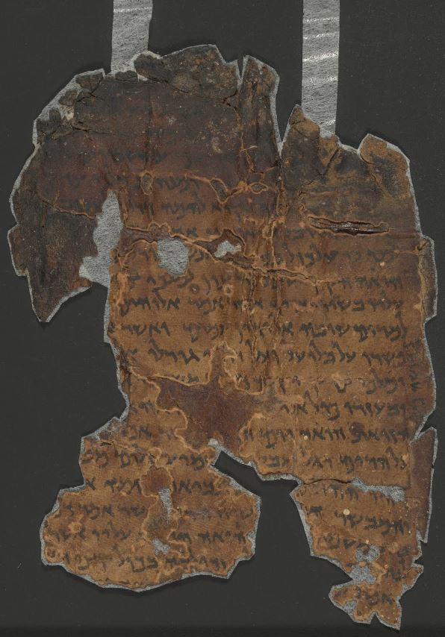
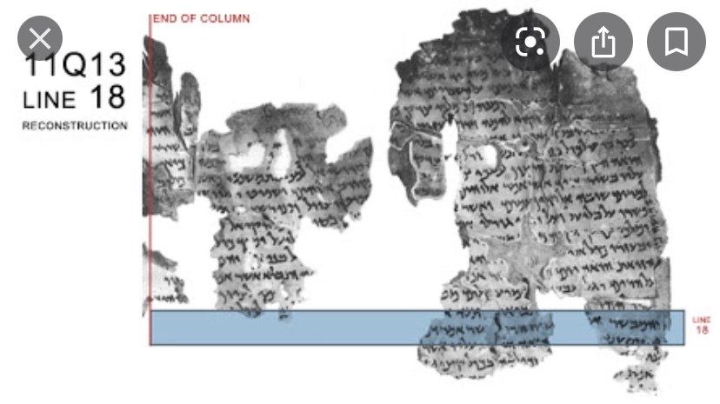
11Q‎13 (11QMelch)‎ ‎II (1, 2i, 3i, 4)‎:‎18‎
And the messenger is the anointed of the spirit about whom Daniel spoke........
‭18 ‬והמבשר הו[אה‏ ]מ̇שיח הרו̇[ח‏] כ֯אשר אמר דנ̇[יאל

Slide 18
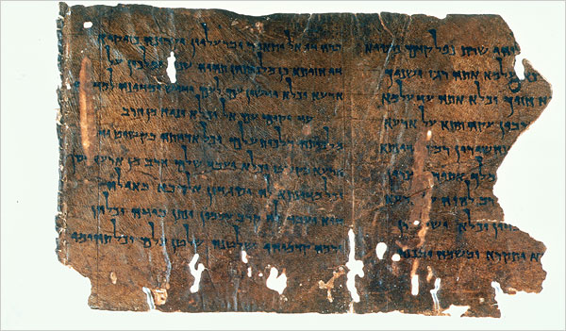
“Aramaic Apocryphon of Daniel,” one of the Dead Sea Scroll fragments in an exhibition at the Jewish Museum.Credit...Israel Antiquities Authority

Slide 19
民數記 6:24-26
願耶和華賜福給你,保護你.
願耶和華使他的臉光照你,賜恩給你.
願耶和華向你仰臉,賜你平安.
‎ יְבָרֶכְךָ יְהוָה וְיִשְׁמְרֶךָ׃ Numbers 6:24-26
יָאֵר יְהוָה פָּנָיו אֵלֶיךָ וִיחֻנֶּךָּ׃
‎יִשָּׂא יְהוָה פָּנָיו אֵלֶיךָ וְיָשֵׂם לְךָ שָׁלוֹם׃

