Slide 1
死海古卷中的
詩篇書卷
Psalms Scrolls from Qumran
金京來博士 Kyungrae Kim, Ph.D.

Slide 2
根據發現的抄本數量排名的書（前15名）
Books Ranked According to Number of
Manuscripts found (top 15)
Books | INo. found | Books | No. found | Books | No. found
Psalms | 39 | Jubilees | 21 | Daniel | 8
Deuteronomy | 33 | Exodus | 18 | Jeremiah | 6
1 Enoch | 25 | Leviticus | 17 | Ezekiel | 6
Genesis | 24 | Numbers | 11 | Job | 6
Isaiah | 22 | Minor Prophets | 10 | 1 & 2 Samuel | 4

Slide 3
死海古卷中的詩篇書卷: 一共39卷 (1-10)
Psalms Scrolls from Qumran: total 39 copies (1-10)
 | Name | Contents (Psalms Passages)
1 | 1QPsª (1Q10) | 86:5-8; 92:12-14; 94:16; 95:11-96:2; 119:31-34, 43-48, 77-79
2 | 1QPs^{b} (1Q11) | 126:6; 127:1-5; 128:3
3 | 1QPs^{c} (1Q12) | 44:3-5, 7, 9, 23-25
4 | 2QPs(2Q14) | 103:2–11; 104:6–11
5 | 3QPs(3Q2) | 2:6-7
6 | 4QPsª(4Q83) | 5:9-13; 6:1-4; 25:15; 31:24-25; 33:1-12; 35:2, 14-20, 26-28; 36:1-9; 38:2-12, 16-23; 47:2; 53:4-7; 54:1-6; 56:4; 62:13; 63:2-4; 66:16-20; 67:1-7; 69:1-19; 71:1-14
7 | 4QPs^{b} (4Q84) | 91:5-8, 12-15; 92:4-8, 13-15; 93:5; 94:1-4, 8-14, 17-18, 21-22; 96:2; 98:4; 99:5-6; 100:1-2; 102:5, 10-29; 103:1-6, 9-14, 20-21; 112:4-5; 113:1; 115:2-3; 116:17-19; 118:1-3, 6-11, 18-20, 23-26, 29
8 | 4QPs^{c} (4Q85) | 16:7-9; 18:3-14, 16-18, 33-41; 27:12-14; 28:1-2, 4; 35:27-28; 37:18-19; 45:8-11; 49:1-17; 50:14-23; 51:1-5; 52:6-11; 53:1
9 | 4QPs^{d} (4Q86) | 146:10; 147:1-3, 13-17, 20; 104:1-5, 8-11, 14-15, 22-25, 33-35
10 | 4QPs^{e} (4Q87) | 76:10-12; 77:1; 78:6-7, 31-33; 81:2-3; 86:10-11; 88:1-4; 89:44-46, 50-53; 104:1-3, 20-21; 105:22-24, 36-45; 109:13; 115:15-18; 116:1-3; 120:6; 125:2-5; 126:1-5; 129:8; 130:1-3

Slide 4
死海古卷中的詩篇書卷: 一共39卷 (11-23)
Psalms Scrolls from Qumran: total 39 copies (11-23)
 | Name | Contents (Psalms Passages)
11 | 4QPs^{f} (4Q88) | 22:14-17; 107: 2-4, 8-11, 13-15, 18-19, 22-30, 35; 109:4-6, 25-28; Apostrophe to Zion; Apostrophe to Judah; Eschatological Hymn
12 | 4QPs^{g} (4Q89) | 119:37-43, 44-46, 49-50, 73, 81-83, 90
13 | 4QPs^{h} (4Q90) | 119:10-21
14 | 4QPs^{j} (4Q91) | 48:1-7; 49:6, 9-12, 15, 17
15 | 4QPs^{k} (4Q92) | 26:7-12; 27:1; 30:9-13; 135:7-16;
16 | 4QPs^{l} (4Q93) | 104:3-5, 11-12
17 | 4QPs^{m} (4Q94) | 93:3-5; 95:3–6; 97:6-9; 98:4-8
18 | 4QPs^{n} (4Q95) | 135:6-9, 11–12; 136:23-24
19 | 4QPsº (4Q96) | 114:7; 115:1-2, 4; 116:3, 5, 7-10
20 | 4QPs^{p} (4Q97) | (olim 4Q237) 143:2-4, 6-8
21 | 4QPs^{q} (4Q98) | 31:24-25; 33:1-18; 35:4-20
22 | 4QPs^{r} | (4Q98a) 26:7-12; 27:1; 30:9-13
23 | 4QPs^{s} | (4Q98b) 5:8-13; 6:1

Slide 5
死海古卷中的詩篇書卷: 一共39卷 (24-33)
Psalms Scrolls from Qumran: total 39 copies (24-33)
 | Name | Contents (Psalms Passages)
24 | 4QPs^{t} | (4Q98c) 88:15-17
25 | 4QPs^{u} | (4Q98d) 42:5
26 | 4QPs^{v} | (4Q98e, olim 4QPs^{u} frg. 2) 99:1
27 | 4QPs^{w} | (4Q98f) 112:1-9
28 | 4QPs^{x} | (4Q98g, olim 4Q236) 89:20-22, 26, 23, 27-28, 31
29 | 5QPs(5Q5) | 119:99-101, 104, 113-20, 138-42
30 | 6Q5 | (pap6QPs or 6QpapPs?) 78:36-37
31 | 8QPs(8Q2) | 17:5-9, 14; 18:5-12
32 | 11QPsª (11Q5) | (the Main Manuscript) (105:25-45; 146; 148; 121-123; 119; 135-136; 118; 145; 139; 137-138; 93; 141; 133; 144; 142-143; 149-150; 140; 134 / (Fragments A-E) Psalms 101-103; 109; 118; 104; 105:1-12; 114; 117 (+ non-canonical Psalms)
33 | 11QPs^{b} (11Q6) | 77:18-21; 78:1; 109:3-4; 118:1,15-16; 119:163-165; 133:1-3; 141:10; 144:1-2

Slide 6
死海古卷中的詩篇書卷: 一共39卷 (34-39)
Psalms Scrolls from Qumran: total 39 copies (34-39)
 | Name | Contents (Psalms Passages)
34 | 11QPs^{c} (11Q7) | 2:1-8; 9:3-7; 12:5-9; 13:1-6; 14:1-6; 17:9-15; 18:1-12; 19:4-8; 25:2-7
35 | 11QPs^{d} (11Q8) | 6:2-4; 9:3-6; 18:26-29, 39-42; 36:13; 37:1-4; 39:13-14; 40:1; 43:1-3; 45:6-8; 59:5-8; 68:1-5; 68:14-18; 78:5-12; 81:4-9; 86:11-14; 115:16-18; 116:1
36 | 11QPs^{e} (11Q9) | 50:3-7
37 | Masada-Psª | 81:6-85:6 (identical with the Masoretic text)
38 | Masada-Ps^{b} | 150:1-6 (identical with the Masoretic text)
39 | 5/6HevPsalm (Nahal Hever) | 7:12-17; 8:1, 3-9; 9:12-21; 10:1-6, 8-10, 18; 11:1-5; 12:5-8; 13:1-2; 14:2-4; 15:1-5; 16:1; 18:5-12, 16-35, 37-42; 22:3-8; 14-20; 23:2-6; 24:1-2; 25:4-7; 29:2; 30:2; 31:1-21
死海古卷中詩篇的解經書卷 Psalms Pesher Scrolls from Qumran
(3 Manuscripts) 1QpPs (1Q16) 4QpPs-a (4Q171) 4QpPs-b (4Q173)

Slide 7
死海古卷中各種感謝讚美歌
Various Hymns, Thanksgiving Scrolls from Qumran
1 | 1QHª | Hodayot or Thanksgiving Hymns
2 | 1Q35 | (1QH^{b}) Hodayot or Thanksgiving Hymns
3 | 1Q36 | "Hymns"
4 | 1Q37 | "Hymnic Composition"
5 | 1Q38 | "Hymnic Composition"
6 | 1Q39 | "Hymnic Composition"
7 | 1Q40 | "Hymnic Composition"
8 | 3Q6 | (3QHymn) Unidentified Hymn of Praise
9 | 4Q400-407 | (4Q Non-Canonical Psalms A) Songs of Sabbath Sacrifice or the Angelic Liturgy
10 | 4Q434 | (4Q Barkhi Nafshiª) Apocryphal Psalms
11 | 4Q448 | (4Q Apocr. Psalm and Prayer) Hymn or Prayer for King Jonathan / Psalms 154
12 | 8Q5 | (8QHymn) Unidentified hymn
13 | 11Q11 | (11QapocrPs) Apocryphal Paraphrase of Psalm 91
14 | 11Q15 | (11QHymnsª)
15 | 11Q16 | (11QHymns^{b})

Slide 8
詩篇書卷 The Great Psalms Scroll (11Q5/11QPsª)
-Discovered: by Bedouin; February, 1956; Cave 11
-Written on Parchment / almost four meters in length
-This scroll contains about 50 individual psalms (including eight non-canonical Psalms and a prose composition)
-The scroll contains twenty-eight incomplete columns of text. Each of the preserved columns contains fourteen to seventeen lines; it is clear that six to seven lines are lacking at the bottom of each column.
-The Tetragrammaton (the four-letter divine name YHWH) is written in the paleo-Hebrew script.
-M. H. Goshen-Gottstein proposed that the scroll is a secondary liturgical collection based on the already standardized Masoretic Psalter.

Slide 9
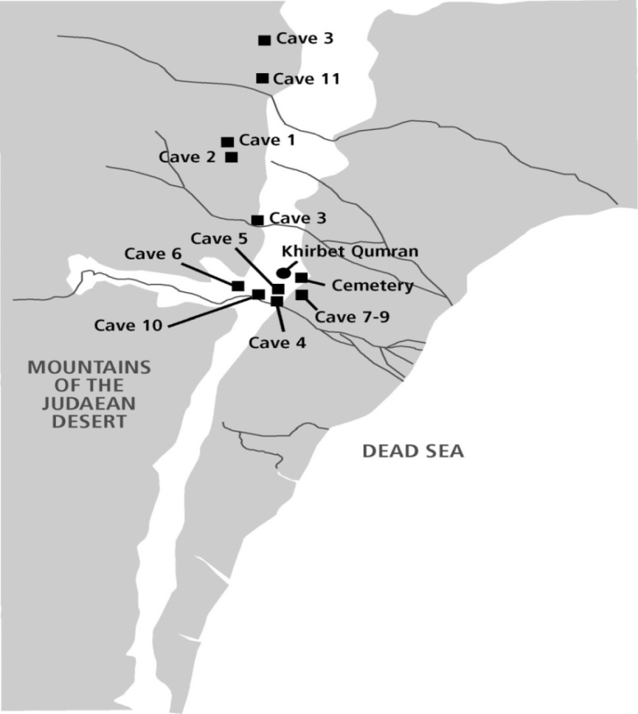
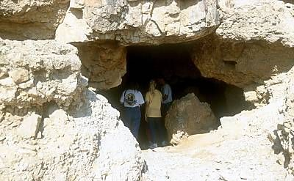
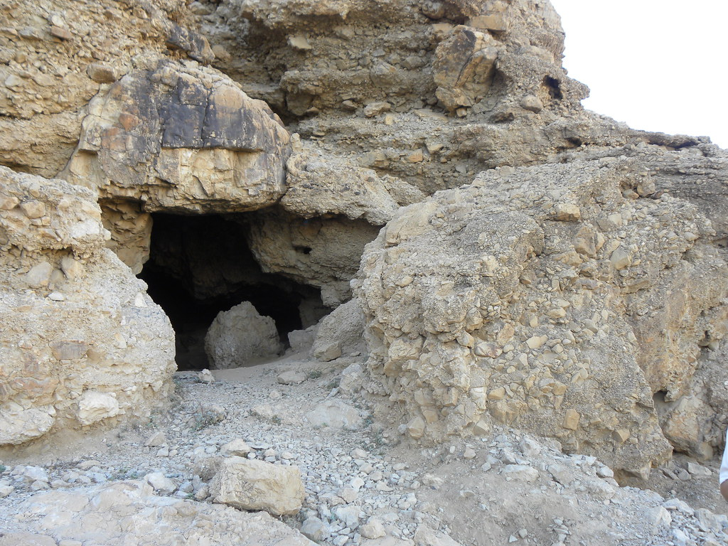
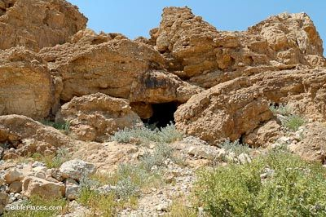
Qumran Cave 11 Entrance

Slide 10
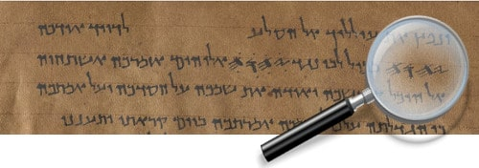
The Great Psalms Scroll (11Q5/11QPs-a)
The four-letter
divine name YHWH (the Tetragrammaton ) is written in the paleo-Hebrew script.

Slide 11
The Great Psalms Scroll (11Q5 = 11QPs-a)
-Psalms scroll in color: a multi-spectral image of a scroll fragment from the book of Psalms. Photograph: Shai Halevi, courtesy of the IAA
-The scroll contains twenty-eight incomplete columns of text. Each of the preserved columns contains fourteen to seventeen lines; it is clear that six to seven lines are lacking at the bottom of each column.

Slide 12
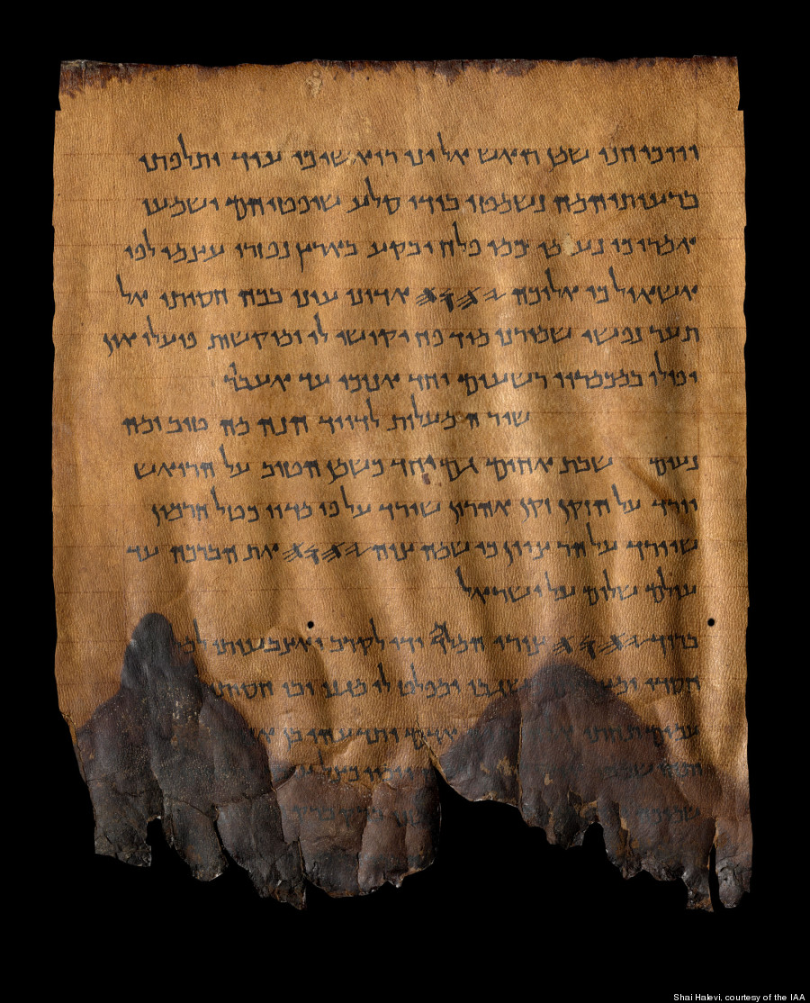
The Great Psalms
Scroll (11Q5)
Psalms 133:1-3
Photograph: Shai Halevi,
courtesy of the IAA
(Ps. 141:5-10)
(Psalm 133:1) שִׁ֥יר הַֽמַּעֲל֗וֹת לְדָ֫וִ֥ד הִנֵּ֣ה מַה־טּ֭וֹב וּמַה־
נָּעִ֑ים שֶׁ֖בֶת אַחִ֣ים גַּם־יָֽחַד׃ ² כַּשֶּׁ֤מֶן הַטּ֙וֹב׀ עַל־הָרֹ֗אשׁ
יֹרֵ֗ד עַֽל־הַזָּקָ֥ן זְקַֽן־אַהֲרֹ֑ן שֶׁ֜יֹּרֵ֗ד עַל־פִּ֥י מִדּוֹתָֽיו׃ ³ כְּטַל־חֶרְמ֗וֹן
שֶׁיֹּרֵד֘ עַל־הַרְרֵ֪י צִ֫יּ֥וֹן כִּ֤י שָׁ֙ם׀ צִוָּ֣ה יְ֭הוָה אֶת־הַבְּרָכָ֑ה חַ֜יִּ֗ים עַד
הָעוֹלָֽם׃ ‎שָׁ֜ל֗וֹם עַל־יִשְׂרָאֵֽל (Ps. 125:5)
(Ps. 144:1~)
(Psalm 133) 1大衛上行之詩。看哪、弟兄和睦同居、是何等的善、何等的美。 2 這好比那貴重的油、澆在亞倫的頭上、流到鬍鬚．又流到他的衣襟． 3 又好比黑門的甘露、降在錫安山．因為在那裡有耶和華所命定的福、就是永遠的生命。 (125:5) ……. 願平安歸於以色列.

Slide 13
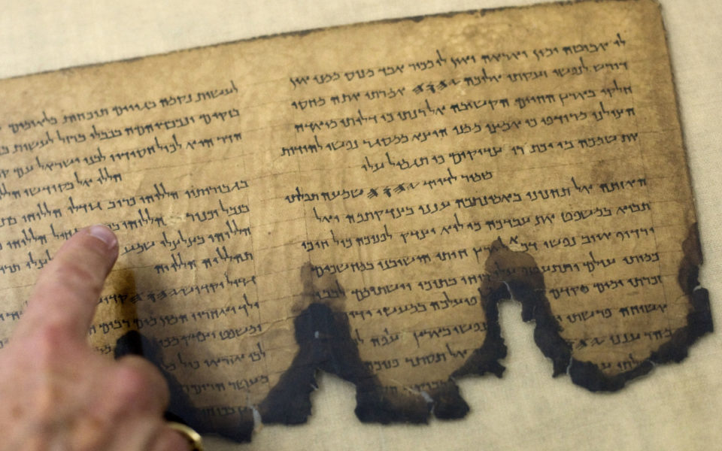
https://presslasvegas.com/news/world/archaeologists-claim-new-fragments-of-dead-sea-scrolls-found-in-israel/
Psalm 142:3 (the last word) - 142:8
Psalm 143:1-6
‎ ¹מִזְמ֗וֹר לְדָ֫וִ֥ד יְהוָ֤ה שְׁמַ֬ע תְּפִלָּתִ֗י
הַאֲזִ֥ינָה אֶל־תַּחֲנוּנַ֑י בֶּאֱמֻנָתְךָ֥ עֲ֜נֵ֗נִי בְּצִדְקָתֶֽךָ׃² וְאַל
תָּב֣וֹא בְ֭מִשְׁפָּט אֶת־עַבְדֶּ֑ךָ כִּ֤י לֹֽא־יִצְדַּ֖ק לְפָנֶ֣יךָ כָל־חָֽי׃ ³ כִּ֥י
רָ֨דַ֤ף אוֹיֵ֙ב נַפְשִׁ֗י דִּכָּ֣א לָ֭אָרֶץ חַיָּתִ֑י הוֹשִׁיבַ֥נִי בְ֜מַחֲשַׁכִּ֗ים
כְּמֵתֵ֥י עוֹלָֽם׃ ⁴ וַתִּתְעַטֵּ֣ף עָלַ֣י רוּחִ֑י בְּ֜תוֹכִ֗י יִשְׁתּוֹמֵ֥ם לִבִּֽי׃
⁵ זָ֨כַ֤רְתִּי יָמִ֙ים׀ מִקֶּ֗דֶם הָגִ֥יתִי בְכָל־פָּעֳלֶ֑ךָ בְּֽמַעֲשֵׂ֖ה יָדֶ֣יךָ
אֲשׂוֹחֵֽחַ׃ ⁶ פֵּרַ֣שְׂתִּי יָדַ֣י אֵלֶ֑יךָ נַפְשִׁ֓י כְּאֶֽרֶץ־עֲיֵפָ֖ה לְךָ֣ סֶֽלָה׃
‎⁷מַ֨הֵ֤ר עֲנֵ֙נִי יְהוָה֘ כָּלְתָ֪ה ר֫וּחִ֥י אַל־תַּסְתֵּ֣ר פָּנֶ֣יךָ מִמֶּ֑נִּי
Psalm 143:1 大衛的詩。耶和華阿、求你聽我的禱告、留心聽我的懇求、憑你的信實和公義應允我。 6 我向你舉手我的心渴想你、如乾旱之地盼雨一樣。細拉.

Slide 14
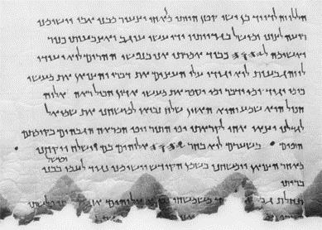
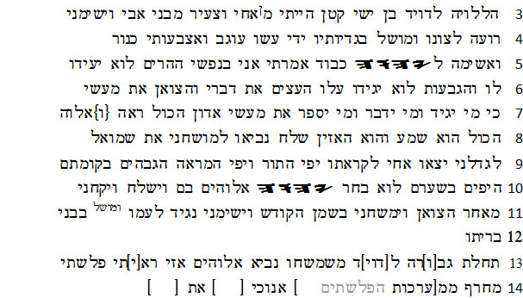
Psalm 151
(11Q5 = 11QPs-a)
Below:
Printed Letters
Psalm 151 is a short Psalm found in most copies of the Septuagint (LXX) but not in the Masoretic Text of the Hebrew Bible.

Slide 15
詩篇22:16[17] 翻譯上的問題
Textual Difference in Psalm 22:16[Heb. 22:17]
22:16[17] ‎ כִּ֥י סְבָב֗וּנִי כְּלָ֫בִ֥ים עֲדַ֣ת מְ֭רֵעִים הִקִּיפ֑וּנִי כָּ֜אֲרִ֗י יָדַ֥י וְרַגְלָֽי׃
^{LXX} ὅτι ἐκύκλωσάν με κύνες πολλοί συναγωγὴ πονηρευομένων
περιέσχον με ὤρυξαν χεῖράς μου καὶ πόδας (For many dogs have compassed me: the assembly of the wicked doers has beset me round: they pierced my hands and my feet.)
^{CUV}犬類圍著我．惡黨環繞我．他們扎了我的手、我的腳。
^{CNV}犬類圍著我，惡黨環繞我，他們扎了（按照《馬索拉文本》，「他們扎了」作「像獅子」;現參照《七十士譯本》等古譯本翻譯）我的手我的腳。
^{ESV} For dogs encompass me; a company of evildoers encircles me; they have pierced my hands and feet– / ^{NKJ} They pierced / ^{NIV} they pierce / ^{TNK} Dogs surround me; a pack of evil ones closes in on me, like lions they maul my hands and feet.

Slide 16
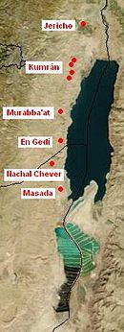
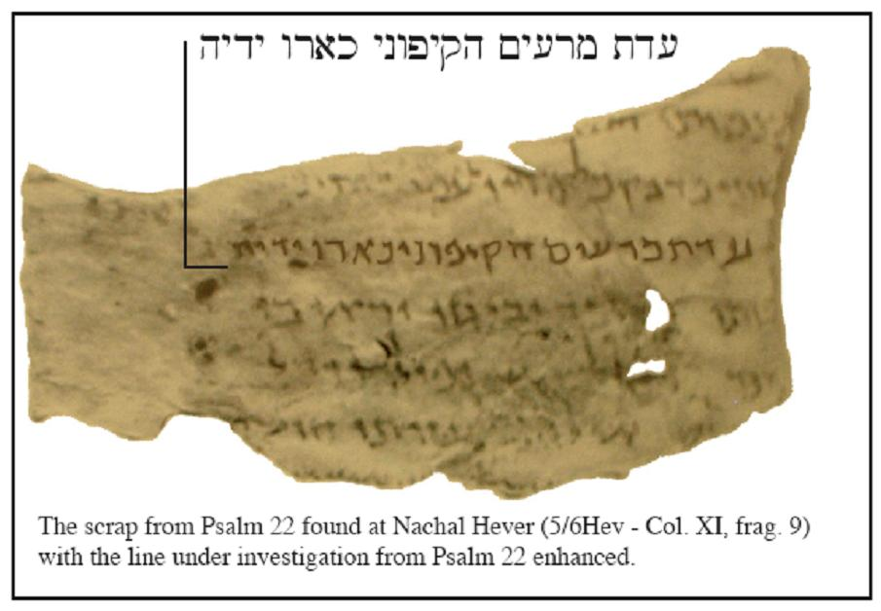
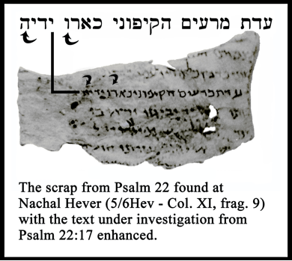
39 | 5/6Hev Psalm (Nahal Hever) | 7:12-17; 8:1, 3-9; 9:12-21; 10:1-6, 8-10, 18; 11:1-5; 12:5-8; 13:1-2; 14:2-4; 15:1-5; 16:1; 18:5-12, 16-35, 37-42; 22:3-8; 14-20; 23:2-6; 24:1-2; 25:4-7; 29:2; 30:2; 31:1-21

Slide 17
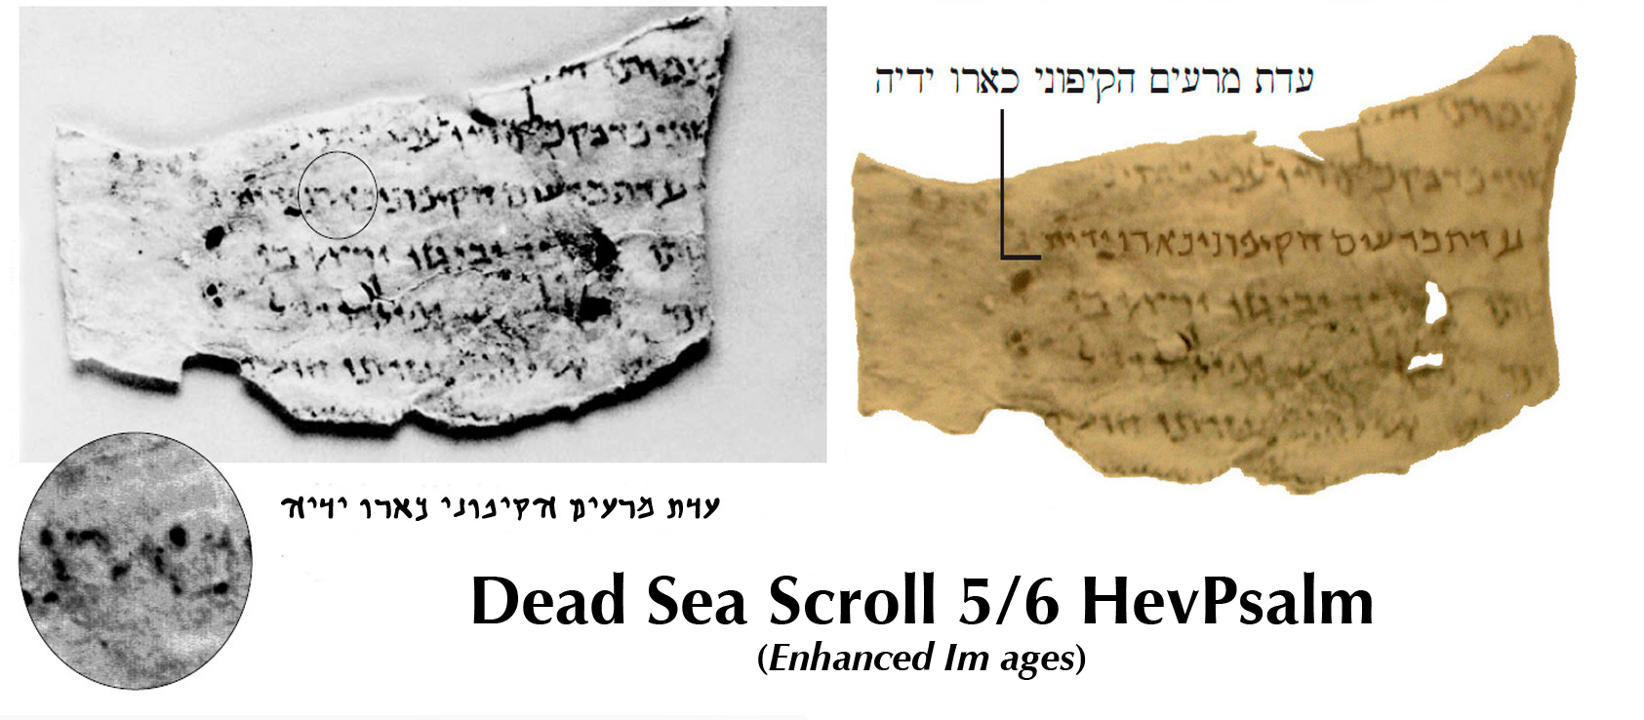
詩篇22:16 [Hebrew 22:17]
כִּ֥י סְבָב֗וּנִי כְּלָ֫בִ֥ים עֲדַ֣ת מְ֭רֵעִים הִקִּיפ֑וּנִי כָּ֜אֲרִ֗י יָדַ֥י וְרַגְלָֽי׃
犬類圍著我．惡黨環繞我．他們扎了我的手、我的腳。

Slide 18
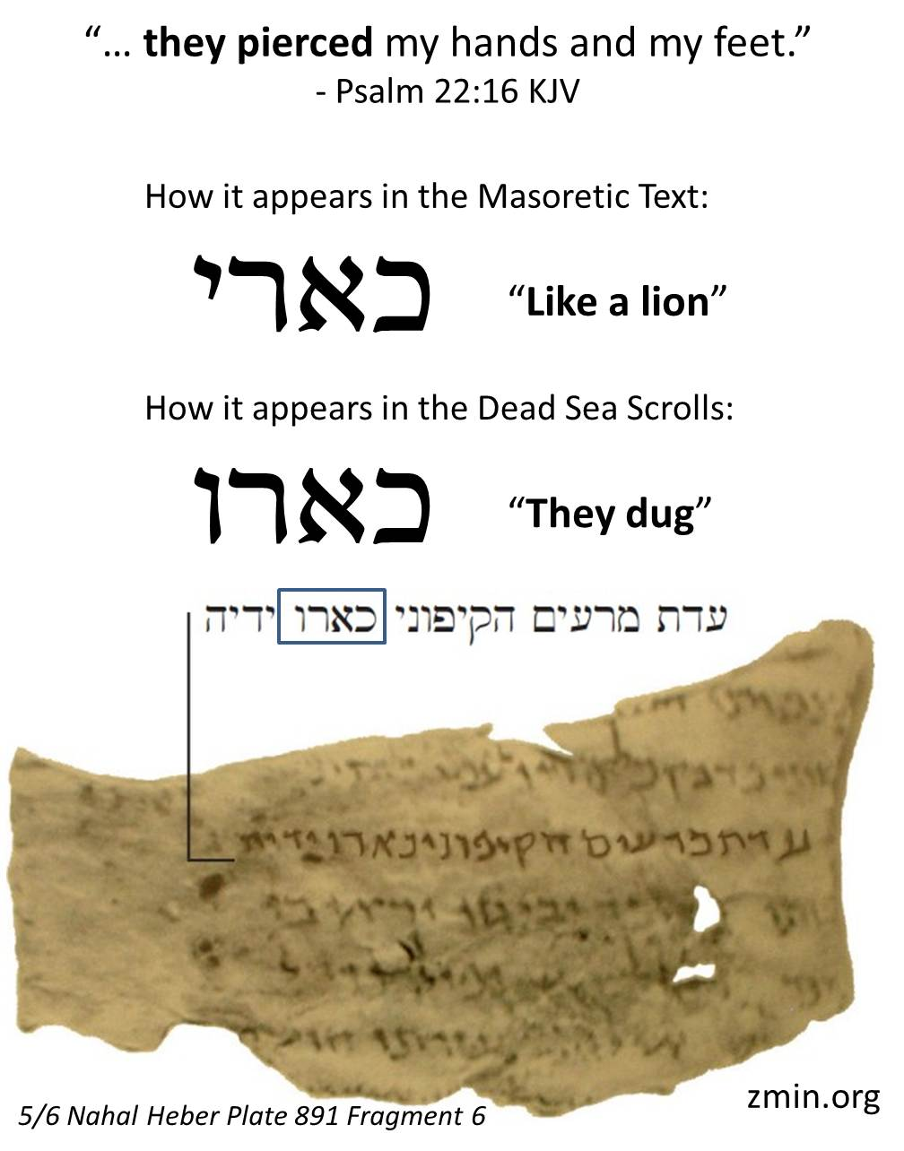
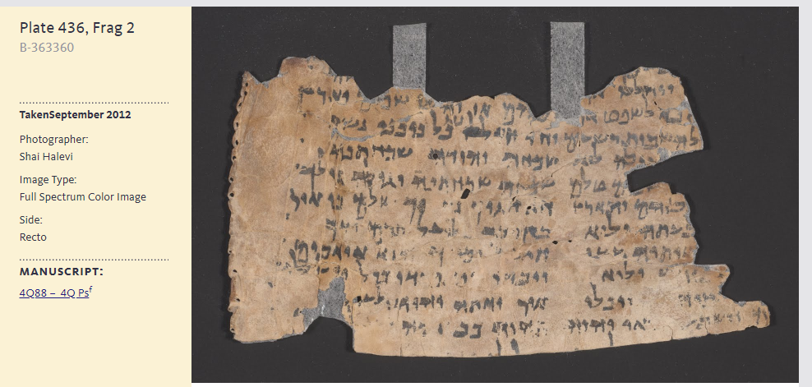
11 | 4QPs^{f} (4Q88) | 22:14-17; 107: 2-4, 8-11, 13-15, 18-19, 22-30, 35; 109:4-6, 25-28; Apostrophe to Zion; Apostrophe to Judah; Eschatological Hymn
https://www.deadseascrolls.org.il/explore-the-archive/image/B-363360

Slide 19
民數記 6:24-26
願耶和華賜福給你,保護你.
願耶和華使他的臉光照你,賜恩給你.
願耶和華向你仰臉,賜你平安.
‎ יְבָרֶכְךָ יְהוָה וְיִשְׁמְרֶךָ׃ Numbers 6:24-26
יָאֵר יְהוָה פָּנָיו אֵלֶיךָ וִיחֻנֶּךָּ׃
‎יִשָּׂא יְהוָה פָּנָיו אֵלֶיךָ וְיָשֵׂם לְךָ שָׁלוֹם׃

Slide 21
The Great Psalms Scroll (11Q5) Psalm 151
Below: Dead Sea Scrolls
Electronic Library
Col. XXVIII (Psalm 151 A and B)
3הללויה לדויד בן ישי קטן הייתי מ^{ן}אחי וצעיר מבני אבי וישימני
4רועה לצונו ומושל בגדיותיו ידי עשו עוגב ואצבעותי כנור
5ואשימה ליהוה כבוד אמרתי אני בנפשי ההרים לוא יעידו
6לו והגבעות לוא יגידו עלו֯ העצים את דברי֯ והצואן את מעשי֯
7כי מי יגיד ומי ידבר ומי יספר את מעשי֯ אדון הכול ראה‏ {ו֯‏}אלוה
8הכול הוא שמע והוא האזין שלח נביאו למושחני את שמואל
9לגדלני יצאו אחי לקראתו יפי התור ויפי המראה הגבהים בקומתם
10היפים בשערם לוא בחר יהוה אלוהים בם וישלח ויקחני
11מאחר הצואן וימשחני בשמן הקודש וישימני נגיד לעמו ^{ומושל} בבני
12בריתו‏ vacat
LXX-Psalm 151
Vulgata
Syriac ?????

Slide 22
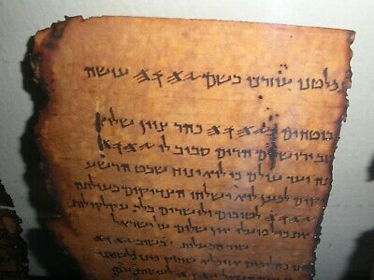

Slide 23
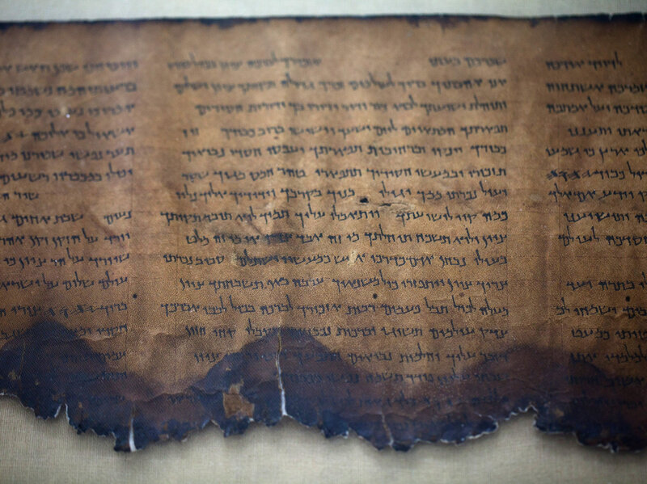
The Great Psalms Scroll (11Q5)
IAA

Slide 24
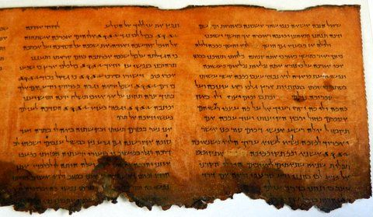
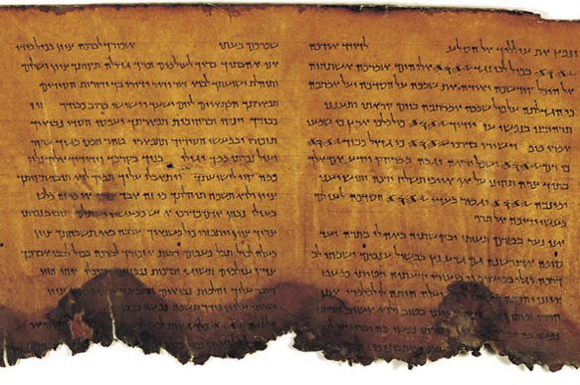

Slide 25
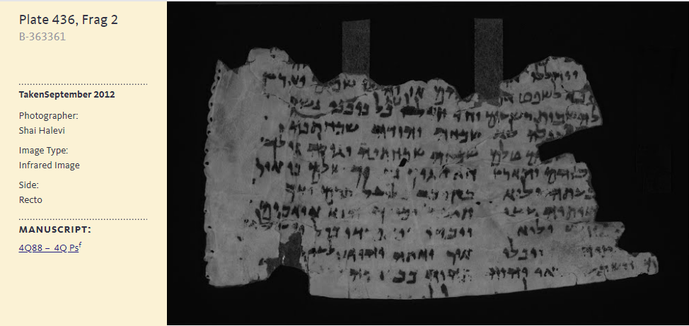
https//www.deadseascrolls.org.il/explore-the-archive/image/B-363361

