Slide 1
死海古卷中的
古代希伯來語字體書卷
Palaeo-Hebrew Script Scrolls from Qumran
金京來博士 Kyungrae Kim, Ph.D.

Slide 2
現代希伯來語字體 Hebrew Alphabet (22 Letters)

Slide 3
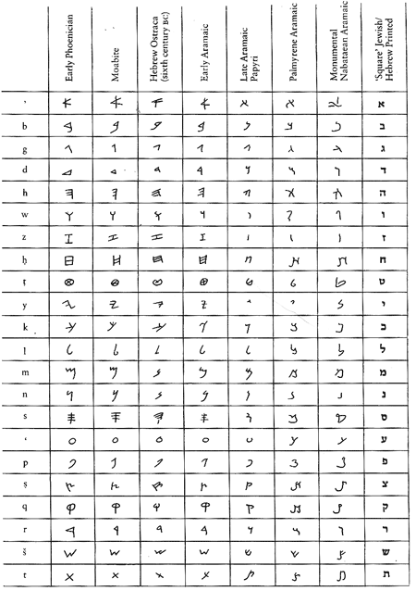
希伯來語字體
變化的歷史
History of
Hebrew Alphabet

Slide 4
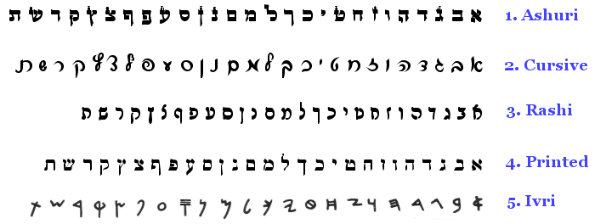

Slide 5
古代希伯來語字體 Ancient Hebrew Scripts

Slide 6
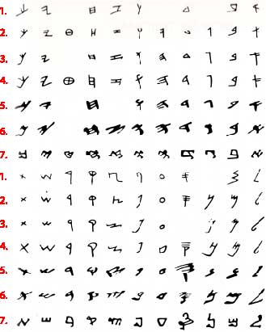

Slide 7
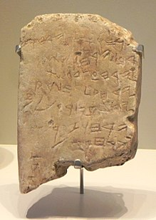
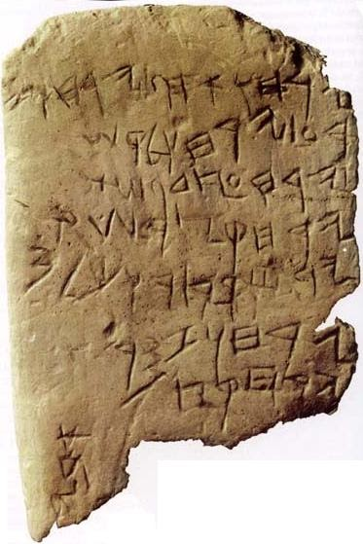
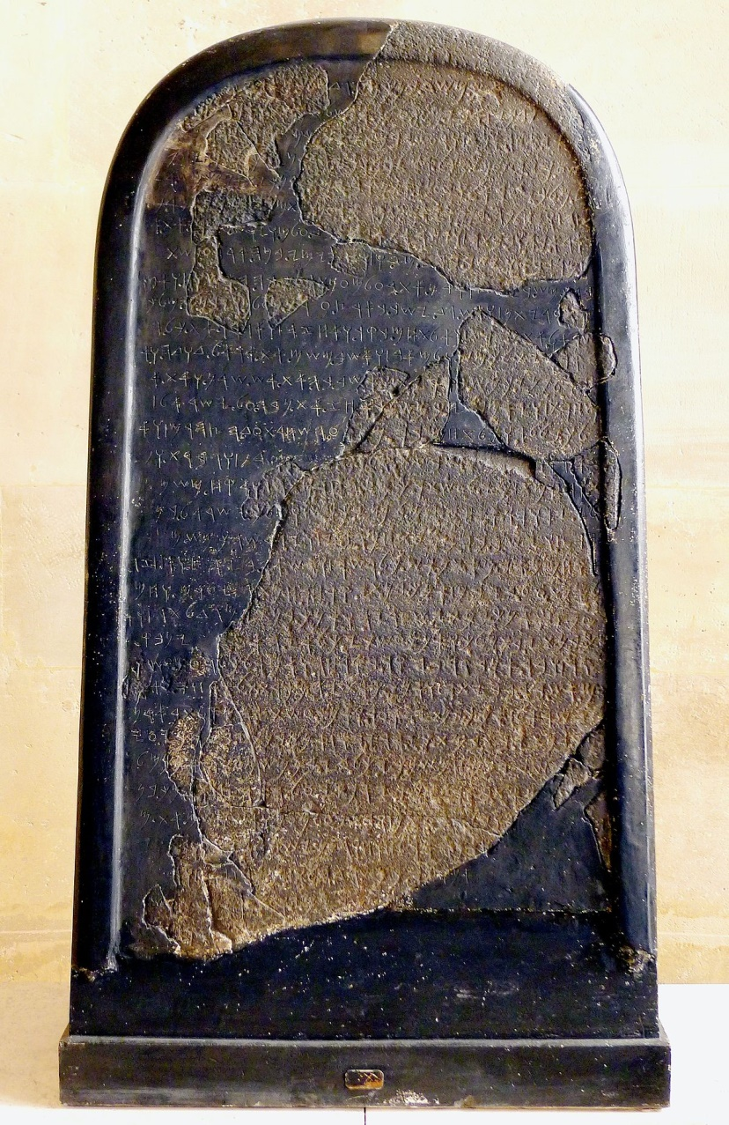
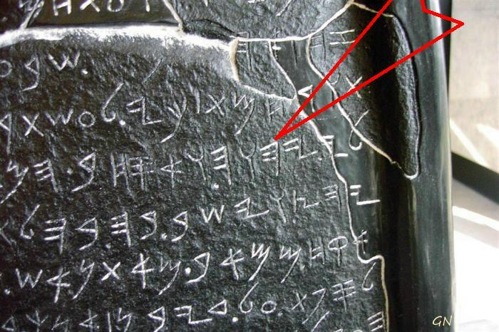
更早的古希伯來語史料
Earlier Ancient paleo-Hebrew Epigraphic Materials
Mesha Inscription
(the Moabite Stone)
(ca. 840 BC)
The Divine Name (YHWH)
The Gezer Calendar
(ca. 950–918 BCE)

Slide 8
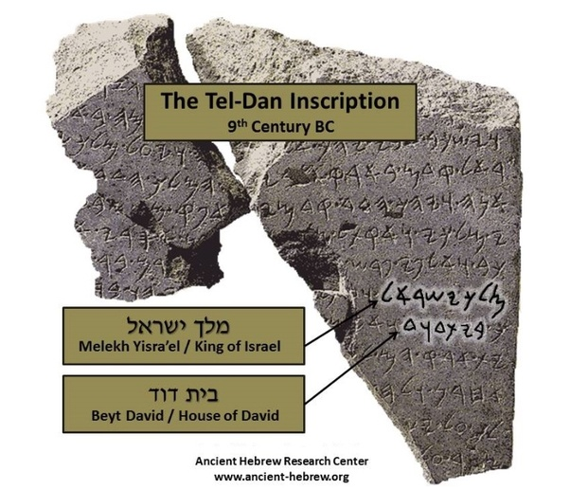
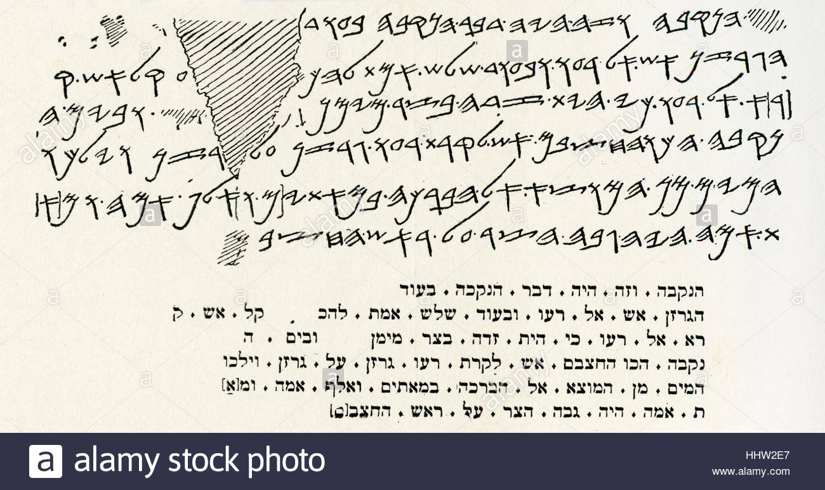
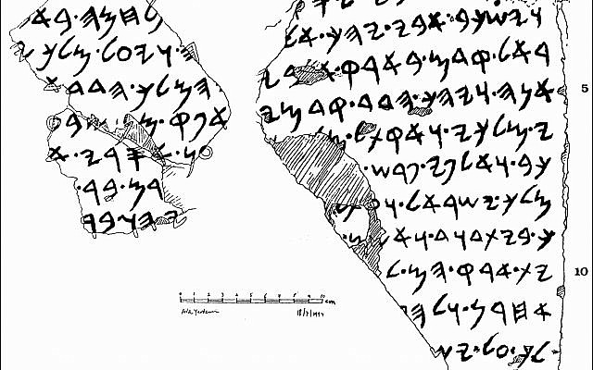

Slide 9
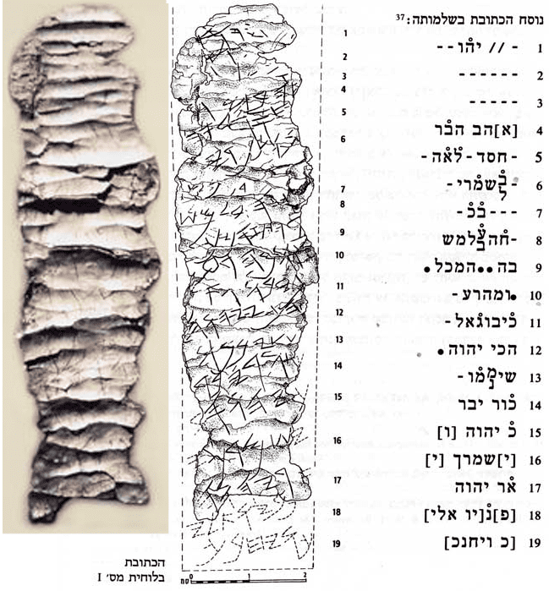
Ketef Hinnom Priestly Blessing
Numbers 6:24-27
7th Century BC

Slide 11
死海古卷中的古代希伯來語字體聖經書卷: 一共11卷 (1-5)
Paleo-Hebrew Script Bible Scrolls from Qumran: total 11 copies (1-5)
 | Name | Contents (Biblical Passages)
1 | 1QpaleoLev (1Q3) | Leviticus 11:10–11; 19:30–34; 20:20–24; 21:24–22:6; 23:4–8; Numbers 1:48–50
2 | 2QpaleoLev (2Q5) | Leviticus 11:22-29
3 | 4QpaleoGen-Exod^{l} (4Q11) | Genesis 50:26; Exodus 1:1–5; 2:10,22–25; 3:1–4,17–21; 8:13–15, 19–21; 9:25–29, 33–35; 10:1–5; 11:4–10; 12:1–11, 42–46; 14:15–24; 16:2–7, 13–14,18–20,23–25,26–31,33–35; 17:1–3,5–11; 18:17–24; 19:24–25; 20:1–2; 22:23–24; 23:5–16; 25:7–20; 26:29–37; 27:1, 6–14; 28:33–35,40–42; 36:34–36
4 | 4QpaleoGen^{m} (4Q12) | Genesis 26:21–28; Exodus 6:25–30; 7:1–19,29; 8:1,5,12–26; 9:5–16,19–21,35; 10:1–12,19–28; 11:8–10; 12:1–2,6–8,13–15,17–22,31–32,34–39; 13:3–7,12–13; 14:3–5,8–9,25–26; 15:23–27; 16:1,4–5,7–8,31–35; 17:1–16; 18:1–27; 19:1,7–17,23–25; 20:1,18–19; 21:5–6, 13–14,22–32; 22:3–4,6–7,11–13,16–30; 23:15–16,19–31; 24:1–4,6–11; 25:11–12,20–29,31–34; 26:8,15,21–30; 27:1–3,9–14,18–19; 28:3–4,8–12,22–24,26–28,30–43; 29:1–5,20,22–25,31–41; 30:10,12–18,29–31,34–38; 31:1–8,13–15; 32:2–19,25–30; 33:12–23; 34:1–3,10–13,15–18,20–24,27–28; 35:1; 36:21–24; 37:9–16
5 | 4QpaleoExod^{m} (4Q12) | Exodus 6:25–7:19,29–8:1,[5],12–22; 9:5–16, 19–21, 35–10:12, 19–28; 11:8–12:2,6–8, 13–15, 17–22, 31–32, 34–39; 13:3–8, 12–13; ... 37:9–16

Slide 12
死海古卷中的古代希伯來語字體聖經書卷: 一共11卷(6-11)
Paleo-Hebrew Script Bible Scrolls from Qumran: total 11 copies (6-11)
6 | 4QpaleoDeut^{r} (4Q45) | Deuteronomy 7:2–7, 16–25; 11:28,30–12:1,11–12; 13:19; 14:19–22, 26–29; 15:5–6, 8–10; 19:2–3; 21:8–9; 22:3–6,12–15; 28:15–18, 20; 30:7–8; 32:2–8,10–11,13–14, 33–35; 33:2–8, 29; 34:1–2
7 | 4QpaleoDeut^{s} | (4Q46) Deuteronomy 26:14–15
8 | 4QpaleoJob^{c} | (4Q101) Job 13:18–20, 23–27; 14:13–18
9 | 6QpaleoGen | (6Q1) Genesis 6:13–21
10 | 6QpaleoLev | (6Q2) Leviticus 8:12–13
11 | 11QpaleoLevª (11Q1) | Leviticus 4:24–26; 10:4–7; 11:27–32; 13:3–9, 39-43; 14:16–21; 14:52–15:5; 16:2–4; 16:34–17:5; 18:27–19:4; 20:1–6; 21:6–11; 22:21–27; 23:22–29; 24:9–14; 25:28–36; 26:17–26; 27:11–19
Other Fragments in paleo-Hebrew script
1 | 4QpaleoparaJosh (4Q123) | Parts of Joshua 21 (Paraphrase on Joshua, Rewritten Joshua)
2 | 4Q124 | Unidentified
3 | 4Q125 | Unidentified

Slide 13
根據發現的抄本數量排名的書（前15名）
Books Ranked According to Number of
Manuscripts found (top 15)
Books | Found | Books | Found | Books | Found
Psalms | 39 | Jubilees | 21 | Daniel | 8
Deuteronomy | 33 | Exodus | 18 | Jeremiah | 6
1 Enoch | 25 | Leivicus | 17 | Ezekiel | 6
Genesis | 24 | Numbers | 11 | Job | 6
Isaiah | 22 | Minor Prophets | 10 | 1&2 Samuel | 4
死海古卷中的古代希伯來語字體聖經書卷
-These scrolls contain only texts of the Torah (= the Pentateuch) and Job, all of which are traditionally ascribed to Moses.
-The two longest text written in the paleo-Hebrew script are 11QpaleoLevª and 4Qpaleo-Exod ^{m}.
-Similarity between the Samaritan Pentateuch and 4Qpaleo-Exod ^{m} (the pre-Samaritan Text)

Slide 15
Paleo-Hebrew Leviticus scroll (11QpaleoLev = 11Q1)
-Discovered in cave 11 in January of 1956 by local Bedouins:
The cave 11 also yielded the Great Psalms Scroll (11QPs) and the
Temple Scroll (11QT) (being the longest of the Dead Sea Scrolls).
-The Leviticus scroll consists of fifteen fragments and one scroll of seven columns, measuring 100.5 cm (39.6 in) in length. The surviving scroll, showing portions of the Book of Leviticus, shows only the bottom portion of two sheets of parchment (ca. one-fifth of its original height), now measuring 10.9 cm (4.3 in) in height. The two sheets of parchment are shown sewn together; one containing three columns, and the other four columns, for a total of seven extant columns.
-The scroll is thought to have been penned by the scribe between the late 2nd-century BC to early 1st-century BC.
-Individual words are divided by dots.
-The 11QpaleoLev scroll is close to the Masoretic Text.

Slide 16
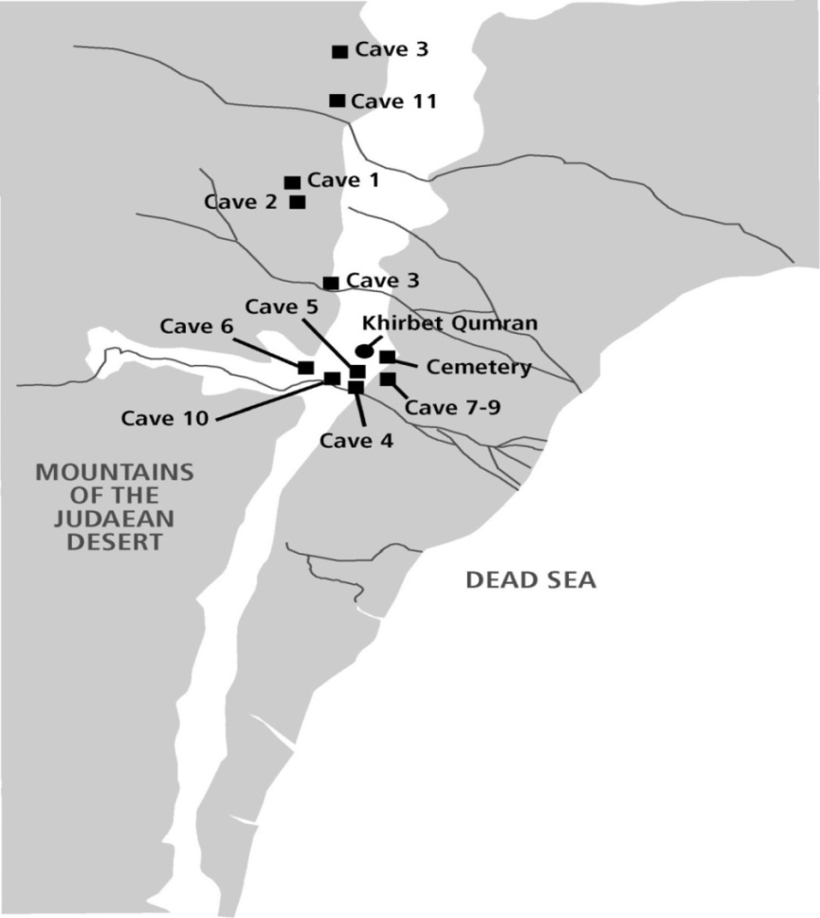
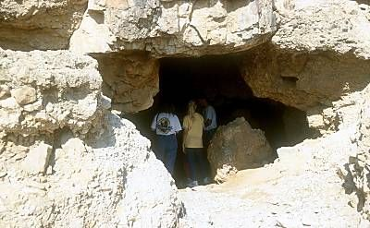
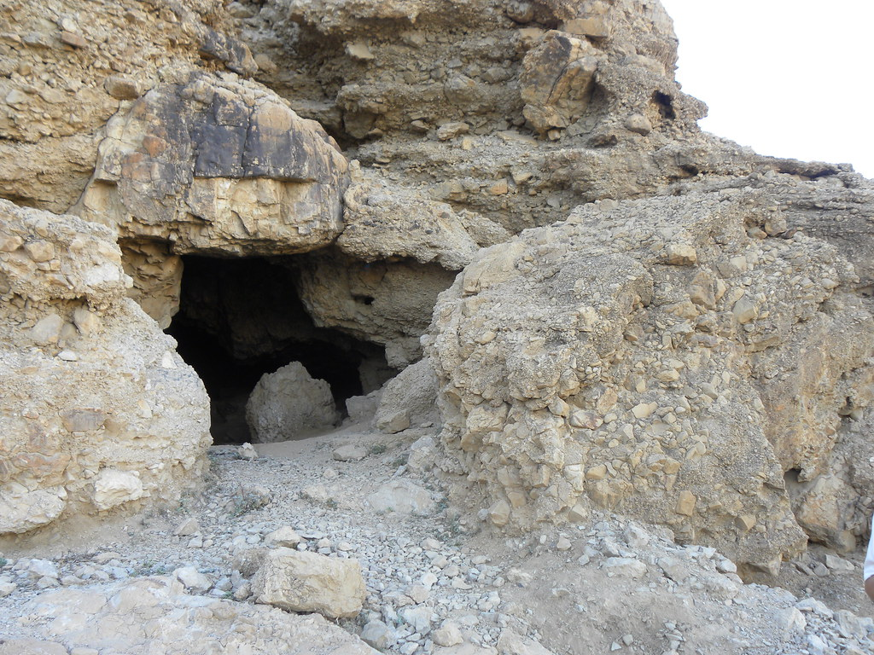
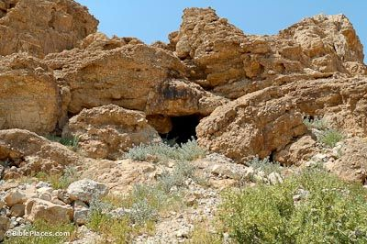
Qumran Cave 11 Entrance

Slide 17
11QpaleoLev (11Q1)
Height 10.9 cm (4 1/4 in.)
length 100.5 cm (39 1/2 in.)
11QpaleoLev (11Q1) Fragments

Slide 19
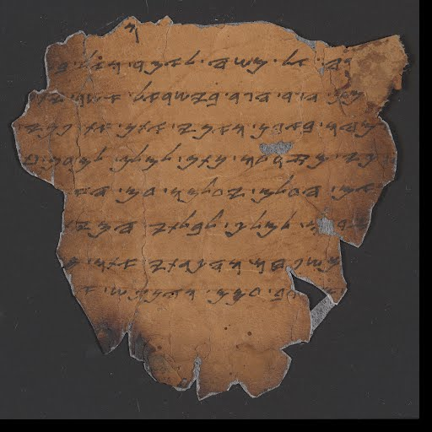
11QpaleoLev
Leviticus 20:1-6
וַיְדַבֵּ֥ר יְהוָ֖ה אֶל־מֹשֶׁ֥ה לֵּאמֹֽר׃ 1
‎ 2 וְאֶל־בְּנֵ֣י יִשְׂרָאֵ֨ל תֹּאמַר֒ אִ֣ישׁ אִישׁ֩ מִבְּנֵ֙י יִשְׂרָאֵ֜ל וּמִן־הַגֵּ֣ר הַגָּ֣ר בְּיִשְׂרָאֵ֗ל אֲשֶׁ֙ר יִתֵּ֧ן מִזַּרְע֛וֹ לַמֹּ֖לֶךְ מ֣וֹת יוּמָ֑ת עַ֥ם הָאָ֖רֶץ יִרְגְּמֻ֥הוּ בָאָֽבֶן׃
‎ 3 וַאֲנִ֞י אֶתֵּ֤ן אֶת־פָּנַי֙ בָּאִ֣ישׁ הַה֔וּא וְהִכְרַתִּ֥י אֹת֖וֹ מִקֶּ֣רֶב עַמּ֑וֹ כִּ֤י מִזַּרְעוֹ֙ נָתַ֣ן לַמֹּ֔לֶךְ לְמַ֗עַן טַמֵּא֙ אֶת־מִקְדָּשִׁ֔י וּלְחַלֵּ֖ל אֶת־שֵׁ֥ם קָדְשִֽׁי׃
‎ 4 וְאִ֡ם הַעְלֵ֣ם יַעְלִימֽוּ֩ עַ֙ם הָאָ֜רֶץ אֶת־עֵֽינֵיהֶם֙ מִן־הָאִ֣ישׁ הַה֔וּא בְּתִתּ֥וֹ מִזַּרְע֖וֹ לַמֹּ֑לֶךְ לְבִלְתִּ֖י הָמִ֥ית אֹתֽוֹ׃
‎ 5 וְשַׂמְתִּ֙י אֲנִ֧י אֶת־פָּנַ֛י בָּאִ֥ישׁ הַה֖וּא וּבְמִשְׁפַּחְתּ֑וֹ וְהִכְרַתִּ֙י אֹת֜וֹ וְאֵ֣ת כָּל־הַזֹּנִ֣ים אַחֲרָ֗יו לִזְנ֛וֹת אַחֲרֵ֥י
הַמֹּ֖לֶךְ מִקֶּ֥רֶב עַמָּֽם׃ ‎ 6 וְהַנֶּ֗פֶשׁ אֲשֶׁ֙ר …..

Slide 20
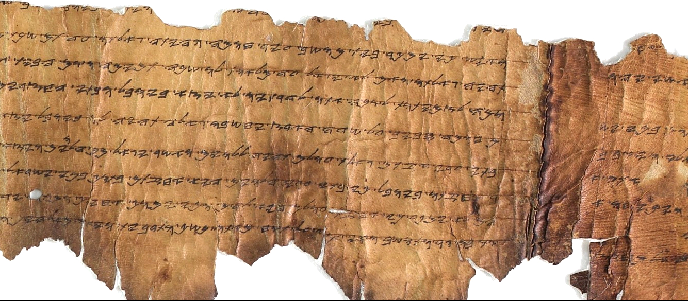
11QpaleoLev (11Q1)
Photograph: Shai Halevi, courtesy of the IAA

Slide 21
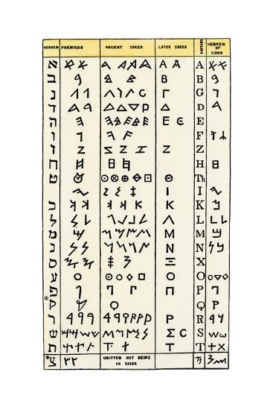
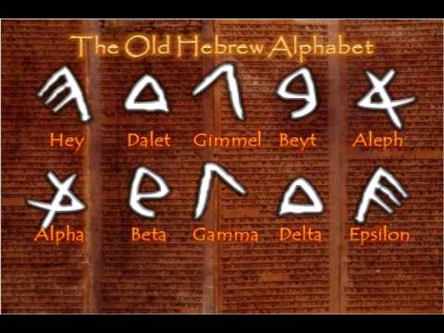
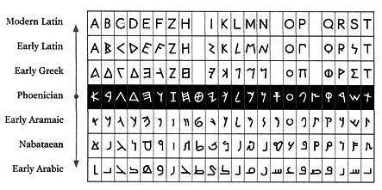
Alphabet: from Hebrew to Greek, then to Latin

Slide 22
一點一畫
(馬太5:18)
我實在告訴你們,就是到天地都廢去了,律法的一點一畫也不能廢去,都要成全。 (ἰῶτα ἓν ἢ μία κεραία)
Matthew 5:18 ^{ESV} For truly, I say to you, until heaven and earth pass away, not an iota, not a dot, will pass from the Law until all is accomplished.

Slide 23
民數記 6:24-26
願耶和華賜福給你,保護你.
願耶和華使他的臉光照你,賜恩給你.
願耶和華向你仰臉,賜你平安.
‎ יְבָרֶכְךָ יְהוָה וְיִשְׁמְרֶךָ׃ Numbers 6:24-26
יָאֵר יְהוָה פָּנָיו אֵלֶיךָ וִיחֻנֶּךָּ׃
‎יִשָּׂא יְהוָה פָּנָיו אֵלֶיךָ וְיָשֵׂם לְךָ שָׁלוֹם׃

Slide 25
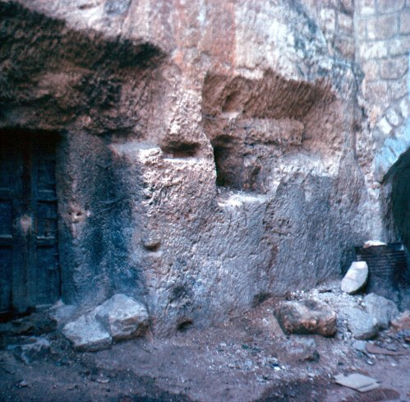
更早的古希伯來語史料
Earlier Ancient paleo-Hebrew Epigraphic Materials

Slide 26
