Slide 1
Un Buen Ojo y un Mal Ojo de Mateo 6:22-23
A Good Eye & a Bad Eye
of Matthew 6:22-23
מְקוֹר מַיִם חַיִּים
ἡ πηγή ὕδατος ζωῆς
The Spring of Living Water
생명수 샘 生命水的泉源
La Fuente de Agua Viva
La Source d'Eau Vive
Die Quelle Lebendigen Wassers
Fonte de Água Viva
‎ يَنْبُوعَ الْمِيَاهِ الْحَيَّةِ،
~yYI©x; ~yIm:å ŸrAqåm. Wbøz>[' yti’ao yMi_[; hf'ä[' tA[ßr" ~yIT:ïv.-yKi( `~yIM")h; WlkiÞy"-al{ rv<ïa] ~yrIêB'v.nI ‘troaBo tArêaBo ‘~h,l' bcoÜx.l;
Jeremías 2:13 ^{R60} Porque dos males ha hecho mi pueblo: me dejaron a mí, fuente de agua viva, y cavaron para sí cisternas, cisternas rotas que no retienen agua.
Kyungrae (Ezra) Kim, Ph.D. (1995, Hebrew University of Jerusalem)

Slide 2
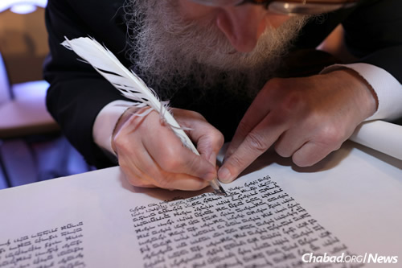
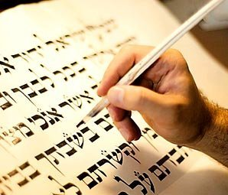
Shalom! My name is Ezra. I am a Korean Christian who is always grateful to the Jewish people who have faithfully transmitted the Bible for humanity. Thanks to them and the Book, I was able to know the Creator of the universe and meet His Son Jesus, the Savior of the world. That was the best thing that ever happened to me. And since then the Bible has become my favorite Book.

Slide 3
Passages that appear to be out of context
Among the writers of the Four Gospels, Matthew is a person who likes to organize stories according to their content. In Matthew, many stories on the same or similar topics are grouped together in the same context. For example, Matthew chapter 13 deals with the parables of the Kingdom of Heaven. The so-called ‘Sermon on the Mount’, which consists of the new interpretations of Jesus of the Torah, is found in Matthew chapters 5-7. Among these three chapters, chapter 6 begins with Jesus’ teachings on almsgiving (6:1-4), prayer (6:5-15), and fasting (6:16-18). And then, the teaching related to money continues (6:19-34). But in this last section (6:19-34), the passages in 6:22-23 seem to be out of context.

Slide 4
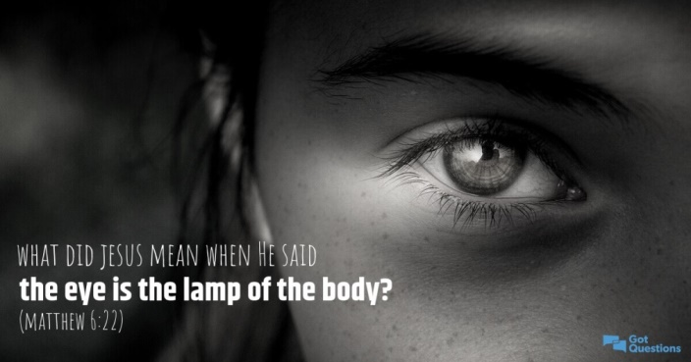
Matthew 6:22-23. 22 Ὁ λύχνος τοῦ σώματός ἐστιν ὁ ὀφθαλμός. ἐὰν οὖν ᾖ ὁ ὀφθαλμός σου ἁπλοῦς, ὅλον τὸ σῶμά σου φωτεινὸν ἔσται· 23 ἐὰν δὲ ὁ ὀφθαλμός σου πονηρὸς ᾖ, ὅλον τὸ σῶμά σου σκοτεινὸν ἔσται. εἰ οὖν τὸ φῶς τὸ ἐν σοὶ σκότος ἐστίν, τὸ σκότος πόσον.
Passages in Matthew 6:22-23
^{NIV} 22 "The eye is the lamp of the body. If your eyes are good, your whole body will be full of light. 23 But if your eyes are bad, your whole body will be full of darkness. If then the light within you is darkness, how great is that darkness!
^{RV1960} 22 La lámpara del cuerpo es el ojo; así que, si tu ojo es bueno, todo tu cuerpo estará lleno de luz; 23 pero si tu ojo es maligno, todo tu cuerpo estará en tinieblas. Así que, si la luz que en ti hay es tinieblas, ¿cuántas no serán las mismas tinieblas?
^{NVI} 22 »El ojo es la lámpara del cuerpo. Por tanto, si tu visión es clara, todo tu ser disfrutará de la luz. 23 Pero si tu visión está nublada, todo tu ser estará en oscuridad. Si la luz que hay en ti es oscuridad, ¡qué densa será esa oscuridad!

Slide 5
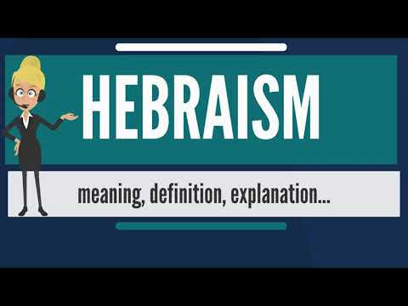
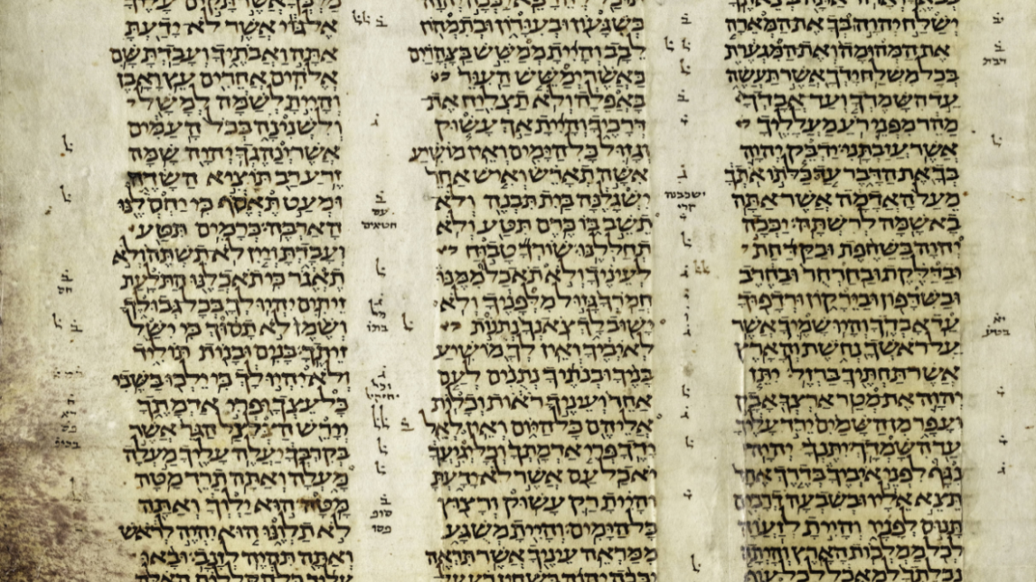
Hebraism in the New Testament
Jesus’ sayings in Matthew 6:22-23 have puzzled many Bible readers. Before continuing to speak of these passages, we must first mention ‘Hebraism’. The New Testament, although written in Greek, is full of the Old Testament and characteristic features of the Hebrew (and Aramaic) language. By the so-called ‘Hebraism’, Bible scholars refer to such characteristic features of the Hebrew (or Aramaic) language that appear in the Greek New Testament. Such Hebraism or Hebrew elements are incorporated in numerous passages of the Greek New Testament. To better understand and interpret the New Testament, we need the help of the Old Testament and its original languages (Hebrew and Aramaic).

Slide 6
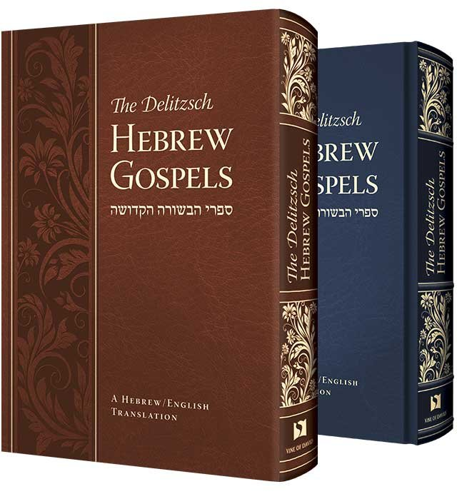
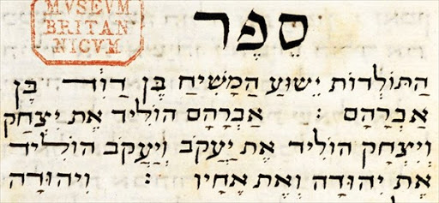
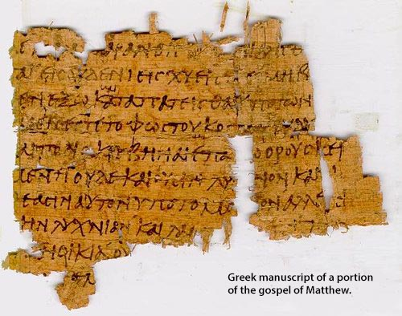
Hebraism in Matthew 6:22-23
Every language has its own idioms. When each word of an idiom is literally translated into another language, the expression usually no longer makes sense in that language. We have to keep in mind that although the Gospels were written in Greek, the original wording of most of the quotations in them had been mainly spoken either in Hebrew or Aramaic by Jesus and his disciples. The expressions ‘a good eye’ and ‘a bad eye’ in these passages are not well understood in the Greek wording. These expressions, however, make a good sense according to the Hebrew wording.

Slide 7
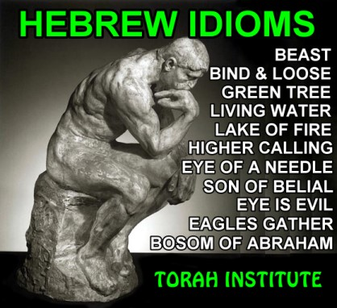
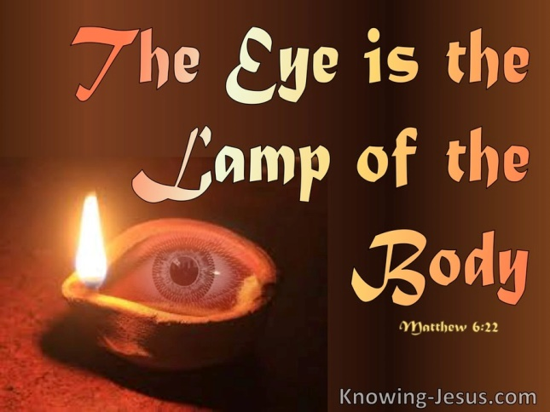
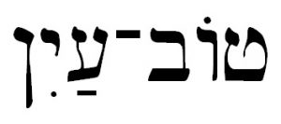
Hebrew Idioms: ‘Good Eye’ & ‘Bad Eye’
‘A good eye’ is an idiomatic expression in the Hebrew language and means ‘generosity’ in which one is willing to use his own money or wealth for the poor. On the contrary, ‘a bad eye,’ which is also a Hebrew idiom, means ‘stinginess, selfishness, lack of generosity’ regarding the use of money or wealth. The following Old Testament passages will suffice to demonstrate that the two expressions are idioms in the Hebrew language.

Slide 8
Old Testament Passages with these Idioms
-Proverbs 22:9 ‎ טֽוֹב־עַ֭יִן ה֣וּא יְבֹרָ֑ךְ כִּֽי־נָתַ֖ן מִלַּחְמ֣וֹ לַדָּֽל׃
(NKJ) “He who has a generous (literally, ‘good’) eye will be blessed, For he gives
of his bread to the poor”. // ^{RV1960} El ojo misericordioso (literalmente, ‘buen ojo’) será bendito, Porque dio de su pan al indigente. / ^{NVI} El que es generoso será bendecido, pues comparte su comida con los pobres.
-Proverbs 23:6 אַל־תִּלְחַ֗ם אֶת־לֶ֭חֶם רַ֣ע עָ֑יִן וְאַל־תִּ֜תְאָ֗יו לְמַטְעַמֹּתָֽיו׃
(NKJ) “Do not eat the bread of a miser (literally, ‘a bad eye’), Nor desire his delicacies”.
^{RV1960} No comas pan con el avaro (literalmente, ‘mal ojo’), Ni codicies sus manjares; / ^{NVI} No te sientes a la mesa de un tacaño, ni codicies sus manjares,
-Proverbs 28:22 ‎ נִֽבֳהָ֥ל לַה֗וֹן אִ֭ישׁ רַ֣ע עָ֑יִן וְלֹֽא־יֵ֜דַע כִּי־חֶ֥סֶר יְבֹאֶֽנּוּ׃
(NKJ) “A man with an evil eye hastens after riches, And does not consider that poverty will come upon him”. // ^{RV1960} Se apresura a ser rico el avaro (literalmente, ‘mal ojo’), Y no sabe que le ha de venir pobreza. / ^{NVI} El tacaño ansía enriquecerse, sin saber que la pobreza lo aguarda.

Slide 9
Old Testament Passages with these Idioms
-Deuteronomy 15:9 ‎ הִשָּׁ֣מֶר לְךָ֡ פֶּן־יִהְיֶ֣ה דָבָר֩ עִם־לְבָבְךָ֙ בְלִיַּ֜עַל לֵאמֹ֗ר
קָֽרְבָ֣ה שְׁנַֽת־הַשֶּׁבַע֘ שְׁנַ֣ת הַשְּׁמִטָּה֒ וְרָעָ֣ה עֵֽינְךָ֗ בְּאָחִ֙יךָ֙ הָֽאֶבְי֔וֹן
וְלֹ֥א תִתֵּ֖ן ל֑וֹ וְקָרָ֤א עָלֶ֙יךָ֙ אֶל־יְהוָ֔ה וְהָיָ֥ה בְךָ֖ חֵֽטְא׃
(NKJ) “Beware lest there be a wicked thought in your heart, saying, 'The seventh year, the year of release, is at hand,' and your eye be evil against your poor brother and you give him nothing, and he cry out to the LORD against you, and it become sin among you”.
-Deuteronomio 15:9 ^{RV1960} Guárdate de tener en tu corazón pensamiento perverso, diciendo: Cerca está el año séptimo, el de la remisión, y mires con malos ojos a tu hermano menesteroso para no darle; porque él podrá clamar contra ti a Jehová, y se te contará por pecado. / ^{NVI} No des cabida en tu corazón a la perversa idea de que, por acercarse el año séptimo, año del perdón de las deudas, puedes hacerle mala cara (literalmente, ‘mal ojo’) a tu hermano hebreo necesitado y no darle nada. De lo contrario, él podrá apelar al SEÑOR contra ti, y tú resultarás convicto de pecado.

Slide 10
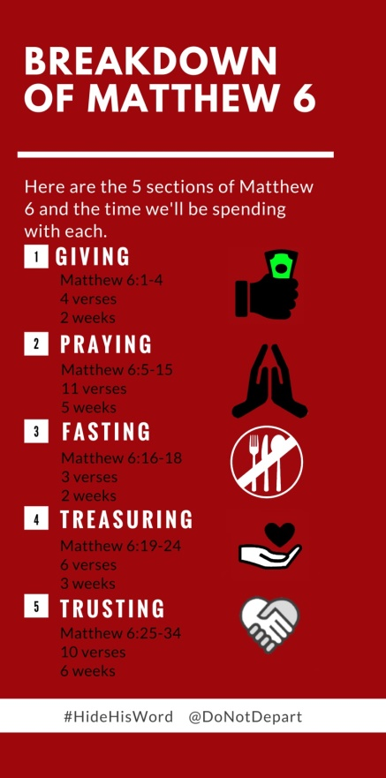
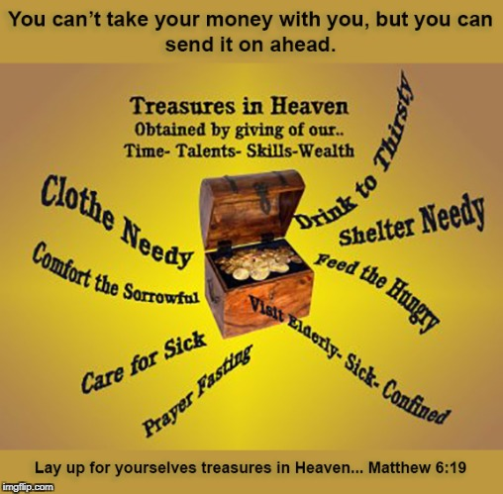
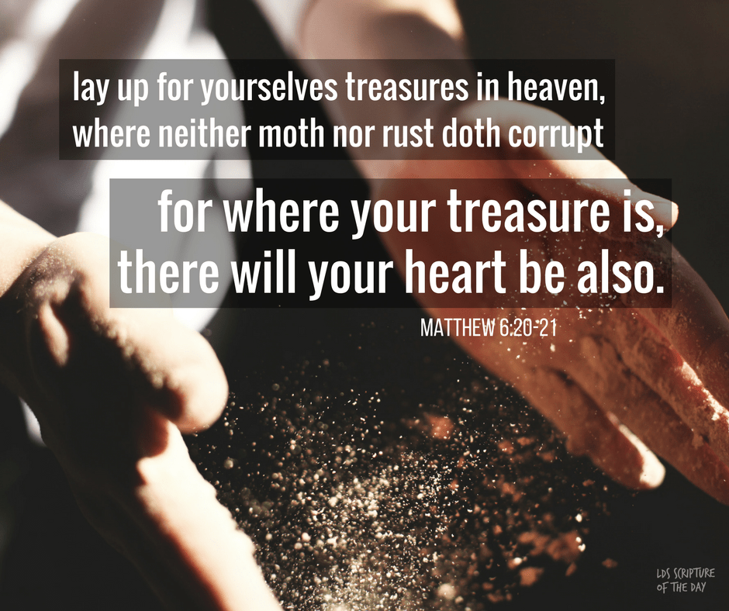
The Context of Matthew 6:19-34 (I)
In addition to these Old Testament passages, the context of the Gospel shows that the passage of the problem is related to use of money or wealth. The passages in Matthew 6:19-34 are teachings from our Lord about the possession and use of wealth. In the first place, Jesus teaches ‘not to store up treasures on earth, but in heaven’ (verses 19-21). ^{<RV1960> 19} No os hagáis tesoros en la tierra, donde la polilla y el orín corrompen, y donde ladrones minan y hurtan; ²⁰ sino haceos tesoros en el cielo, donde ni la polilla ni el orín corrompen, y donde ladrones no minan ni hurtan. ²¹ Porque donde esté vuestro tesoro, allí estará también vuestro corazón.

Slide 11
The Context of Matthew 6:19-34 (II)
In the second paragraph (verses 22-23) he explains how to store up
in heaven – giving generously to those in need.
He then continues that "No one can serve God and money” at the
same time (verse 24). ^{<RV1960> 24} Ninguno puede servir a dos señores; porque o aborrecerá al uno y amará al otro, o estimará al uno y menospreciará al otro. No podéis servir a Dios y a las riquezas.
Finally, he teaches that physical materials are not the object of our seeking, but “the kingdom of God and His righteousness” (verses 25-34). ^{<RV1960>} ²⁵ Por tanto os digo: No os afanéis por vuestra vida, qué habéis de comer o qué habéis de beber; ni por vuestro cuerpo, qué habéis de vestir. ¿No es la vida más que el alimento, y el cuerpo más que el vestido? …… ³¹ No os afanéis, pues, diciendo: ¿Qué comeremos, o qué beberemos, o qué vestiremos? ³² Porque los gentiles buscan todas estas cosas; pero vuestro Padre celestial sabe que tenéis necesidad de todas estas cosas. ³³ Mas buscad primeramente el reino de Dios y su justicia, y todas estas cosas os serán añadidas. ³⁴ Así que, no os afanéis por el día de mañana, porque el día de mañana traerá su afán. Basta a cada día su propio mal.

Slide 12
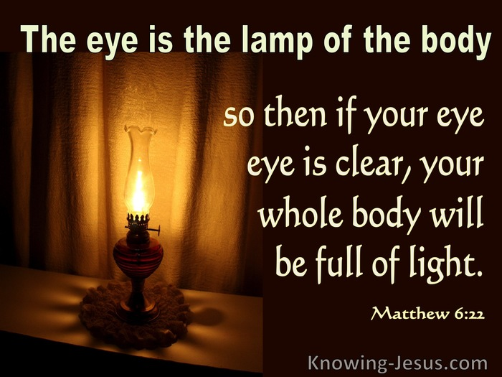
A Play on Words in Matthew 6:22-23
Besides the Hebrew idioms, there is also a play on words in Matthew 6:22-23. Jesus, speaking in Hebrew, used a good combination of a word play and Hebrew idioms. Considering all these features of the passage, we can paraphrase the two verses as follows: "The lamp of the body is the eye. If your physical eye is good, i.e. healthy, your whole body will be full of light. Likewise, if you are generous to the poor, your life will be full of light. But if your physical eye is bad, your whole body will be full of darkness. Likewise, if you are stingy with the poor, in other words, if the light that is in you is darkness, how great is that darkness!”

Slide 13
Números 6:24-26
²⁴ Jehová te bendiga, y te guarde; ²⁵ Jehová haga resplandecer su rostro sobre ti, y tenga de ti misericordia; ²⁶ Jehová alce sobre ti su rostro, y ponga en ti paz.
‎ יְבָרֶכְךָ יְהוָה וְיִשְׁמְרֶךָ׃ Números 6:24-26
יָאֵר יְהוָה פָּנָיו אֵלֶיךָ וִיחֻנֶּךָּ׃
‎יִשָּׂא יְהוָה פָּנָיו אֵלֶיךָ וְיָשֵׂם לְךָ שָׁלוֹם׃

