Slide 1
Tres Etapas de la Vida Humana (Lucas 16:19-31)
Three Stages of Human Life (Luke 16:19-31)
מְקוֹר מַיִם חַיִּים
ἡ πηγή ὕδατος ζωῆς
The Spring of Living Water
생명수 샘 生命水的泉源
La Fuente de Agua Viva
La Source d'Eau Vive
Die Quelle Lebendigen Wassers
Fonte de Água Viva
‎ يَنْبُوعَ الْمِيَاهِ الْحَيَّةِ،
~yYI©x; ~yIm:å ŸrAqåm. Wbøz>[' yti’ao yMi_[; hf'ä[' tA[ßr" ~yIT:ïv.-yKi( `~yIM")h; WlkiÞy"-al{ rv<ïa] ~yrIêB'v.nI ‘troaBo tArêaBo ‘~h,l' bcoÜx.l;
Jeremías 2:13 ^{R60} Porque dos males ha hecho mi pueblo: me dejaron a mí, fuente de agua viva, y cavaron para sí cisternas, cisternas rotas que no retienen agua.
Kyungrae (Ezra) Kim, Ph.D. (1995, Hebrew University of Jerusalem)

Slide 2
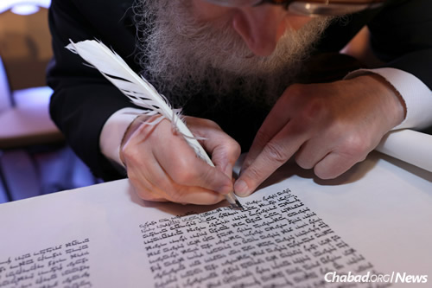
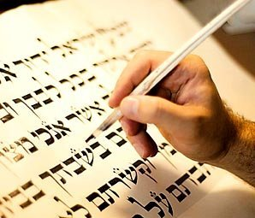
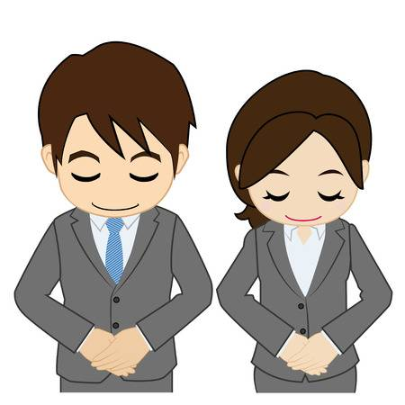
Shalom! My name is Ezra. I am a Korean Christian who is always grateful to the Jewish people who have faithfully transmitted the Bible for humanity. Thanks to them and the Book, I was able to know the Creator of the universe and meet His Son Jesus, the Savior of the world. That was the best thing that ever happened to me. And since then the Bible has become my favorite Book.

Slide 3
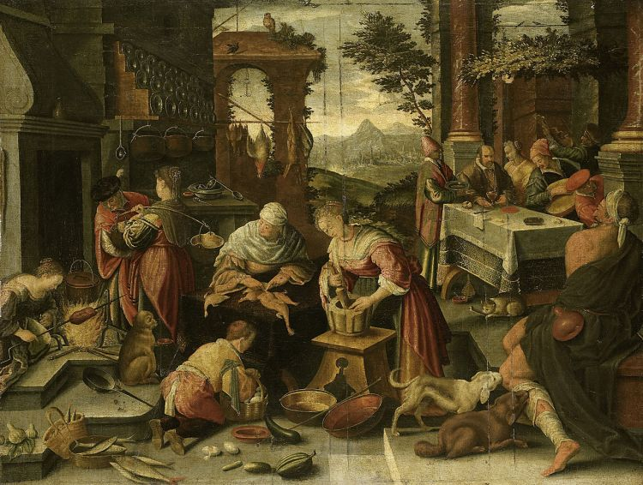
<The rich and the poor living together> (v. 19-21)
The story of ‘a rich man and Lazarus’ is written only in the Gospel of Luke. In this story, Jesus relates the life of two men, one is rich and lives in luxury, the other is poor and very ill. The rich man is presented like this: (verse 19) “There was a rich man who was dressed in purple and fine linen and lived in luxury every day”. Don’t forget that ‘purple and fine linen’ were very expensive in those days. It seems that this man was so rich that he never had to work.
Lucas 16:19 ^{R95} Había un hombre rico, que se vestía de púrpura y de lino fino y hacía cada día banquete con esplendidez.

Slide 4
The description on Lazarus is longer: (verses 20-21) “At his
gate was laid a poor man named Lazarus, covered with sores, and longing to eat what fell from the rich man's table. Even the dogs came and licked his sores”. The name ‘Lazarus’ (Λάζαρος) derives from the Hebrew ‘Elazar’ (אֶלְעָזָר), which signifies ‘God helps’. Contrary to the meaning of his name, Lazarus was miserable. The rich man who allowed this poor and sick Lazarus to be laid at his gate does not seem like a bad guy. Being rich is not a sin.
Lucas 16:20-21 ^{R95} Había también un mendigo llamado Lázaro, que estaba echado a la puerta de aquel, lleno de llagas, y ansiaba saciarse de las migajas que caían de la mesa del rico; y aun los perros venían y le lamían las llagas.

Slide 5
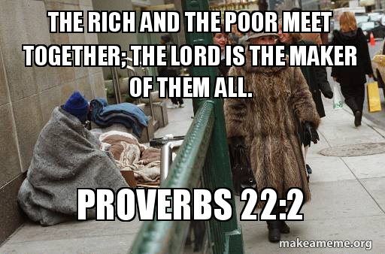
The rich and the poor live together on this earth, but no one lives forever. Both the rich and the poor die at last. In Verse 22, it says that the two men died. A man’s time span from birth to death is called ‘life’ (v. 25 lifetime). This ‘life’ has a beginning (birth) and an end (death). It lasts approximately 70 ~ 80 years, and today even longer. Life can be happy because of health, wealth, human relationships and prosperity. It can also be miserable because of poverty, disease, tragedy and other similar happenings. Many people want and strive to improve the quality of this life. It is worth doing the best to make life happy. The quality of life can change at any time, though.

Slide 6
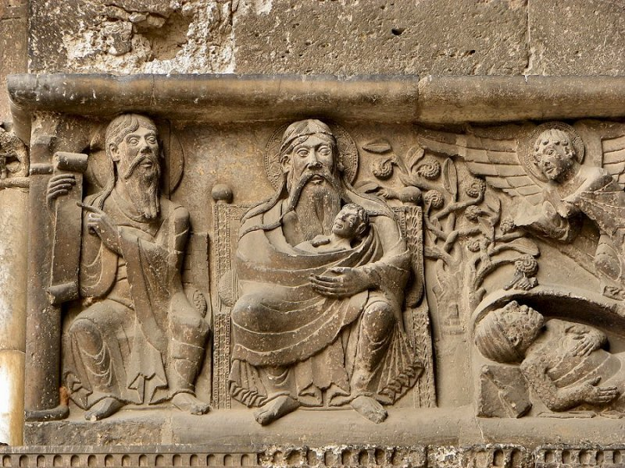
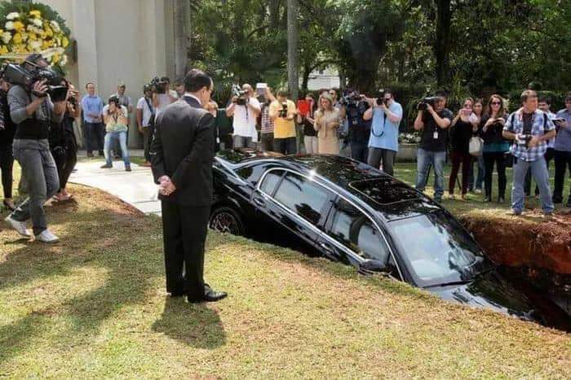
Lucas 16:22 ^{R95} Aconteció que murió el mendigo, y fue llevado por los ángeles al seno de Abraham; y murió también el rico, y fue sepultado.
<The story beyond death> (v. 22-26)
The story of ‘a rich man and Lazarus’ does not end at the time of death of both men. After their death, the story moves to another world that we barely know. This part of story is much longer than the life story we just talked about. (verse 22) “The time came when the poor man died and the angels carried him to Abraham's bosom. The rich man also died and was buried”. The moment Lazarus dies, the angels come to him and carry him to Abraham’s bosom. Abraham had lived about 2000 years before the time of Jesus, and had died a long time ago. What does ‘Abraham’s bosom’ mean? We who live on this earth find it difficult to answer such a question. Anyway, it must be a good place.

Slide 7
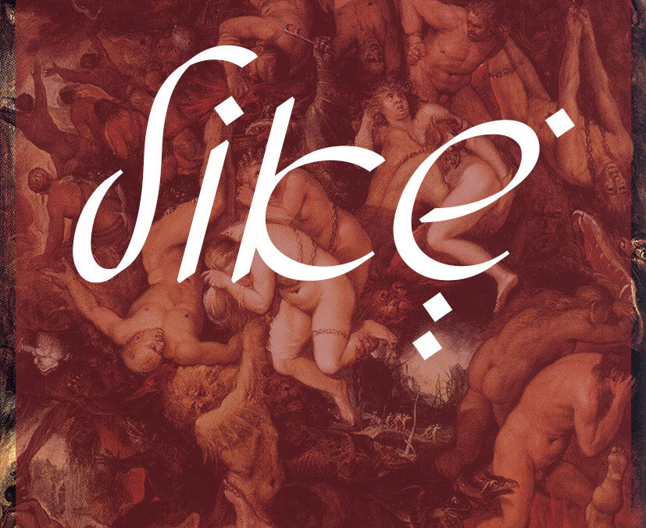
Lucas 16:23 ^{R95} En el Hades alzó sus ojos, estando en tormentos, y vio de lejos a Abraham, y a Lázaro en su seno.
After the rich man died we find him in Hades (verse 23). In the Bible, ‘Hades’ is a place where the dead go. From our point of view, anyone who is in Hades is dead. But Jesus says that ‘In Hades, he was being tormented.’ The rich man also ‘looked up and saw Abraham far away and Lazarus in his bosom.’ According to this description and the following ones, this so called ‘Hades’ is full of life instead of death. Believe it or not, this is really another kind of life.

Slide 8
Lucas 16:24 ^{R95} Entonces, gritando, dijo: "Padre Abraham, ten misericordia de mí y envía a Lázaro para que moje la punta de su dedo en agua y refresque mi lengua, porque estoy atormentado en esta llama".
The following dialogue between the rich man and Abraham (verses 24-31)
is the most interesting part of this story. (verse 24) “So he called to him,
'Father Abraham, have pity on me and send Lazarus to dip the tip of
his finger in water and cool my tongue, because I am in agony in this flame'”.
In fact, the rich man did not die. He is crying to Abraham who also did not die. The rich man is in extreme agony in the flame, unable to be turned into lifeless ash. He asks Abraham his ancestor, a favor. We still don’t know why the rich man suffers this agony after his death.

Slide 9
Lucas 16:25 ^{R95} Pero Abraham le dijo: "Hijo, acuérdate que recibiste tus bienes en tu vida, y Lázaro, males; pero ahora este es consolado aquí, y tú atormentado.
(verse 25) “But Abraham replied, 'Son, remember that in your lifetime you received your good things, while Lazarus received bad things, but now he is comforted here and you are in agony”. Abraham’s words are a little strange to us. If we enjoy our life on earth, are we going to be tormented after death? Or if we suffer during life on earth, are we going to be comforted after death? I don’t think this thought is correct. One thing I am sure of is that the rich man was interested only in earthly life. He did not care about his life after death. There are many people who live their lives like this rich man.

Slide 10
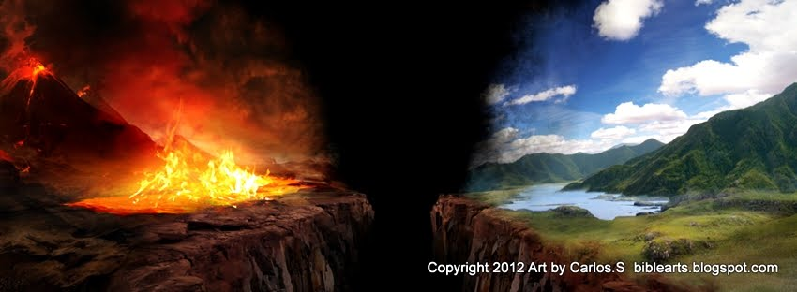
Abraham continues: (verse 26) “And besides all this, between us and you a great chasm (χάσμα) has been fixed, so that those who want to go from here to you cannot, nor can anyone cross over from there to us'”. On earth, the rich can become poor, and the poor rich. This happens to many people. But the change of state, happy and miserable, does not take place after death. Once they take you to a place, you will be there forever. It is impossible to cross from one place to another. There is a great chasm between the two places.
Lucas 16:26 ^{NVI} Además de eso, hay un gran abismo entre nosotros y ustedes, de modo que los que quieren pasar de aquí para allá no pueden, ni tampoco pueden los de allá para acá.

Slide 11
Lucas 16:27-28 ^{R95} Entonces le dijo: "Te ruego, pues, padre, que lo envíes a la casa de mi padre, porque tengo
cinco hermanos, para que les testifique a fin de que
no vengan ellos también a este lugar de tormento".
<The first problem of the rich man> (v. 27-29)
When his request was turned down, the rich man asks Abraham for another favor. (verses 27-28) “He answered, 'Then I beg you, father, send Lazarus to my father's house, for I have five brothers. Let him warn them, so that they will not also come to this place of torment'”. The rich man now pleads for his family. He is one of those typical men who take care of themselves and their families. He asks Abraham for something that is a good idea for him. If Lazarus, who died and known by his family, is sent back to earth and warns them about the place of torment after death, the rich man thinks, they would change their course of life and avoid going to this painful place. So far, we still do not know anything of what was wrong with this rich man during his earthly life.

Slide 12
Lucas 16:29 ^{R95} Abraham le dijo: "A Moisés y a los Profetas tienen; ¡que los oigan a ellos!".
At his request, Abraham gives him an unexpected answer: (verse 29) “Abraham replied, 'They have Moses and the Prophets; let them listen to them'”. The phrase ‘Moses and the Prophets’ refers to the Bible of that time, i.e., the Old Testament of today. God gave His Word to the world. We believe that the Bible is the Word of God, as mentioned in the Bible itself. In the Bible, both the Old and New Testaments, we can find enough information about the life beyond death. The Word of God warns us not to come to the place of torment for our unbelief. The world has the Bible. The opportunity to avoid being in the place of torment in the future only occurs in earthly life.

Slide 13
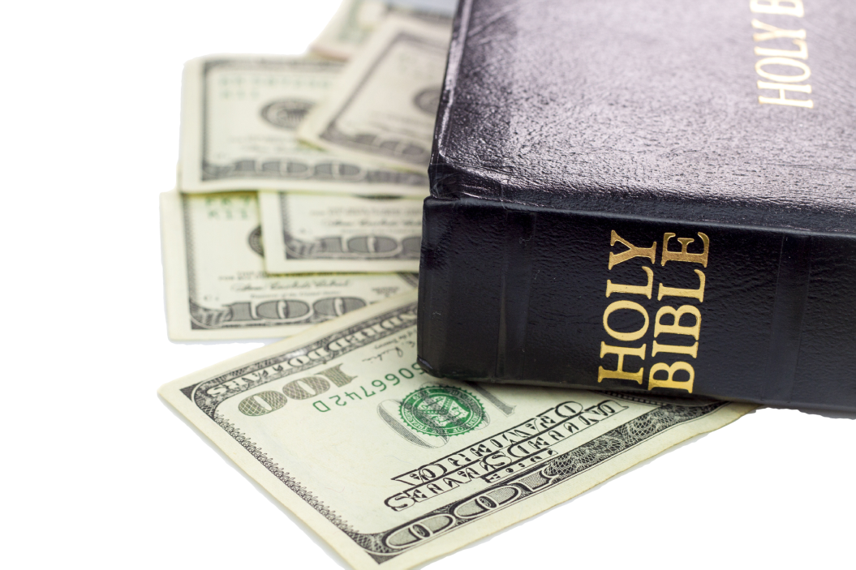
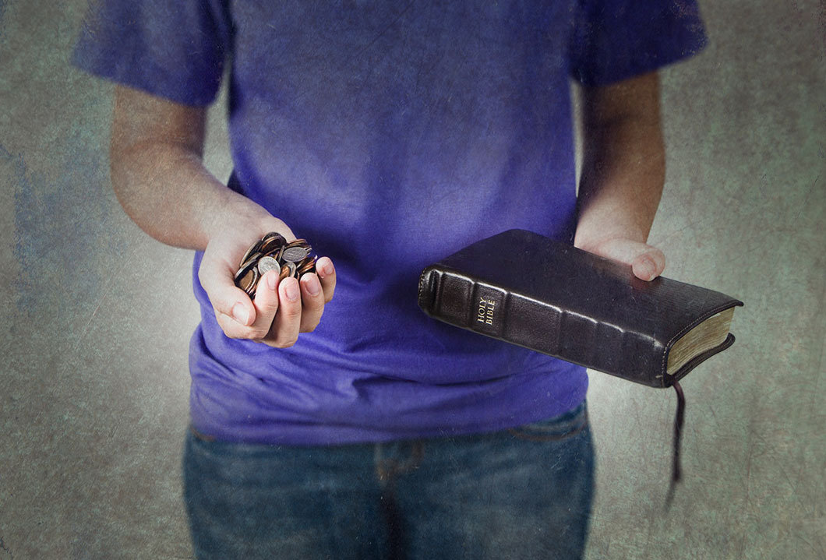
We can find the first problem of the rich man in this verse (29). He did not believe or obey the Word of God. He was interested in increasing his wealth and enjoying it instead of paying attention to the Bible. This was the worst mistake he ever made, and now it is too late to regret it. The Bible is not for people in the Hades, i.e., the place of the dead. It is for the people on this earth. God will be angry when you pay more attention to worldly wealth or others than to His Word.

Slide 14
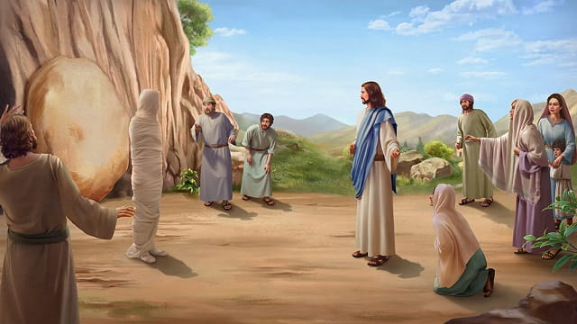
Lucas 16:30 ^{R95} Él entonces dijo: "No, padre Abraham; pero si alguno de los muertos va a ellos, se arrepentirán".
<The second problem of the rich man> (v. 30-31)
The rich man immediately refutes Abraham: (verse 30)'No, father
Abraham,' he said, 'but if someone from the dead goes to them, they
will repent'”. ‘Resurrection’ of the dead can be a powerful means of
witness for the living. In a sense he is correct. We can find the second problem of the rich man in this verse. Listen, what the rich man says: ‘they will repent.’ It is certain that the rich man did not repent while living on earth.

Slide 15
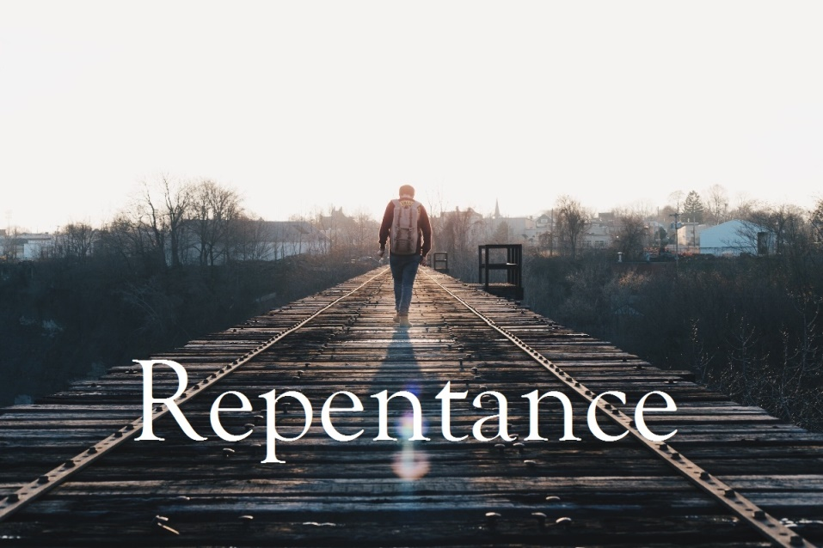
What is repentance? Why do we have to repent? When a man, who used to look for something else instead of God, turns his search, changes his direction and begins to relate to God, we call this ‘repentance.’ Those who do not repent before God are destined to be tormented forever after death. That’s why we must repent. Each of us must reestablish our life direction towards God the Creator. Without repentance, men will likely be servants of money or other worldly vanities rather than serving God.

Slide 16
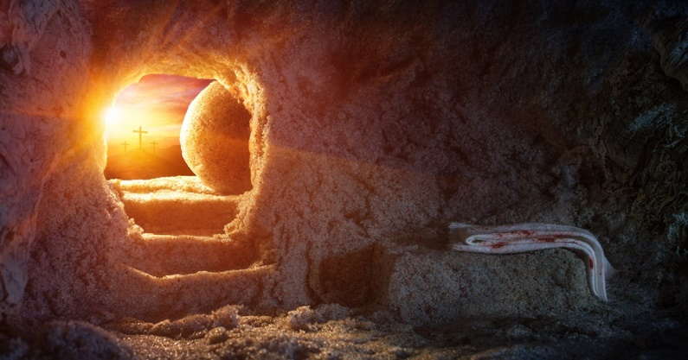
Lucas 16:31 ^{R95} Pero Abraham le dijo: "Si no oyen a Moisés y a los Profetas, tampoco se persuadirán aunque alguno se levante de los muertos"
Jesus closes this story with the final answer of Abraham. (verse 31) “He said to him, 'If they do not listen to Moses and the Prophets, they will not be convinced even if someone rises from the dead.'” Our God has raised His Only Son Jesus Christ from the dead as an important sign of salvation. Even this powerful means of proof cannot convince you if you do not listen to the Word of God. There was another man also called Lazarus who was actually raised from death by Jesus (John 11:1-46; 12:1, 9-11). Israel’s religious leaders have tried to kill Jesus and Lazarus because of this event.

Slide 17
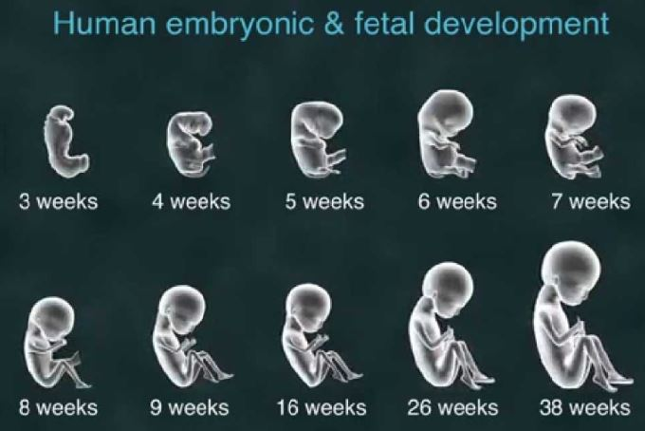
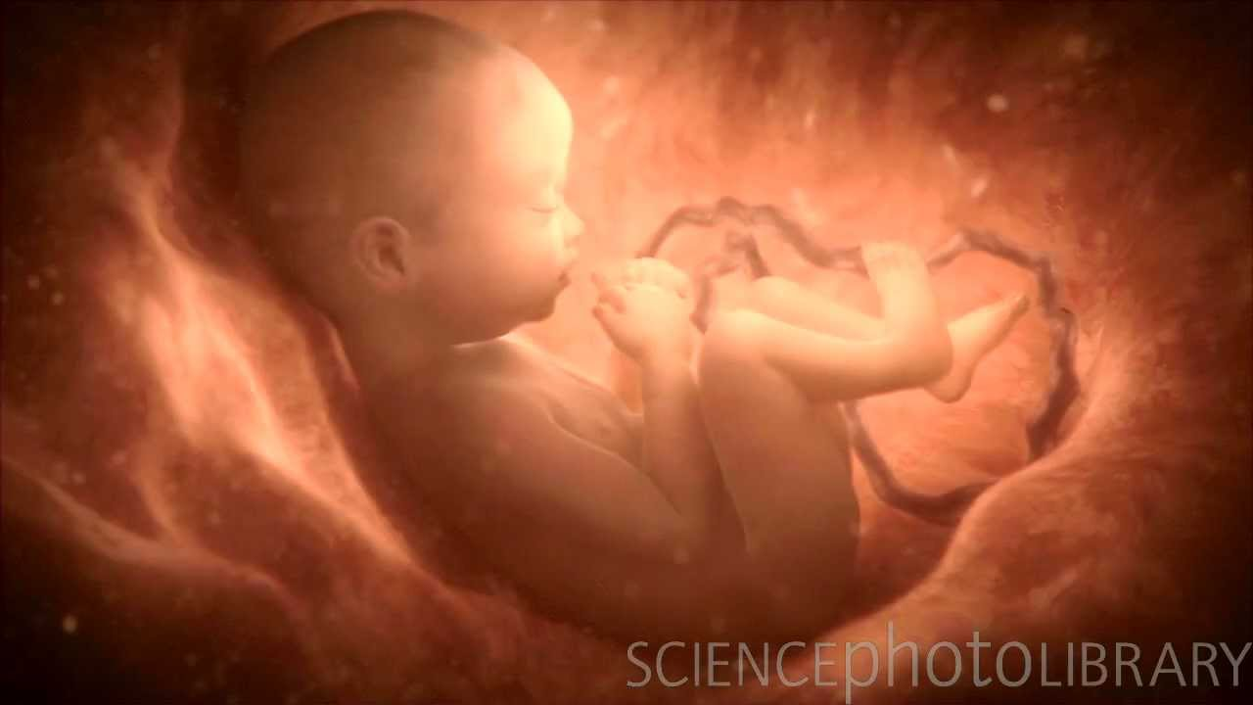
<Three Stages of Human Life>
Let’s summarize briefly. There is another life after our physical death. This ‘physical death’ is not actual death. In a sense, no one actually dies. After our death, life continues in a totally different form. That life lasts forever. Once your destiny is decided there, it can never be changed. If you want to enjoy a happy life there, you have to listen (= believe and obey) the Word of God and repent.
Is it hard to believe that there is another life after physical death? Think of life in the mother’s womb. A small fetus, conceived in the womb of a woman, is a life. Labor occurs approximately 38 weeks after conception, 40 weeks from a woman’s last normal menstrual period.

Slide 18
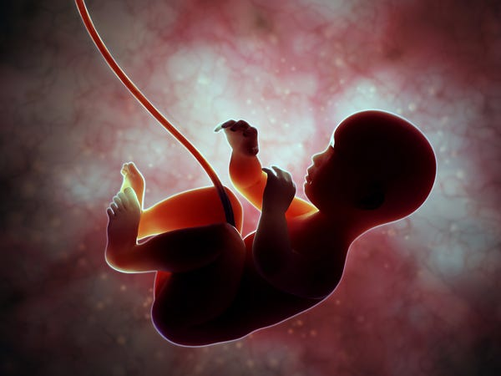
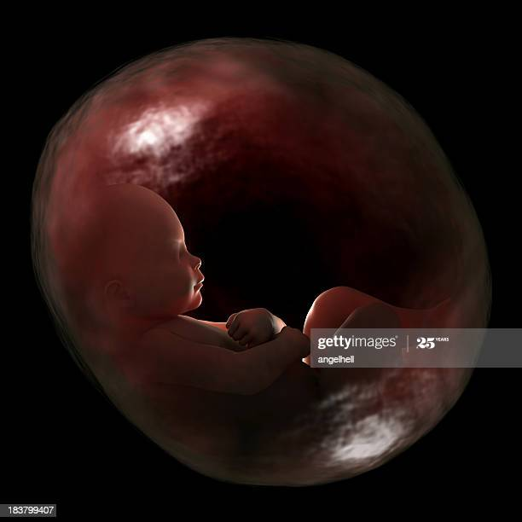
I can imagine a vivid living being in
a woman’s womb. The only world it
knows is full of water and darkness.
The world of a fetus is quite similar
to the primeval earth as described in
Genesis 1:2 (^{NKJ} The earth was without form, and
void; and darkness was on the face of the deep.
And the Spirit of God was hovering over the face of the waters.)
Génesis 1:2 ^{R95} La tierra estaba desordenada y vacía, las tinieblas estaban sobre la faz del abismo y el espíritu de Dios se movía sobre la faz de las aguas.

Slide 19
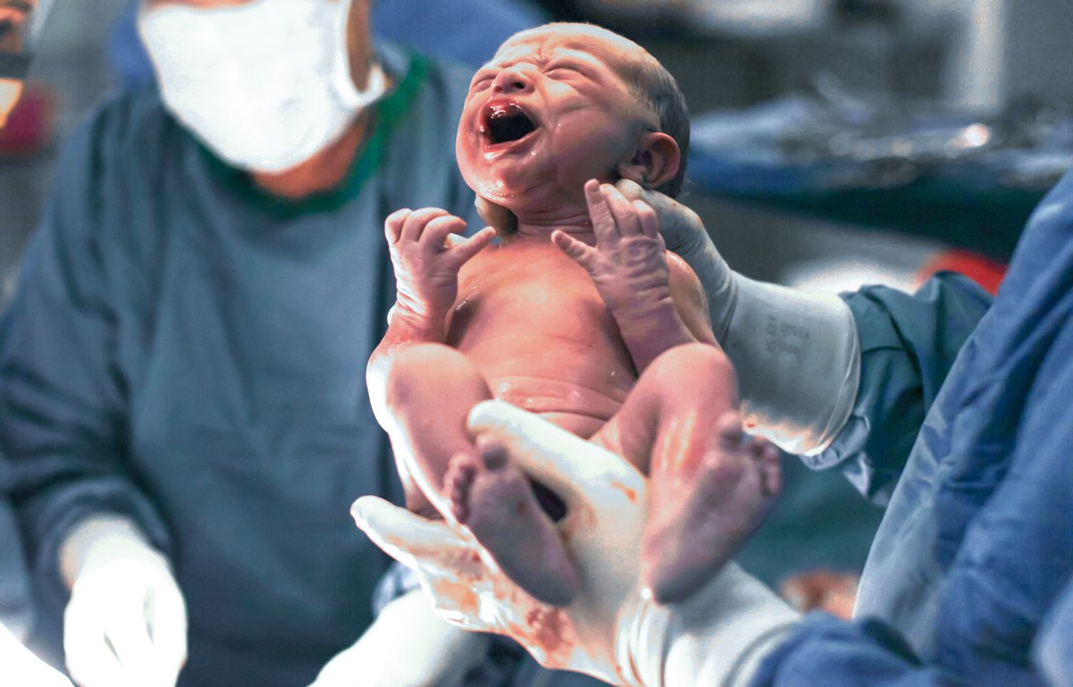
It knows nothing of what is happening outside,
despite the fact that many people are waiting
for it to be born, to come out to the new world. One day, suddenly the water around it is draining rapidly and a ray of light that it had never seen before seeps into its world and a powerful energy pulls it out. It is afraid of this sudden change, for the fetus it is like ‘the end of the world’. It cannot resist it, though. At the precise moment when it leaves that comfortable world, in which it has been living till then, it utters a loud cry, probably thinking that it is going to die now. In fact, as we all know, it is born into a new stage of life – ‘a baby, a human being.’

Slide 20
Regardless of this incorrect knowledge of the fetus, there is
a new stage of human life in the beautiful world of light, which lasts
much longer than the first stage of life. We who live on earth know
that it is true. When a man dies, others mourn him, because they
think that the person died or reached the end of his life. But did the person really die or move to another world? Who knows, we misinterpret our physical death as a baby does at birth. If we believe in the testimonies of the Bible and in the teachings of Jesus Christ, we will know that our physical death does not mean the end of our life, but the starting point of a new stage of eternal life. Now, if you believe in the Word of God, you will realize that there are three stages of human life.
the 1st Life (Fetus): in the mother’s womb / 9~10 months (cf. Psalm 139:13-16)
the 2nd Life: on earth / 70~80 years or 120 years (cf. Psalm 90:10; Genesis 6:3)
the 3rd Life: in heaven / eternal (cf. John 3:16; 5:29; Revelation 21:1-5)

Slide 21
The condition of the first stage of life is essential to the
quality of the second stage of life. Likewise, the eternal quality of
the third stage of life will be decided by what you believe and do
during the second stage of life. Our Lord Jesus Christ himself
experienced the first and second stages of life and continues to live the third. He was born of a woman, lived as a human, and died as a human. But he was raised from the dead by his Father. Now he is living an eternal and fully divine life. His course of life will be followed by many. What should we do then?
1) Do not give in to the desire for worldly wealth, but pay attention to the Word of God (Listen and Obey it).
2) Turn the direction of your life towards God and follow Him (Repentance).
3) Install Jesus Christ, who is the power and wisdom of God, in your life through the Holy Spirit, and then let Jesus Christ live in your body (Galatians 2:20; cf. 1 Corinthians 1:9, 18-31).

Slide 22
Números 6:24-26
²⁴ Jehová te bendiga, y te guarde; ²⁵ Jehová haga resplandecer su rostro sobre ti, y tenga de ti misericordia; ²⁶ Jehová alce sobre ti su rostro, y ponga en ti paz.
‎ יְבָרֶכְךָ יְהוָה וְיִשְׁמְרֶךָ׃ Números 6:24-26
יָאֵר יְהוָה פָּנָיו אֵלֶיךָ וִיחֻנֶּךָּ׃
‎יִשָּׂא יְהוָה פָּנָיו אֵלֶיךָ וְיָשֵׂם לְךָ שָׁלוֹם׃

