Slide 1
Riqueza, Fama
y Prosperidad
Wealth, Fame & Prosperity
מְקוֹר מַיִם חַיִּים
ἡ πηγή ὕδατος ζωῆς
The Spring of Living Water
생명수 샘 生命水的泉源
La Fuente de Agua Viva
La Source d'Eau Vive
Die Quelle Lebendigen Wassers
Fonte de Água Viva
‎ يَنْبُوعَ الْمِيَاهِ الْحَيَّةِ،
~yYI©x; ~yIm:å ŸrAqåm. Wbøz>[' yti’ao yMi_[; hf'ä[' tA[ßr" ~yIT:ïv.-yKi( `~yIM")h; WlkiÞy"-al{ rv<ïa] ~yrIêB'v.nI ‘troaBo tArêaBo ‘~h,l' bcoÜx.l;
Jeremías 2:13 ^{R60} Porque dos males ha hecho mi pueblo: me dejaron a mí, fuente de agua viva, y cavaron para sí cisternas, cisternas rotas que no retienen agua.
Kyungrae (Ezra) Kim, Ph.D. (1995, Hebrew University of Jerusalem)

Slide 2
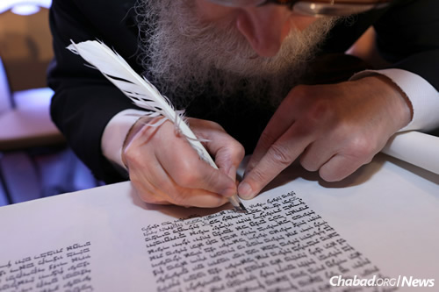
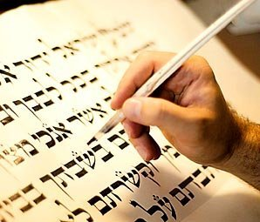
Shalom! My name is Ezra. I am a Korean Christian who is always grateful to the Jewish people who have faithfully transmitted the Bible for humanity. Thanks to them and the Book, I was able to know the Creator of the universe and meet His Son Jesus, the Savior of the world. That was the best thing that ever happened to me. And since then the Bible has become my favorite Book.

Slide 3
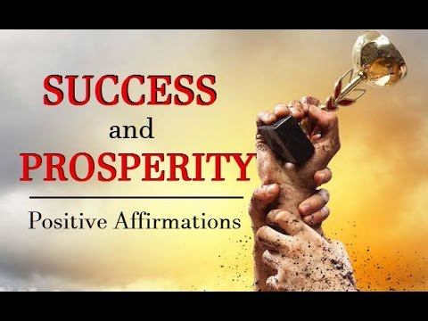
<Wealth, Fame & Prosperity: Everyone’s Interest>
Religious or not, most people like to achieve wealth, fame, and prosperity in their lives and beyond. Religious people try to obtain them by the help of their God. It may be one of the most common phenomena of all the world’s religions. Their prayers are like this: “Give me money. Give me a job. Give me health. Give me wife. Give me husband. Give me children. Give me a house. Make me prosper on my path or career, etc.”

Slide 4
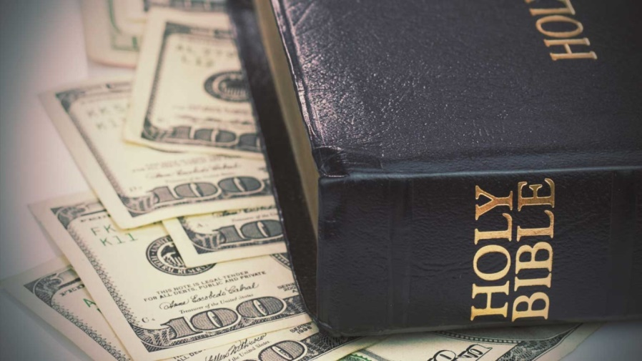
<Meaning of Wealth, Fame, & Prosperity>
People have a certain idea regarding the concept of wealth, fame and prosperity in their mind. They may say that wealth is having a lot, fame is being known to many people, and prosperity is having and enjoying what they want. For many people, one of the most common purposes in life is to get them in their hands. We, as Christians, can and have to seek wealth, fame and prosperity, as long as we know their true meaning. According to my understanding of the teachings of the Bible, wealth is self-satisfaction without feeling lack, fame is being known to God, and prosperity is seeing God’s will accomplished in my life.

Slide 5
<Wealth: Self-satisfaction without Feeling Lack>
There are many people who always complain of lack of money
despite sufficient income. It seems that many people think they are
not rich even though they possess a lot. The real wealth is not having
a lot but a state of self-satisfaction without feeling lack. Let me illustrate it through Psalm 23:1 ^{NIV} A psalm of David. The LORD is my shepherd, I shall not be in want. / Salmo 23:1 ^{LBA} Salmo de David. El SEÑOR es mi pastor, nada me faltará.
In ancient times, the shepherds of Israel did not keep and graze the sheep in a certain fenced area. Generally, water and grass were not sufficient for the flock in the land of the Bible. So the sheep needed shepherds. Even today, many Bedouins (nomads) maintain the same lifestyle that dates back several thousand years.

Slide 6
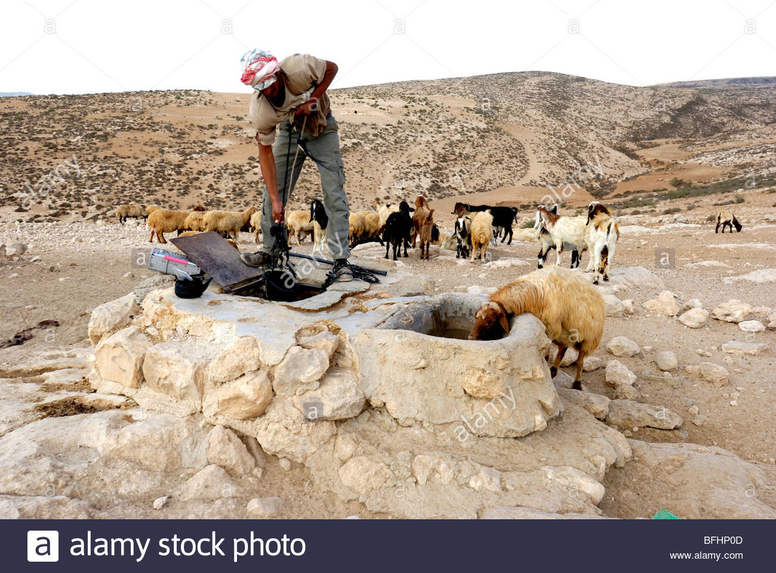
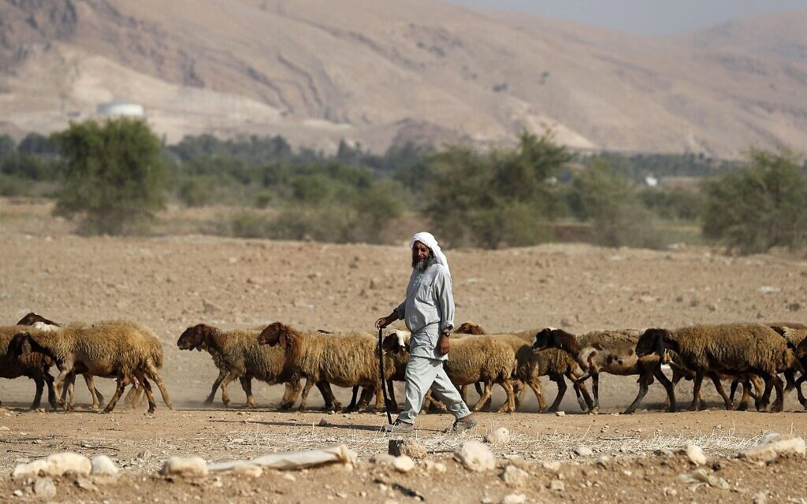
Sheep in general cannot manage an independent life. They cannot take care of themselves. They are dependent animal. They need a shepherd. When God becomes our shepherd, it is His responsibility to feed and raise us. As long as we depend on Him, God will do the best job. We need all kinds of nourishment – physical, emotional, and spiritual. God is the only One who can provide all of this and satisfy our real need. When we have the Lord as our Shepherd, we shall not be in want for anything and thus become rich.

Slide 7
With this in mind, we can understand what Jesus said in Matthew 5:3.
^{NIV} “Blessed are the poor in spirit (οἱ πτωχοὶ τῷ πνεύματι), for theirs is the
kingdom of heaven.” / Mateo 5:3 ^{LBA} “Bienaventurados los pobres en espíritu,
pues de ellos es el reino de los cielos”. When we feel lack, we are poor. When
we realize that we are poor in spirit, we are blessed, because we will seek to be
rich in spirit. God is the only One who can make our spirit rich. When we live under the guidance of this good Shepherd, we can live a rich life. Jesus said: John 10:10 ^{NIV} “The thief comes only to steal and kill and destroy; I have come that they may have life, and have it to the full.” / Juan 10:10 ^{LBA} “El ladrón sólo viene para robar y matar y destruir; yo he venido para que tengan vida, y para que la tengan en abundancia”.
To be truly rich, we also have to learn self-satisfaction. Philippians 4:12-13 ^{NIV} “I know what it is to be in need, and I know what it is to have plenty. I have learned the secret of being content in any and every situation, whether well fed or hungry, whether living in plenty or in want. I can do everything through him who gives me strength.” / Filipenses 4:12-13 ^{LBA} “Sé vivir en pobreza, y sé vivir en prosperidad; en todo y por todo he aprendido el secreto tanto de estar saciado como de tener hambre, de tener abundancia como de sufrir necesidad. Todo lo puedo en Cristo que me fortalece”. Paul the Apostle was really a rich man in the Lord Jesus Christ.

Slide 8
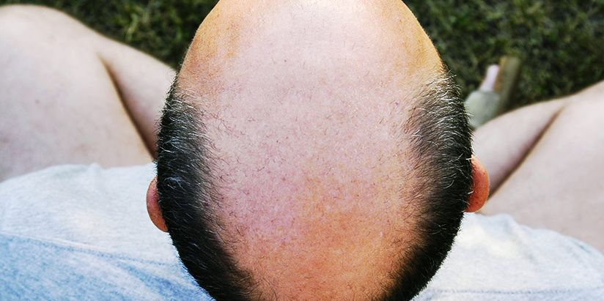
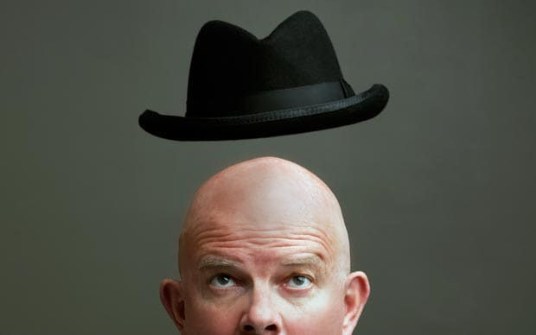
Let me give my own example for another illustration. As you can see, I am bald. However, I never feel I am poor when I speak of my hair. Because I never feel like my hairs are lacking. I am fine with my bald hair. Commercials for treating baldness never catch my eye. There are actually many benefits to being bald. First of all, I do not need Shampoo or hair dryer. I just need some hats to warm my head in winter, and to avoid strong sun in summer. I am satisfied with my current hair situation.

Slide 9
<Fame: Being Known to God>
Generally speaking, not only celebrities but also most people are
very sensitive to their reputation among others. People usually want
to be known, accepted and respected by others. The Word of God
teaches us that real fame is being known by Jesus and the greatest
tragedy is being denied by him. Listen to Jesus’ warning of dangerous fame: Luke 6:26 ^{NIV} Woe to you when everyone speaks well of you, for that is how their ancestors treated the false prophets.
Watch out! There will be many of the so-called prophets who claim that they know Jesus very well but are not known to him and will be finally and permanently denied by him. See Matthew 7:21-23 ^{ESV} Not everyone who says to me, 'Lord, Lord,' will enter the kingdom of heaven, but the one who does the will of my Father who is in heaven. On that day many will say to me, 'Lord, Lord, did we not prophesy in your name, and cast out demons in your name, and do many mighty works in your name?' And then will I declare to them, 'I never knew you; depart from me, you workers of lawlessness.'

Slide 10
When you become a disciple of Jesus and follow him, you must be
prepared for hatred and rejection of people. Jesus says: Luke 6:22 ^{NIV}
Blessed are you when people hate you, when they exclude you and
insult you and reject your name as evil, because of the Son of Man.
Jesus explains why: John 15:19 ^{NIV} If you belonged to the world, it would love you as its own. As it is, you do not belong to the world, but I have chosen you out of the world. That is why the world hates you.
We should seek true fame. True fame is that my name is written in heaven in the book of life. Luke 10:20 ^{ESV} Nevertheless, do not rejoice in this, that the spirits are subject to you, but rejoice that your names are written in heaven." What a blessing that my name is confessed by Jesus before his Father and His angels! - Revelation 3:5 ^{ESV} The one who conquers will be clothed thus in white garments, and I will never blot his name out of the book of life. I will confess his name before my Father and before his angels. Without true fame, you will end in great calamity: Revelation 20:15 ^{ESV} And if anyone's name was not found written in the book of life, he was thrown into the lake of fire.

Slide 11
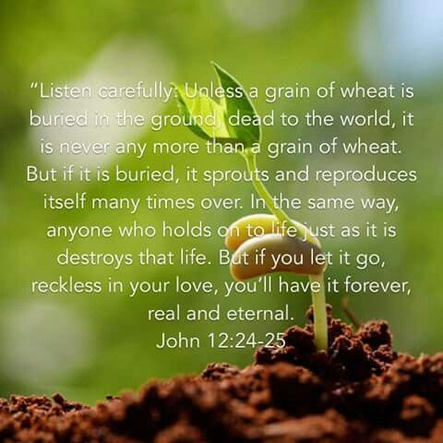
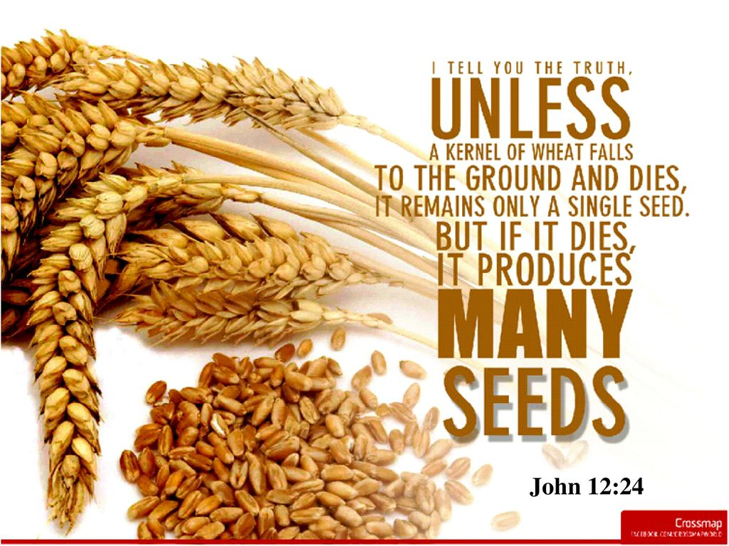
<Prosperity: the Will of God Being Accomplished in My Life>
People will say that “prosperity is getting and enjoying what you want”. But the Word of God teaches us that real prosperity is seeing the will of God being accomplished in my life. Jesus explained this simple truth through a seed planted in the ground. John 12:24 ^{ESV} Truly, truly, I say to you, unless a grain of wheat falls into the earth and dies, it remains alone; but if it dies, it bears much fruit. Suppose a seed fallen to the ground strives not to die and maintain its vitality. Then it will remain alone forever. If it dies, however, it will produce many seeds. For the grain, dying is true prosperity.

Slide 12
The same truth is mentioned in Isaiah’s Messianic prophecy,
too. Isaiah 53:10 Yet it was the LORD's will to crush him and cause
him to suffer, and though the LORD makes his life a guilt offering,
he will see his offspring and prolong his days, and the will of the
LORD will prosper in his hand. Jesus came into this world as a human being by the will of God his Father. He suffered the death of the crucifixion for our sins. That was again according to the will of God. By his obedience, the will of God for the salvation of sinners has been fulfilled. This is true prosperity.
The most important thing we have to deal with while living in this world is for our sins to be completely forgiven. This is possible only by repenting of our sins and believing in Jesus and accepting him as Lord and King. When the problem of sin is solved, the will of God will prosper in our lives. The true prosperity of human beings begins with the forgiveness of their sins.

Slide 13
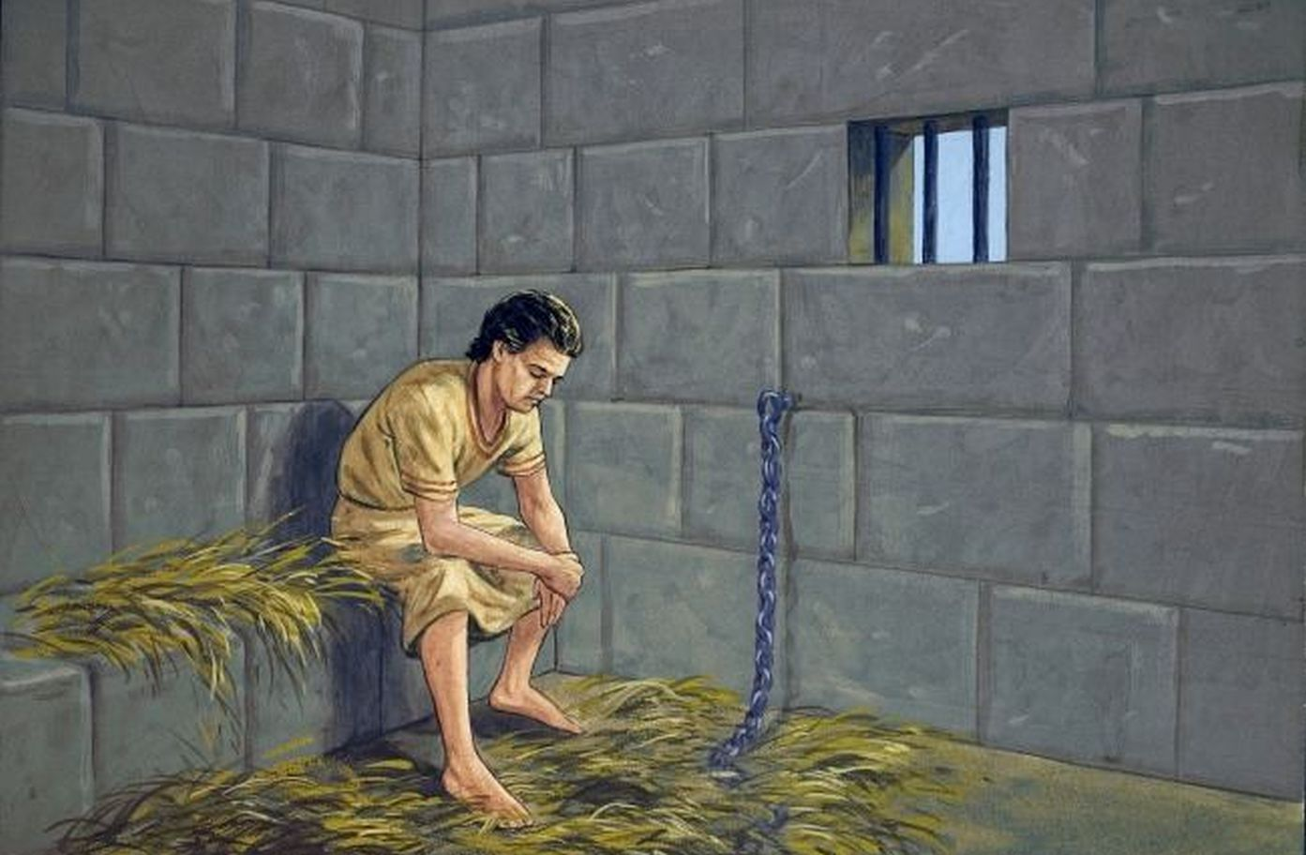
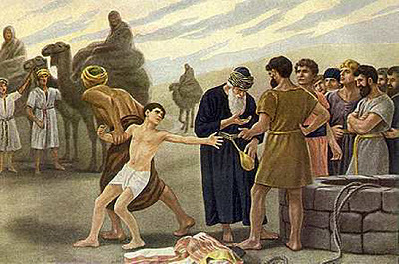
<Genesis Chapter 39: Joseph’s 13 Year Suffering>
Joseph lived 110 years. He was the favorite son of his father Jacob and the beloved child by his mother Rachel. He was happy for the first 17 years, from birth till age 17 at his father’s house. He was extremely prosperous for the final 80 long years from age 30 to his deathbed at age 110 in Egypt. However, between age 17 and 30, Joseph’s life was full of agony and suffering. Genesis chapter 39 describes this 13-year period of suffering.

Slide 14
Surprisingly, the Scriptures say that Joseph prospered
during these years. The same Hebrew word ‘tsalach’ (צלח
prosper) that occurs in Isaiah 53:10 also occurs in Genesis
chapter 39, not once but three times: (Genesis 39:2) “The
LORD was with Joseph and he prospered”; (Genesis 39:3) “the LORD was with him and that the LORD gave him success in everything he did”; (Genesis 39:23) “because the LORD was with Joseph and gave him success in whatever he did”. God’s will was Joseph’s suffering for 13 years. Because of that suffering, Joseph became the most powerful man after Pharaoh in Egypt and was able to save Egypt and his own family from the severe 7-year famine. Likewise, the will of God was to save sinners through the suffering of His only Son Jesus Christ.

Slide 15
<Closing Words>
Are you looking for eternal life? Jesus himself gives the definition of ‘eternal life’: John 17:3 ^{NIV} “Now this is eternal life: that they know you, the only true God, and Jesus Christ, whom you have sent.” Do you know God the Creator? Do you know Jesus Christ His Son? Jesus Christ came to earth to give us eternal life, in other words, to make us children of God. This is the Good News that we preach. We must enthusiastically seek the knowledge of God and the truth that will guide us into the eternal life and true freedom. Let us invite Jesus into our lives and let him play the leading role in our lives. So we can enjoy true wealth, fame and prosperity. That is the true religion with power.

Slide 16
Números 6:24-26
²⁴ Jehová te bendiga, y te guarde; ²⁵ Jehová haga resplandecer su rostro sobre ti, y tenga de ti misericordia; ²⁶ Jehová alce sobre ti su rostro, y ponga en ti paz.
‎ יְבָרֶכְךָ יְהוָה וְיִשְׁמְרֶךָ׃ Números 6:24-26
יָאֵר יְהוָה פָּנָיו אֵלֶיךָ וִיחֻנֶּךָּ׃
‎יִשָּׂא יְהוָה פָּנָיו אֵלֶיךָ וְיָשֵׂם לְךָ שָׁלוֹם׃

