Slide 1

Horse Terms
Whispering Oak Stables

Slide 2
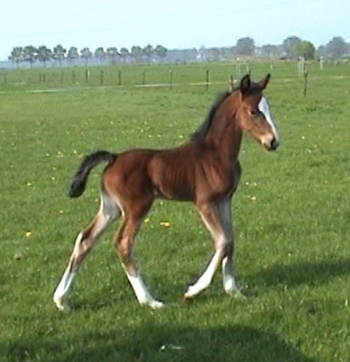
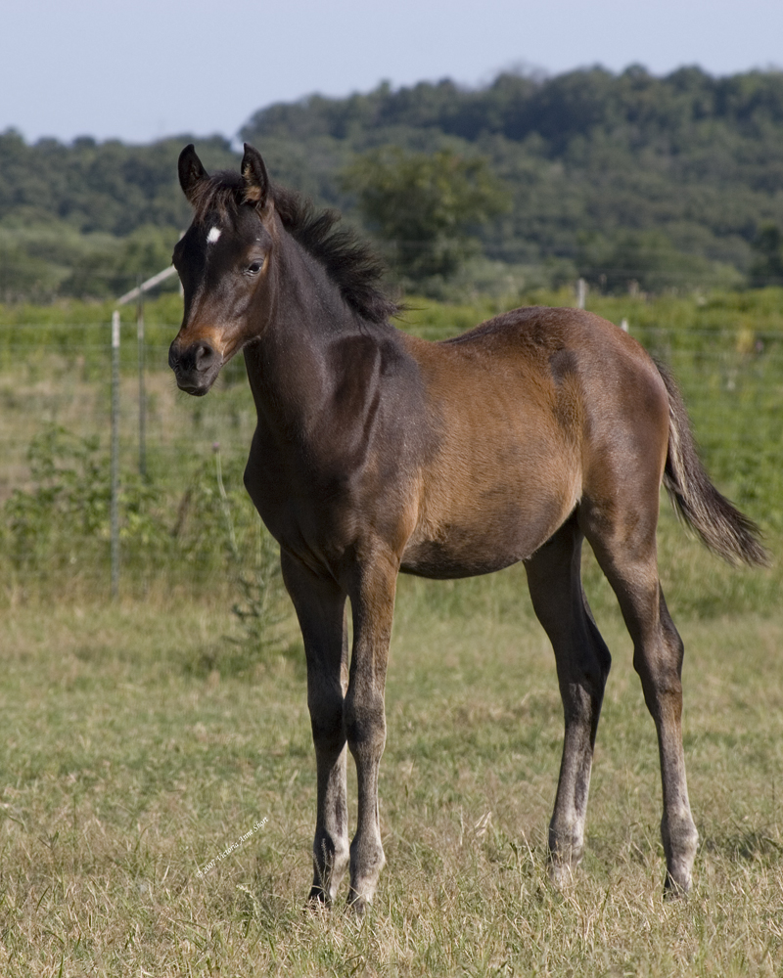
Horse Terms
A horse/Pony who is a year old is called a yearling.
A Baby Horse is called a Foal.

Slide 3
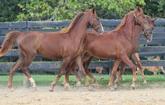
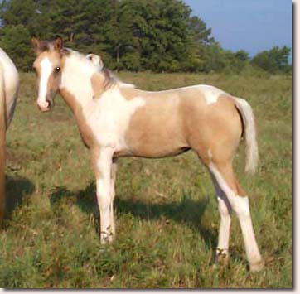
Horse Terms
A young male horse under 4 years old is called a colt.
A young female horse under four years old is called a filly.

Slide 4
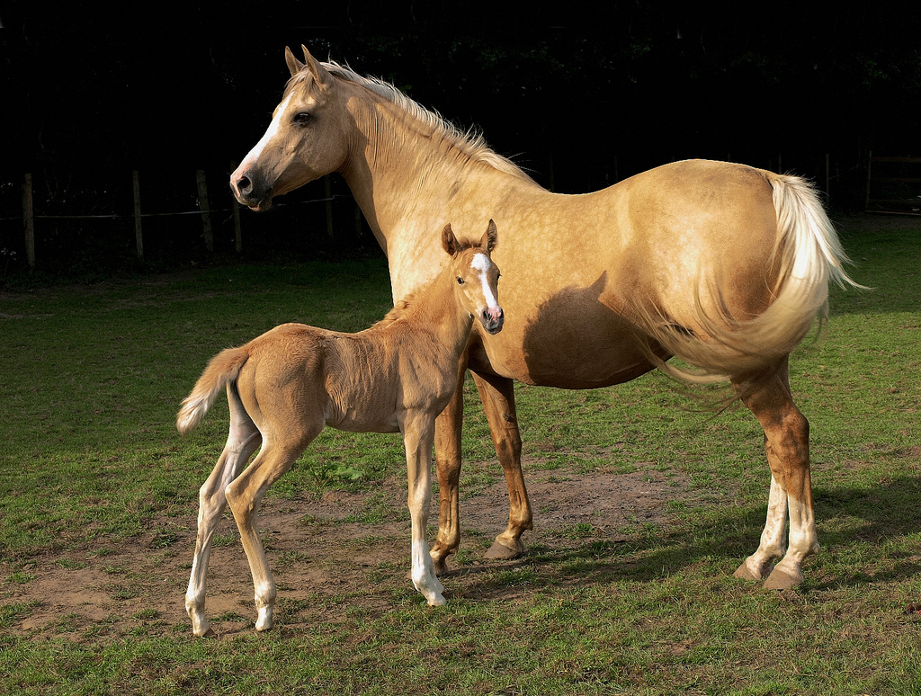
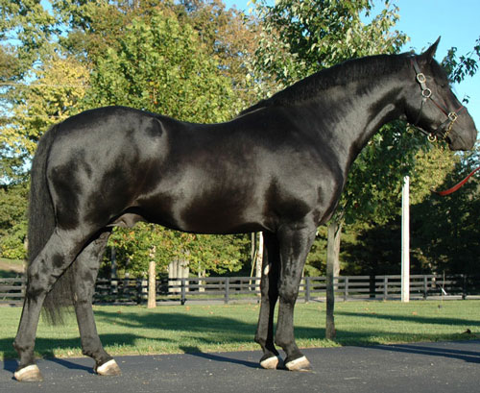
Horse Terms
The Mother of a horse/pony is called a Dam.
The Father of a horse/pony is called a Sire.

Slide 5
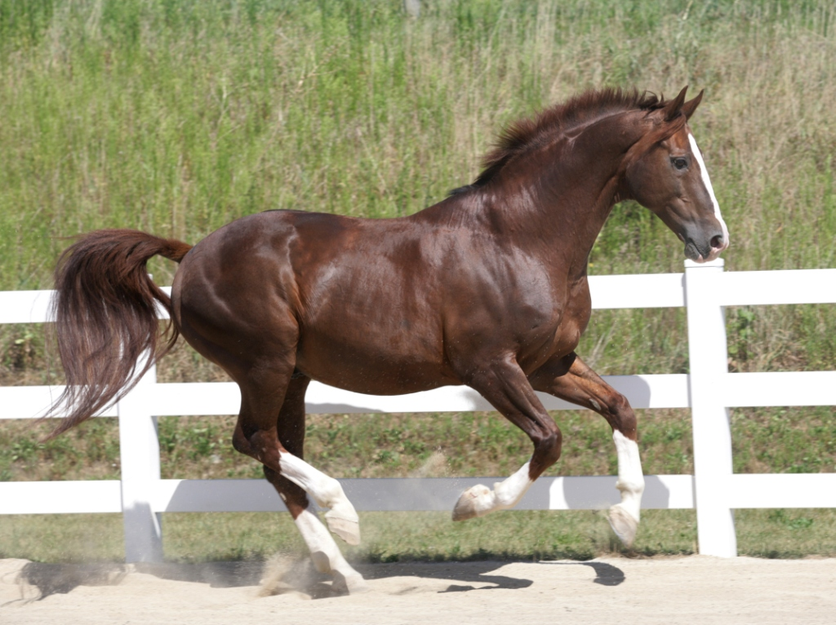
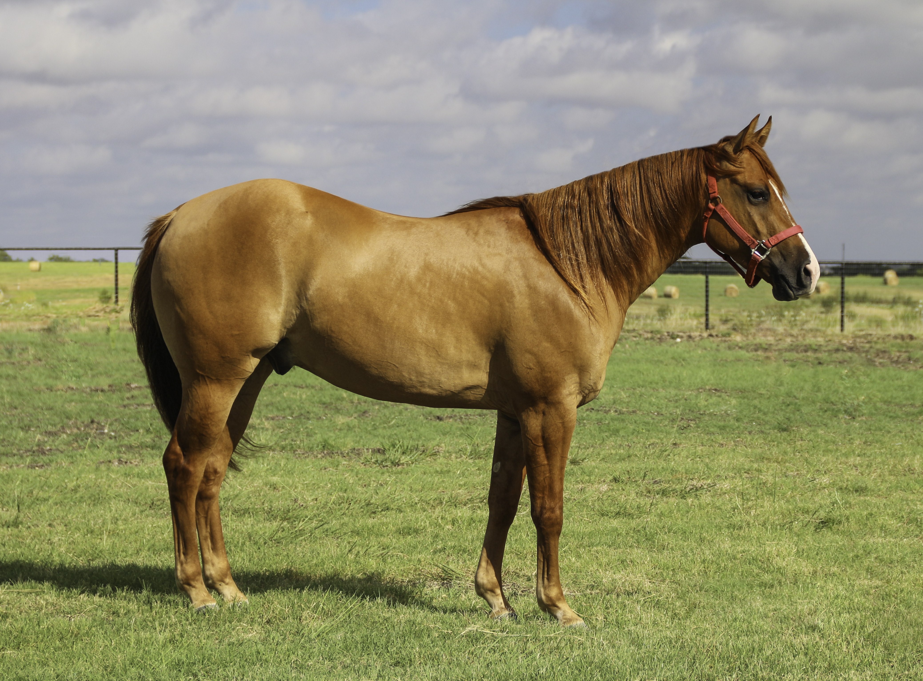
Horse Terms
A male horse four years and older who can be used for breeding is called a stallion.
A male horse of any age who has been neutered is called a gelding.
This Photo by Unknown Author is licensed under CC BY-SA
This Photo by Unknown Author is licensed under CC BY-SA

Slide 6
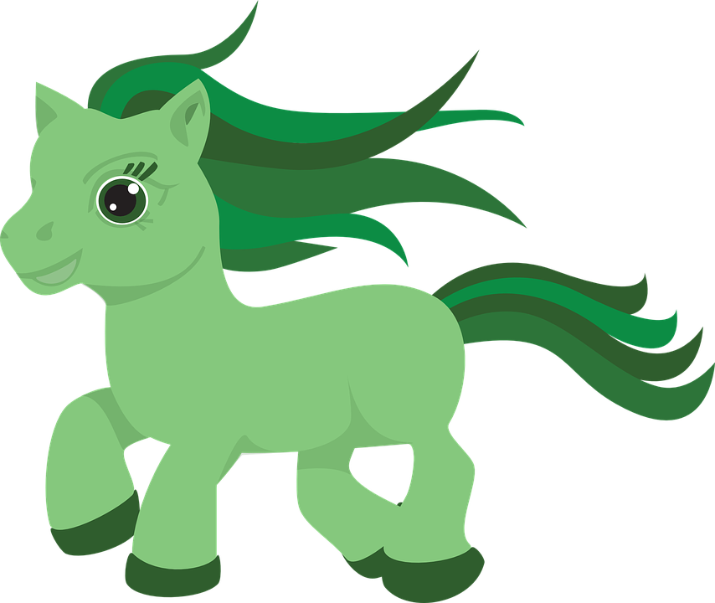
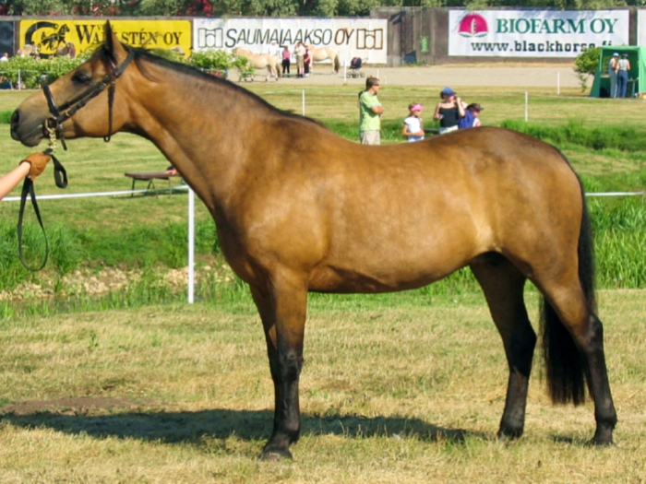
Horse Terms
A horse/pony who doesn’t have a lot of experience being ridden is called a green broke horse.
A Female horse/pony who is four years or older is called a mare.

Slide 7
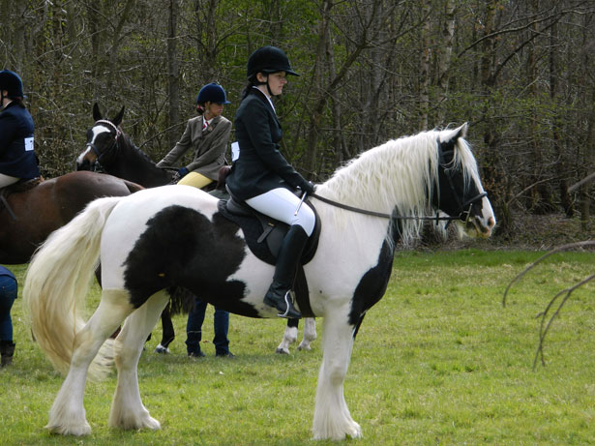
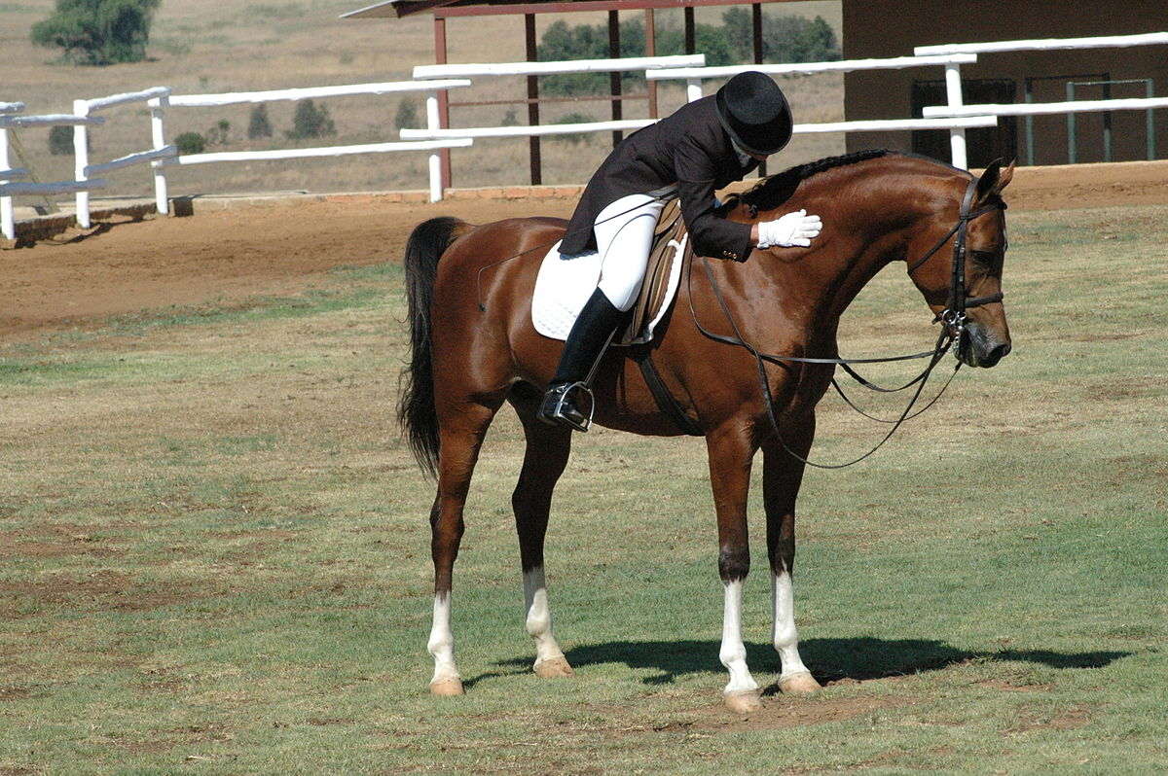
Horse Terms
A horse that has a lot of experience being ridden is called a broke horse. They are great for beginning riders.
The left side of the horse is called the near side, it is the side we mount the horse from. The offside is the right side of the horse.
This Photo by Unknown Author is licensed under CC BY-SA

Slide 8
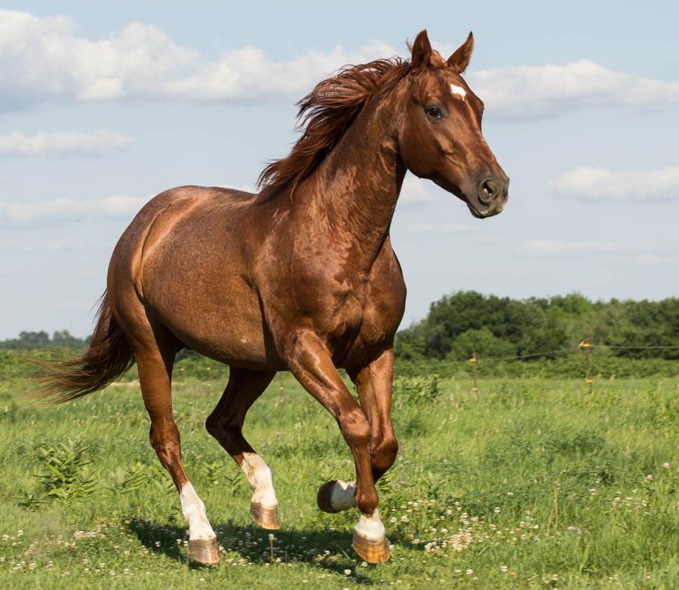
Horse Terms
Have Fun Riding Your horse.

Slide 9

Horse Terms

