Slide 1
THE
OWNER/EMPLOYEE RELATIONSHIP
Peter Wolf
Wolfpack Business Coaching
© 2019 Peter Wolf
Notes:
THANK YOU JACK
MY SESSION THIS MORNING IS ABOUT EMPLOYEES AND OWNERS AND THE RELATIONSHIP. OWNING A SMALL BUSINESS PUTS US IN CONSTANT INTERACTION WITH EVERYONE WHO WORKS FOR US. WE ARE UP THERE IN THE FRONT LINES EVERY DAY.
I KNOW THE PITFALLS AND THE SUCCESSES OF RUNNING A SIGN SHOP. OVER THE YEARS MY WIFE AND I GREW OUR SIGN SHOP TO OVER $3 MILLION IN SALES AND 30 EMPLOYEES. WE LEARNED THAT YOU CAN’T DO THAT WITHOUT A STRONG TEAM.
IN THE COURSE OF OUR 20+ YEARS WE CYCLED THROUGH CLOSE TO 100 EMPLOYEES.
WE HAD A FEW EMPLOYEES STAY WELL OVER 15 YEARS AND SOME THAT LASTED LESS THAN 15 DAYS. HIRING HAS ALWAYS BEEN AN IMPERFECT ACTIVITY.
WE TRIED HARD TO BUILD AN UNDERSTANDING OF HOW OUR EMPLOYEES THOUGHT AND WHAT MOTIVATED THEM AND DEMOTIVATED THEM.
WE LEARNED HOW TO BUILD A MORE SOLID TEAM.

Slide 2

Notes:
WE’RE SMALL BUSINESS OWNERS. WE WEAR LOTS OF DIFFERENT HATS. ONE OF THE HATS WE WEAR IS THE HR DEPARTMENT. WE ARE THE ONES MAKING THE “PEOPLE” DECISIONS.
WE ARE THE ONES WHO CREATE AND MOLD OUR EMPLOYEES INTO OUR TEAM.
WE ARE THE ONES WHO SHOULD BE SETTING THE CULTURE OF OUR BUSINESS. WHAT WE DO, WHAT WE ALLOW SETS THE TONE.

Slide 3

Notes:
ULTIMATELY OUR BUSINESS WILL SUCCEED AND THRIVE ONLY WHEN OUR TEAM SUCCEEDS AND THRIVES
HOW WE SEE EACH OTHER AND HOW WE WORK TOGETHER IS AN INTERESTING DYNAMIC.
THESE ARE SOME OF THE CHALLENGES WE FACE AS THE HR MANAGER/OWNER.
THAT’S WHAT WE’RE GOING TO TALK ABOUT THIS MORNING.
I HAVE OBSERVED THAT THERE ARE ALL TYPES OF PERSONALITIES AND TRAITS ON BOTH THE EMPLOYEE AND OWNER SIDE.
WE HAVE TO FIND THAT MIX WHICH MAKES OUR TEAM GREAT
LET’S GO ON A LITTLE JOURNEY AND TAKE A LOOK AT SOME OF THE DIFFERENT PERSONALITY TRAITS THAT IMPACT OUR TEAM.

Slide 4

Notes:
YOU HOPE YOU ONLY MAKE GOOD HIRES AND YOU HOPE THEY STAY.
BUT LET’S FACE IT. THERE ARE GOOD EMPLOYEES AND BAD EMPLOYEES. MOST ALL OF US WILL EXPERIENCE BOTH TYPES IN THE COURSE OF OWNING OUR BUSINESSES.
AND TO THE EMPLOYEES OUT THERE, YOU WILL EXPERIENCE THEM AS TEAMMATES AS WELL. HOW WE DEAL WITH THEM IMPACTS OUR BUSINESS GREATLY.

Slide 5

Notes:
LET’S START WITH THE BAD. NO MATTER HOW HARD YOU TRY, SOONER OR LATER YOU WILL HAVE SOME.
THIS IS AN ISSUE I CERTAINLY ENCOUNTERED AND I HAVE SEEN IN IT MANY OTHER SHOPS AS WELL.
THESE ARE THE FOLKS WHO ARE TEAM DESTROYERS. THEY COST US ALL IS SO MANY WAYS.

Slide 6
THE TOXIC EMPLOYEE
POOR JOB PERFORMANCE
DOESN'T WORK WELL WITH OTHERS
NOT RESPONSIVE TO COACHING
RESISTANT TO CHANGE
NEVER TAKES OWNERSHIP
BLAMES OTHERS
Notes:
WE KNOW WHAT THE BAD EMPLOYEE LOOKS LIKE.

Slide 7

Notes:
SO WHY DON’T WE JUST DELIVER THE NEWS TO THOSE TOXIC EMPLOYEES?
WHY ARE THEY STILL THERE AFTER WE IDENTIFY THEM?

Slide 8
TOP 5 REASONS
WE DON’T FIRE
NO TIME TO HIRE & TRAIN (DEVIL WE KNOW)
EMPLOYEE IS A NICE PERSON
CONFLICT AVOIDANCE
HOPING PERFORMANCE WILL IMPROVE
GUILT FOR NOT OFFERING BETTER SUPPORT
Notes:
\
WE MAKE ALL KINDS OF EXCUSES WHY WE DON’T JUST FIRE AN POOR PERFORMING OR TOXIC EMPLOYEE
BUT THEY ARE STILL WORKING FOR YOU.

Slide 9
TOP 5 REASONS
WE SHOULD FIRE
YOUR FINANCES ARE SUFFERING
YOUR CULTURE IS BEING HIJACKED
STRESS IS DAMAGING YOUR PERFORMANCE
YOUR CUSTOMERS ARE BEING AFFECTED
ITS UNFAIR TO EVERYONE
Notes:
THE COST OF NOT FIRING A BAD EMPLOYEE IS HUGE.
AND ULTIMATELY THEY WILL BE GONE ONE WAY OR THE OTHER
ALL THE EXPERTS SAY –MAKE A PLAN AND MOVE ON IT NOW! IF YOU HAVE THAT TOXIC EMPLOYEE, START THE PROCESS NOW.
FIND THAT GREAT EMPLOYEE

Slide 10

Notes:
YES, THOSE GREAT EMPLOYEES. THE ONES WHO MAKE COMING TO WORK A PLEASURE.
THEY HAVE WONDERFUL TRAITS AND INFUSE OUR COMPANIES WITH POSITIVE ENERGY.
THEY FIT OUR CULTURE AND UNDERSTAND OUR MISSION. THEY ARE CUSTOMER CENTRIC.

Slide 11
THE GREAT EMPLOYEE
ATTITUDE
AMBITIOUS
AUTONOMOUS
PASSIONATE
HONEST
CREATIVE
RELIABLE
EAGER
POSITIVE
TEAM PLAYER
Notes:
THEY DEFINE THEMSELVES WITH MANY OF THESE ATRIBURES

Slide 12

12 DIFFERENT EMPLOYERS
Notes:
MY BROTHER GRADUATED COLLEGE, WENT TO WORK FOR IBM AND SPENT OVER 35 YEARS THERE UNTIL HE RETIRED, HIS ONLY JOB.
AFTER COLLEGE, I HAD 4 EMPLOYERS BEFORE I BECAME AN ENTREPRENEUR. THEN I HAD 4 DIFFERENT BUSINESSES.
TODAY THE AVERAGE WORKER WILL HAVE 12 DIFFERENT EMPLOYERS IN THEIR LIFETIME. THAT WORKS OUT TO 3 TO 4 YEARS AVERAGE PER EMPLOYER – NOT COUNTING PROMOTIONS. SOME WILL BE LONGER, SOME SHORTER.
AND THAT MEANS EMPLOYEE TURNOVER.

Slide 13
GALLOP POLL
Notes:
GALLUP'S LATEST STATE OF THE AMERICAN WORKPLACE REPORT IS EYE-OPENING, TO SAY THE LEAST,

Slide 14
51%
LOOKING
Notes:
THE REPORT SAYS THE MAJORITY OF EMPLOYEES (51 PERCENT) ARE NOW ACTIVELY SEARCHING FOR NEW JOBS OR WATCHING FOR OPENINGS.

Slide 15
EMPLOYEE
TURNOVER
GOOD
OR BAD
Notes:
HERE IS REALITY - WHETHER THEY ARE GOOD EMPLOYEES OR BAD. AT SOME POINT EMPLOYEES WILL LEAVE YOU.
WE LIVE AND WORK IN A DIFFERENT GENERATIONAL ERA.
ONE WHERE THE REALITY IS EMPLOYEE TURNOVER OF BOTH GOOD AND BAD EMPLOYEES HAPPENS OFTEN
AND THAT IS EXPENSIVE TO ANY BUSINESS.

Slide 16

Notes:
EMPLOYEE TURNOVER COSTS US A LOT
LET’S LOOK AT SOME OF THE RAMIFICATIONS OF AN EMPLOYEE LEAVING.
IN OUR SMALL SIGN BUSINESSES THE NUMBER 1 THING WE ARE IMMEDIATELY HIT WITH IS WORKLOAD ISSUES. INVARIABLY THE OWNER MUST JUMP IN AND FILL THE VOID OF A VACANCY HIM OR HERSELF ON AN IMMEDIATE BASIS.
WE DROP ALL OTHER ACTIVITIES TO MAKE SURE JOBS GETS DONE.
THE WORK HAS TO CONTINUE AND THE CUSTOMER NEEDS MUST BE MET.

Slide 17

RECRUITING
Notes:
THEN WE HAVE TO START THE RECRUITING PROCESS TO HIRE AND ONBOARD A NEW EMPLOYEE. WRITE AND PLACE THE ADS. SCREEN RESUMES. PHONE INTERVIEWS. IN PERSON INTERVIEWS. REFERENCE CHECKING.

Slide 18
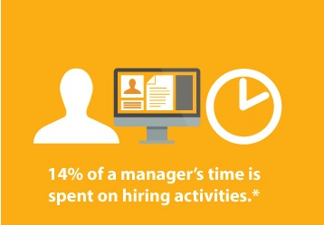
Notes:
IN FACT, HIRING IS A TIME CONSUMING PROCESS FOR AN OWNER.
IT PULLS THEM AWAY FROM THEIR DAY TO DAY MANAGERIAL AND ENTREPRENEURIAL ACTIVITIES
IT MOVES THEIR FOCUS FROM CUSTOMERS AND WORKFLOW.
ACCORDING TO THE SBA, ON AVERAGE 14% OF AN OWNERS TIME IS SPENT IN THE HIRING PROCESS ALONE

Slide 19
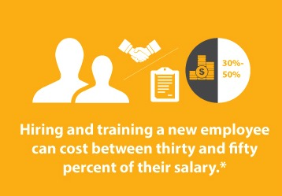
Notes:
ACCORDING TO THE US DEPARTMENT OF LABOR
HIRING AND TRAINING A NEW EMPLOYEE TYPICALLY AVERAGE BETWEEN 30-50% OF THEIR SALARY
IN OUR WORLD OF CUSTOM MANUFACTURING THE REALITY IS THAT NEW EMPLOYEES MAKE MORE MISTAKES WHICH CARRIES EVEN MORE COSTS.

Slide 20
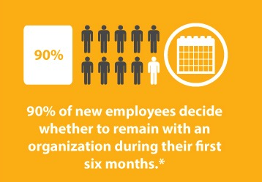
Notes:
AND, SADLY, YOU MAY NOT EVEN KEEP THEM FOR VERY LONG.
90% MAKE THE DECISION TO STAY OR LEAVE DURING THE FIRST 6 MONTHS

Slide 21
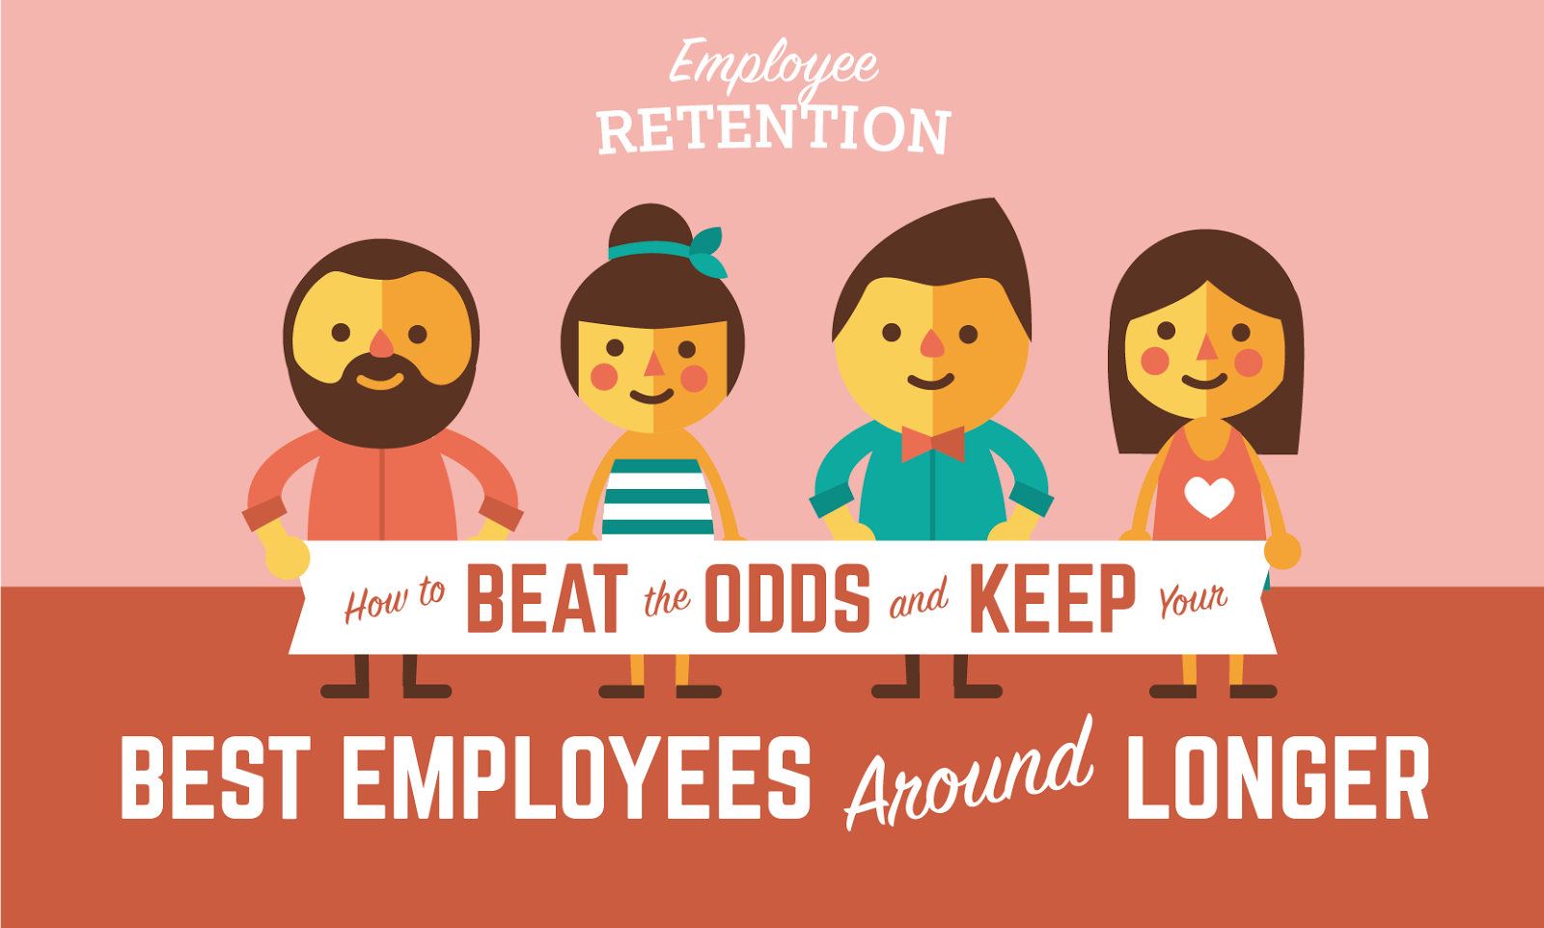
Notes:
THAT’S WHY WE NEED TO DO EVERYTHING WE CAN TO INSURE OUR BEST EMPLOYEES STAY AROUND LONGER.
WE NEED TO UNDERSTAND THE ISSUES OF EMPLOYEE RETENTION AND HAVE AN ACTIVE PLAN TO ENGAGE AND KEEP OUR TOP PERFORMERS

Slide 22

Notes:
SO WHY DO GOOD EMPLOYEES LEAVE?

Slide 23
GOOD EMPLOYEES LEAVE BECAUSE:
RELOCATION
PERSONAL/FAMILY ISSUES
BETTER JOB OFFER
MORE MONEY
Notes:
SURE SOME RELOCATE TO A DIFFERENT AREA OR ARE AFFECTED BY PERSONAL ISSUES,
THESE ARE ISSUES MOSTLY BEYOND THE CONTROL OF AN OWNER

Slide 24
GOOD EMPLOYEES LEAVE BECAUSE:
CURRENT WORKPLACE
COMPANY CULTURE
FELLOW EMPLOYEES
JOB STIFLED
LACK OF GROWTH OPPORTUNITY
Notes:
BUT THE MAJORITY OF REASONS WHY EMPLOYEES QUIT THEIR JOB ARE UNDER THE CONTROL OF THE OWNER.
IN FACT, ANY ELEMENT OF YOUR CURRENT WORKPLACE,
YOUR COMPANY CULTURE,
THE WORK ENVIRONMENT,
FELLOW EMPLOYEES,
THE EMPLOYEE’S PERCEPTION OF HIS JOB,
GROWTH OPPORTUNITIES ARE ALL FACTORS THAT THE EMPLOYER HAS SOME LEVEL OF CONTROL OVER.
BUT THE NUMBER 1 REASON TO LOVE IT OR LEAVE IT COMES DOWN TO THE BOSS

Slide 25

Notes:
GOOD BOSS – BAD BOSS
I AM GOING TO PAINT A BLACK AND WHITE PICTURE OF GOOD BOSS/BAD BOSS. BUT IN REALITY IT IS MUCH MORE SHADES OF GRAY. WE HAVE TRAITS FROM BOTH LISTS. WE WANT TO WORK ON GETTING RID OF THE BAD HABITS AND BUILD ON THE GOOD ONES.

Slide 26

THE TOXIC BOSS
THE TOXIC BOSS
Notes:
JUST AS THERE ARE SOME TOXIS EMPLOYEES OUT THERE, THERE ARE ALSO SOME TOXIC BOSSES. THE ONES WHO WHO CREATE A TOXIC ENVIRONMENT AND HAVE ISSUES WITH JUST ABOUT EVERYTHING.

Slide 27
THE TOXIC BOSS
PEOPLE TREATED AS OBJECTS, NOT HUMANS
PASSIVE AGGRESSIVENESS
A FOCUS ON THE NEGATIVE
NOT OPEN TO OTHERS’ OPINIONS OR IDEAS
NO LEADERSHIP
NO RECOGNITION OF EMPLOYEE’S EFFORTS
Notes:
TOXIC BOSSES HAVE TRAITS THAT TURN OFF EMPLOYEES.

Slide 28
THE TOXIC BOSS
DO WHAT I SAY, NOT WHAT I DO
DOESN’T KEEP THEIR WORD
DOESN’T ADMIT WHEN THEY WRONG
MAKES PROMISES THAT CANNOT BE KEPT
CRITICIZES OTHERS BUT CAN’T TAKE CRITICISM
THEIR WAY IS THE RIGHT (AND ONLY) WAY
Notes:
THIS IS WHAT EMPLOYEES SAY TURNS THEM OFF, DEMOTIVATES THEM AND, ULTIMATELY, MAKES THEM LEAVE.

Slide 29
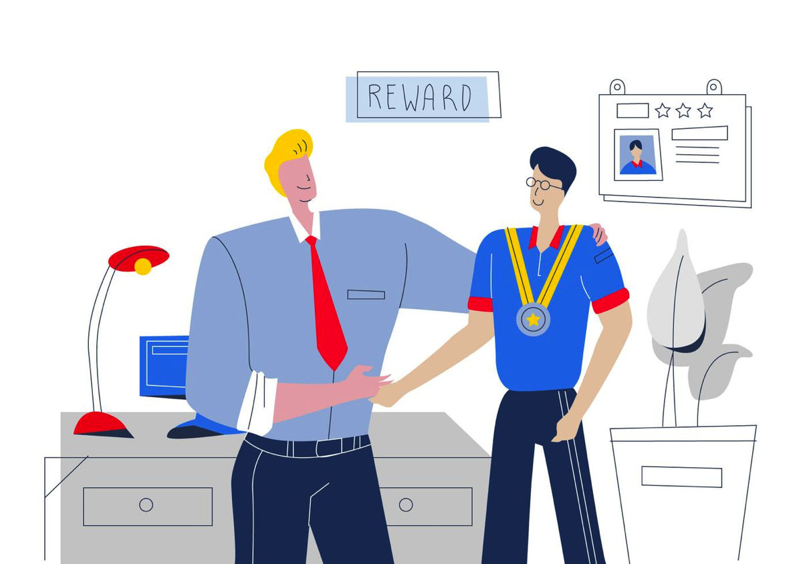
THE GREAT BOSS
Notes:
AND THERE ARE A LOT OF GREAT BOSSES OUT THERE. THEY ARE DEFINED BY MANY DIFFERENT ATTRIBUTES BY EMPLOYEES

Slide 30
THE GREAT BOSS
LEADERS NOT DICTATORS
SEEKS INPUT FROM TEAM
CARES ABOUT EMPLOYEE WELLBEING
GIVES EMPLOYEES OWNERSHIP
RECOGNIZES EFFORTS AND ACCOMPLISHMENTS
MAINTAINS A POSITIVE ATTITUDE
BUILDS UP TEAM, NOT TEAR DOWN
Notes:
AS WE WILL SEE IN A MINUTE, SIGNWORLD OWNERS MOSTLY DISPLAY TRAITAS IN THE GREAT BOSS CATEGORY.

Slide 31

Notes:
THE GREAT BOSSES ARE TEAM BUILDERS AND PEOPLE BUILDERS.
THEY KNOW AND UNDERSTAND THE VALUE OF A STRONG, FOCUSSED TEAM.
THEY PUT SIGNIFICANT EFFORT INTO ALL THESE ACTIVITIES TO MAKE THEIR TEAM SUCCESSFUL

Slide 32

OUR TEAM
RELATIONSHIPS
Notes:
LET’S TAKE A LOOK AT ALL THIS THROUGH THE LENS OF OUR SIGNWORLD SHOPS

Slide 33

Notes:
IN DECEMBER A SURVEY WAS SENT OUT TO SIGNWORLD OWNERS AND EMPLOYEES.
OVER 130 RESPONSES
WE ASKED A LOT OF QUESTIONS TO DISCOVER HOW WE SEE EACH OTHER
GOOD BOSS/BAD BOSS – GOOD EMPLOYEES/BAD EMPLOYEES – GOOD ENVIRONMENT/BAD ENVIRONMENT
WE’RE GOING TO SPEND A BIT OF TIME DIGGING INTO SOME NUMBERS THAT MAY SURPRISE A LOT OF YOU.
HOW OWNERS LOOK AT THEIR BUSINESS AND EMPLOYEES- AND HOW EMPLOYEES LOOK AT THEIR JOBS AND THEIR OWNERS.
THE POINT OF ALL THIS IS TO STIMULATE YOUR THINKING INTO HOW TO MAKE YOUR BUSINESS A BETTER WORKPLACE.
HAPPY, SATISFIED EMPLOYEES CONTRIBUTE MORE AND STAY LONGER REDUCING TURNOVER. AND THAT IS A DIRECT BENEFIT FOR OUR COMPANIES.
THERE ARE SOME CONSISTENCIES IN THE DATA AND SOME MAJOR DISCONECTS.
THE GOAL TODAY IS TO OPEN LINES OF COMUNICATION BETWEEN OWNERS AND EMPLOYEES TO BETTER FACILITATE STRONGER, MORE COHESIVE TEAMS.
LOOK AT SOME OF THE RESULTS

Slide 34
DEMOGRAHICS
WHO RESPONDED
77 OWNERS & 58 EMPLOYEES
1/2 FROM OWNERS FROM SHOPS OPEN 3+ YEARS
3/4 FROM OWNERS WITH FEWER THAN 4 EMPLOYEES
2/3 FROM EMPLOYEES LESS THAN 3 YEARS
1/2 FROM SHOPS WITH 6+ EMPLOYEES
Notes:
FIRST - WHO REPOSONDED. TYPICALLY A 5-10% RESPONSE RATE IS CONSIDERED VERY GOOD.
FROM A STATISICAL STANDPOINT WE HAD A VERY EXCELLENT DIVERSE REPRESENTATION. JACK COMMENTED THAT THIS WAS THE BEST SURVEY PARTICIPATION FROM THE SIGNWORLD GROUP.
LET’S SEE WHAT YOU ALL THOUGHT AND WHAT TAKE AWAYS WE CAN LEARN TO MAKE OUR COMPANIES BETTER.

Slide 35
7.7
9.2
Notes:
THE FIRST QUESTION WAS HOW WE RATED EACH OTHER.
EMPLOYEES RATED THEIR OWNERS A 9.2
OWNERS RATED THEIR EMPLOYEES ONLY A 7.7
THAT’S A SIGNIFICANT DIFFERENCE IN SATISFACTION LEVEL
OWNERS ARE MORE FRUSTRATED BY THEIR EMPLOYEES THAN EMPLOYEES ARE WITH THEIR OWNERS.

Slide 36
OWNERS VIEW OF EMPLOYEE ISSUES
Notes:
SO WHY DID OWNERS RATE EMPLOYEES SO LOW?
ONLY 14% OF OWNERS RATED THEIR TEAM GREAT WITH NO PROBLEMS. THAT’S ONLY 1 SHOP IN 7
FOR THE EMPLOYEES IN THE AUDIENCE TODAY, THIS IS WHAT BUGS OWNERS.

Slide 37
7.7
8.6
Notes:
MORE COMMENTS WERE MADE ABOUT THE WORK ENVIRONMENT THAN ANY OTHER SUBJECT IN THE SURVEY.
OWNERS THEMSELVES SEE THAT WORK ENVIRONMENT AS SOMETHING THAT NEEDS IMPROVING
MANY COMMENTS WERE MADE ABOUT THE PHYSICAL SPACE – SIZE, TEMPERATURE, CLEANLINESS, ORGANIZATION AND ESPECIALLY OPERATIONS AND SYSTEMS

Slide 38
UNDERSTAND MISSION, PHILOSOPHIES AND GOALS
7.0
8.9
0 1 2 3 4 5 6 7 8 9 10
OWNERS EMPLOYEES
Notes:
HERE IS A SIGNIFICANT DISCONNECT. EMPLOYEES THINK THEY UNDERSTAND THE COMPANY’S MISSION, PHILOSOPHIES AND GOALS.
OWNERS, NOT SO MUCH.
TO THE OWNERS OUT THERE, I WOULD SUGGEST THIS IS AN OPPORTUNITY TO MAKE SURE YOUR VISION AND VALUES OF THE COMPANY AND YOUR PATHWAY FORWARD ARE POWERFULLY COMMUNICATED TO YOUR TEAM. THIS COMES DOWN TO COMPANY CULTURE. THERE ARE MANY WAYS TO CREATE AND CONTROL YOUR CULTURE. DO YOU HAVE YOUR MISSION STATEMENT, PHILOSOPHIES AND GOALS WRITTEN ON YOUR WALLS WHERE EMPLOYEES ENCOUNTER THEM EVERY DAY?

Slide 39
HIRES & ONBOARDS WELL
6.4
8.9
0 1 2 3 4 5 6 7 8 9 10
OWNERS EMPLOYEES
Notes:
THE BIGGEST DISCONNECT – HIRES AND ONBOARDING.
IT IS THE SECOND HIGHEST NUMBER OF COMMENTS AND A HUGE OPPORTUNITY TO BE BETTER.
LET ME SHARE SOME COMMENTS FROM OWNERS AND EMPLOYEES ALIKE.
(PRINT OUTS)

Slide 40
ON-BOARDING
JOB DUTIES & RESPONSIBILITIES
STANDARDS & PERFORMANCE
COMMUNICATE CULTURE
FORMAL TRAINING PLAN
DAILY/WEEKLY FOLLOW UP
Notes:
THERE WAS ONE MORE COMMENT ABOUT ONBOARDING.- AND IT STOOD ALONE
“WE HAVE A DOCUMENTED ORIENTATION PLAN THAT IS TAILORED FOR EACH NEW EMPLOYEE. WE MONITOR IT ON A WEEKLY BASIS FOR THE FIRST 90 DAYS. I HAVE REALLY LIKED EVERYONE WE HIRED “
THE MOST CRITICAL POINT THAT DICTATES THE SUCCESS OF A NEW EMPLOYEE IS ONBOARDING
IN WRITING – A PLAN

Slide 41

Notes:
SET OUR TEAM UP FOR SUCCESS
SO OFTEN IN MY COACHING SIGNWORLD OWNERS I HEAR COMPLAINTS ABOUT EMPLOYEES WHO ARE JUST NOT LIVING UP TO EXPECTATION. RESUME LOOKED GREAT, INTERVIEW WAS IMPRESSIVE, BUT JUST MAKING TOO MANY MISTAKES, NOT FOLLOWING THROUGH PROPERLY. MORE OFTEN THAN NOT, THE PROBLEM IS THE BUSINESS OWNER. WHY? THE EMPLOYEE WAS NOT SET UP FOR SUCCESS – AND THAT STARTS WITH PROPER ON-BOARDING.
TOMORROW AFTERNOON AT 4:00, I WILL BE CONDUCTING A UNIQUE SESSION DEVOTED COMPLETELY TO “SET UP FOR SUCCESS”. I PROMISE AN ENTERTAINING AND INFORMATIVE HOUR.

Slide 42

Notes:
SEVERAL QUESTION ON THE SURVEY DEALT WITH EMPLOYEE MOTIVATION
WHAT OWNERS THOUGHT MOTIVATED EMPLOYEES
AND WHAT EMPLOYEES TOLD THE SURVEY WHAT MOTIVATED THEM.
AGAIN SOME DISCONNECTS AND A LOT OF COMMONALITY

Slide 43
WORK ENVIRONMENT
EMPLOYEES
OWNERS
0 10 20 30 40 50 60 70 80 90 100
Notes:
LET’S IDENTIFY THE SCALE FROM RIGHT TO LEFT - LIGHT BLUE ON THE RIGHT MEANS IT IS A TOP RATED MOTIVATOR
PURPLE MEANS IT IS PRETTY IMPORTANT, LIGHT GREEN – SOMEWHAT IMPORTANT
ORANGE AND BLUE EITHER NOT AT OR OR JUST A LITTLE IMPORTANT
THE TOP RATED MOTIVATOR IS THE WORK ENVIRONMENT

Slide 44
TEAMMATES
EMPLOYEES
OWNERS
0 10 20 30 40 50 60 70 80 90 100
Notes:
TEAMMATES ARE A BIG PART OF THE WORK ENVIRONMENT. AGAIN EMPLOYEES SEE THIS AS 4X MORE OF A TOP MOTIVATOR THAN OWNERS SEE IT.
THE TAKE AWAY IS WE SHOULD REALLY CREATE OPPORTUNITIES TO DO TEAM BUILDING.

Slide 45

Notes:
TEAM BUILDING IS CRITICAL FOR A SUCCESSFUL BUSINESS.
IN MY 20+ YEARS WE DID MANY TEAM BUILDING EVENTS AND EXERCISES.
NOT ONLY DID WE HAVE PICNICS, FRIDAY PIZZA PARTIES, PAINTBALLING, BOWLING, JET SKIING, HOLIDAY PARTIES AND LOTS MORE.
WE HAD EMPLOYEE OF THE QUARTER AND EMPLOYEE OF THE YEAR AWARDS.
WE FOCUSSED ON COMMUNICATION ACTIVITIES, PROBLEM SOLVING AND DECISION MAKING ACTIVITIES, ADAPTABILITY AND PLANNING ACTIVITIES, AND ACTIVITIES THAT FOCUSED ON BUILDING TEAM TRUST.
GOOGLE TEAM BUILDING AND GET SOME IDEAS FOR YOUR TEAM

Slide 46
MONEY
EMPLOYEES
OWNERS
0 10 20 30 40 50 60 70 80 90 100
Notes:
SAME WITH MONEY. NO SURPRISE HERE
MONEY MOTIVATES

Slide 47
BENEFITS
EMPLOYEES
OWNERS
0 10 20 30 40 50 60 70 80 90 100
Notes:
AGAIN EMPLOYEES SEE THIS AS MORE IMPORTANT THAN OWNERS.
WE ALL CERTAINLY UNDERSTAND THAT, AS BUSINESS OWNERS, THERE IS CONSTANT PRESURE TO CONTROL COSTS AND BE PROFITABLE. WITHOUT A PROFITABLE BUSINESS, EVERYONE LOSES. HOW WE ALLOCATE OUR EMPLOYEE COSTS, THOUGH, IS A TOPIC FOR DISCUSSION WITH YOUR TEAM, YOU MIGHT BE SURPRISED WHAT EMPLOYEES VALUE MORE.

Slide 48
BEING CREATIVE
EMPLOYEES
OWNERS
0 10 20 30 40 50 60 70 80 90 100
Notes:
BRING CREATIVE IS A PRETTY SIGNIFICANT ASPECT OF WHAT WE DO.
EMPLOYEES THINK IT IS ONE OF THE MOST IMPORTANT PART OF THEIR JOB. EVEN MORE SO THAN OWNERS.
A 2015 STUDY OF MANUFACTURING JOBS BY TEXAS CHRISTIAN UNIVERSITY DREW A DIRECT LINK BETWEEN JOB CREATIVITY AND EMPLOYEE RETENTION
THE TAKE AWAY – ENCOURAGE THAT CREATIVITY

Slide 49
BEING MENTORED
EMPLOYEES
OWNERS
GROWTH POTENTIAL
EMPLOYEES
OWNERS
0 10 20 30 40 50 60 70 80 90 100
Notes:
THIS REALLY PUZZLES ME. LESS THAN HALF OF EMPLOYEES SAID BEING MENTORED WAS TOP OR VERY IMPORTANT MOTIVATOR YET
80% OF EMPLOYEES SAID GROWTH POTENTIAL WAS TOP OR VERY IMPORTANT.
IN FACT, GROWTH POTENTIAL WAS EVEN HIGHER THAN MONEY AS THE TOP MOTIVATOR.
OWNERS DON’T SEE THESE NUMBERS THE SAME WAY.
MY QUESTION - HOW ARE YOU GOING TO GROW WITHOUT SOLID MENTORING ESPECIALLY IN A SMALL BUSINESS
HOW DO YOU CREATE OPPORTUNITIES FOR EMPLOYEES TO GROW? WHAT PROGRAMS DO YOU HAVE WHICH CREATE A PATHWAY FOR YOUR EMPLOYEES. THIS IS ONE OF THE KEY FACTORS IS HELPING RETENTION.

Slide 50
EMPLOYEE PERSPECTIVE
Notes:
THIS WAS AN AGREE/DON’T AGREE SERIES OF QUESTIONS
1/3 OF EMPLOYEE RESPONSES GAVE COMMENTS. THIS IS MOST TELLING. ALMOST ALL THE NEGATIVE COMMENTS WERE ABOUT TRAINING, SYSTEMS AND PROCEDURES.

Slide 51
SYSTEMS
RUN BUSINESSES
WELL TRAINED EMPLOYEES OPERATE THE SYSTEM
51
Notes:
HERE IS WHAT I KNOW – SYSTEMS RUN BUSINESSES
SYSTEMS ARE A FIXED WAY OF DOING SOMETHING TO PRODUCE A DESIRED REPEATABLE EFFECT. THEY ARE ALIVE AND CONSTANTLY EVOLVING.
Systems Run Businesses
Every big business has documented systems. What creates the consistency of a STARBUCKS in any country in the world? SYSTEMS. Ever take a tour of a fast food restaurant? Picture books for training and standards.
SYSTEMS MUST HAVE COMPETENT, WELL TRAILED EMPLOYEES EXECUTING THE SYSTEMS.

Slide 52
SYSTEMS
  POS ORDER ENTRY
  DESIGN/PRODUCTION
  INSTALL CHECKLIST
  SALES SCRIPTING
  CREATE SYSTEMS
52
Notes:
SYSTEMS FALL INTO MANY CATEGORIES. BUT ALL SHARE SOME COMMON FEATURES. THESE WERE THE FIRST ONES WE IMPLEMENTED.
ORDER ENTRY POS – INSTALLER CHECKLIST – PAPERWORK – SALES SCRIPTING

Slide 53
CREATING SYSTEMS
Establish Goals/Benefits - Get Buy In
Get Right People Involved
Team Drafts Strategies & Tactics
Revise, Finalize and Document
Implement & Train
Refine Again & Again & Again
Highly Visible
Hold Accountable
53
Notes:
THE MOST IMPORTANT WAS THE SYSTEM TO CREATE A SYSTEM?
SO HERE IS A REALITY. YOU CAN DO ALL THOSE THINGS TO CREATE SYSTEMS AND LEAVE IT IN A DRAWER FOR NO ONE TO LOOK AT.
WHEN YOU SIGNED ON WITH SIGNWORLD YOU RECEIVED AN OUTSTANDING PROCEDURES GUIDE. WHERE IS THAT TODAY? HAS IT EVOLVED AS YOUR SHOP EVOLVED? IS IT ALIVE AND WELL AND IN THE FACES OF ALL YOUR TEAM OR SITTING ON SOME SHELF?
YOU HAVE TO HAVE WRITTEN INSTRUCTION – FORM – CHECKLIST – COMPUTER DATABASE – SIGN ON WALL OR ANY OTHER STRUCTURE THAT DEFINES WHAT THE GOAL IS; HOW THE SYSTEM ACCOMPLISHES THE GOAL; AND HOW TO WORK THE SYSTEM.

Slide 54
If it’s NOT
In Writing,
It Does NOT
Exist
Notes:
YOUR SYSTEMS MUST BE DOCUMENTED
ALL KINDS OF SYSTEMS FROM CHECKLISTS TO PROCEDURE MANUALS TO JOB BOARD TO CRM AND PRODUCTION MANAGEMENT SOFTWARE.
CLEARLY FROM THE SURVEY RESULTS, ONLY 40% OF EMPLOYEES BELIEVE THEIR COMPANIES HAVE SYSTEMS THAT ARE WRITTEN.

Slide 55
3 ESSENTIAL
EMPLOYER/EMPLOYEE AGREEMENTS
Notes:
I READ AN INTERESTING ARTICLE IN FORBES LAST MONTH.
IT DISCUSSED THREE ESSENTIAL EMPLOYER/EMPLOYEE AGREEMENTS.
THESE AREN’T EMPLOYMENT CONTRACTS—THESE ARE BEHAVIORAL AGREEMENTS.
THESE AGREEMENTS, OR CODES OF CONDUCT, HELP AN EMPLOYEE BOTH INTEGRATE INTO YOUR COMPANY AS WELL AS TO BRING THEIR PERSONAL BEST.

Slide 56

Notes:
THE FIRST AGREEMENT IS ABOUT COMPANY CULTURE
THIS IS THE BEDROCK OF YOUR COMPANY. IT IS WHO YOU ARE.
I SPEND A LOT OF TIME WITH MY SIGNWORLD COACHING CLIENTS TO HELP THEM BUILD A POSITIVE AND CONSTRUCTIVE CULTURE THAT DRIVES THEIR BUSINESS FORWARD.
CULTURE IS A CRITICAL ELEMENT THAT DETERMINES THE HAPPINESS AND ENGAGEMENT OF YOUR EMPLOYEES.

Slide 57
OWNER’S JOB
INSURE EMPLOYEE UNDERSTANDS THE ORGANIZATION’S MISSION, VISION, VALUES AND HOW THEY CONNECT TO THEM
MODEL THEM EVERY SINGLE DAY. TALK ABOUT THEM, AND PRAISE PEOPLE FOR HONORING THEM IN THEIR BEHAVIOR
PROVIDE AN IMPACT DESCRIPTION FOR EMPLOYEES
PAY ATTENTION TO YOUR PEOPLE AND GIVE THEM FEEDBACK
Notes:
OWNER’S JOB IN THIS AGREEMENT
MAKE SURE THE EMPLOYEE UNDERSTANDS THE ORGANIZATION’S MISSION, VISION, VALUES AND HOW THEY CONNECT TO THEM
MODEL THE MISSION, VISION, VALUES EVERY SINGLE DAY, AND TALK ABOUT THEM, AND PRAISE PEOPLE FOR HONORING THEM IN THEIR BEHAVIOR
PROVIDE AN IMPACT DESCRIPTION FOR EACH ROLE SO EVERYONE KNOWS HOW THEY SUPPORT THE MISSION, VISION, VALUES AND HOW THEY CONTRIBUTE TO THE ORGANIZATION
PAY ATTENTION TO YOUR PEOPLE AND GIVE THEM FEEDBACK

Slide 58
EMPLOYEE’S JOB
UNDERSTAND THE COMPANY’S MISSION, VISION, VALUES AND PHILOSOPHIES AND HOW YOU CONNECT TO THEM
BE A ROLE MODEL TO OTHERS
BRING IDEAS FOR HOW TO IMPROVE THINGS
IF ANYTHING IS UNCLEAR, ASK YOUR OWNER FOR HELP
GIVE YOUR OWNER FEEDBACK
Notes:
EMPLOYEE’S JOB:
UNDERSTAND THE COMPANY’S MISSION, VISION, VALUES AND HOW YOU CONNECT TO THEM
BE A ROLE MODEL OF AT LEAST THREE OF THE VALUES (LET’S ASSUME THERE ARE 5-6)
BRING IDEAS FOR HOW TO IMPROVE THINGS, SOLVE PROBLEMS, REDUCE STRESS TO YOUR LEADER
IF ANY OF THE ABOVE ARE UNCLEAR, ASK YOUR LEADER FOR HELP
GIVE YOUR LEADER FEEDBACK TO HELP THEM GROW THEIR ENGAGEMENT

Slide 59

Notes:
THE SECOND AGREEMENT IS ABOUT OPTIMIZING EXECUTION AND RESULTS
WE MEASURE THE RESULTS IN MANY WAYS – PRODUCTIVITY, PROFITABILITY, SALES
ULTIMATELY HOW WE EXECUTE DETERMINES WHO WE ARE.

Slide 60
OWNER’S JOB
PRIORITIZE AND EXPLAIN WHY WE’RE DOING WHAT & WHEN
HELP THE TEAM UNDERSTAND HOW TO DO IT
OPTIMIZE HIGH VALUE TIME, MINIMIZE LOW VALUE TIME
UNDERSTAND AND COMMUNICATE DEPENDENCIES AND CONTINGENCIES SO ALL ARE CLEAR
KEEP COMMUNICATION FLOWING SO EVERYONE CAN DO THEIR BEST WORK
Notes:
LEADER’S JOB:
PRIORITIZE AND EXPLAIN WHY WE’RE DOING WHAT AND WHEN AND THE IMPACT IT HAS FOR US ALL
HELP THE TEAM UNDERSTAND HOW TO DO IT IF THEY GET STUCK AND ENCOURAGE THEM TO SEEK INPUT
OPTIMIZE HIGH VALUE-ADDED ACTIVITIES, MINIMIZE LOW VALUE-ADDED ACTIVITIES
UNDERSTAND AND COMMUNICATE DEPENDENCIES, CONTINGENCIES, AND NEEDLE MOVERS SO ALL ARE CLEAR—ALL NEED TO KNOW WHAT COULD INTERRUPT EXECUTION AND HOW TO NAVIGATE AROUND IT AND PREVENT IT
KEEP THE COMMUNICATION FLOWING SO EVERYONE CAN DO THEIR BEST WORK

Slide 61
EMPLOYEE’S JOB
THINK THINGS THROUGH TO ENSURE PRIORITIES ARE CLEAR
BE PRESENT IN YOUR INTERACTIONS TO SAVE EVERYONE TIME AND ENSURE THINGS ARE DONE RIGHT THE FIRST TIME
UNDERSTAND THE OUTCOMES YOUR WANTED
IF PROGRESS TOWARD OUTCOMES ISN’T HAPPENING, OR IF ANYTHING’S UNCLEAR, ASK YOUR OWNER FOR HELP
GIVE FEDBACK ON PRIORITIZING THE EXECUTION PLAN
Notes:
EMPLOYEE’S JOB:
THINK THINGS THROUGH, BE PROACTIVE TO ENSURE PRIORITIES ARE CLEAR
BE PRESENT IN YOUR INTERACTIONS TO SAVE EVERYONE TIME AND ENSURE THINGS ARE DONE RIGHT THE FIRST TIME
UNDERSTAND THE OUTCOMES YOUR TEAM AND LEADER WANT AND WHEN, AND HOW THEY ALIGN WITH YOUR ORGANIZATION’S OUTCOMES AND THOSE OF OTHER TEAMS SO CONTINGENCIES AND DEPENDENCIES ARE NAVIGATED EFFECTIVELY
IF PROGRESS TOWARD OUTCOMES ISN’T HAPPENING, OR IF ANYTHING’S UNCLEAR, ASK YOUR LEADER FOR HELP
IF YOUR LEADER ISN’T CLEARLY PRIORITIZING, GIVE THEM FEEDBACK TO HELP THEM IMPROVE

Slide 62

Notes:
LEARN AND GROW
THIS IS THE THIRD AGREEMENT
A COMMITMENT FOR BOTH OWNERS AND EMPLOYEES TO LEARN AND GROW AND CREATE THE ENVIRONMENT FOR GROWTH.

Slide 63
OWNER’S JOB
MAP OUT INDIVIDUAL DEVELOPMENT PLANS SO EMPLOYEES CAN SEE HOW THEY’LL GROW AT YOUR COMPANY
CREATE A GROWTH & LEARNING PLAN FOR YOURSELF AS WELL
INVOLVE TEAM IN IDENTIFYING AND OPTIMIZING PROCESS CHANGES THAT WILL IMPROVE EFFECTIVENESS
IMPROVE EMPLOYEES’ SKILL SETS THROUGH CLASSES, TRADE SHOWS & TRAINING, VENDORS AND ON-LINE
Notes:
OWNER’S JOB:
HELP YOUR PEOPLE MAP OUT INDIVIDUAL DEVELOPMENT PLANS SO THEY CAN SEE HOW THEY’LL GROW AT YOUR COMPANY
WHAT ARE YOUR LEARNING GOALS AND HOW WILL YOU ACHIEVE THEM?
IDENTIFY WAYS THE TEAM CAN BE MORE IMPACTFUL TO THE BUSINESS
INVOLVE YOUR TEAM IN IDENTIFYING AND OPTIMIZING PROCESS CHANGES THAT WILL IMPROVE EFFECTIVENESS
DO YOU SEND YOUR EMPLOYEES TO CLASSES, TRADE SHOWS, TRAINING SESSIONS? HOW DO YOU CROSS TRAIN?

Slide 64
EMPLOYEE’S JOB
UNDERSTAND YOUR DEVELOPMENT PLAN AND THE GROWTH OPPORTUNITIES AT YOUR COMPANY
ATTEND CLASSES, TRADE SHOWS & TRAINING TO IMPROVE KNOWLEDGE AND SKILLS. USE THE INTERNET AND VENDORS.
REVIEW AND HELP BUILD COMPANY TRAINING MANUALS AND DOCUMENTATION
WORK WITH OWNER TO CREATE OPERATIONAL SYSTEMS
Notes:
EMPLOYEE’S JOB:
UNDERSTAND YOUR DEVELOPMENT PLAN AND THE GROWTH OPPORTUNITIES AT YOUR COMPANY
ATTEND CLASSES, TRADE SHOWS & TRAINING TO IMPROVE KNOWLEDGE AND SKILLS
REVIEW AND HELP BUILD COMPANY TRAINING MANUALS AND DOCUMENTATTION
WORK WITH OWNER TO CREATE OPERATIONAL SYSTEMS

Slide 65

94% OF EMPLOYEES SAY THEY WOULD STAY AT A COMPANY LONGER FOR THIS
Notes:
TO UNDERSTAND THE IMPACT OF GROWTH, ACCORDING TO LINKEDIN'S 2019 WORKFORCE LEARNING REPORT, 94 PERCENT OF EMPLOYEES SAY THAT THEY WOULD STAY AT A COMPANY LONGER IF IT SIMPLY INVESTED IN HELPING THEM LEARN.
THIS INTEREST IN LEARNING AND DEVELOPMENT IS PARTICULARLY STRONG AMONG YOUNGER WORKERS. LINKEDIN'S RESEARCH FOUND THAT ROUGHLY A QUARTER OF GEN Z AND MILLENNIALS SAY LEARNING IS THE NUMBER ONE THING THAT MAKES THEM HAPPY AT WORK, AND OVER A QUARTER (27 PERCENT) OF GEN Z AND MILLENNIALS SAY THE NUMBER ONE REASON THEY'D LEAVE THEIR JOB IS BECAUSE THEY DID NOT HAVE THE OPPORTUNITY TO LEARN AND GROW.

Slide 66

Notes:
SO WHAT’S THE TAKE AWAY FROM THIS SESSION?

Slide 67
THE TAKE AWAY
TURNOVER IS EXPENSIVE & DISRUPTIVE
BITE THE BULLET – FIRE BAD EMPLOYEES
RETENTION OF GOOD ONES = MORE PROFIT
ONBOARDING IS A CRITICAL LINK
OPPORTUNITIES TO BETTER MENTOR
NEED STRONGER WRITTEN SYSTEMS
CONTINUE TO BE GREAT BOSSES

Slide 68
WHY WORK FOR
OUR SMALL BUSINESSES
WORK CLOSELY WITH OWNER
EXPOSURE TO ENTIRE BUSINESS
YOUR IDEAS ACTUALLY MATTER
BE AN INFLUENCER OF GROWTH
PERSONAL GROWTH AND DEVELOPMENT
Notes:
THERE ARE POWERFUL REASONS FOR AN EMPLOYEE TO WORK FOR A SMALL BUSINESS LIKE YOURS. THE EMPLOYEES WHO VALUE THESE ARE THE ONES YOU SHOULD BE RECRUITING, ONBOARDING SUCCESSFULLY AND WORKING HARD TO RETAIN.

Slide 69
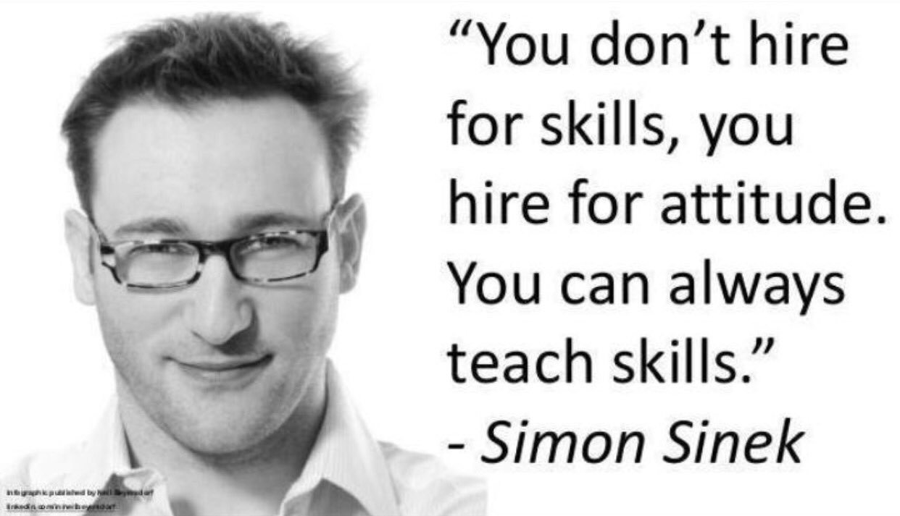
Notes:
REMEMBER
ESPECIALLY IF YOU HAVE STRONG SYSTEMS.

Slide 70
Coach Peter Wolf
Wolfpack Business Coaching
(619)606-7139
CoachPeterWolf.com
© 2018 Peter Wolf
Notes:
PLUG BOOK
A FEW MINUTES FOR QUESTIONS

