Slide 1
The Situation with Paul Martin
Five Minute Message: Getting Prepared Quickly for Coronavirus

Slide 2
www.covid19ready.com

Slide 3
Key Takeaways 1/3
More cases are likely to be identified in the coming days, including more cases in the United States.
It’s also likely that person-to-person spread will continue to occur, including in the United States.
Widespread transmission of COVID-19 in the United States would translate into large numbers of people needing medical care at the same time.

Slide 4
Key Takeaways 2/3
Schools, childcare centers, workplaces, and other places for mass gatherings may experience more absenteeism.
Public health and healthcare systems may become overloaded, with elevated rates of hospitalizations and deaths.
Other critical infrastructure, such as law enforcement, emergency medical services, and transportation industry may also be affected.

Slide 5
Key Takeaways 3/3
Health care providers and hospitals may be overwhelmed. At this time, there is no vaccine to protect against COVID-19 and no medications approved to treat it.
Nonpharmaceutical interventions would be the most important response strategy.

Slide 6
Supplies You’ll Need
Pedialyte/Gatorade
Clorox Wipes/Sani-Cloth wipes
N95 or better masks
Non-latex gloves
OTC pain and fever reducers
Acetaminophen-Tylenol
Ibuprofen – Advil
Naproxen – Aleve
Children’s Tylenol and Motrin (if appropriate)
Decongestants
Sudafed or Mucinex
Anti-diarrheal medications
Imodium
Pepto-Bismol or Kaopectate
Oral thermometers
Household bleach
Toilet Paper
Paper Towels
Cough Drops
Ice
Laundry detergent
Feminine hygiene items
Kleenex
Trash can with plastic trash bags
Purel or equivalent
Disposable straws
Humidifier
Cash on Hand
Red Bull/caffeinated beverages

Slide 7
Procedures/Things to do
See WHO guidance at the end of this checklist
Check with medical professionals on what OTC meds are recommended
Designate sick room
Clarify work arrangements with employers
Top off propane/gas in all vehicles

Slide 8
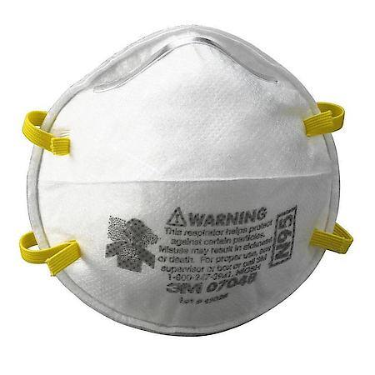
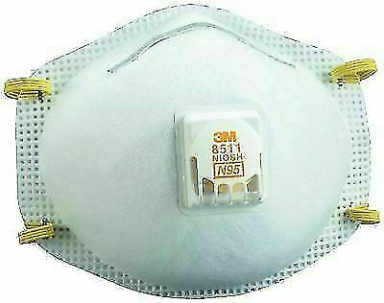
A Word on Masks

Slide 9
Patient Healthy Person

Slide 10
Procedures/Things to Do
Get prescriptions filled
Increase water and Emergen-C intake
Begin monitoring social media feeds of local public health officials
Plan to decontaminate common surfaces with Clorox wipes or bleach solution

Slide 11
Professional Guidance
Do what your medical professional says
CDC - The Flu: Caring for Someone Sick at Home
WHO - “Home care for patients with suspected novel coronavirus (2019-nCoV) infection presenting with mild symptoms and management of contacts”

Slide 12
Key Takeaways 3/3
Health care providers and hospitals may be overwhelmed. At this time, there is no vaccine to protect against COVID-19 and no medications approved to treat it.
Nonpharmaceutical interventions would be the most important response strategy.

