Slide 1
COVID-19 Update
Austin Preparedness Meet Up
March 12, 2020

Slide 3
Coronavirus or COVID-19?
Coronavirus is the virus that causes the disease.
The disease you get from this strain of coronavirus is called COVID-19.

Slide 4
COVID-19 Specifics
Infected to date: 1,215
Deaths to date: 36
States in which the virus is active: 43 (including D.C.)
Current as of 3:45 PM, 3/12/2020

Slide 5
What’s So Bad About COVID-19?
We have no vaccine for it.
We have no medication to treat it.*
It spreads faster than the flu.
It overwhelms medical facilities.
It has a relatively high CFR: Case Fatality Rate

Slide 6
COVID-19 Math
Case Fatality Rate (CFR)
Number of Deaths Caused by COVID-19 Number of Confirmed Cases
= CFR%

Slide 7
COVID-19 Math
Case Fatality Rate (CFR)
Number of Deaths Caused by COVID-19 Number of Confirmed Cases
= CFR%

Slide 8
COVID-19 Math
As we test more people, the confirmed case rate goes UP.
As the confirmed case rate goes UP, the CFR goes DOWN.

Slide 9
COVID-19 Math
Case Fatality Rate (CFR)
Number of Deaths Caused by COVID-19 Number of Confirmed Cases
= CFR%

Slide 10
COVID-19 Math
R0 – pronounced “R nought”
R0 measures transmissibility of a disease
Example: if a illness has a R0 of 2, that means each case will create two new cases.

Slide 11
COVID-19 Math
R0 on a cruise ship: 2.28
R0 in China in late January: 4.08
R0 for Measles: 12-18

Slide 12
Key Points
As we test more people, we will have more confirmed cases.
That can be helpful, because:
It gives us a better sense of the scope of the disease
It creates learning opportunities for medical professionals
It enables us to identify who has it and (hopefully) isolate them

Slide 13
Pros/Cons of Being in U.S. During Pandemic
Pros
Great healthcare technology
Phenomenal resources
Large geography creates capacity nationwide
Cons
We don’t do what we’re told
We are dependent on Chinese for medications and supplies
Political concerns often drive decisions
Obese population

Slide 14
How does COVID-19 infection compare to regular flu?
Regular flu
Immunization available
Anti-virals available
Plenty of test kits
R0 = 1.3
CFR= 0.1%
COVID-19
No vaccine available
No FDA approved medicine*
Limited number of test kits
R0 = 2 – 4
CFR=3%; with full testing, maybe between 0.5% and 2% *Remdesivir showing some promise

Slide 15
What’s the deal with masks?

Slide 16
CDC Says…
Don’t wear masks, because they don’t work.
You’ll be treating COVID-19 patients at home.
If you’re a health care professional, wear a N95 mask when treating COVID-19 patients because they help prevent infection of caregivers.
See a problem in the logic here?

Slide 17
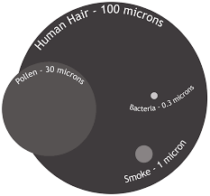
Should you buy masks or not?
COVID-19 virus is 0.125 microns

Slide 18
Should you buy masks or not?
N95 mask: filters out 95% of particles that are 0.3 microns or larger.
0.125 microns < 0.3 microns
Therefore, a N95 mask cannot filter out COVID-19 virus
…..Or can it?

Slide 19
What do the experts say?
“…the flu virus does not float in the air by itself. The flu virus is transported from patient to patient on droplets of excretions from sneezing and coughing. These particles are typically 5 microns or larger.”
https://www.envirosafetyproducts.com/resources/dust-masks-whats-the-difference.html

Slide 20
A Word on Masks

Slide 21
Patient Healthy Person

Slide 22
So Why The Panic?
Inconsistent messages from medical experts (no masks for you, but masks for us)
Inconsistent messages from government (be prepared...but don’t large quantities of things you need to be prepared)
Decisions made in part based on politics
Incessant media coverage
The need to “take a side” on the gravity of the situation
Images and news out of China
What do you expect people to do in this situation?

Slide 23
Our Tasks
You can panic or prepare. Pick!
Be a resource of quality news and guidance.
Set an example of how to manage the situation.

Slide 24
What should we be doing now?
Supplies to get
Actions to take
Questions to ask
Answers to provide to others

Slide 25
Supplies To Get
Pedialyte/Gatorade
Clorox Wipes/Sani-Cloth wipes
N95 or better masks
Non-latex gloves
OTC pain and fever reducers
Acetaminophen-Tylenol
Ibuprofen – Advil
Naproxen – Aleve
Children’s Tylenol and Motrin (if appropriate)
Decongestants
Sudafed or Mucinex
Anti-diarrheal medications
Imodium
Pepto-Bismol or Kaopectate
Oral thermometers
Household bleach
Toilet Paper
Paper Towels
Cough Drops
Ice
Laundry detergent
Feminine hygiene items
Kleenex
Trash can with plastic trash bags
Purel or equivalent
Disposable straws
Humidifier
Cash on Hand
Bleach
Hand Soap

Slide 26
Actions To Take
Get prescriptions filled
Increase water and nutrient-dense food intake
Begin monitoring social media feeds of local public health officials
Plan to decontaminate common surfaces with Clorox wipes or bleach solution

Slide 27
Actions To Take
Check with medical professionals on what OTC meds are recommended
Designate sick room
Top off propane/gas in all vehicles
Shop for things at opportune times
Plan for some “snow days”

Slide 28
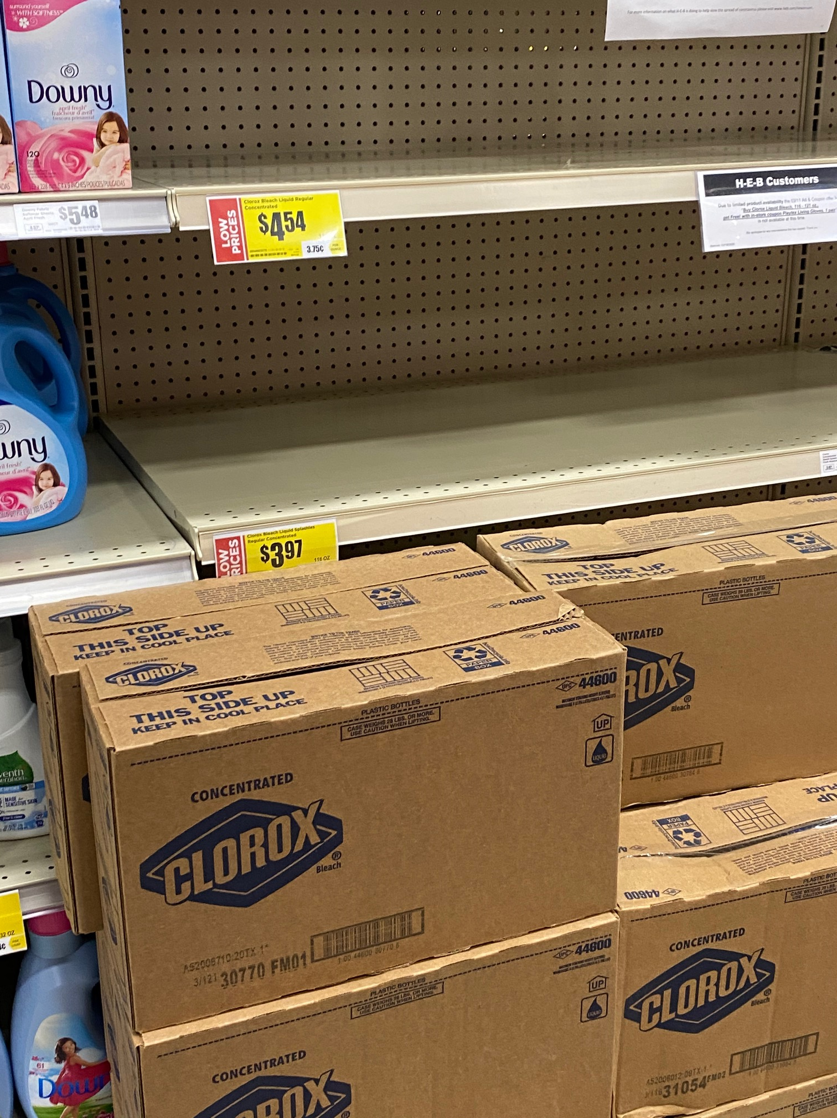
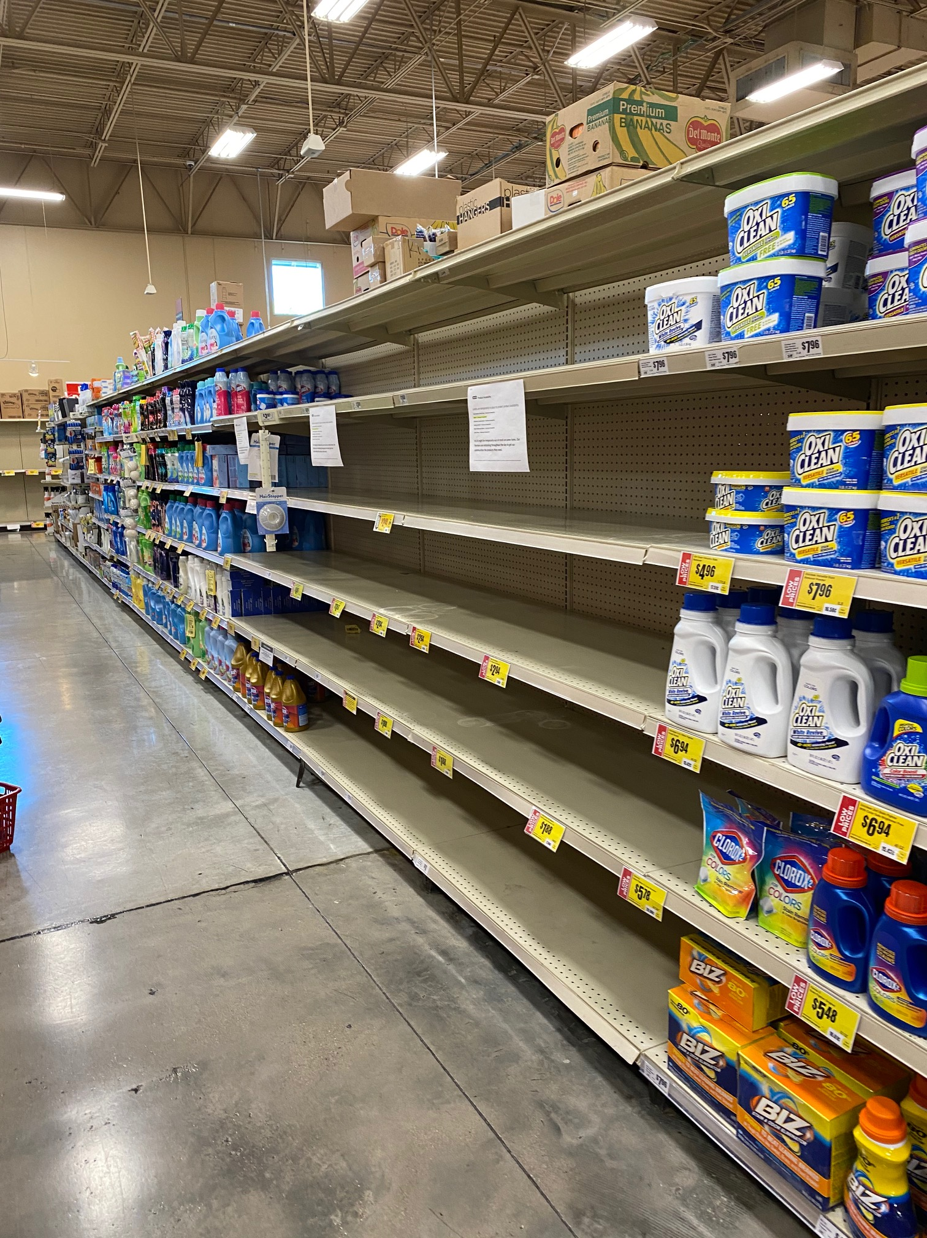
Shop Late and Win!
11 PM 3/11/2020
11 AM 3/12/2020

Slide 29
Questions To Ask
Employers: What’s the plan for telecommuting? Payroll? Staffing?
Childcare: Hours? Decon procedures?
Churches: Services? Shaking hands?
Friends/family: Who can you help? How can you help?

Slide 30
Answers To Provide To Others
We are a nation that fought world wars, put a man on the moon, and built the most powerful nation on earth. We got this!
Execute the basics well: sanitation and social distancing

Slide 31
Moving Forward
Get your information from multiple sources.
Reach your own conclusions.
You are responsible for your and your family’s well being.
Not everything is a conspiracy.

