Slide 1
Alternative Enrollment/ Call Center Protocol COVID-19 Legacy WellCare

Slide 2
COVID-19 Protocol
While government agencies work to learn more about how COVID-19 (Coronavirus) is transmitted and treated, Centene is providing guidance to keep agents, their families and our communities healthy, while continuing to provide opportunities to help prospective members get the Medicare plan that fits their needs.
This course will guide you through the steps to take to utilize the telephonic protocol as an alternative enrollment option.

Slide 3
Pre-Enrollment Requirement
In order to utilize the process we’re about to discuss, an Appointment Verification Line (AVL) code is required. The AVL code will ensure the agent is credited for the sale and remains the agent of record (AOR).
Calling the AVL line is simple, but does require the beneficiary to be on the line. The call center agent will capture the beneficiary’s agreement to, and the scope of, your appointment with them. At the end of the call, you will be provided with an AVL code, which is a required piece to conduct the telephone enrollment process.
The AVL lines are available from 7am to Midnight Eastern Time.
National AVL | 8777803920
PDP AVL | 8772973625

Slide 4
Telephonic Enrollment Option
Once the prospect agrees to enroll, and all other required steps have been completed, the agent may move to the telephonic enrollment process detailed below:
Telephonic enrollment via the call center protocol plan:
Prior to calling you must have the following items ready:
Appointment ID# (AVL ID)
Plan Name
Plan Effective Date
Date of Birth
Special Election Period (SEP) being used on application
Medicare ID# (from red, white, blue card)
Part A Effective Date
Part B Effective Date
Field agent initiates a 3-way call to a dedicated TFN established specifically for this campaign
Field agent remains on the line and is the point of contact for any plan or benefit related questions (Call center agent in most instances is non-licensed and is not permitted to answer any benefit questions)
Field agent will remain agent of record for the sale
Enrollment is processed and submitted by non-licensed telesales agent

Slide 5
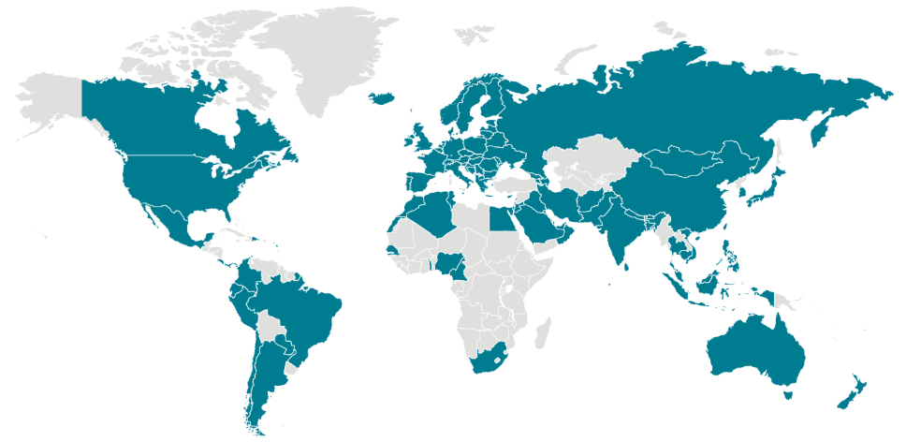
Protocol Notes
Hours of use for the call center protocol plan:
WellCare Agents Call: 844-914-0020
The call center will retain the recording of the enrollment and track the number of protocol enrollments
Field agent will remain agent of record
Changes to record will be made at the corporate level if telesales agent is not able to enter field agent PID
Time Zone of BC | Hours of Operation
Eastern | 8AM-5:30PM Local Time Zone
Central | 8AM-4:30PM Local Time Zone
Mountain | 8AM-3:30PM Local Time Zone
Pacific | 8AM-3:30PM Local Time Zone
Hawaii | 8AM-3:30PM Local Time Zone

Slide 6
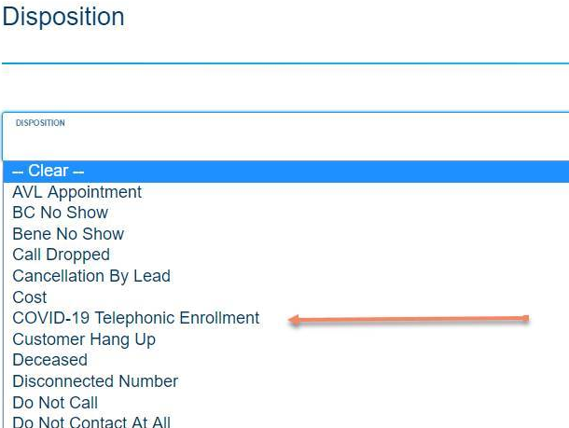
Post Enrollment Salesforce
If your leads are housed in Salesforce, you are required to disposition any lead that results in an enrollment using the telephonic process must be dispositioned as “COVID-19 Telephonic Enrollment” (screenshot below). Doing so will help better predict staffing at the call center to accommodate these calls, and, will help document the irregular process implemented to keep you selling and continue to give our communities the opportunity to enroll into one of our plans. Additionally, this information may be required for future CMS and compliance related audit.
Questions related to this process should be directed to your designated Account Executive or District Sales Manager.

