Slide 1
Lead options at set costs
Final Expense | Med Supp | Turning 65 |Med Advantage | Mortgage Protection
DISCLAIMER This document is strictly private, confidential and personal to its recipients and should not be copied, distributed or reproduced in whole or in part, nor passed to any third party.

Slide 2
Direct mail final expense leads
We mail to:
Ages - 50-85
Income - $10k-$50k
Lead Credit Criteria:
Over 85 (both clients)
Mailed within 60 days of each other (duplicate)
Completely Blank
Says remove from list
*Leads without phone numbers do not qualify for credit
All of the following Final Expense lead samples are used to fulfill orders

Slide 3
All Final expense leads used to fulfill orders

Slide 4
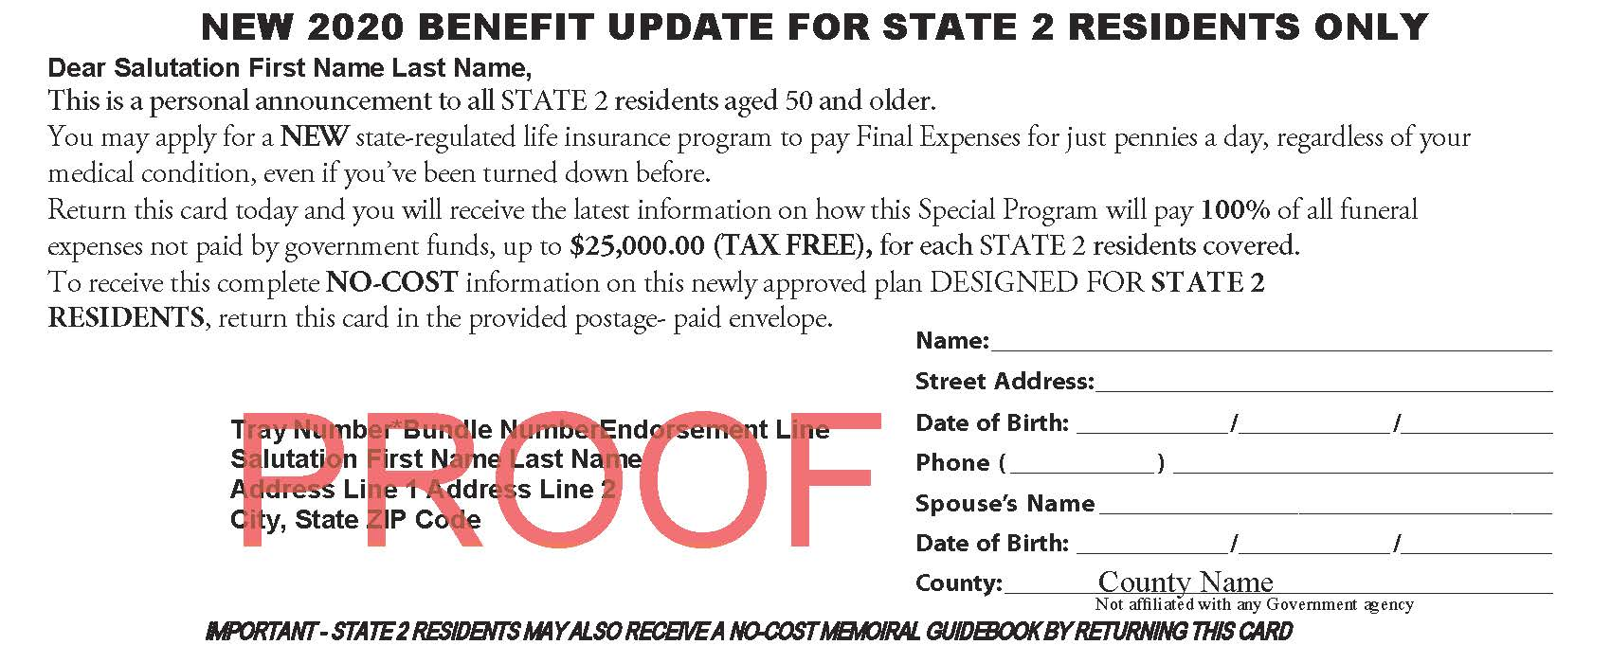
All Final expense leads used to fulfill orders

Slide 5
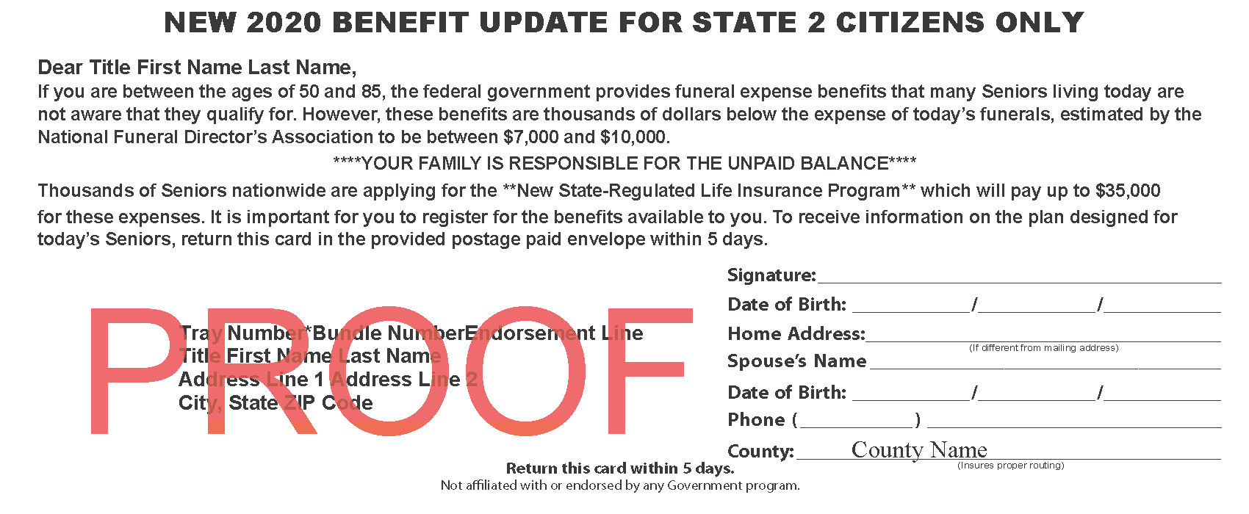
All Final expense leads used to fulfill orders

Slide 6
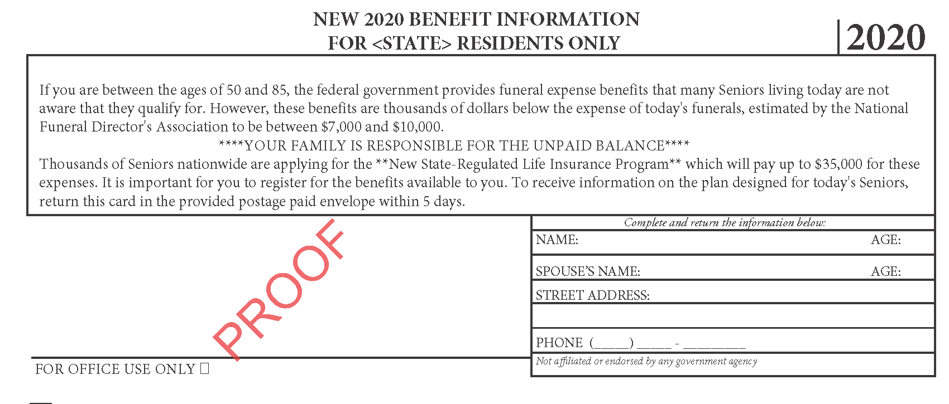
All Final expense leads used to fulfill orders

Slide 7
Direct mail Med Supp leads
We mail to:
Ages – 64.5 - 80
Income - $25k +
Lead Credit Criteria:
Over 80 (both clients)
Mailed within 60 days of each other (duplicate)
Completely Blank
Says remove from list
*Leads without phone numbers do not qualify for credit

Slide 8
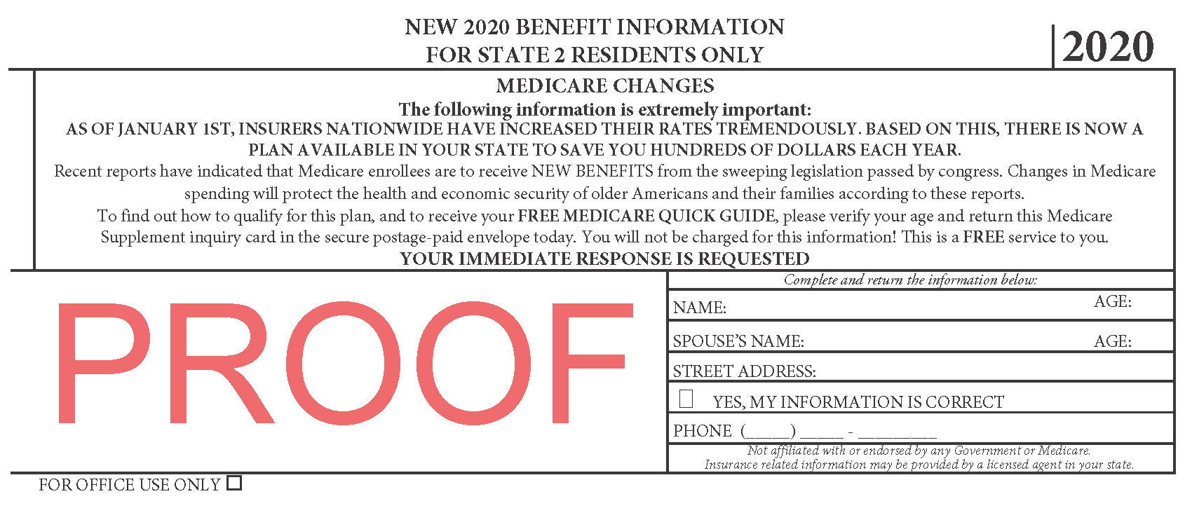
Direct mail Med Supp lead

Slide 9
Direct Mail T-65 leads
We mail to:
Seniors within 6 months of their 65th birthday
Income – no income restrictions
Lead Credit Criteria:
Mailed within 60 days of each other (duplicate)
Completely Blank
Says remove from list
*Leads without phone numbers do not qualify for credit

Slide 10
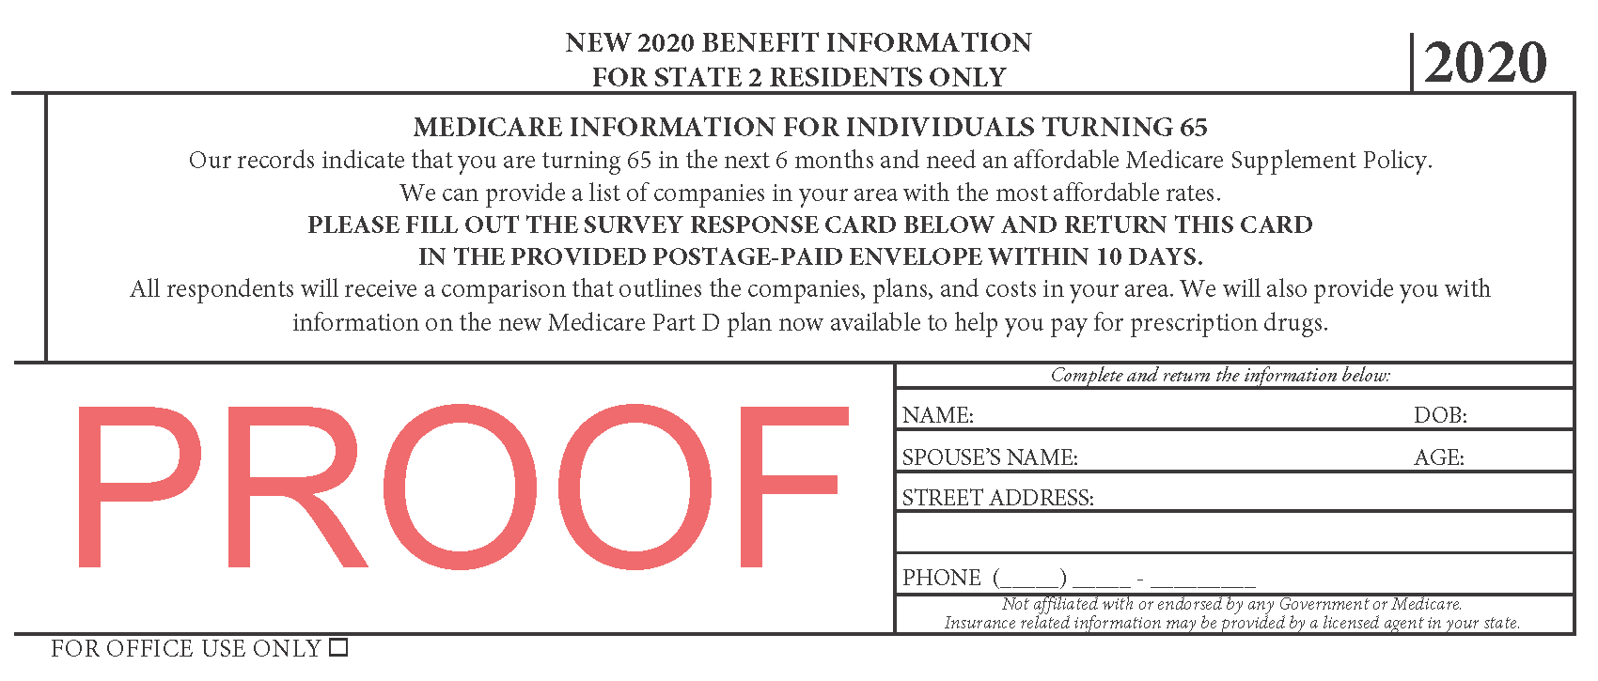
Direct Mail T-65 Med Supp lead

Slide 11
Direct mail Med Advantage leads
We mail to:
Ages – 65 - 80
Income -$0 - $100k
Lead Criteria:
All set cost Med Advantage leads will have a phone # included in order to qualify as a lead.
Additional leads received from your orders w/o numbers will be provided to you FREE of charge.

Slide 12
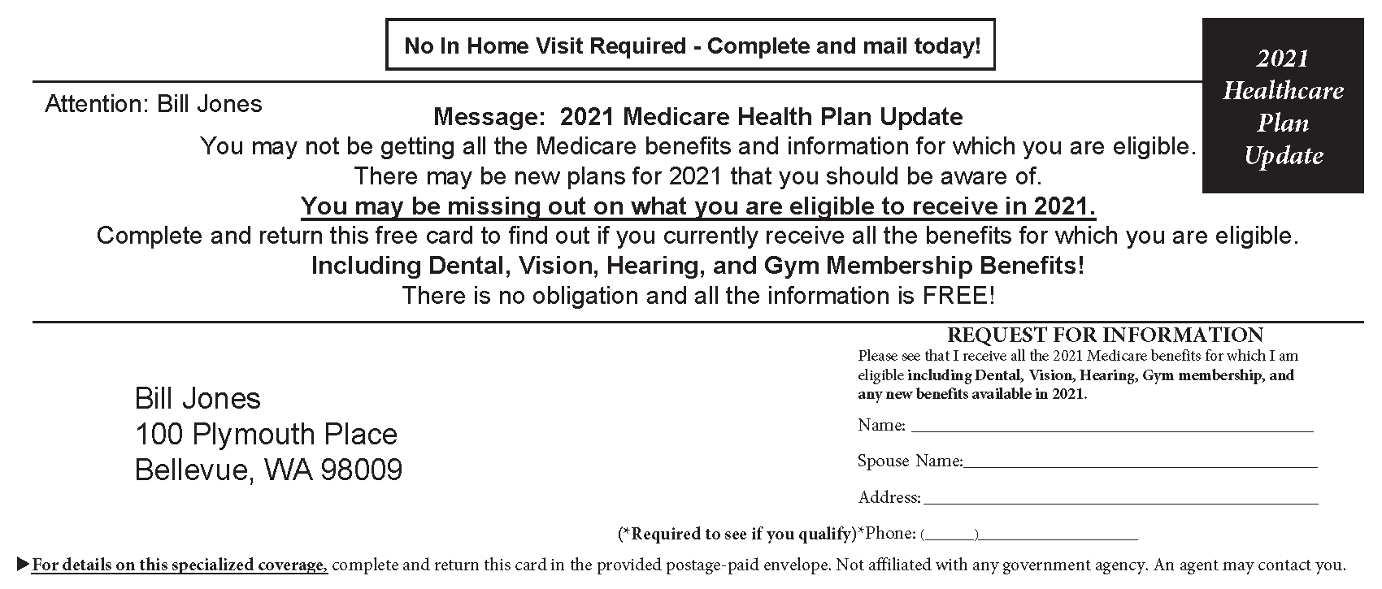
Direct Mail Med Advantage lead

Slide 13
Direct mail Mortgage Protection leads
We mail to:
Ages – 18 - 80
Origination Date 2-10yrs old
New Loans and Refi
Includes Lender Name and Loan Amount
Lead Credit Criteria:
Completely Blank
Says Do Not Mail
*Leads without phone numbers do not qualify for credit
Both of the following MP leads are used to fulfill orders

Slide 14
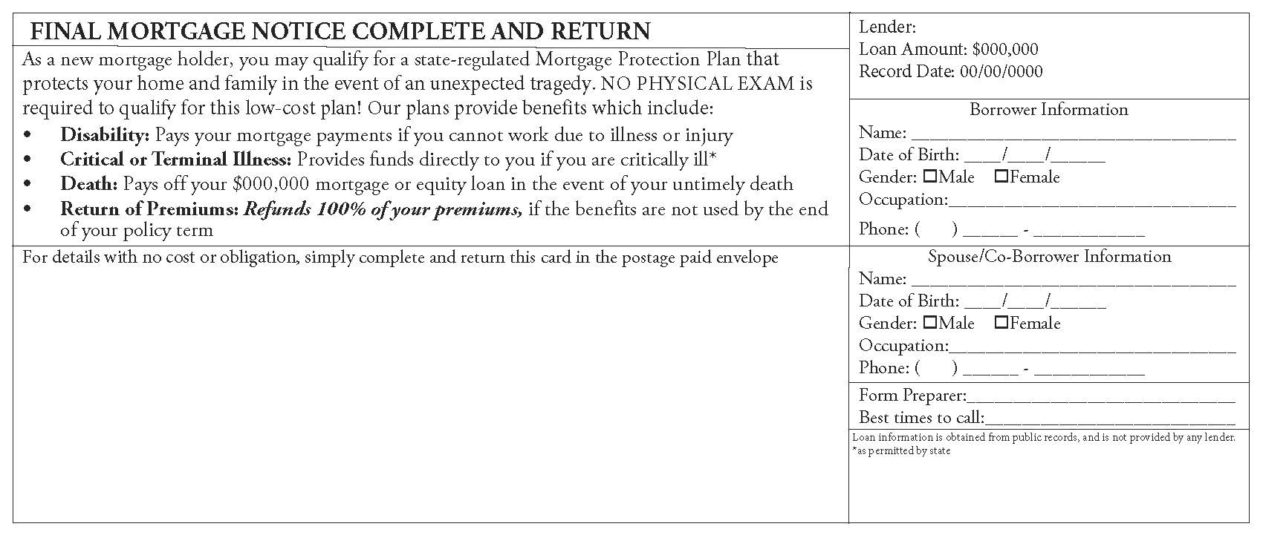
All Mortgage protection leads used to fulfill orders

Slide 15
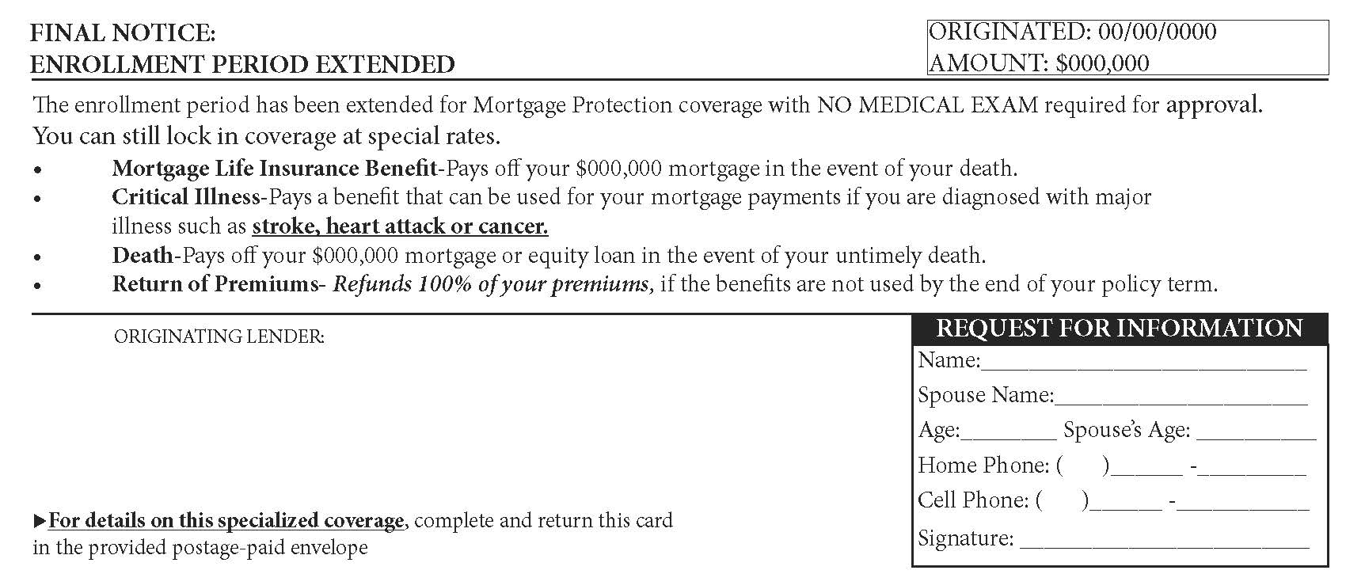
All Mortgage protection leads used to fulfill orders
Front

Slide 16
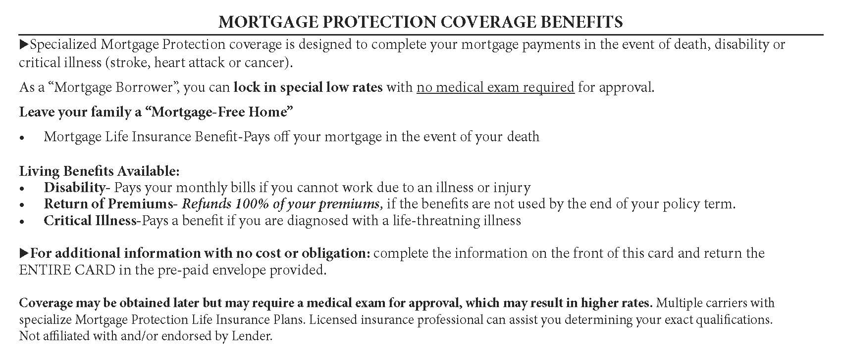
All Mortgage protection leads used to fulfill orders
Back

Slide 17
Purchase Options
#1 DIRECT MAIL FINAL EXPENSE
#2 DIRECT MAIL MED SUPP
#3 DIRECT MAIL T-65
#4 DIRECT MAIL MORTGAGE PROTECTION
#5 DIRECT MAIL MED ADVANTAGE
$29.95
$23.00
$25.00
$79.00
$29.00

Slide 18
To Order Leads
Complete lead order form and email to:
YIGleads@yourinsurancegroup.net
or Fax to 856-206-4049

Slide 19
Order Confirmation and Processing
Confirmation email will be sent upon receipt of order
New Lead orders are charged on Mondays or Wednesdays

Slide 20

Lead Time & Distribution
Leads typically begin to return 3.5-4 weeks after payment is processed
Leads are returned
Leads are distributed via email and also uploaded into the Agency’s or Agent’s Lead Management account (OPT) on Tuesday & Thursday evenings
Distribution message emailed to the person who ordered leads:
“Please see your leads attached and confirm receipt.
In addition to the attached PDFs, your leads will also be loaded into Opt, a no-cost lead management portal, which will assist you keep track of all your leads in one central location. Plus, the software’s robust options will allow you to disposition your leads, leave notes, search leads by Name/County/Zip and many other features you may find to be resourceful and of great value.
Please let us know if you need us to resend your OPT credentials. Thank you.”

Slide 21
Generic Virtual User Training Board URL:
http://optsoft.com/optcrm/
Opt! Leads Manager Mobile App:
https://www.optsoft.com/images/vd/Opt_Leads_Manager_Mobile_App.mp4

