Slide 1


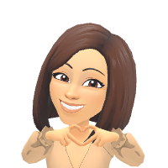
Please sign in.

Slide 2
This Powerpoint has been uploaded to our class website.
www.mblearningtree.com

Slide 3

I was born and raised in Tampa Florida. I graduated from FAU. Go Owls!​
I am married and have two daughters. Ella who is in nursing school and Lauryn who is at MSD High School.
This is my 23rd year teaching. I have taught 1st-4th grade. This is my 14th year at QWE.​
I love teaching fourth grade, and I’m excited to
be a part of your child’s learning experience this year!​

Slide 4
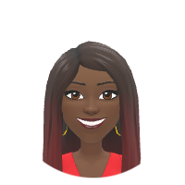
31 Years with Broward County Schools
19 years at Quiet Waters Elementary
I am married with 5 adult children and 10 grandchildren.
I believe learning takes place in a positive and comfortable environment.

Slide 5

Students are allowed into the classroom at 7:55am.
Math and Reading begins at 8:10am
The daily homework is displayed. Homework is also posted online. On Monday students write their homework in their agenda for the week. You will receive a DoJo alert stating,
“Agenda Checked for the Week.”

Slide 6

School begins at 8:00am. Your child is late at 8:01am. Bus riders are not marked tardy and
are allowed to eat breakfast upon their arrival. Breakfast and Lunch are FREE for all students
this 2026-2027 school year.
If you have a change in dismissal, please contact the front office by 12:00 noon.
School begins at 8:00am. Students are late at 8:01am!
Change in dismissal needs to be done by 12:00pm by
notifying the front office

Slide 7

We are planning 1-2 field trips this school year.
Seminole Reservation in Fort Lauderdale
on November 13. More information forthcoming.
Waiting approvals for Parker Playhouse
ALL Field trips are paid online. A payment link will
also be available on our class website.

Slide 8

You must register online and be approved as a volunteer before attending field trips. You may register online at:
https://apps.raptortech.com/Apply/NDgyMDplbi1VUw==
The website link is located on our class website under Online Resources for Parents.

Slide 9

Team Teaching !!!!!!
Students personal items are kept in their containers and travels with them! Your child begin the day and end the day with their Homeroom teacher.

Slide 10
iReady Inform
Formerly known as iReady Diagnostics

Slide 11

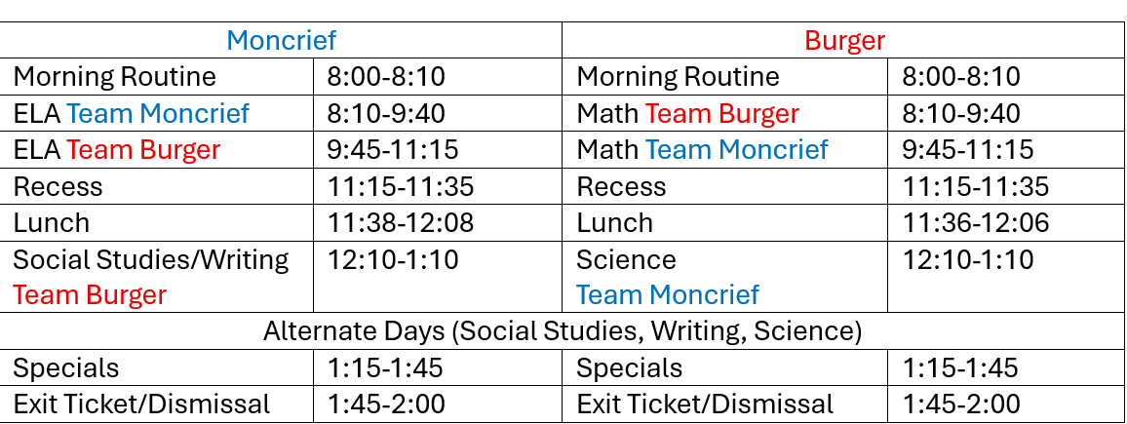


Slide 12

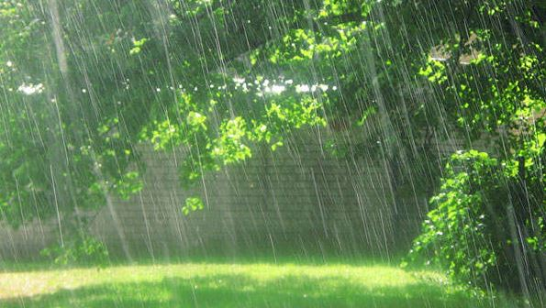
Recess: 11:15am-11:35am
Indoor Recess
Rainy Days
Heat Index is HIGH
Cold Weather

Slide 13

Team Burger 11:36am-12:06pm
Team Moncrief 11:38am-12:08pm
Breakfast and Lunch are FREE for all students.

Slide 14

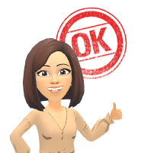
SPECIALS ARE HELD ON TWO CONSECUTIVE DAYS
Specials Rotation by Letter
1:15pm-1:45pm Daily

Slide 15


Students MUST be dressed in our unified dress/colors each day. Shirts should be Forest Green, Navy Blue, Canary Yellow or White and bottoms should be khaki and dark blue. Jeans are not permitted. However, Spirit shirts can be worn on Fridays with uniform bottoms.

Slide 16

School-Wide Rule
Three R’s
Respect
Responsibility
Ready to Learn

Slide 17


Classdojo encourages positive behavior in the classroom and throughout the school day. It is primarily to keep parents abreast of their child’s daily activities.
Students can earn points for staying on task, helping others, etc. Parents/Guardians will receive Alerts for missing homework.

Slide 18

Reading passages are paper-based (due daily) until laptops are released, then it will be iReady Reading
  iReady differentiate each child’s reading based on their iReady Inform Test
Math Homework are paper-based and due daily
Reading & Math Homework are participation grades
    10% of overall reading and math grade
You will be notified if homework is missed through a Classdojo Alert
  IF HOMEWORK IS CHANGED, IT WILL BE NOTED IN YOUR CHILD’S AGENDA.

Slide 19
Assessments
F.A.S.T.
Florida Assessment of Student Thinking
  3 times a year (PM1 was administered today, September 2nd ELA & September 10th Math)
  ELA, Math, (Writing)
ALL assessments are administered online

Slide 20

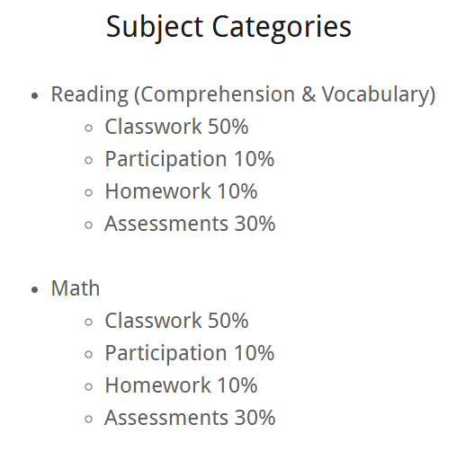
Students will be assessed digitally at the end of each Envisions chapter/topic. They must receive a score of 70% or higher to be on grade level in Math.
The math BEST standards will be taught through:
*Savvas/Envision
*iReady Math
*Success Maker
*Fluency Flight
*Khan Academy is a great resource for extra support. Also, check out the video QR code on each math page.
In fourth grade, students will take the FAST Math assessment.
Please visit flfast.org for more information.
PER ADMINISTRATION, MATH AND/OR READING MUST BEGIN AT 8:10 AM!!!

Slide 21
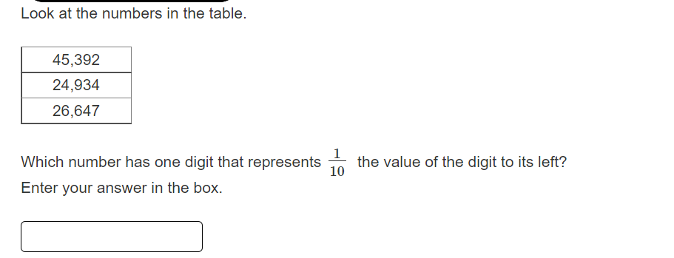


Slide 22

Literacy Block – 90 Minutes
Reading and Language Arts
Whole Group Mini Lesson (Benchmark Advance)
Literacy Rotations
iReady Reading, Sora online books, Epic Reading, Content Centers, Small Group Instruction with the Teacher

Slide 23


2. This question has two parts. First, answer Part A. Then, answer Part B.
Part A
What is the theme of Passage 1?
A. High hopes can lead to disappointment.
B. Listen to those who are older and wiser.
C. If you are nice to others, they will be nice to you.
D. When planning an event, be sure to include everyone.
Part B
Which sentence from the story supports the answer in Part A?
A. “She would wait for them, she said, and would not set until all three
returned and told her about their pleasant visit.” (paragraph 2)
B. “‘What did you bring me from the supper?’ she asked.” (paragraph 5)
C. “She ate it, and then she turned to her three children, for she had
something important to say to them.” (paragraph 6)
D. “‘To those who are thoughtful of their mother, great blessings come.’”
(paragraph 9):

Slide 24

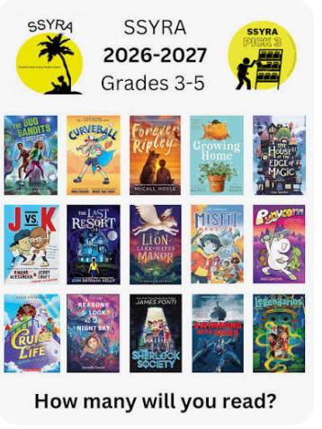
Sunshine State Books (SSYRA)
*Read 15 Sunshine states books & Pass the assessments (70% or above).
SSYRA books are available in our school library
and your local public library. You can also buy books
from Amazon and bookstores.
I’ve purchases books for
the class to share.
Book Check-out: September 8, 2026 (Every two weeks)

Slide 25

Reading Across Broward
R.A.B.
Students are required to read chapter books. Books are to be logged into Beanstack.
Before logging in any books, they must submit a summary (form available next to the mailboxes).
Window for R.A.B. is from April 1, 2026 – May 31, 2027
Any books read between April 1, 2026 – August 9, 2026 DO NOT require a summary.
Scholastics Book Club for Fun!!!!

Slide 26
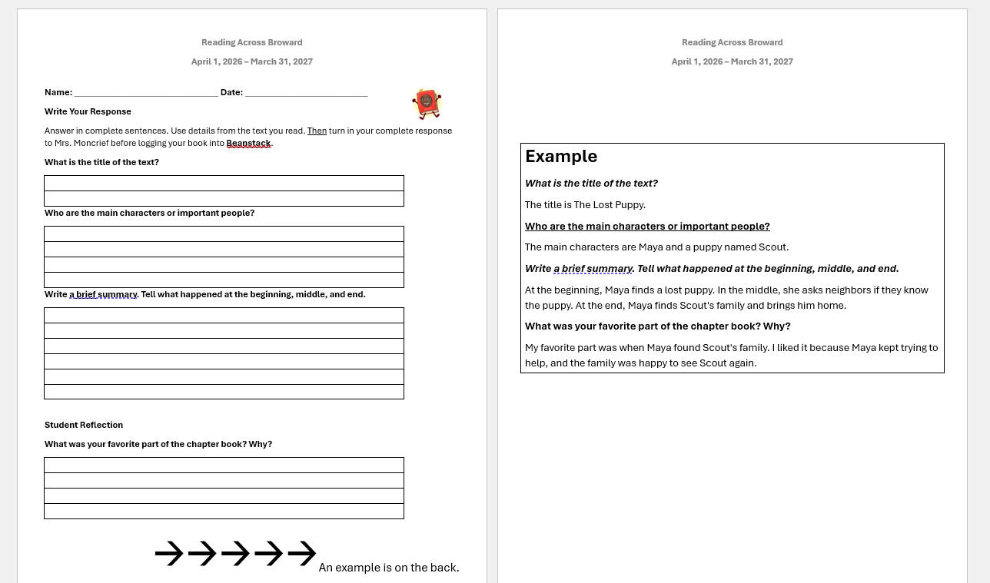
Why Chapter Books Matter for 4th Graders
Building Reading Stamina Chapter books help children develop the ability to focus and sustain attention over longer reading periods.
Deeper Story Engagement Unlike picture books, chapter books allow stories to unfold gradually, which strengthens comprehension and critical thinking skills.
Vocabulary Growth Chapter books introduce more sophisticated vocabulary in context.
Preparation for Academic Success By 4th grade, students transition from "learning to read" to "reading to learn."
One (1) chapter book with
summary are required
each month for a participation
grade in reading. We encourage students to
read two books per month when possible.

Slide 27


Spelling tests are paper-based. It require students to recognize the correct words and know the phonic skill.
Example: long “a” and short “a”

Slide 28

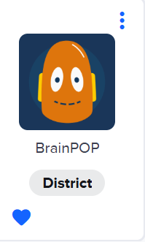

Delivery of Social Studies Instruction on
Gallopade
Social Studies Book
& Online Book

Slide 29

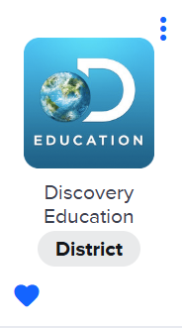

We will use Discovery Tech throughout the year to teach all Fourth grade science standards.
We will also use various online websites, such as, Study Jams, Generation Genius, BrainPop, and Discovery Ed.

Slide 30


WRITING ASSESSMENT IS NOT FOR PROMOTION
Elementary Learning has developed writing lessons for grades 3-5 that are aligned to Social Studies standards.

Slide 31

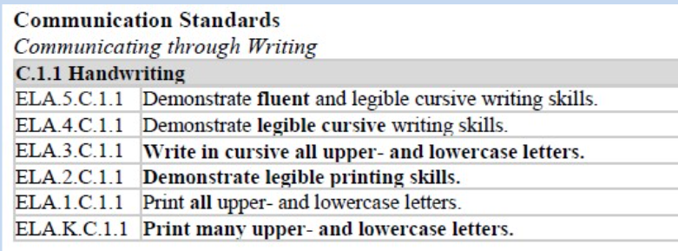
BCPS and Benchmark Advance Cursive Writing Curriculum with Callie Cursive

Slide 32

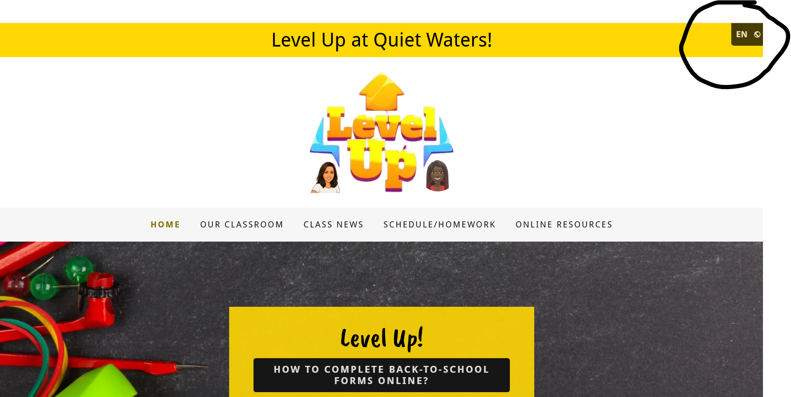

www.mblearningtree.com

Slide 33
Please join our PTA!!
Quiet Waters PTA Board of Directors
President: Amanda Fields
1st Vice President: Heather Quercia
2nd Vice President: Sytonya Carrington
3rd Vice President: Christina Carril
4th Vice President: Dustin Jeffers
Treasurer: Wyndi Harris
Recording Secretary: Heather Quercia
Corresponding Secretary: Michelle Giraldo
Historian: Val Mayer

Slide 34


How to opt-in to accept laptop property pass.

Slide 35

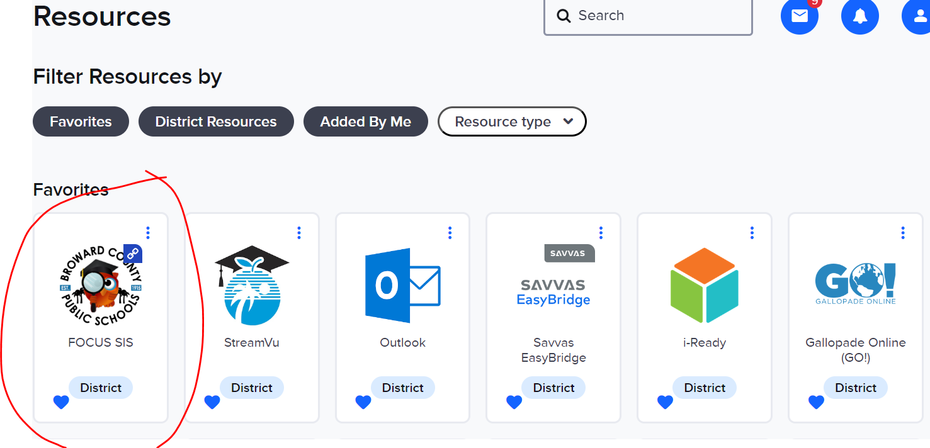
To log into Clever:
06student number@my.browardschools.com
Password: qwe1
View Current Grades!!!

Slide 36
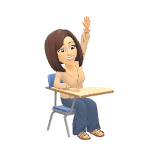
No stickers on the laptops.
Students MUST bring the laptop to school each day, FULLY charged.

Slide 37


Birthdays are celebrated DURING lunch. All items must be store-bought NOT homemade.

Slide 38

Mrs. Burger and Mrs. Moncrief will meet with parents/guardians together through Microsoft Teams, via phone, or in person.
Two(2) Meetings per school year
Availability
2:10p.m. - 2:40p.m
7:30a.m. – 7:50 a.m.

Slide 39

What can I do for my child at home?
Be attentive of what websites your child is on.
Make sure the laptop is charged so your child will be ready to learn when arriving to school.
Verify that homework is complete. No need to teach.
Allow your child to read aloud to you. This could be done while you’re cooking.
iReady, iReady, iReady!!!!!!!!

Slide 40


www.mblearningtree.com
jennifer.burger@browardschools.com
veronica.moncrief@browardschools.com
ClassDojo messaging
Any Questions?

