Slide 1


Please sign in.

Slide 2

23 Years of Teaching
17 years at Quiet Waters Elementary
I believe learning takes place in a positive and comfortable environment, free from STRESS.

Slide 3

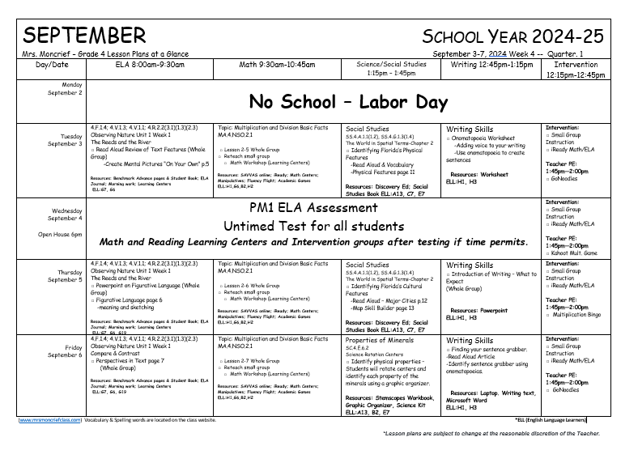
Students are escorted into class
at 7:50am.
ELA (Reading) Morning Work
Monday’s Weekly Agenda
Lesson Plans at a Glance is online for students and parents

Slide 4

School begins at 8:00am. Your child is late at 8:01am. Bus riders are not marked tardy and
are allowed to eat breakfast upon their arrival.
If you have a change in dismissal, please contact the front office by 12:00 noon.
School begins at 8:00am. Students are late at 8:01am!
Change in dismissal needs to be done by 12:00pm by
notifying the front office

Slide 5

We are planning 2-3 field trips this school year.
Museum of Discovery & Science in November
Miracle Ranch in January
Movies
ALL Field trips are paid online.

Slide 6

You must register online and be approved as a volunteer before attending field trips. You may register online at:
https://www.browardschools.com/Page/37924
The website link is located on my class website.

Slide 7

Wordly Wise Vocabulary Program
The program provide direct academic vocabulary instruction to develop the critical link between vocabulary and reading comprehension.
During Intervention Time
All students can benefit from it!

Slide 8
Grades PK-5 teachers have access to Scholastic Literacy Pro, Short Reads Digital, and Scholastic F.I.R.S.T. (Foundations In Reading, Sounds, and Text).

Slide 9


Opening Routine
Literacy Block 8:00-9:30
ELA Morning Work Review
Mini Benchmark Advance Lessons
Small Group
Learning Centers
Math Block 9:30-10:45
Whole Group
Math Workshop
Intervention 12:15-12:45
(Wordly Wise Vocabulary Program)
Writing 12:45-1:15
Science/Social Studies 1:15-1:45

Slide 10

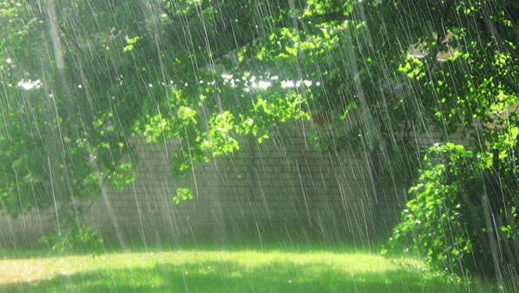
Recess: 11:15am-11:35am
Indoor Recess
Rainy Days
Heat Index is HIGH
Cold Weather

Slide 11

Lunch: 11:42am – 12:12pm
Lunch and Breakfast are FREE for all students.

Slide 12

SPECIALS ARE HELD ON TWO CONSECUTIVE DAYS
Specials Rotation
10:45am-11:15a.m Daily
Science (Pink Day – Mr. Lustig)
Music (Green Day - Mrs. Corelli)
P.E. (Purple Day - Coach Kiene)
Art ( Red Day - Ms. Gasher)
STEM (Blue Day - Mr. Hebster)

Slide 13


Students should be dressed in our unified dress/colors each day. Shirts should be Forest Green, Navy Blue, Canary Yellow or White and bottoms should be khaki and dark blue. Jeans are not permitted.

Slide 14

School-Wide Rule
Three R’s
Respect
Responsibility
Ready to Learn

Slide 15


Classdojo encourages positive behavior in the classroom and throughout the school day. It is primarily to keep parents abreast of their child’s daily activities.
Students can earn points for staying on task, helping others, etc.
Students are able to use their points to earn incentives, such as, lunch bunch, use teacher’s chair for a day….

Slide 16

Planners are completed on Monday for the week. I check that each planner is complete with a STAR and parents are notified that the planner has been checked through Classdojo.
Reading passages are paper-based until laptops are released, then it is iReady Reading
  iReady differentiate each child’s reading based on their iReady Diagnostic
Math Homework are paper-based and due daily
We check Math daily during our math block
Reading & Math Homework are participation grades -- EFFORT
You will be notified if homework is missed through a Classdojo Alert

Slide 17
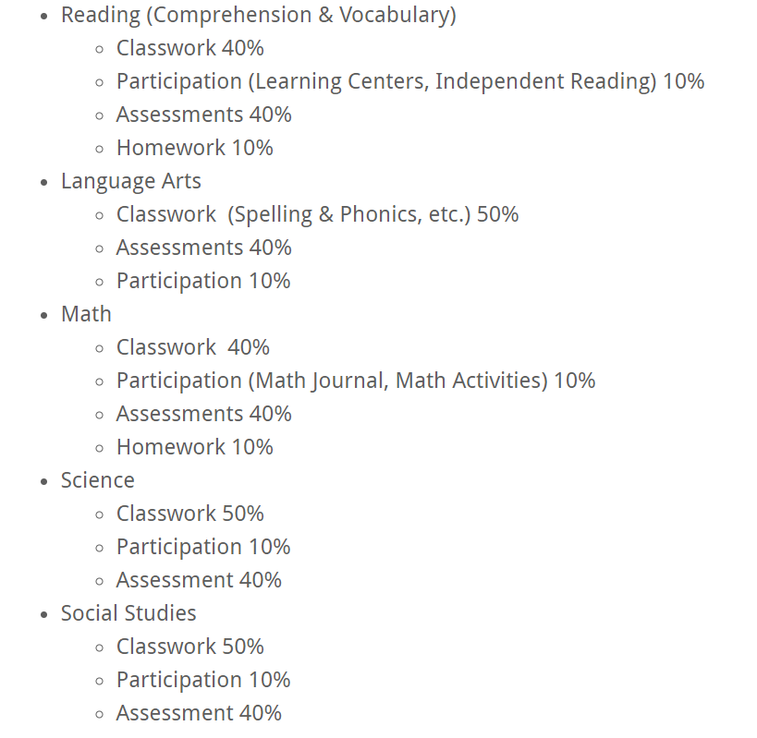
Assessments
Categories
F.A.S.T.
Florida Assessment of Student Thinking
  3 times a year (PM1 administered today!)
  ELA, Math, (Writing)
ALL assessments are administered online

Slide 18

Literacy Block – 8:00am-9:30am
Reading and Language Arts
ELA morning work (Language Arts and Reading)
Whole Group Mini Lesson (Benchmark Advance)
Literacy Rotations
Reading Games, Reading Books/Epic online books, Content Centers, Small Group Instruction with the Teacher

Slide 19


2. This question has two parts. First, answer Part A. Then, answer Part B.
Part A
What is the theme of Passage 1?
A. High hopes can lead to disappointment.
B. Listen to those who are older and wiser.
C. If you are nice to others, they will be nice to you.
D. When planning an event, be sure to include everyone.
Part B
Which sentence from the story supports the answer in Part A?
A. “She would wait for them, she said, and would not set until all three
returned and told her about their pleasant visit.” (paragraph 2)
B. “‘What did you bring me from the supper?’ she asked.” (paragraph 5)
C. “She ate it, and then she turned to her three children, for she had
something important to say to them.” (paragraph 6)
D. “‘To those who are thoughtful of their mother, great blessings come.’”
(paragraph 9):

Slide 20


Sunshine State Books (SSYRA)
*Read 10 Sunshine states books & Pass the assessments (70% or above) OR complete a project for a Party.
*Read 14 Sunshine states books & Pass the assessments (70% or above) or complete a project for a Party and Field Trip.
SSYRA books are available in our school library
and your local public library. You can also buy books
from Amazon and bookstores.

Slide 21


Spelling tests & ELA pamphlets are paper-based. Spelling tests are given 2-3 times within a each unit. It require students to recognize the correct words and know the phonic skill.
Example: long “a” and short “a”

Slide 22


9:30am – 10:40am
Math Block
Whole Group – Math Instruction
Math Workshop:
iReady Math (My Path) (2) SAVVAS practice (3) Math Manipulatives or Enrichment (4) iReady Fluency Flight (Multiplication)
Teacher Table: Review Homework

Slide 23
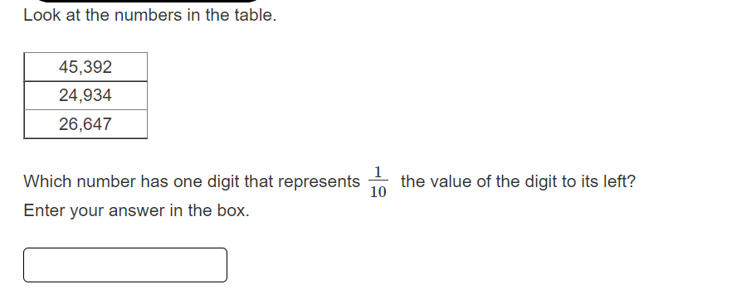

Slide 24



Delivery of Social Studies Instruction on Tuesday & Thursday
Gallopade
Social Studies Book
& Online Book

Slide 25





Delivery of Science
Instruction on Monday,
Wednesday, & Friday
Science Book & Online Science Book

Slide 26

Awaiting New Writing Program
Core Connection
Lori Gondalfo of Core Connections
Classroom visit on Sept. 5
Writing Preparation: Sentence structure, extended sentences with details, Microsoft Word, Typing Program, etc.

Slide 27


Slide 28

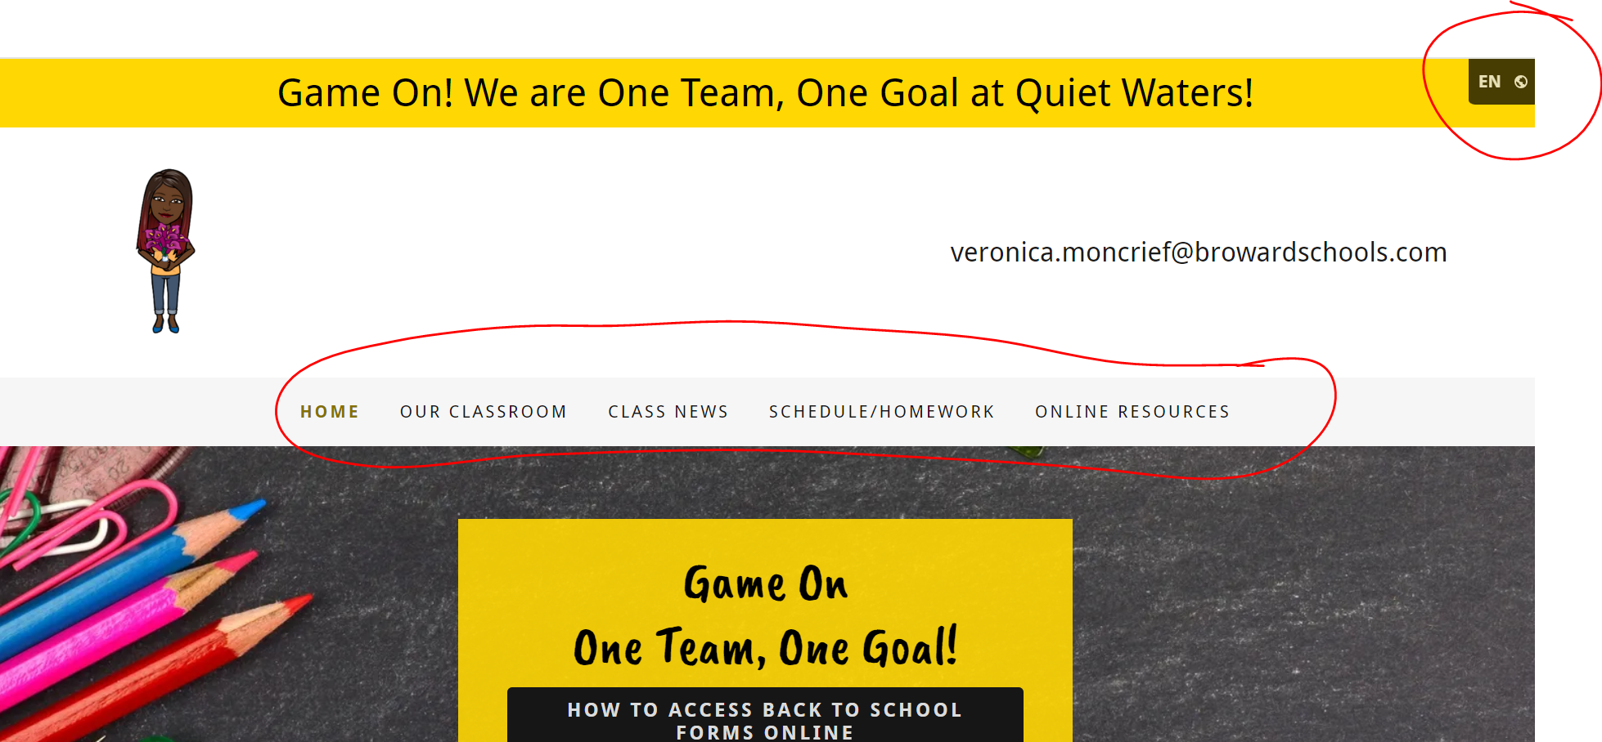

Slide 29
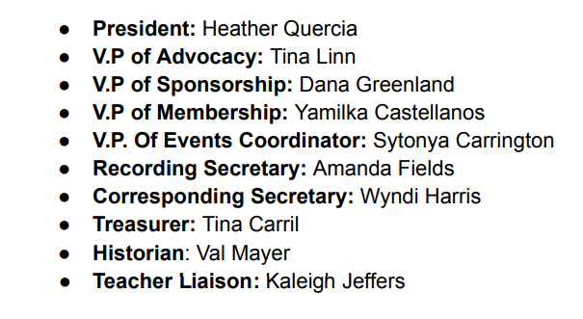
Please join our PTA!!

Slide 30

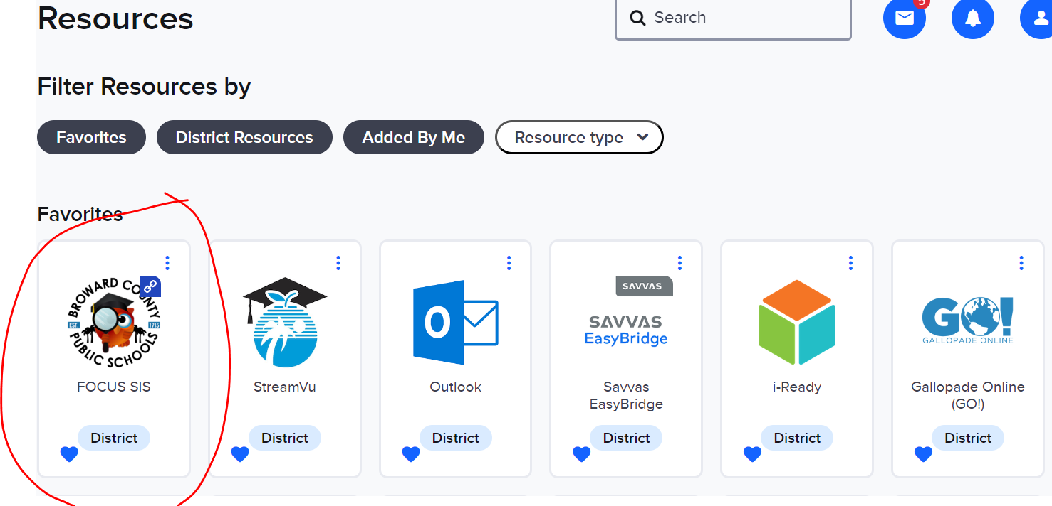
To log into Clever:
06student number@my.browardschools.com
Password: qwe1
View Current Grades!!!

Slide 31


Students will be communicating, collaborating, researching, and presenting their learning to their classmates and teachers.
Students MUST bring the laptop to school each day, FULLY charged.
Any technical issues will be handled at the school during the school day but may result in a loss of the laptop for the evening.
Contact your child’s teacher immediately if the laptop is damage or lost. Timing is critical to the possible recovery and repair/replacement of the device.
The laptop is to be used only for school assignments and school work. Refrain from accessing internet sites not related to classroom assignments. No additional software or applications are to be installed on the laptop. If so, this may result in lost of laptop privileges.
When students are connected to the district’s network, they will be blocked through our proxy/content filtering appliances. When they are connected outside of the district’s network, the proxy/content filtering will not be active.
No stickers or profile pictures.

Slide 32

Property passes must be signed in order for laptops
to be released for home.

Slide 33



Birthdays are celebrated DURING lunch. All items must be store-bought NOT homemade.
Caution: We are a peanut-free classroom!

Slide 34

I will meet with parents through Microsoft Teams, via phone, or in person.
Two(2) Meetings per school year
Available 7:30a.m. - 7:55a.m. OR 2:15p.m. - 2:45p.m
I can meet later in the evening on TEAMS.

Slide 35

What can I do for my child at home?
Be attentive of what websites your child is on.
Make sure the laptop is charged so your child will be ready to learn when arriving to school.
Verify that homework is complete. No need to teach.
Allow your child to read aloud to you. This could be done while you’re cooking.
SAVVAS math has remediation and enrichment online. After I’ve assigned a math playlist in class, the computer
automatically assign either remediation or enrichment.

Slide 36


www.mrsmoncriefclass.com
veronica.moncrief@browardschools.com
ClassDojo messaging
Any Questions?
Let’s hop over to the class website!

