Slide 1

SERVICE PROPOSAL — MAY 2026
Service Description
For the integrated assessment and management of your operational risks
PREPARED BY
Services É-risque industriel majeur Inc.
Éric Clément, B.Sc., M.Env., ABCP, PHA Leader
Amine Lefkir, P.Eng., M.Sc.A., PHA Leader

Slide 2
Company Profile
01 / COMPANY PROFILE
OUR MISSION
Making operational risks manageable — through rigorous expertise, a vision that is both strategic and operational, and clear communication with all stakeholders.
26+
years of experience
200+
projects delivered
4
provinces covered
FR / EN
bilingual
Core expertise: hazardous substances (major industrial / technological hazards)
Full coverage: risk analysis, prevention, preparedness, response, communication and business continuity
Field and corporate management experience
Active involvement in dozens of real-world emergencies
Pan-Canadian and international network

Slide 3
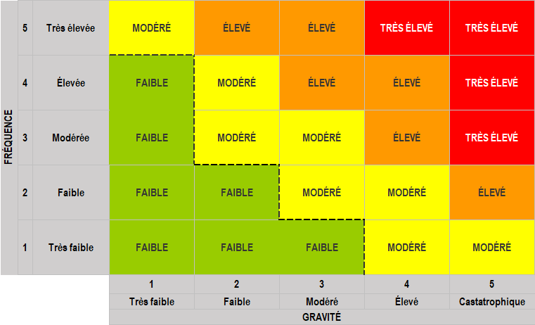
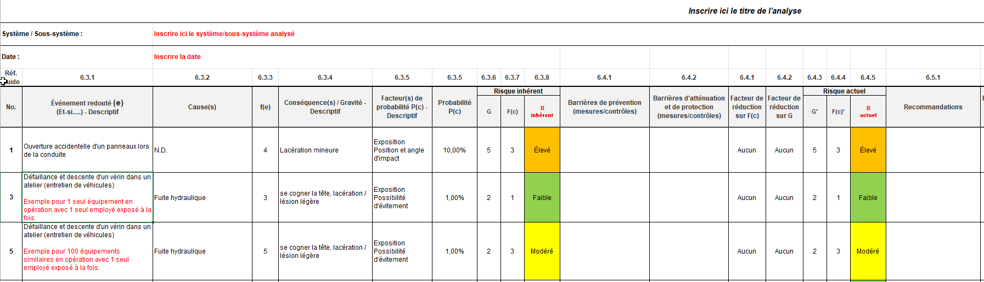
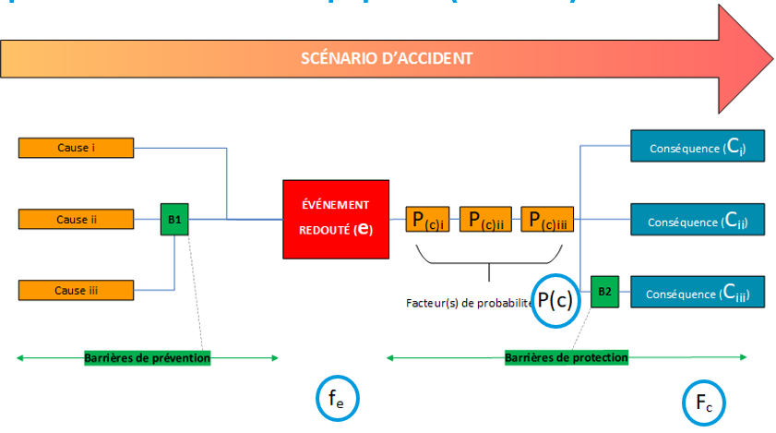
Risk assessment / process Hazard analysis
02 / EXPERTISE — RISK ASSESSMENT / PROCESS HAZARD ANALYSIS
Systematic identification of accident scenarios and qualitative or semi-quantitative risk evaluation.
HAZID / PHA — Hazard identification
What-if — Structured questioning analysis
HAZOP — Hazard and Operability Study
Bow-Tie — Causes / consequences / barriers representation
FMEA / FMECA — Failure modes and effects analysis
LOPA — Layers of protection analysis
TRA — Threat and risk assessment (security)
Siting Study / OBRA — Location selection study
ATEX Study
Development of corporate risk acceptability matrices
Visual to insert

Slide 4
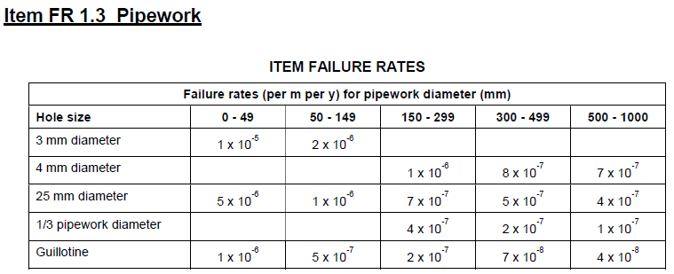
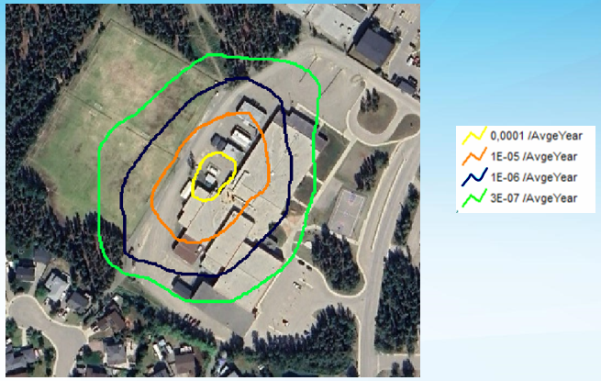
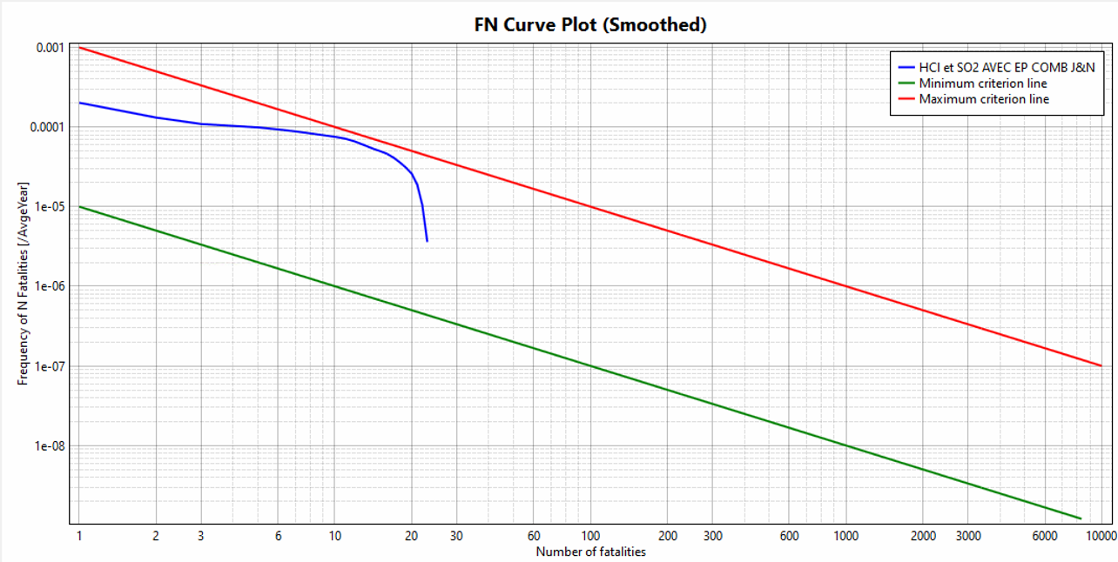
Quantitative Risk Analysis (QRA)
03 / EXPERTISE — QRA
Quantified risk evaluation combining frequencies and consequences to support fully informed decision-making.
Location specific individual risk (LSIR) — isocontours for land use planning
Societal risk (F-N curves for land use planning)
Individual Risk Per Annum (IRPA) for a site
Identification of major contributing scenarios
Comparison against recognized acceptability criteria
Risk Assessment Report (RBQ — art. 85 Quebec Safety Code)
Compliance with standards (e.g. CSA Z276, clause 14.3)
Recognized software: SAFETI (DNV)
Visual to insert

Slide 5
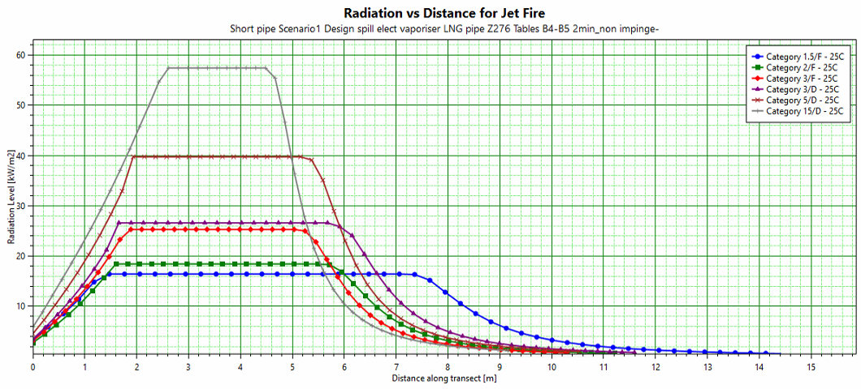
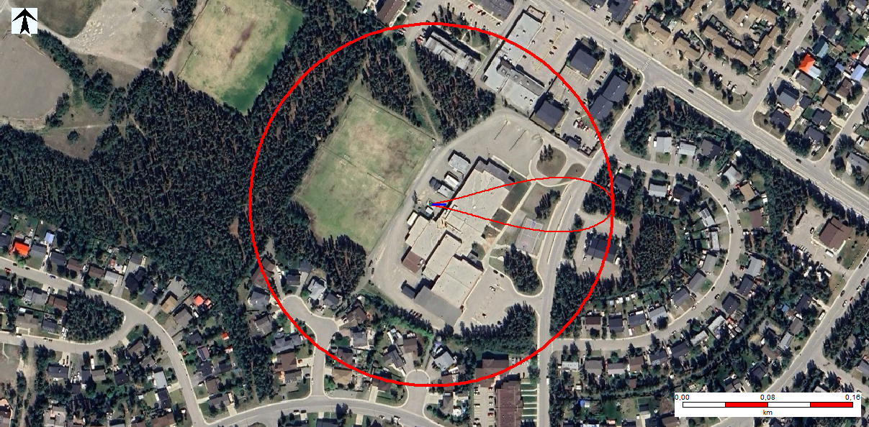
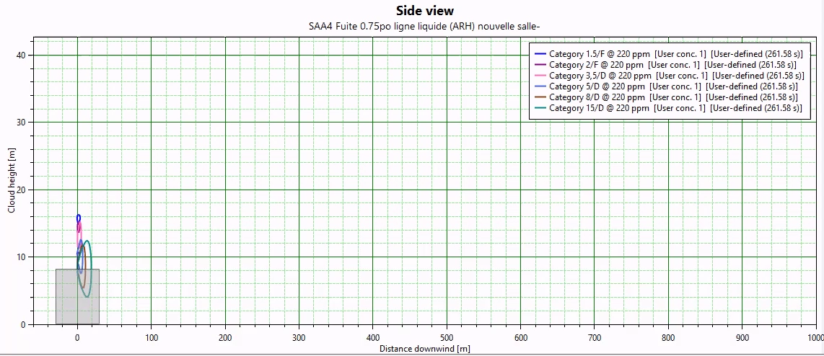
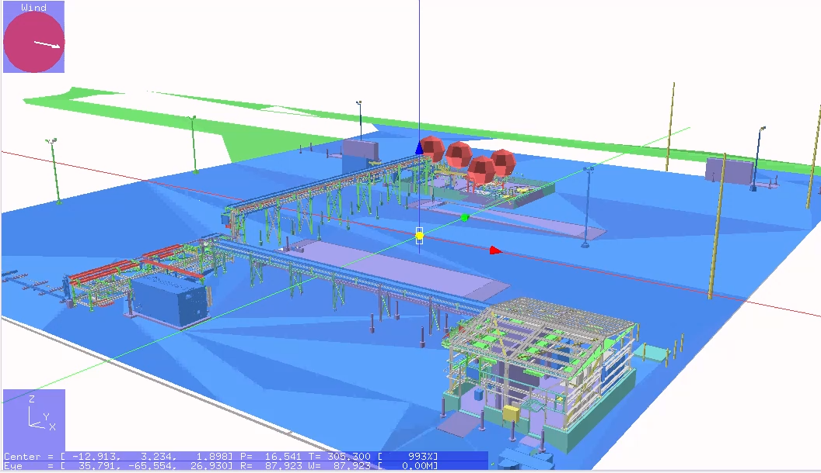
Consequence Modelling
04 / EXPERTISE — MODELLING
Visual to insert
Quantitative evaluation of the effects of a release or incident involving hazardous substances.
Toxic effects (e.g. NH₃, Cl₂, H₂S, SO₂, HCl, TDI, etc.)
Thermal radiation (jet fire, flash fire, BLEVE, pool fire, fireball)
Overpressure (explosion)
Domino effects between equipment
CFD modelling
Recognized software: PHAST (DNV)

Slide 6
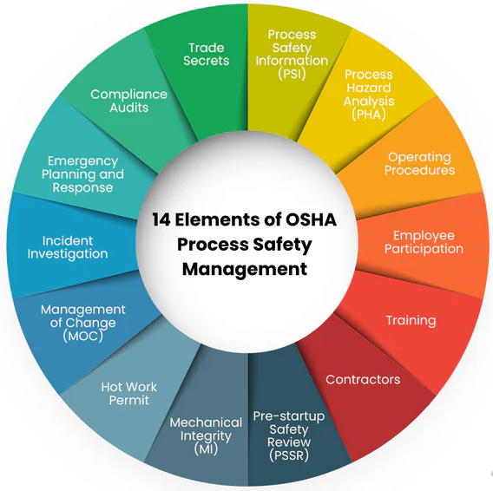
Process Safety Management (PSM)
05 / EXPERTISE — PSM
Support for implementation and improvement of process safety management components
PSM - Process Safety Management
Visual to insert
14 elements of PSM

Slide 7
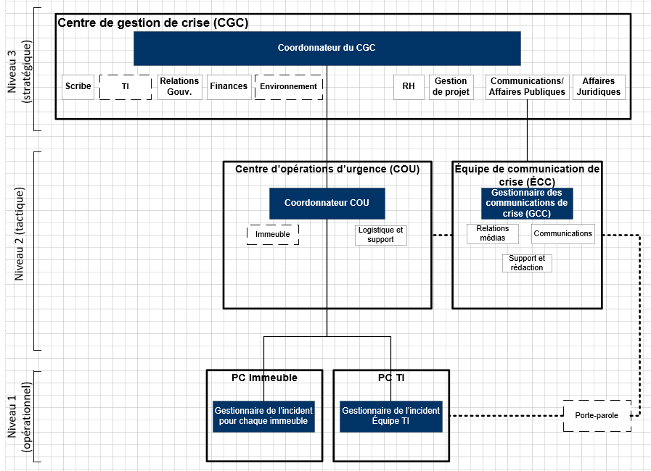
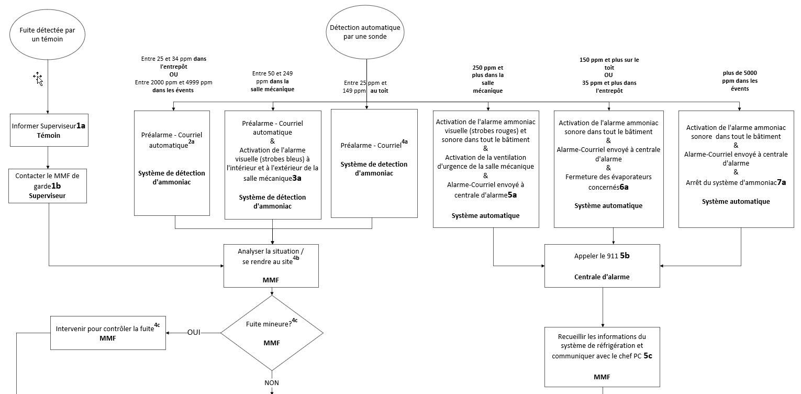
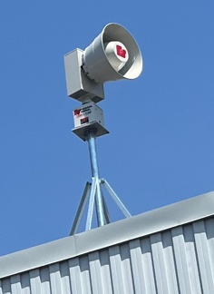
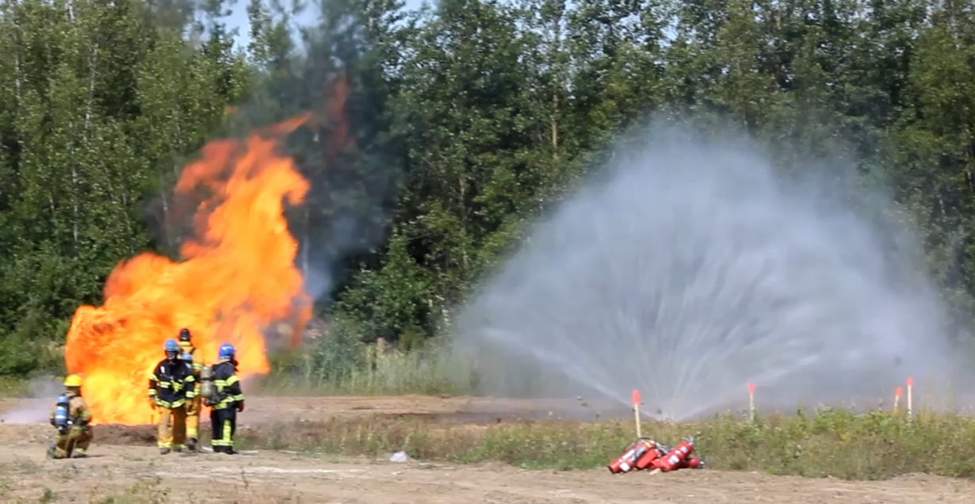
Emergency Planning, Response and Communication
06 / EXPERTISE — EMERGENCY PREPAREDNESS AND RESPONSE
Preparing for emergencies, communicating and responding to - from operational emergency plans to strategic crisis management.
Integrated emergency response and crisis management systems
Emergency plans and procedures (fixed facilities, transportation, buildings)
Emergency training and exercises (tabletop, functional, full-scale)
Risk communication and public alerting (before, during, after)

Slide 8
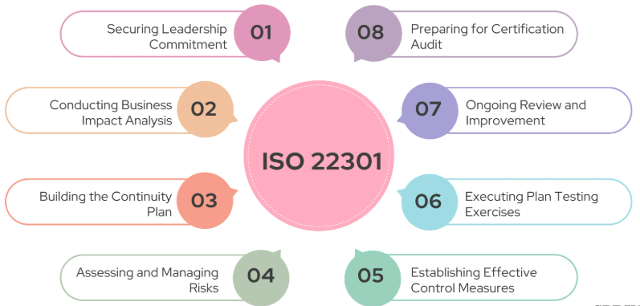
BUSINESS CONTINUITY (BCP)
07 / EXPERTISE — BUSINESS CONTINUITY (BCP)
Preparing for an disruption of operations or business, communicating and activating the plan — from departmental continuity plans to IT disaster recovery and strategic crisis management.
Business Impact Analysis (BIA)
Integrated emergency response and business continuity systems
Continuity plans and procedures
Continuity and recovery training and exercises (tabletop, functional, full-scale)
Continuity and recovery plans (BIA, ISO 22301)
IT disaster recovery plan (DRP)

Slide 9
Most Common Regulatory Framework
08 / EXPERTISE — REGULATORY FRAMEWORK
In-depth knowledge of standards and regulatory requirements.
Environmental Emergency Regulations (E2, ECCC)
Regulation respecting environmental impact assessment and review
Building Code
Quebec Safety Code, Gas Chapter (2026 revision)
Quebec OHS Act
CSA Standards
Z276 (LNG facilities)
Z662 (pipelines)
B52 (refrigeration)
Land use planning support (municipalities and CSA Z663)
Emergency Planning Zones (EPZ) determination (CSA Z246.2)
Involved in multiple CSA standards and regulatory development

Slide 10
Éric Clément, B.Sc., M.Env., ABCP, PHA Leader
09 / MAIN TEAM
Founder and President
26+ years of experience in operational risk management
Former Corporate Director — Risk Prevention, Emergency Preparedness, Security and Continuity at Énergir (8 years)
Corporate Emergency Coordinator (managed coordination centres — EOC, CMT)
Canadian representative — OECD (chemical accidents and safety performance indicators)
Vice-President of the CRAIM Board
Member of CSA Z246.1, Z246.2 and Z663 committees
Pan-Canadian working group on E2 Regulations (ECCC)
Advisory committee — Quebec Safety Code (RBQ)
Bilingual (FR/EN) trainer and speaker, Canada and international

Slide 11
Amine Lefkir, P.Eng., M.Sc.A., PHA Leader
09 / MAIN TEAM
Dedicated resource — Senior Consultant
10 years of experience in operational risk management
Chemical Engineer (member of OIQ, PEO, EGBC)
Research master's in organizational resilience — Polytechnique Montréal
Experience at Énergir: emergency and continuity coordinator, OHS advisor, major projects manager
Managed a project portfolio of $40M+ (RNG stations)
Maintained CSA Z246.2 and ISO 22301 management systems
Field emergency response experience with municipal services (fire departments)

Slide 12
Industry Sectors
10 / CLIENTELE
A diversified clientele, from the private sector to government and municipal organizations.
Energy: natural gas, LNG, CNG, RNG, hydrogen
Food and agri-food industry (NH₃ refrigeration)
Chemical and petrochemical industry
Mining and metallurgical industry
Pulp and paper
Aerospace
Transportation (rail, maritime, TDG dangerous goods)
Government organizations (federal, provincial)
Municipal organizations and CMMI
Education and real estate management
Etc.

Slide 13















Selected Clients
10 / CLIENTELE
A selection of clients who have placed their trust in É-risque
Énergir
Lassonde
Lactalis
Saputo
Agropur
Lineage
Domtar
ALTO
Transport Desgagnés
Stablex
Glencore
Metro Vancouver
STM
Groupe Morneau
Exceldor
Enercon
Municipal & Government
Subcontracting
Notes:
Municipal clients: Victoriaville, Terrebonne, Laval, McMasterville, Montmagny, Longueuil.
É-risque also works as a subcontractor for firms such as Tetratech, Stantec, GHD, BBA and BDO.

Slide 14
Contact Information
11 / CONTACT
Éric Clément, M.Env., ABCP, PHA Leader
President
Phone
514-835-0930
Email
eric.clement@e-risque.ca
Web
www.e-risque.ca
Amine Lefkir, P.Eng., M.Sc., PHA Leader
Senior Consultant
Phone
514-967-3463
Email
amine.lefkir@e-risque.ca
Web
www.e-risque.ca

