Slide 1
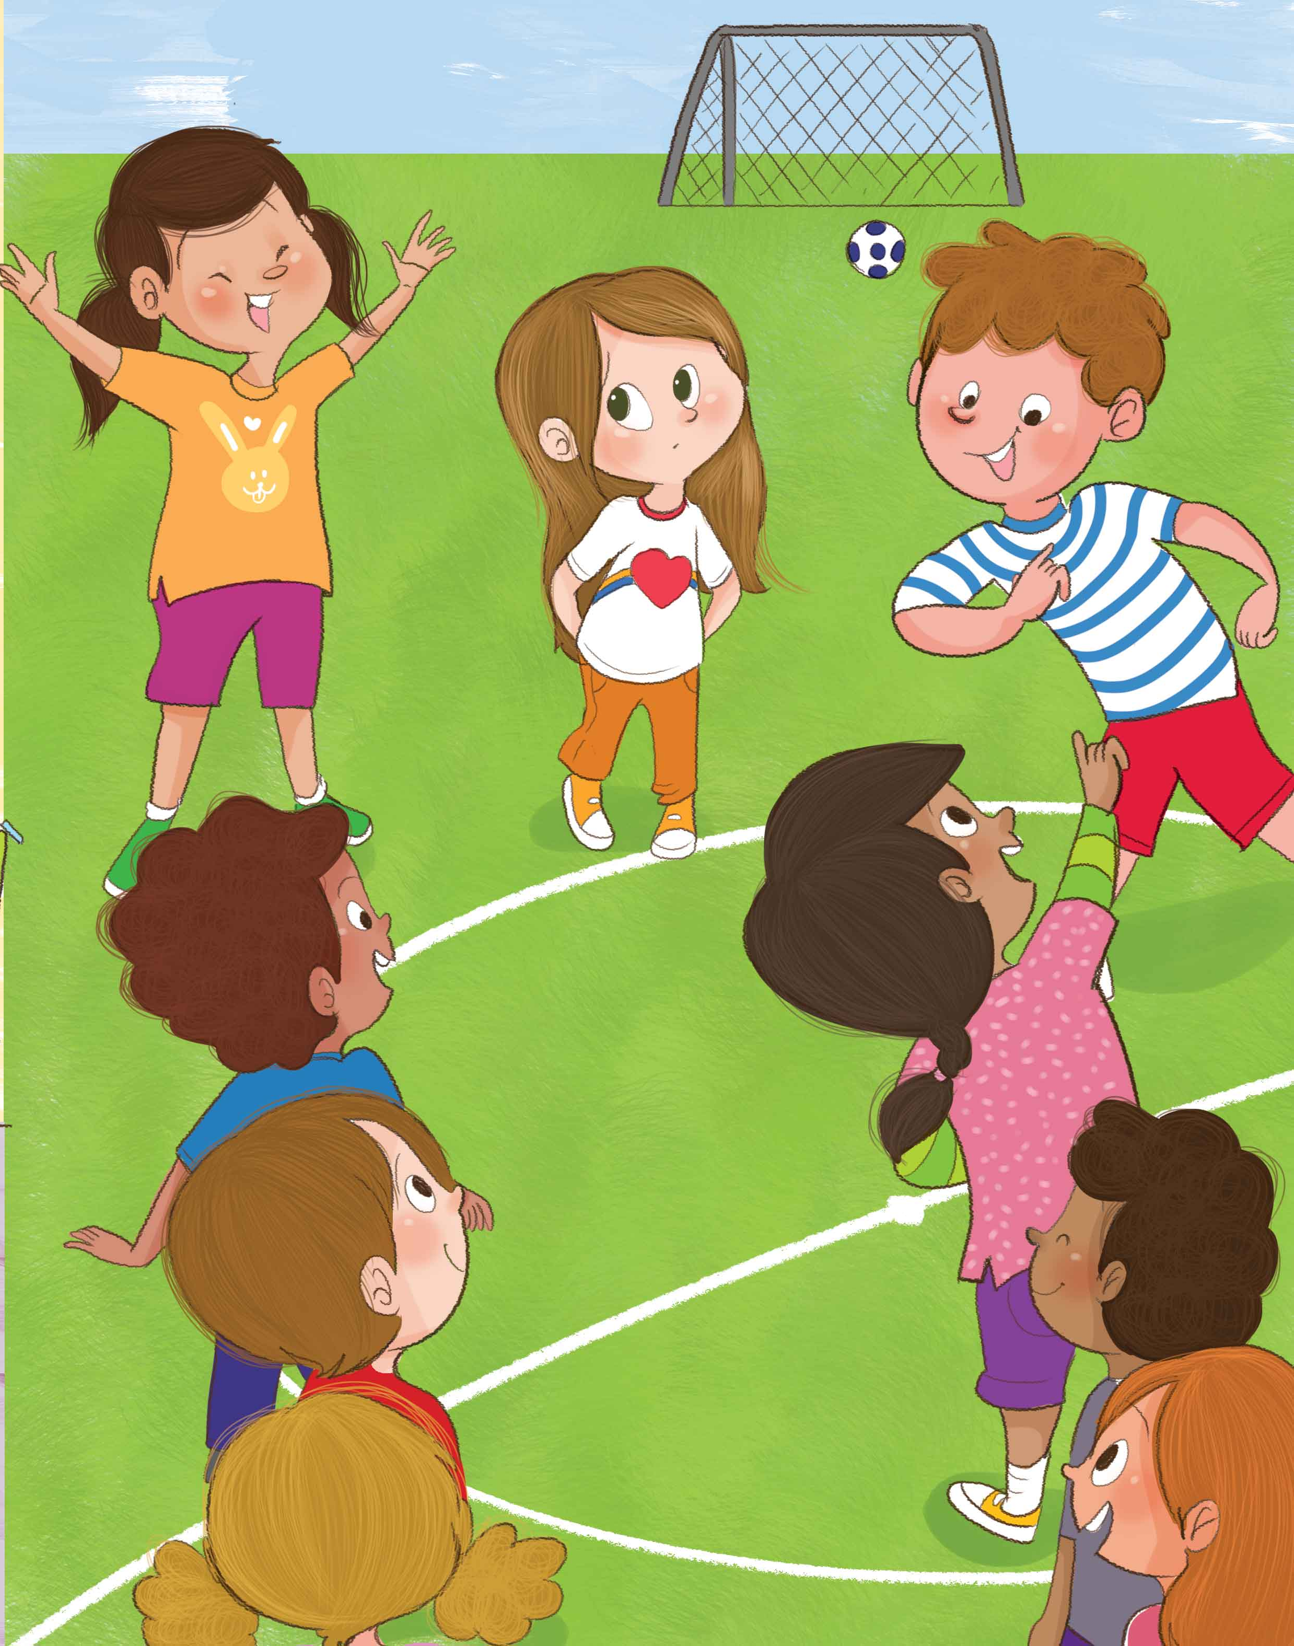
Being Small Bullying Prevention Activity
Direction: Drag the traits into the appropriate category.
You are different
You can’t play with me
Will you play with me?
You are special
Will you sit with me?
Your shirt is pretty
I am better than you
You can’t sit with me
Your shirt is yucky
We are both equal
Go away!
Let’s have fun together!
Bully | Friend

