Slide 1

Mercury
Mailbox Design
Competition
2024

Slide 2


Postcards
Into Space
Mailbox Challenge

Slide 3

Postcards Into Space Mailbox Challenge
Blue Origin Club for the Future sponsors the Postcard into space program.
Any student can write or draw their vision on a postcard for what they think the future of life in space will look like
Postcards are sent to Club for the Future, which will facilitate their launch into space and back on a New Shepard rocket.
Postcards will be returned stamped with "Flown to Space."

Slide 4


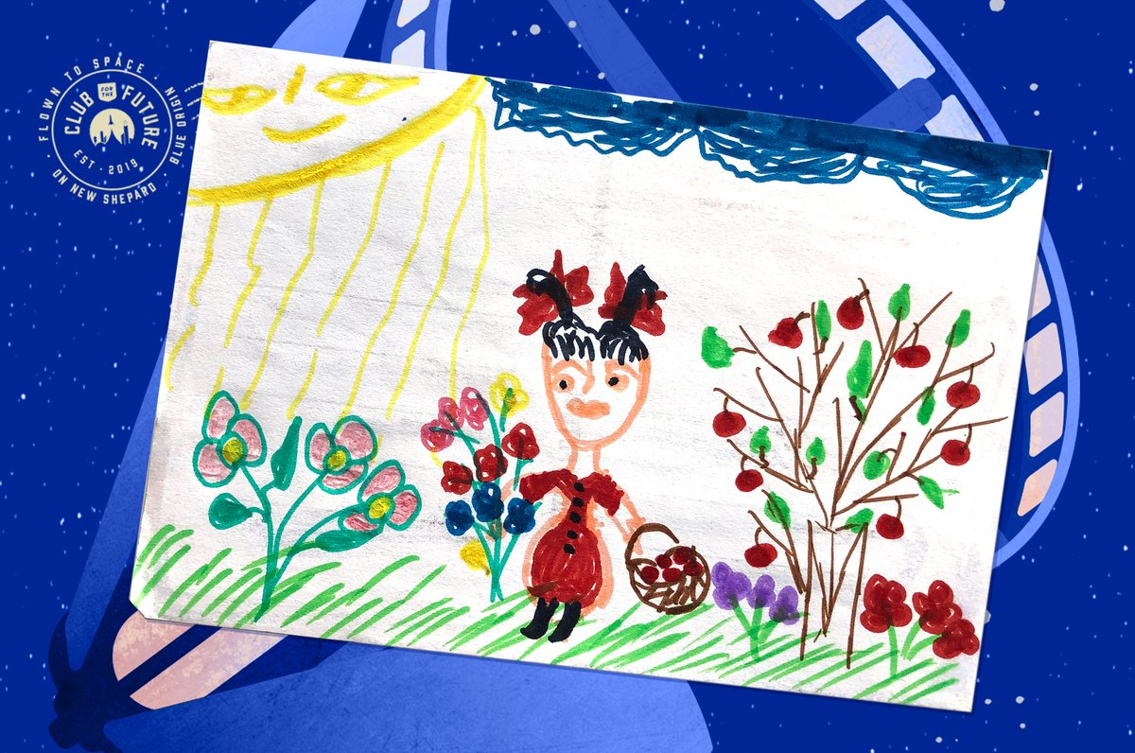
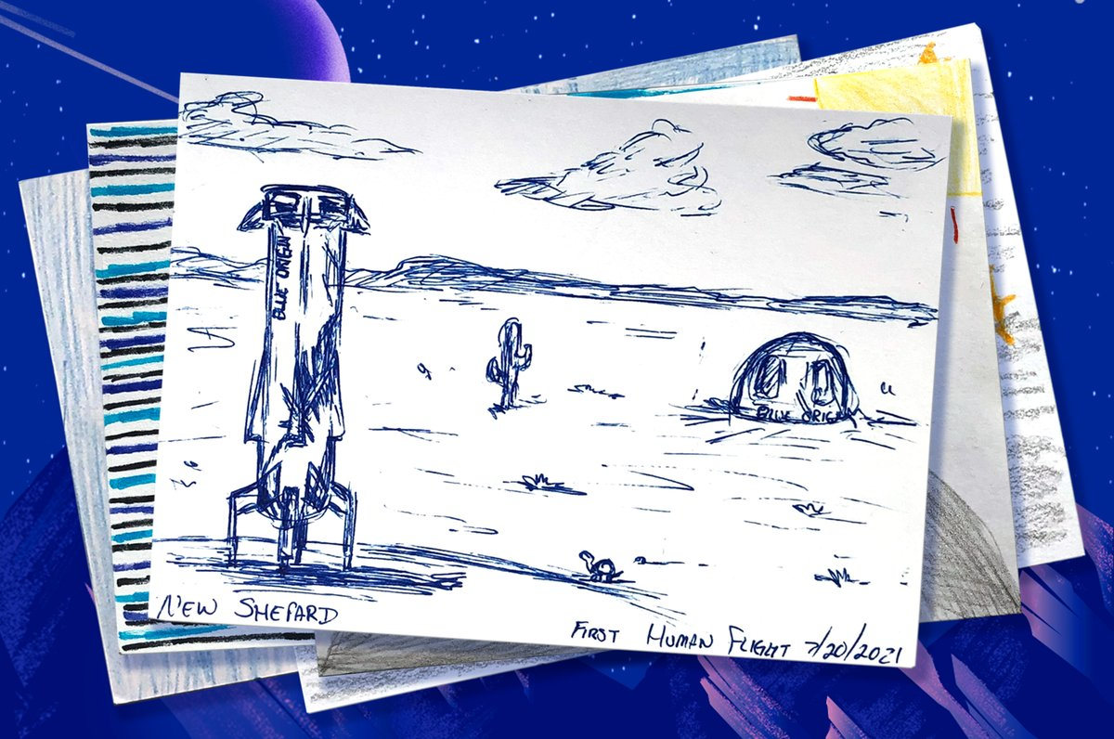
https://www.clubforfuture.org/

Slide 5
Postcards Into Space Mailbox Challenge
In this project, students will design a mailbox for their school to receive the postcards so they can be gathered and sent to Club for the Future.
Student’s will then create a life size mailbox and place it in their school to actively support student participation in this program.

Slide 6
Postcards Into Space Mailbox Challenge
The visual appearance of the mailbox must encompass the subject “Space Exploration, the observing and monitoring of Earth’s Environment”.
The mailbox must be easy to use, and construct and transportable.
The security of the postcards and ease of mailing and mail retrieval must be considered.

Slide 7
Postcards Into Space Mailbox Challenge
The mailbox must be designed according to the following specifications
  15"W x 15"D x 40"H. (does not include the support plate if used)
  Must also incorporate in its design the following logos:
      The participating School’s emblem or logo
      Club for the Future and/or Blue Origin logo
      Student Astronaut Challenge Logo

Slide 8
Postcards Into Space Mailbox Challenge
Comprehensive design plans (perspective drawings, schematics, materials, costs, etc.)
Must construct a functioning life size mailbox and present it at the competition.
Presentation Power Point overview of their project design, construction and a hard copy of the design plans
Presentation should include detailed photographic evidence of what was built and shows it in action at
their school.

Slide 9
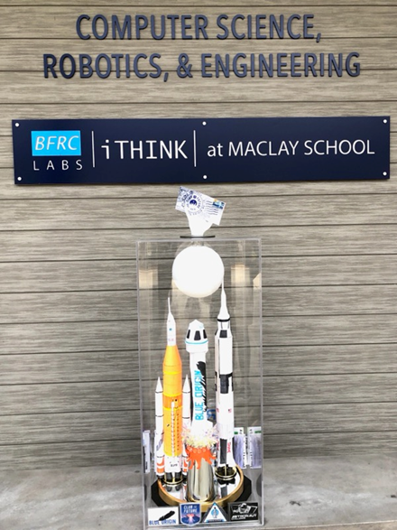
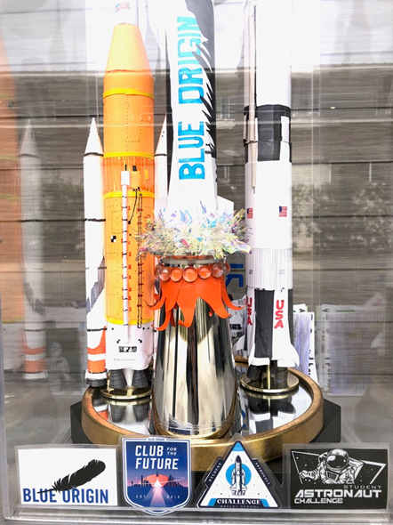

Slide 10
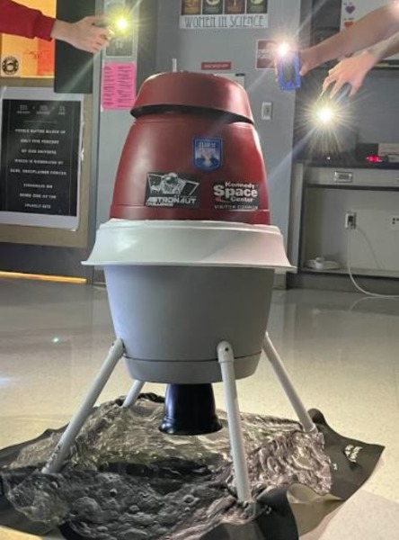
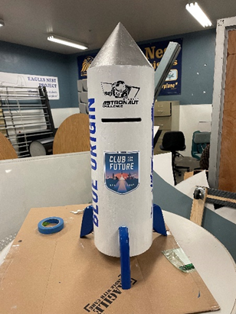

Slide 11
