Slide 1
Autumnwood Property Owners Association Annual Meeting - September 25, 2024
Current APOA Board
Duane Lockas – President
Kim Czyz – Treasurer
Jim Smith – Secretary
Jim Carlson
Lori Kimes

Slide 2
Autumnwood Property Owners Association Annual Meeting - September 25, 2024
Meeting Agenda
Meeting called to order
Welcome Greeting – Duane Lockas
Annual Report – Jim Smith
Treasurer’s Report – Kim Czyz
2025 Budget Proposal
New Business
Vote to install new board members for next 3 years term.
Open floor to property owners for Q&A
Wrap up/Adjourn meeting

Slide 3
Autumnwood Property Owners Association Annual Report September 25, 2024
Since our last Property Owners Association (POA) Annual Meeting on September 26, 2023:
All meeting minutes and reports remain available on our website at https://autumnwoodpoa.com/
Property assessments 2024 were sent and to date we have received all assessment fees. Thank you everyone.
The City resurface of the streets was completed by November 2023.

Slide 4
2024Treasurer’s Report 2025 Proposed Budget Kim Czyz

Slide 6
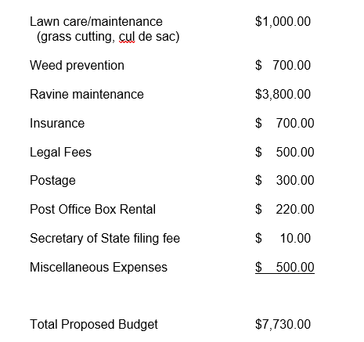
Autumnwood Property Owners Association Treasurer’s 2025 Proposed Budget September 1, 2024 – August 31, 2025

Slide 7
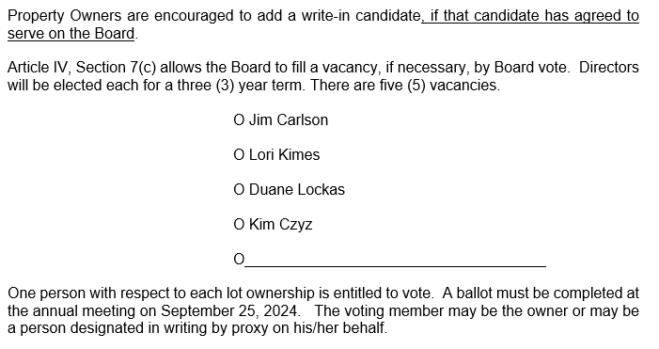
New Business
Vote for new board members
New board election slate and ballot
Vote and Tally

Slide 8
New Business
Topics for consideration
and discussion
New board election slate and ballot
Vote and Tally

Slide 9
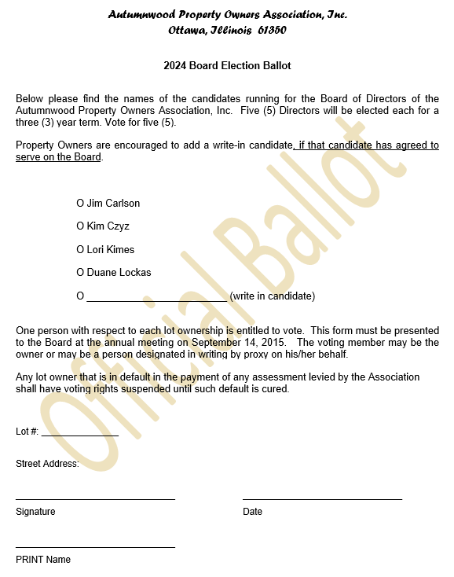

Slide 10
Autumnwood Property Owners Association, Inc.
P.O Box 312
Ottawa, Illinois 61350
https://autumnwoodpoa.com

