Slide 1

College Prep & Funding Strategies for Parents
Presented by The IRG Foundation
Iris Gullatte

Slide 2

Introduction
B.S. Finance | Retired USAF SNCO | Co-Founder of IRG Foundation | Financial Literacy Advocate
Notes:
Hello everyone,
My name is Iris Gullatte,
I want you to start thinking about where you are right now, where you want to be, and where you want your children to be.
We all know money can be emotional. It can be stressful, overwhelming, or even embarrassing to talk about. And the truth is, most of us were never actually taught how to manage it in the first place.
Before we get started, I want to share something important.
This class is purely educational. I don’t sell insurance. I don’t sell investment products. I don’t receive commissions of any kind. My role is simply to give you clear financial education, practical guidance, and accountability support. You and your family remain in full control of every decision you make — and everything you share is completely confidential.
So, a little bit about me…
I was born in Puerto Rico, so Spanish is my first language. I came from humble beginnings, and I also made some dumb mistakes. I dropped out of high school when I was 16 years old to go work at McDonald's. I ended up going back to school through an alternative high school that was attached to a Kmart parking lot. One day an AF recruiter came to my school and gave us a presentation which changed my life. I joined the AF upon graduation. Thanks to the AF, I was able to use the GI Bill and tuition assistance to earn two associates degrees, a Bachelor of Science in Finance, and I recently got accepted into a Master of Science in Quantitative Finance through the University of Denver. But honestly? Most of my education came from the school of hard knocks — learning through mistakes, learning what not to do, and deciding that I wanted something different for my family and my future.
As an NCO you are responsible for the well-being of young adults. I learned quickly these kids needed a lot of guidance.
I helped them build budgets, fix their credit, escape predatory loans, build a debt management plan and turn their credit around. I became obsessed with financial education — first with Dave Ramsey, Clark Howard, and Suze Orman, then later with books like The Psychology of Money, The Power of Broke, The Millionaire Next Door, Rich Dad Poor Dad, and many more.
We started the IRG Foundation: to give back to our community and to make sure families — just like mine, just like yours — are able to reach their full potential and become the best version of themselves.

Slide 3

Learning Objectives
By the end of the session, participants will be able to:
Understand the Five Principles of Money Management (earn, save & invest, spend, borrow, protect).
Understand how these principles apply to college planning.
Create a basic action plan for college preparation and financial readiness.
Understand the purpose of the FAFSA.

Slide 4

The Five Principles of Money Management
Notes:
We are going to talk about how these principles will be tied directly to college planning.

Slide 5

Principle 1: Earn
How Money Is Earned
  W2 employees
  1099 / independent contractors
  Starting a business
  Business types (Sole proprietorship, partnership, corporation, LLC, etc.) https://www.irs.gov/businesses
B. Understanding Your Paycheck
  Gross vs Net income
  Taxes (State, Federal, FICA)
  Retirement contributions (401k, 403b, TSP, Traditional/Roth IRA) https://www.irs.gov/retirement-plans/plan-sponsor/types-of-retirement-plans
  Insurance deductions (medical, dental, vision)

Slide 6
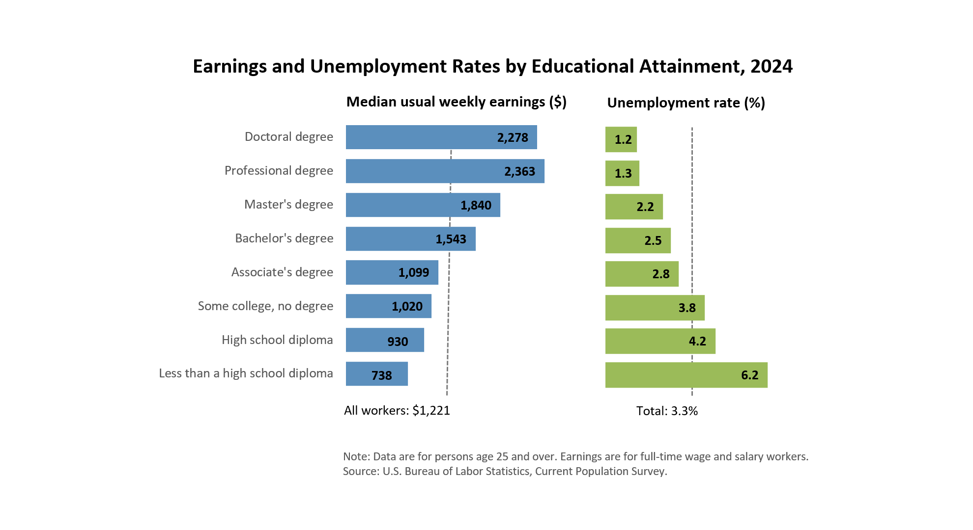
Why a College Education Matters: How occupation impacts Income and Earnings
“Between 2004 and 2024, earnings of those with a high school degree but no college rose 3.2%, while earnings of those with a bachelor’s degree or more went up 6.3%.”
– US Census

Slide 7
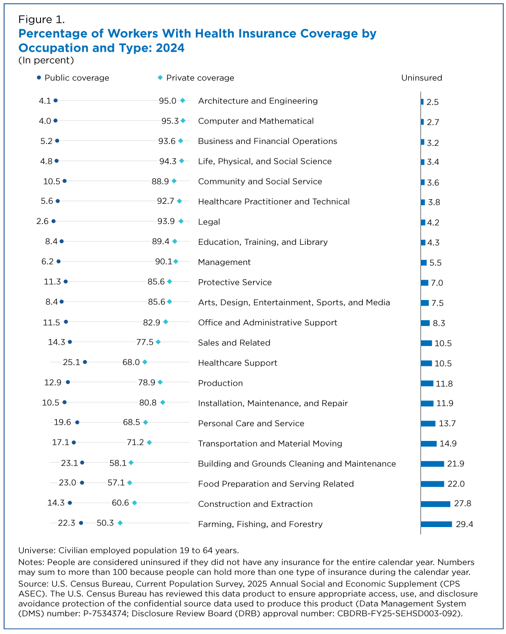
Health Insurance Coverage Varied Significantly by Occupation
https://www.census.gov/library/stories/2025/09/health-coverage-by-occupation.html
Notes:
“Now that we understand why education impacts earnings, let’s talk about preparing for college.”

Slide 8
Laying the Groundwork: Preparing for College
9th–10th grade
Explore interests/majors
build academic profile/ engage in extracurricular activities
Focus on GPA, course rigor
11th-12th grade
Begin applying for scholarships
https://www.fastweb.com
https://www.scholarships.com
https://bigfuture.collegeboard.org
Application Tips
Create a College Board account to register for the SAT, send AP or SAT scores
SAT Prep – Free resource: https://www.khanacademy.org/
B. Build a College List
Compare in-state vs out-of-state tuition
Find the right fit: academic, social, financial
Notes:
High schoolers have extra homework if they want to get ready for college. Here is the suggested timeline they should be following in terms of preparing for college. From 9th to 10th grade, they should be exploring. Getting involved in different clubs, extra curriculum activities, learning what spikes their interest. This is will be helpful when choosing a major.
By 11th grade, they need to be familiar with College Board and taking the SAT. At this point, they have an idea of what they would like to major in and have spent quite a bit of time researching colleges based on their interests. Applying for scholarships is now their part time job.
Application Tips
Give yourself enough time
Meet all application deadlines
Gather materials early (transcripts, letters of recommendation)
Make sure you meet eligibility criteria (ex. GPA)
Answer all required questions/submit all requested materials
Keep track of activities and affiliations
Transition:
“Once you know where you’re heading, the next step is preparing financially.”

Slide 9

Notes:
So now that we understand the Financial principle of earning and its importance, we can skip the rest of the lesson, right? Wrong!
Here is a young lady who at one point of her career was making $600K a year, and had a net worth of about $1 Million dollars as a social media influencer, and other gigs.
This is funny, but it is reality. It is important to know how to make money, but it is equality important understanding how to make your money work for you and how to keep it. This is why the next financial principle we are going to cover is ”Save and Invest”.

Slide 10

Principle 2: Save & Invest
A. Saving Basics
Always Pay yourself first
Your savings account should not be attached to your checking account
Build an emergency fund (3–6 months)
https://www.bankrate.com
B. Investment Basics
The Oxygen Mask Principle
Time is money – calculator
Start Simple – ETFs, Mutual Funds, etc.
The Psychology of Money
Notes:
Always Pay yourself first! Treat your savings as your most important bill
Build an emergency fund of three to six months’ worth of expenses
High yield savings accounts, money market accounts, Go to bankrate.com for the latest rates
Investments:
Put on your own oxygen mask first!! Protecting Your Future, Protect Theirs
Save for Retirement before college!
- You can borrow for college or apply for scholarships but that doesn’t work for retirement
When it comes to investment, it doesn’t have to be super complicated. In this case, Time is your most valuable resource! Warren Buffet calls compound interest “the 8th wonder of the world”
Open an account if you don’t have one, fidelity or Charles Schwab are good options to start. You can choose simple mutual funds, or ETFs to get you started. The key here is diversification. Single stocks can be a good idea, but they required a lot more research on your part.
You do not need to be a high earner to be a good investor
Jesse Livermore - known as the original "Wolf of Wall Street," was a legendary stock trader in the early 20th century, famous for his massive fortunes and equally large losses, particularly making millions during the 1929 crash by shorting the market, though he also went broke multiple times before his suicide in 1940
Ronald Reed – Janitor who died with over $8M in the bank and left a legacy

Slide 11
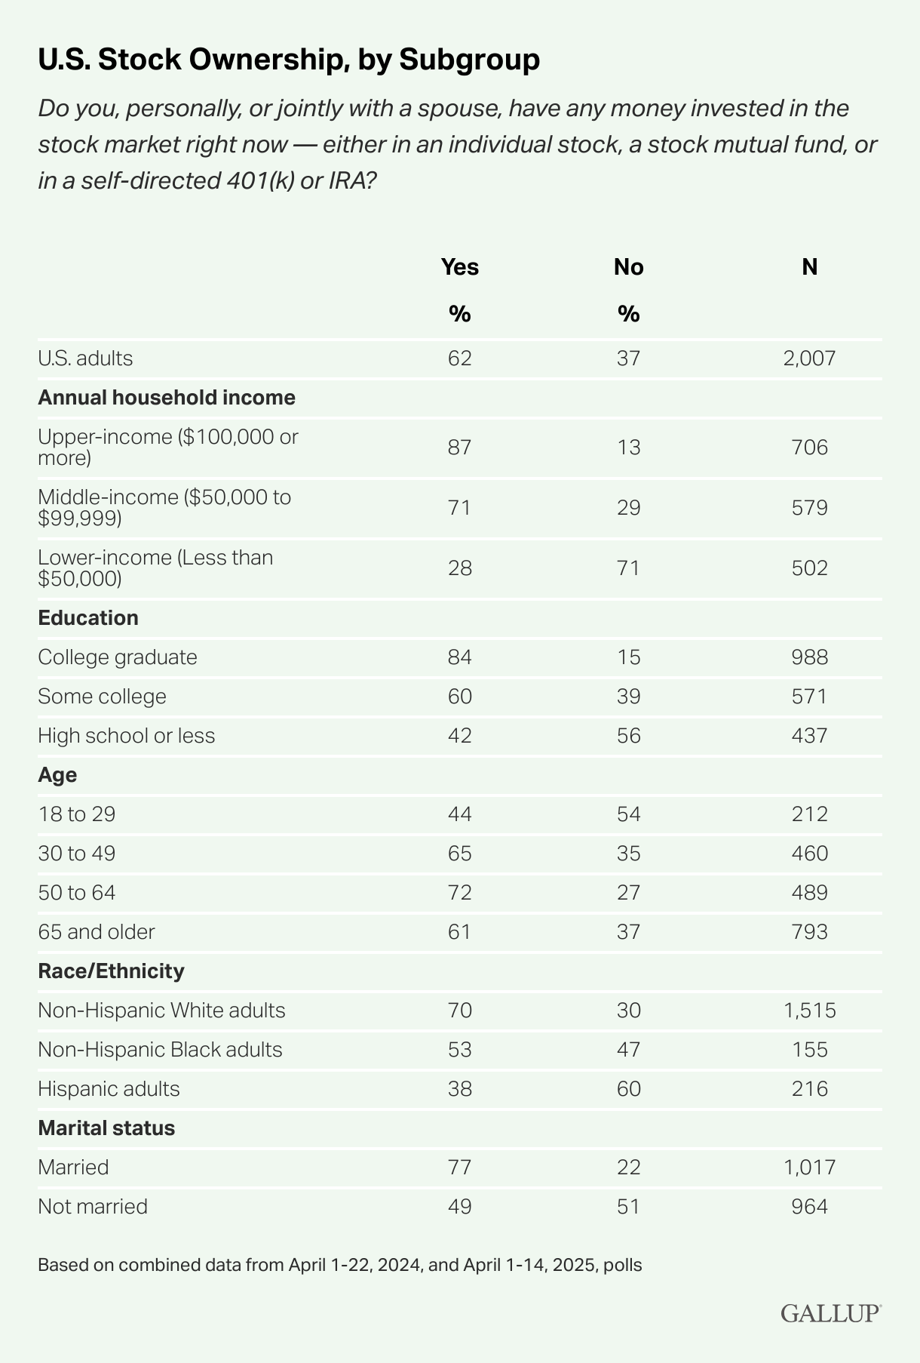
Notes:
According to a recent Gallup poll approximately 37% of Americans do not own stock through either individual stock, mutual funds, or retirement accounts such as an IRA’s or 401k. The numbers are more alarming for those without a college educations and minorities such as African Americans and Hispanics.
Now that we have put on our own oxygen mask, lets talk about college savings for our kids.

Slide 12

Principle 2: Save and Invest
College Savings
College Savings: Start early
College Savings Calculator https://www.collegeinvest.org/college-savings-calculator/
How much do I need to save right now? https://educationsavings.nga.finra.org/calculator/

Slide 13
Principle 2: Save & Invest
College Savings Tools
529 Plan
Tax-free growth for education expenses
Usable for colleges, trade schools, apprenticeships
CollegeInvest 529 Plan
  https://www.collegeinvest.org/compare-529-plans/
Up to $35k rollover allowed into Roth IRA (recent legislation)
Custodial Accounts (UTMA/UGMA)
UTMA = broader asset types
UGMA = money & securities
Control transfers at age 21
Coverdell ESA
Tax-free for K–12 + college expenses
$2,000 annual contribution limit
Whole Life Policies
High cost, slow growth — not recommended for college savings
Notes:
A 529 is an educational savings plan where your money grows tax-free as long as it’s used for specific expenses, ranging from tuition to room and board to laptops, printers, and more.
529s can be used at eligible schools across the country, including trade schools, community colleges, and even apprenticeships
The CollegeInvest 529 Plan is the only 529 plan to offer a state tax deduction for contributions by Colorado taxpayers.
The State of Colorado Offers 4 different choices:
https://www.collegeinvest.org/compare-529-plans/
Recent legislation allows parents to roll over up to $35K of an unused 529 funds into a Roth IRA account for the beneficiary
https://www.finra.org/investors/investing/investment-accounts/college-savings-accounts#types
Custodial accounts (UTMA, UGMA)
UTMA accounts can hold a wider variety of assets like real estate and intellectual property, while
UGMA is limited to gifts like money and securities. In both cases, a custodian manages the account until the child reaches the age of 21
Coverdell Education Savings Accounts (ESA) - you can make tax-free withdrawals to pay for eligible elementary and high school expenses (e.g., special needs services, tutoring and private school tuition), as well as post-secondary school expenses. Limited contribution limit. 2K per beneficiary a year.
Whole Life Insurance Policies – High cost, low return, and slow cash value accumulation
“Saving is important, but protecting what you save is even more important.”

Slide 14

Principle 3: Protect
A. Emergency Fund
B. Monitor Credit Regularly
C. Maintain Adequate Insurance
D. Estate Planning
Will, trust, beneficiary protections
Notes:
If your assets are not protected, an emergency can derail your entire plan
Build an Emergency Fund (3-6 months of expenses)
Check your credit often to ensure everything is accurate and up to date
Insurance (car, auto, homeowner’s, etc.) – Check your rates often
Protect your beneficiaries – consult a Estate Planning Lawyer to set up appropriate accounts (Trust, Will, Reduce Tax burden to beneficiaries)

Slide 15
Principle 4: Spend
A. Budgeting Basics
Income, fixed expenses, debt, flexible expenses, savings
86% use a budget but <25% stick to it
Track spending for 3 months
B. Budget Rules
50/30/20 Rule
28/36 Debt-to-Income Ratio
  Housing ≤ 28%
  Total debt ≤ 36%
  Food 10–15%
https://www.entrustfinancial.com/wp-content/uploads/2023/03/MoneyQuiz.pdf
Notes:
https://www.entrustfinancial.com/wp-content/uploads/2023/03/MoneyQuiz.pdf
Budgeting basics
- 5 Basic elements of a budget: Income, Fixed Expenses, Debt, Flexible/Unplanned Expenses, and Savings
- 86% of people use a budget, but less than 25% actually stick to it
Be realistic with your budget – track spending for at least 3 months to get a clear picture of what is going where
Things that can derail your budget: overspending, increasing expenses, debt, and unrealistic goals
Budget Rules
-50/30/20 Rule
-28/36 Debt-to-income ratio
This is the formula many lenders use to determine how much debt a consumer can safely assume based on their income, other debts, and financial needs. (In addition to credit score and income)
Housing- No more than 28% of your gross monthly income
Total monthly debt payment, including housing 36% (auto loans, student loans, credit card minimum payments)
10-15% should be set aside for food (groceries and dining out)
“Smart spending keeps you from falling into unnecessary debt — especially when planning for college.”

Slide 16
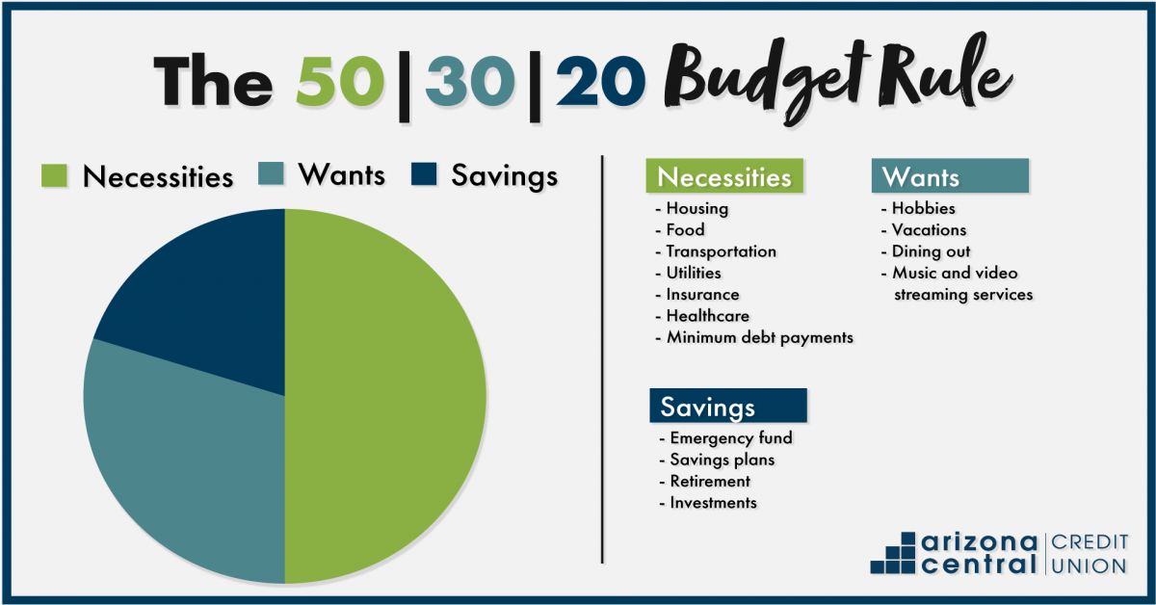
Principle 4: Spend
Budgeting basics
Notes:
The 50/30/20 rule offers one approach that combines paying off debt and saving. Here’s how it works.
Spend 50% of your budget on necessary expenses like rent, groceries, and utilities
Spend 30% on nonessentials such as travel, restaurants, or concert tickets
Direct 20% of your budget toward savings goals and paying down debt

Slide 17
Principle 4: Spend
College Planning
A. Estimate the true cost of attendance
Housing + Food
Books + Supplies
Transportation
Clothing/Personal spending
B. Decide Your Family Funding Strategy
Cash + Savings
Work-study / part-time job
Scholarships / grants
Student loans (only if needed)
C. Scholarship Application Strategy
Apply to small scholarships (easier to win)
Schedule 2 hours/week as a routine
Let your teen build a reusable essay template
Notes:
Be open and honest with your teen when coming up with a plan
Family Money Boundaries
Clear expectations reduce conflict and fear.
“Here’s what I can cover.”
“Here’s what you’ll need to cover.”
“No shame. No lecture. Just clarity.”
You do not sacrifice your retirement or dreams for your child’s early adulthood.
We teach them to stand — we don’t carry them forever.
Choosing between community college, trade school, and 4-year programs
The GI Bill and the military as an option

Slide 18

Principle 5: Borrow
A. Good Debt vs Bad Debt
Good: mortgage, business loans, education (increases future income)
Bad: high-interest credit cards, payday loans, auto loans
B. Credit Health
Review credit reports monthly
FICO factors:
  Payment history
  Utilization (<30%)
  Length of history
  Hard inquiries
Notes:
Good Debt vs Bad Debt
Good debt potentially increases your net worth or future income and can offer tax advantages (student loans fall under this category)
Bad debt hinders your financial progress (credit cards, payday loans, auto loans)
Reminder: Debt-to-Income ratio should be less than 36%
FICO score – the score lenders use to assess your credit risk
Review Credit Report often (free report every month)
Understand what factors are affecting your score
Length of credit history (this is where you can help your child)
Payment History
Credit Utilization Ratio
Ideally less than 30%
Hard inquiries/new debt

Slide 19
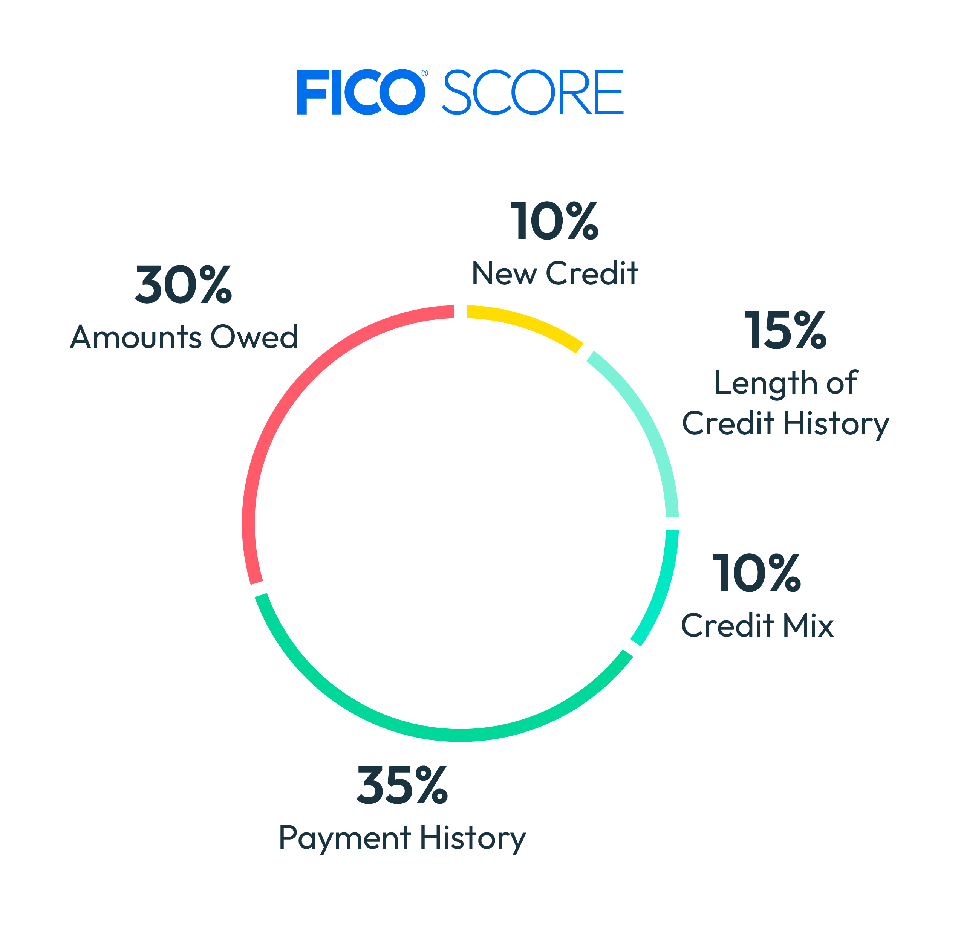
Understanding Annual Percentage Rate (APR)
  https://www.bankrate.com/loans/loan-calculator/

Slide 20

Principle 5: Borrow
Student Loans (High-Level Overview)
Private Loans:
Higher interest
Issued by private institutions
Rates can be fixed or variable
Fewer protections
Federal Loans:
Issued by the U.S. Department of Education
Fixed rates, flexible repayment, potential for forgiveness
Must complete the FAFSA!!
Official Servicer of Federal Student Aid
Important statistics:
43 million borrowers owe $1.6 trillion
Avg repayment: 20 years
Loans not easily discharged
No statute of limitations
Gov can garnish wages/taxes without court order
https://nelnet.studentaid.gov/content/understandingstudentloans
Notes:
“And speaking of federal loans… let’s talk about the key that unlocks all federal aid.”

Slide 21
FAFSA — What Participants Need to Know
A. Why FAFSA Matters
Access to federal grants, loans, work-study
Colleges use it for scholarships
Eligibility for safer federal loans
Requested for certain programs (study abroad, honors, campus jobs)
Protects future aid opportunities
B. Key Takeaway
Filing FAFSA commits you to nothing —
but NOT filing can cost thousands in free money.
Notes:
““My role today isn’t to walk you through every FAFSA field or regulation — there are great resources and counselors who specialize in that. My goal is to help you understand the bigger picture: how to prepare financially for college, where the money comes from, and how to make informed decisions that protect your long-term financial wellness.”

Slide 22
FAFSA:
✅ 1. FAFSA is the gateway to all federal financial aid
✅ 2. Colleges use FAFSA to give out their OWN money
✅ 3. FAFSA determines eligibility for low-interest federal loans
✅ 4. Some schools require FAFSA just to register for certain programs
✅ 5. It keeps your student eligible for future aid
✅ Bottom Line: Filing FAFSA doesn’t commit you to anything — but NOT filing can cost you access to thousands in grants and safer loans.
Filling it out is always the smartest financial move.
Notes:
Without the FAFSA, your student cannot access:
• Federal grants (free money)
• Federal student loans (lower interest, safer terms)
• Work-study
• Many State grants
Even if you think you make “too much,” you’re shutting the door to everything by not filing.
Many schools require FAFSA to award:
• Merit scholarships
• Need-based scholarships
• Institutional grants
• Special programs
• Tuition discounts
Some private colleges give tens of thousands per year — but only if a FAFSA is on file.
Federal loans are significantly safer than private loans.
No FAFSA = no access → then families end up with:
• Higher interest
• Less protection
• Fewer repayment options
Filling out the FAFSA protects you.
Some schools require FAFSA just to register for certain programs
This includes:
• Honors programs
• Study abroad
• Internships
• Emergency grants
• Campus job eligibility
So even middle- and high-income families benefit.
If you skip freshman year’s FAFSA:
• Your student may be ineligible for sophomore/junior-year grants
• If your income drops later, they won’t have the aid history in place
You don’t want to lose money in later years.
thousands in grants and safer loans.
Filling it out is always the smartest financial move.
FAFSA rules change every year.
Some families who assume they won’t qualify end up shocked by how much free aid they receive.

Slide 23

Action Plan: What to Do Next
Start saving early
1
Track spending & create a family budget
2
Research colleges & programs
3
File FAFSA every year
4
Use federal aid before private loans
5
Seek free community resources (counselors, workshops, financial aid offices)
6

Slide 24

Q&A

Slide 25
Contact Info
Linkedin Profile linkedin.com/in/iris-rivera-gullatte-5562b260
Email riveragullatte@gmail.com
B.S. Finance | Retired USAF SNCO | Co-Founder of IRG Foundation | Financial Literacy Advocate

