Slide 1
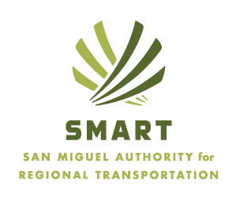
SMART Formation and Progress – an update
2019 CASTA Fall Conference
September 24th, 2019

Slide 2
SMART Formation and Progress – an update
Goals of this presentation:
Talk about the process stakeholders went through to form SMART
Provide an update as we approach our 3rd year of existence

Slide 3
SMART Formation and Progress – an update
RTA formation - process:
1. Agreement on common principles
2. Agreement on why an RTA would be pursued and the role the RTA would play in regional and local transit
3. Agreement on boundaries and taxing levels

Slide 4
SMART Formation and Progress – an update
Agreement on common principles – why is public transit important and why do we need it:
Cuts traffic & demands on parking
Improves regional air quality
Reduces regional GHG emissions
Important for economic development
- Provides an affordable mobility alternative to personal vehicles, especially in light of regional affordable housing crisis.

Slide 5
SMART Formation and Progress – an update
Agreement on why an RTA would be pursued and the role the RTA would play in regional and local transit:
Improved leverage for transit grants
Increased efficiency, (i.e. consolidate staff and reduce service redundancy)
Provide a single stream of public information (transit schedules, website, and marketing)
Merged leadership & expertise
Coordinated transit & infrastructure planning
Other communities can join after established – flexibility for growth
Can include ground transit, trails, rail, aviation, roads, aerial tramway, and related infrastructures such as park-and-ride or parking lots.

Slide 6
SMART Formation and Progress – an update
Agreement on roll of SMART in the context of regional transportation:
Assume operational responsibility and management for existing regional services-
-Norwood -Lawson Hill
-Down Valley - Van pools (Montrose/Ridgway)
Underwrite Mountain Village commuter shuttle program
Grow services (Rico, for instance. Regional bike share is another example)
Gondola funding is not ruled out explicitly at this time, but there is a larger regional conversation taking place about ongoing O/M and capacity expansion on that piece of our regional transit infrastructure

Slide 7
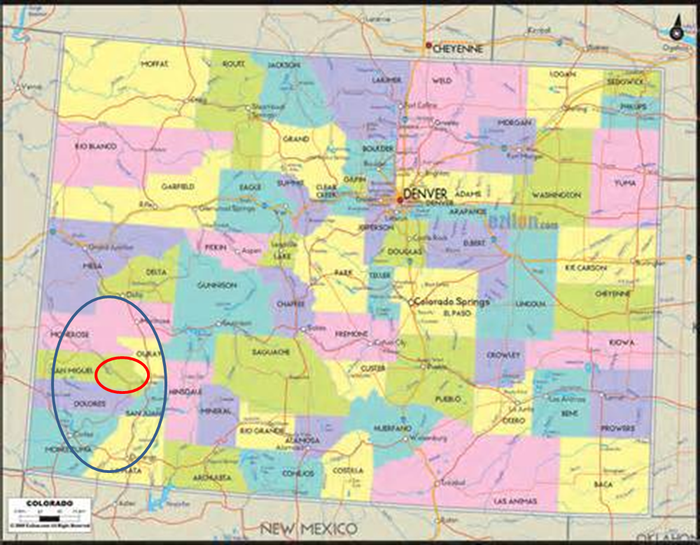
SMART Formation and Progress – an update
Initial membership and boundary discussion:

Slide 8
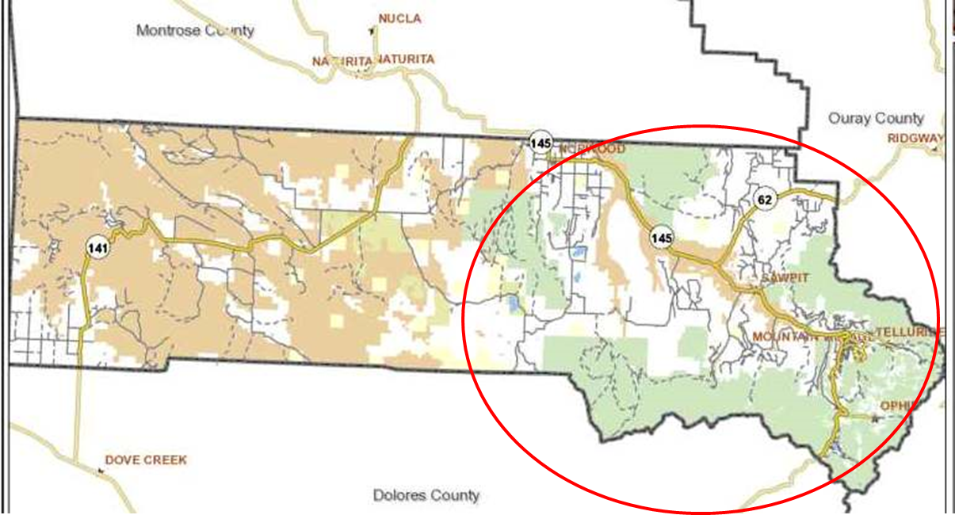
SMART Formation and Progress – an update
Initial membership and boundary discussion:

Slide 9
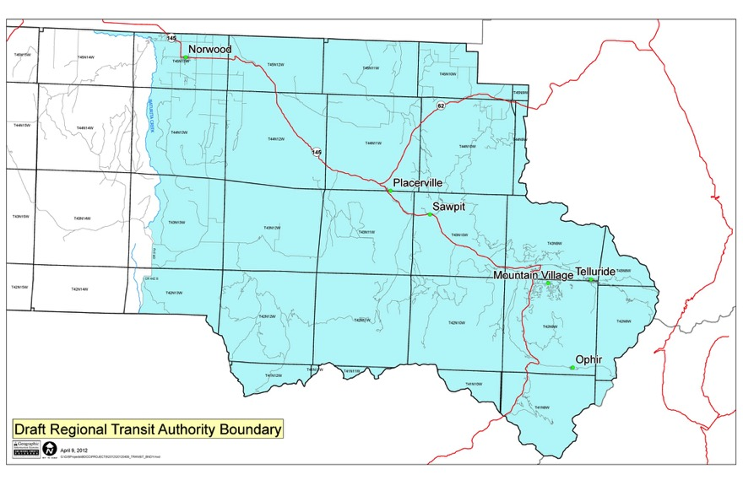
SMART Formation and Progress – an update
Initial membership and boundary discussion:

Slide 10
SMART Formation and Progress – an update
How we did it:
Decades of prior efforts … were unsuccessful
Community volunteer task force (SMACTAC)
Years of data collection identified challenges
Little political will to advance a solution that involved the entire region … perception that it’s (mostly) working internally

Slide 11
SMART Formation and Progress – an update
How we did it (continued):
Facilitated year-long process
All elected officials from all 3 jurisdictions
Administrators from all 3 jurisdictions
Professional facilitation
Thumbs up, thumbs down, or sideways thumb (informed consent – “I can live with it”)
Agreement on principles first, then the details followed

Slide 12
SMART Formation and Progress – an update
How we did it (continued):
Arrive at major points of agreement:
Inter-governmental approach … leave the internal transit systems alone for now
Start small and expand later (RFTA model)
Spread tax burden across users – mix of sales tax and property tax
Keep taxation in line with anticipated needs
Our gondola is NOT part of the initial RTA

Slide 13
SMART Formation and Progress – an update
How we did it (continued):
- Jurisdictions put the question on the ballot (two-part question –
creation and taxation)
- Poll voters
- Campaign!

Slide 14
SMART Formation and Progress – an update
Success! Vote passed with overwhelming support in November of 2016, creating and funding SMART.

Slide 15
SMART Formation and Progress – an update
Main goal at this point is to show voter they made a wise investment :
Assumed responsibility of Norwood/Down Valley operations in November of 2018 through a contractual arrangement with a local operator
Expanded service to Rico in February of 2018 (Rico is now voting to officially join SMART!)
Managing (and hopefully expanding) vanpools out of Ridgway and Montrose
Started building a fleet and a new brand to match
Started managing the new CDOT funded park and ride out at Lawson Hill

Slide 16
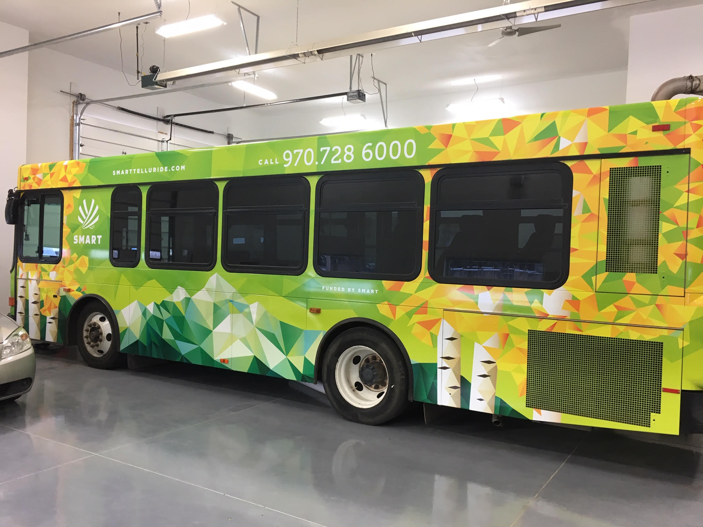
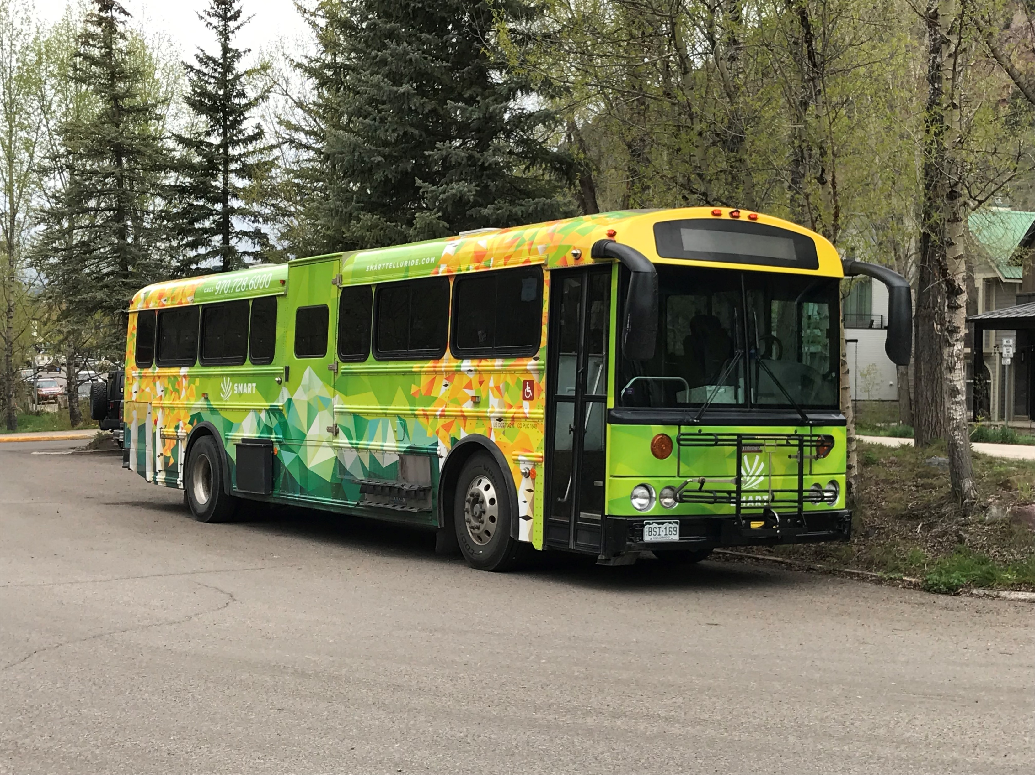
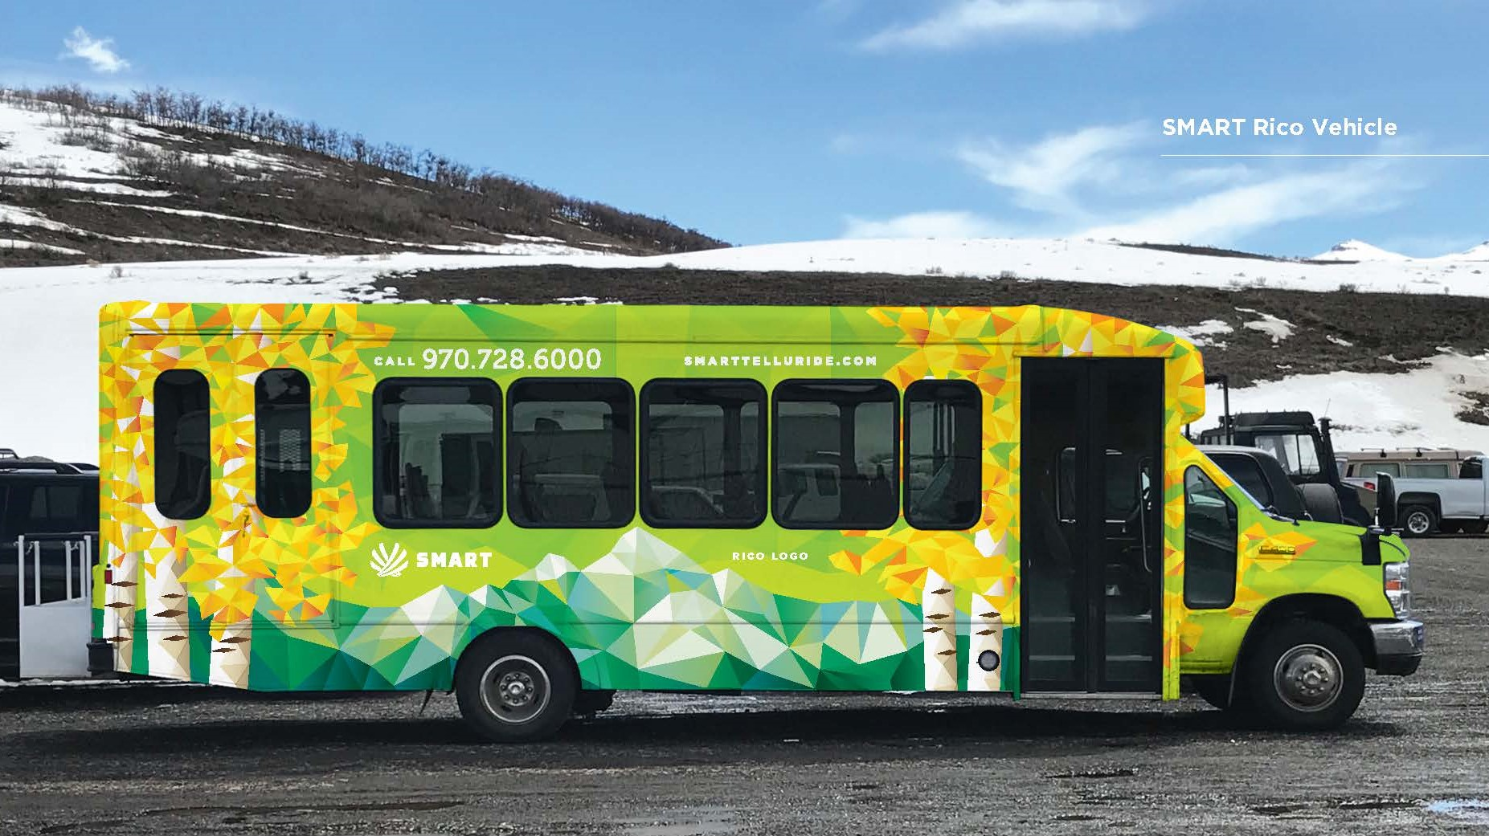
SMART Formation and Progress – an update
Brand – “SMART Commute, Brilliant Views”

Slide 17
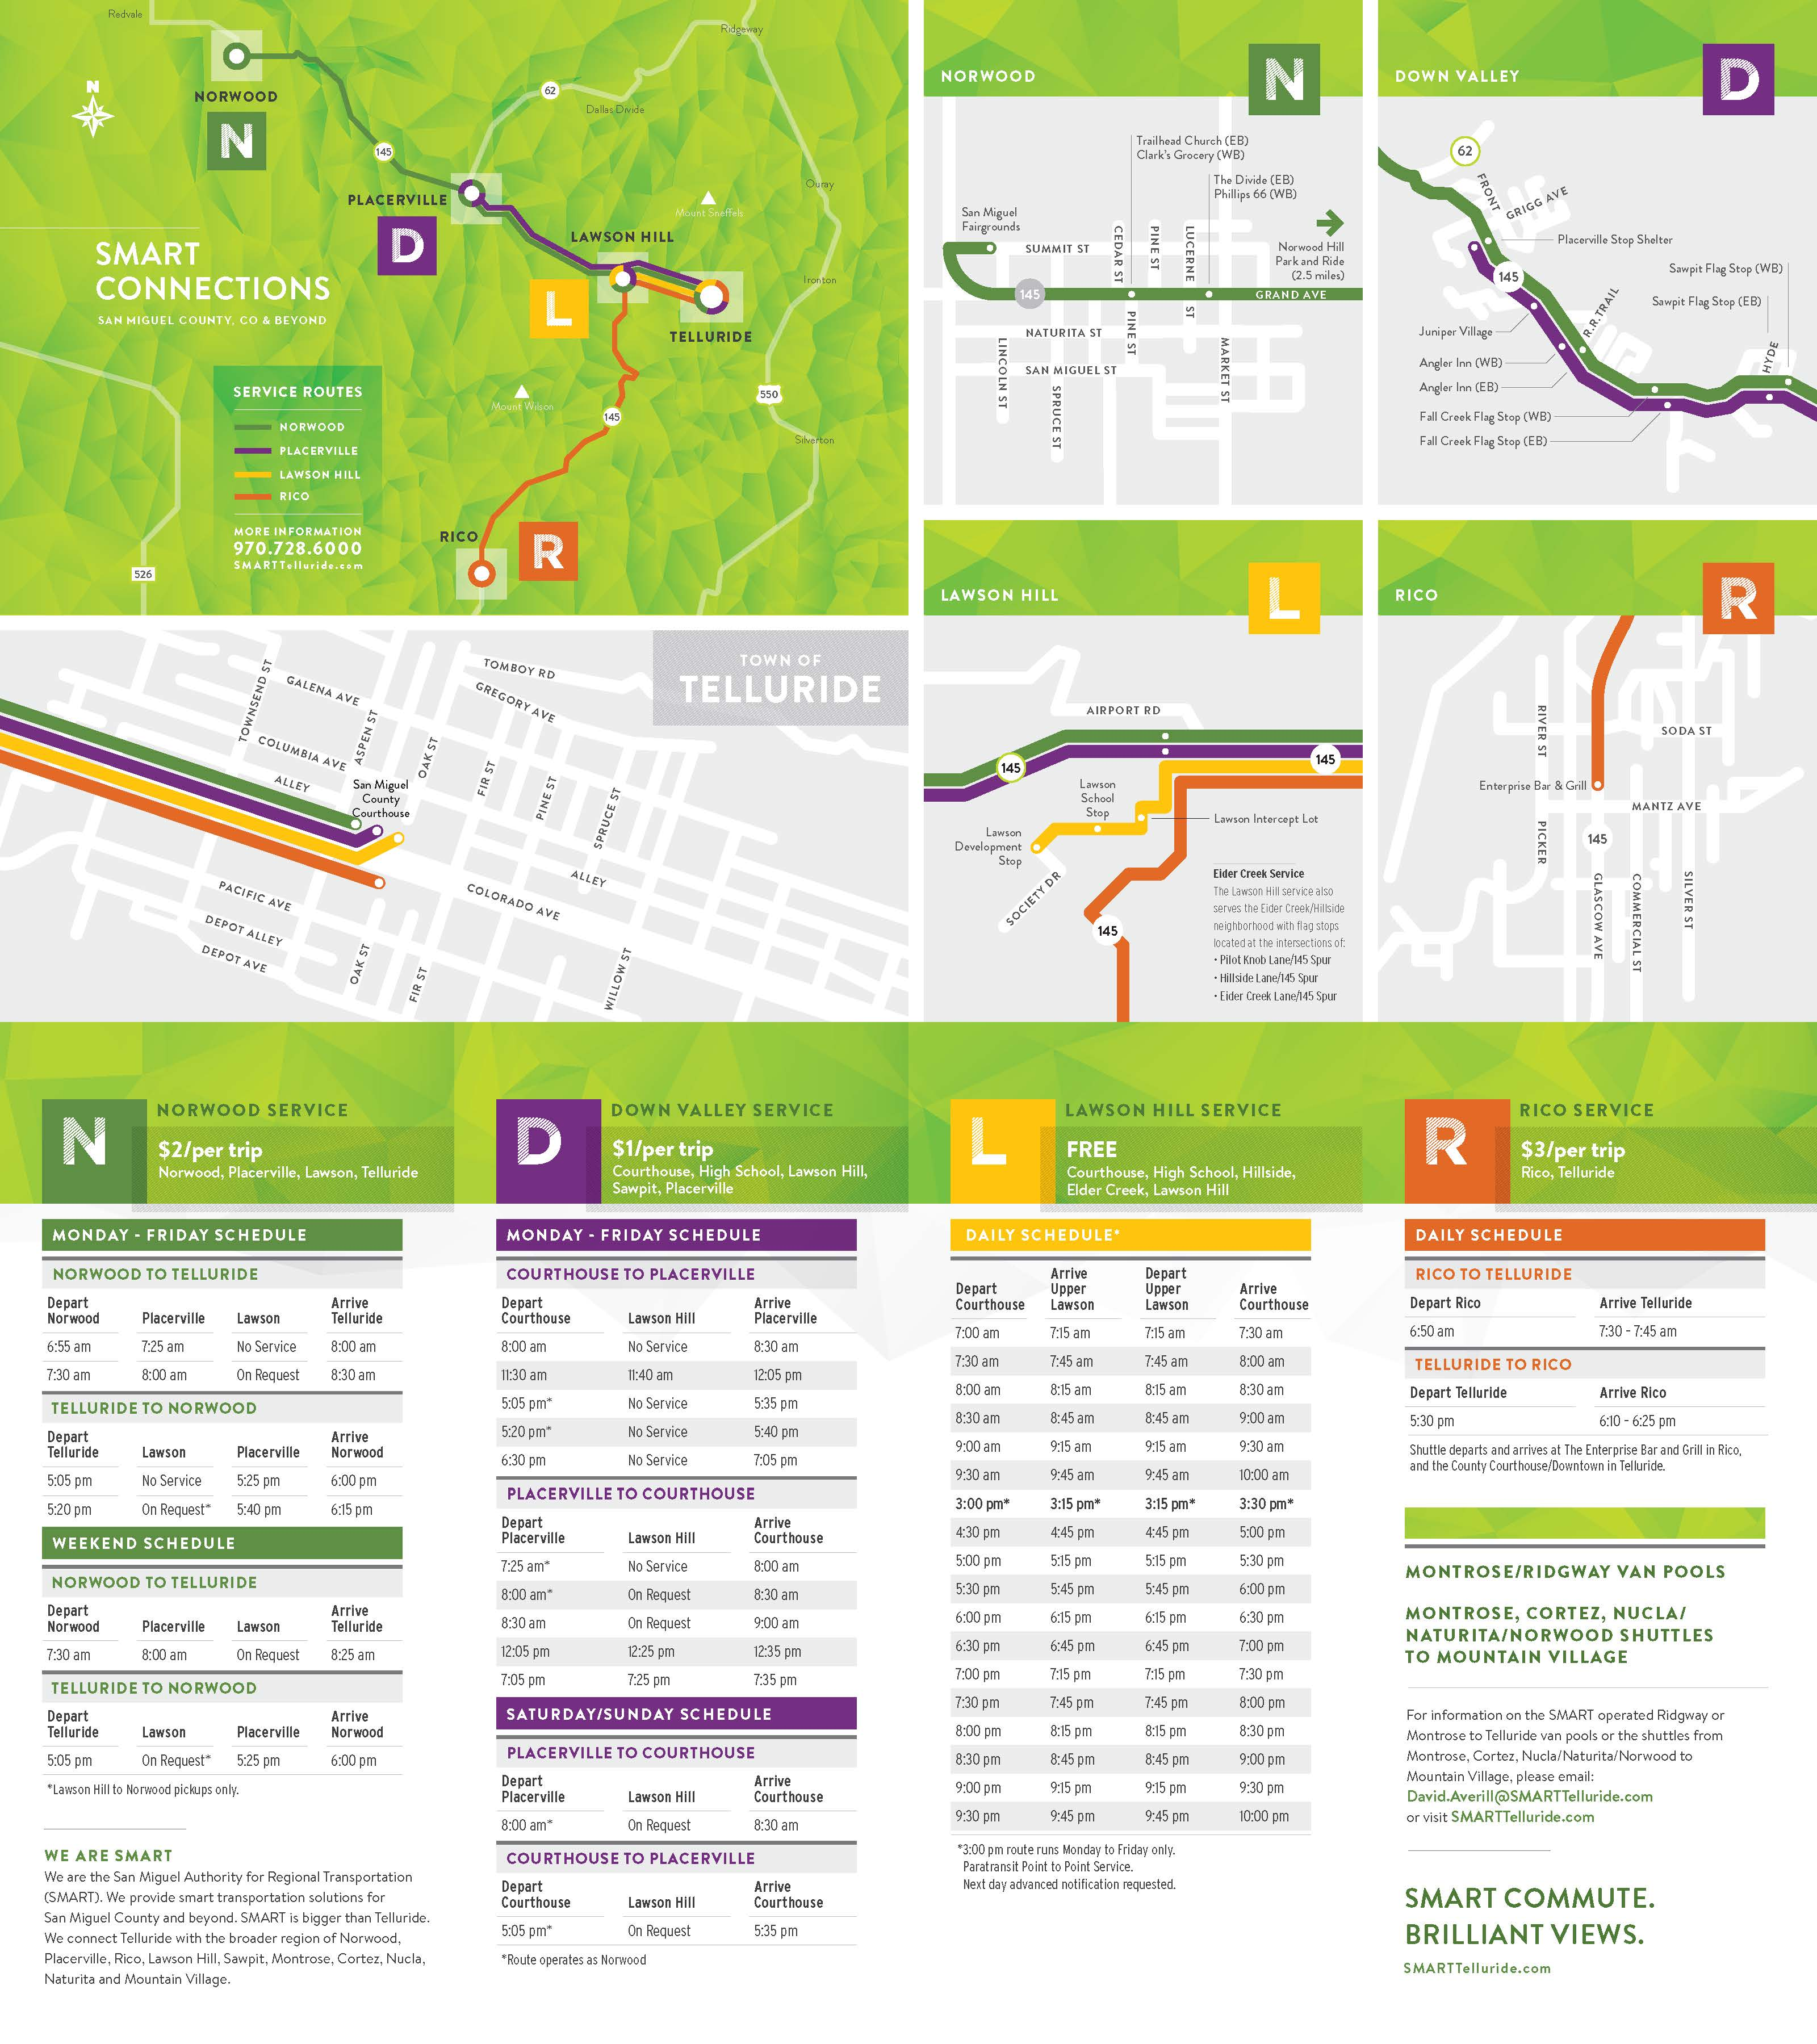
SMART Formation and Progress – an update
SMART Brand – new schedules, maps, brochures:

Slide 18
SMART Formation and Progress – an update
Ribbon cutting for the new Lawson Hill Intercept Lot:

Slide 19
SMART Formation and Progress – an update
Next steps for SMART:
- Development and adoption of a Strategic Operating Plan to serve as a blue print for expansion of services over the next 3-5 years (fall of 2019)
- Building on the results of the SOP, undertake an Electric Bus Feasibility Study (Spring/Summer of 2020)
- Start hunting for a facility or land suitable for an admin. and maintenance facility … if we can afford it. A big if!!

Slide 20
SMART Formation and Progress – an update
Questions or comments?
David Averill
SMART Executive Director
david.averill@smarttelluride.com

