Slide 1
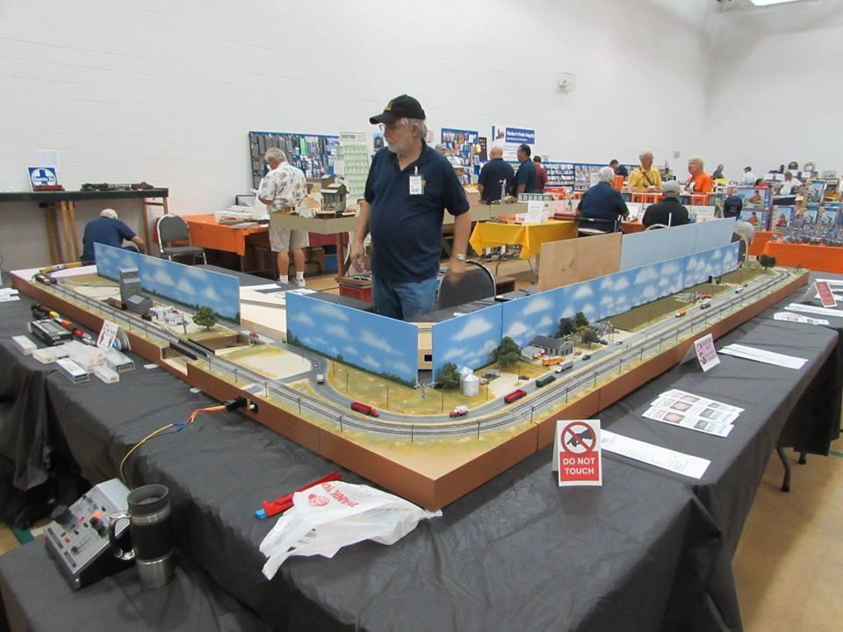
Photo by Bruce Arbo
T-TRAK – MINI MODULES!
Marc Pelletier
January 8, 2020
WinNTrak Model Railway Group

Slide 2
AGENDA
Introduction to T-TRAK
Module and Layout Types
Module Construction
Standards and Variations
  Dimensions
  Track and Electrical
Examples and Gallery
Questions

Slide 3
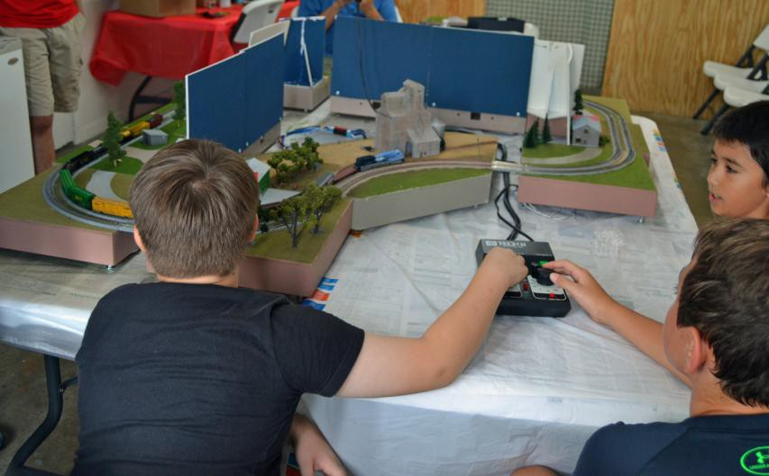
WHAT IS T-TRAK?
Modular Model Railroad System
  Minimal standards focused on interconnect
  Very small size
  Simple base construction
  Flexible scenery options
  Easy to transport, set up, and take down
  Global standard
  N scale (but see below)
Photo by Russell Straw

Slide 4
BENEFITS OF T-TRAK
Compact Size
  Easy to build, store, and transport
Collaborative
  Small format “encourages” group activity
  Low impact / footprint for more venues to show
Creative
  Play outside your main layout / scale / era / etc.
  Try out or practice new scenery techniques
Outreach
  Encourage new folk to “dip their toes”
  Good for youth groups like Scouting
  Easy to set up in non-traditional “show” spaces

Slide 5
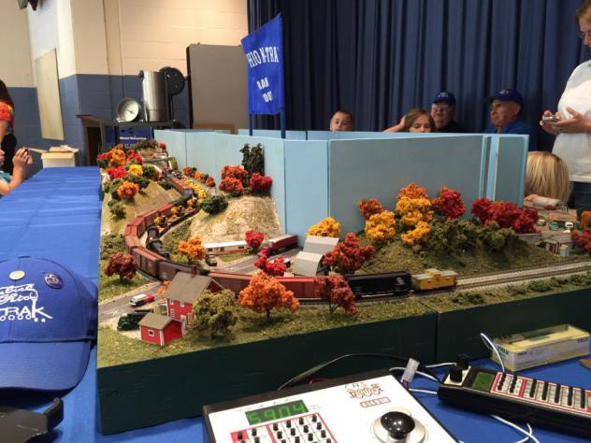
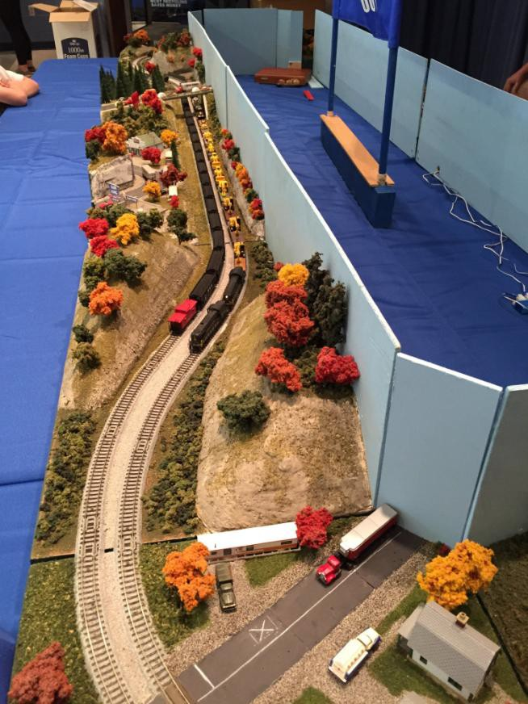
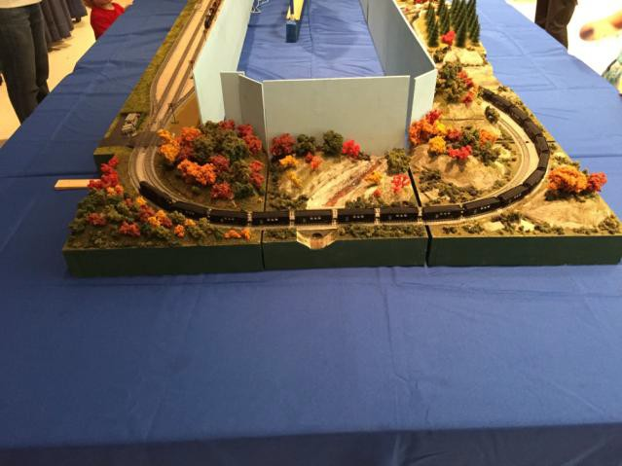
EXAMPLE LAYOUT
Photos by Craig Sonnen, MMR

Slide 6
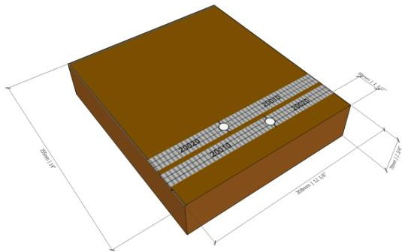
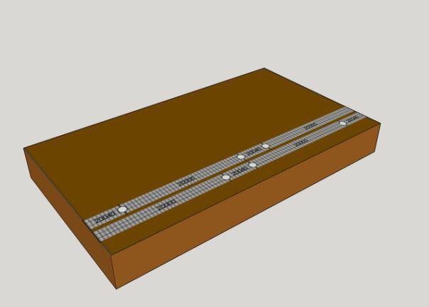
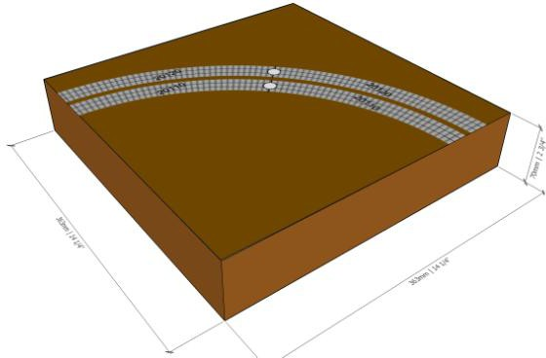
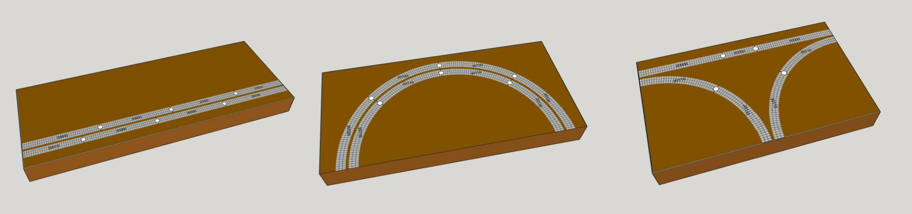
DIFFERENT TYPES OF MODULES
Images courtesy ttrak.org

Slide 7
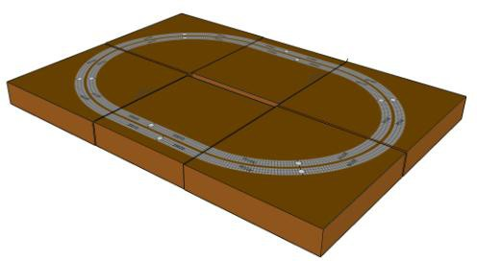
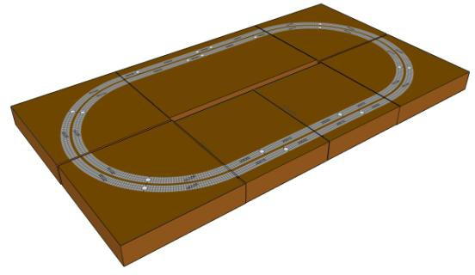
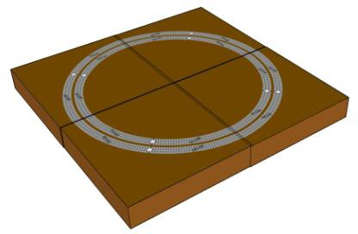
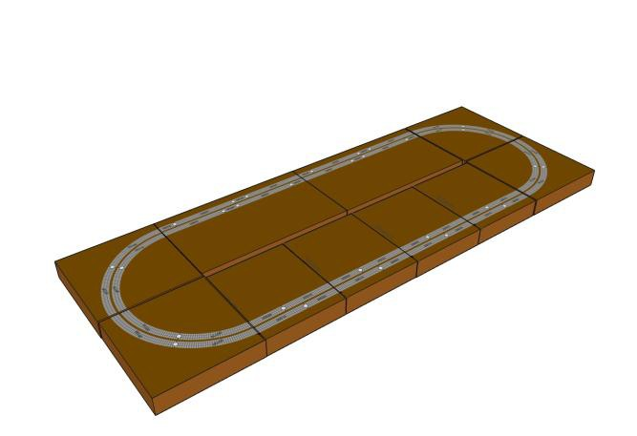
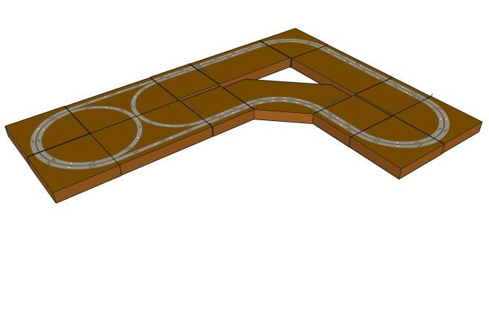
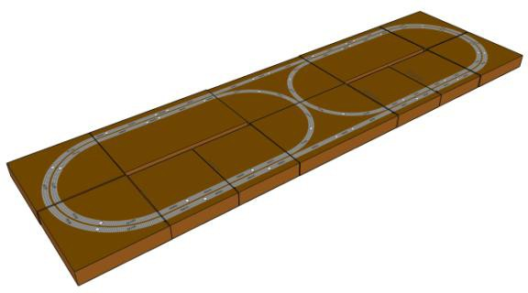
EXAMPLE LAYOUT SHAPES
Images courtesy ttrak.org

Slide 8
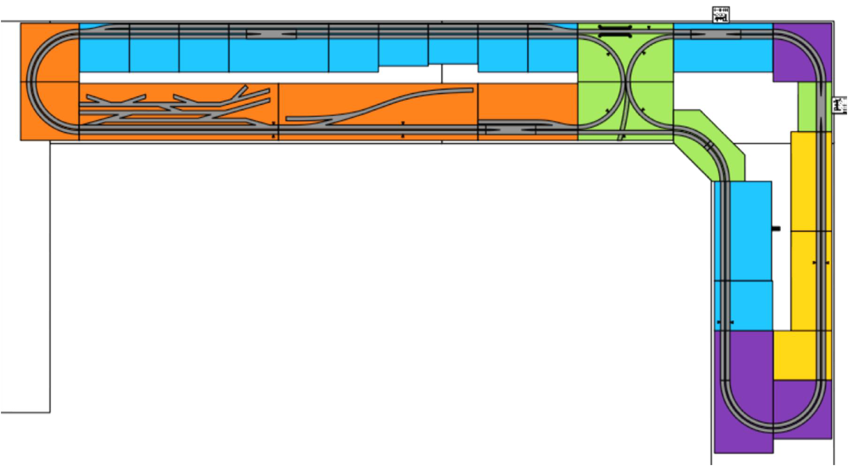
EXAMPLE SHOW LAYOUT DIAGRAM
Northern VA N-Trak Club Bunker Hill Train Show October 10, 2015
Drawing by Steve J.
Color code indicates module ownership
http://ttrak.wikidot.com/northern-virginia-ntrak-t-trak-division

Slide 9
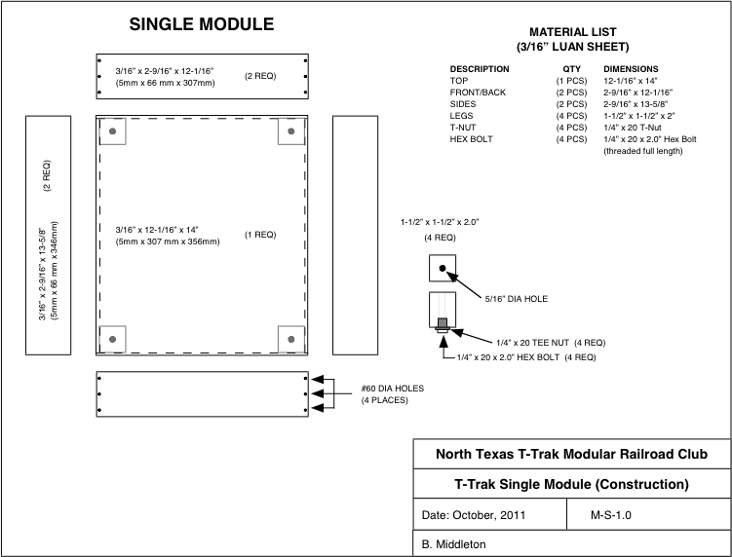
BASE MODULE DESIGN
Drawing from ttrak.wikidot.com

Slide 10
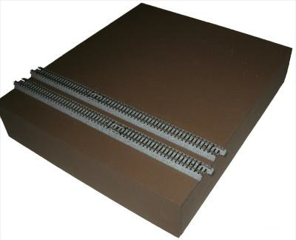
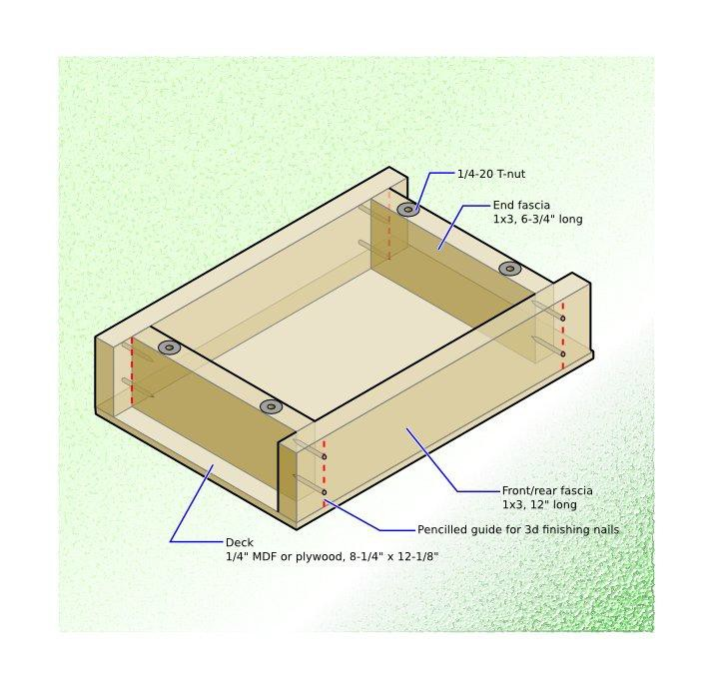
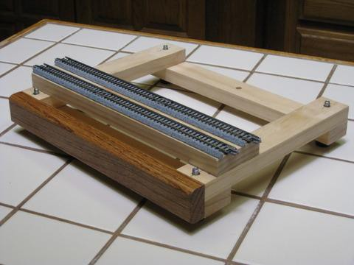
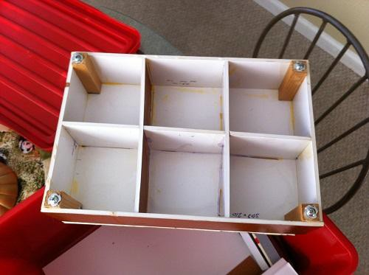
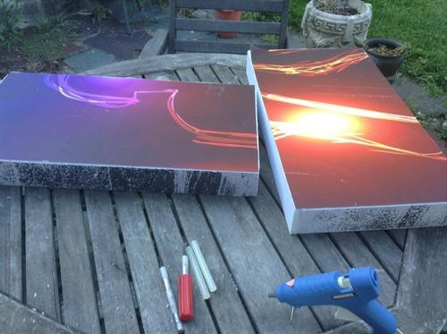
CONSTRUCTION OPTIONS
¼” Plywood Box
1x3
Open Framework
Foam-on-plank
Foam Board / Gatorboard
Corrugated Cardboard
“Cuties” orange crate
CMRProducts.com
MasterpieceModules.com
Woodland Scenics/Kato
Images from ttrak.wikidot.com (various contributors)

Slide 11
MODULE SIZE STANDARDS
Standard “Single” module
  Base Width: 308mm (12-1/16”)
  Base Depth: 8-1/4” up to 14”
  Base Height: 2-3/4” adjustable up to 4” with legs
  Tracks: 2x Kato Unitrack, 33mm spacing, offset 1-
1/2” from fascia to edge of ballast.
Double, Triple, Corner modules
  Double, Triple, etc. are multiples of Single width
  Corners constructed to mate to Singles on either end.
  Corners usually in 90˚ or 180˚
Optional Skyboards
  Full width of module, no set height

Slide 12
Recommended WinNTrak Standards
Apply to Club-Owned Modules Only
  Recommended but not required for member-owned
modules.
Dimensions:
  Maximum 13” depth
  Maximum 4” height above track base
    Applies only if module to be carried in club tote (if constructed)
  Width to T-Trak standards (multiples of 308mm)

Slide 13
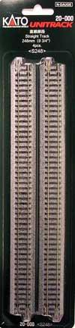
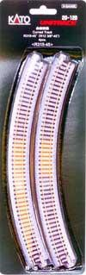
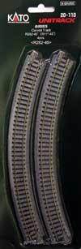
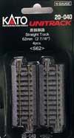
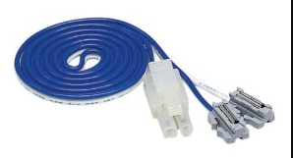
TRACK STANDARDS
Kato Unitrack is Standard
33mm (double track) spacing
Single Module:
  2 pcs 20-000 248mm Straight (1pkg = 2 modules)
  2 pcs 20-040 62mm Straight (1pkg = 2 modules)
  (or equivalent)
  2 pcs 24-818 Terminal UniJoiner 35” Leads (2 pkg = 1 module)
Curve Module:
  2 pcs 20-110 282mm 45˚ Curve (1pkg = 2 modules)
  2pcs 20-120 315mm 45˚ Curve (1pkg = 2 modules)

Slide 14


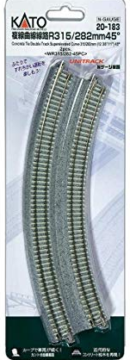
Double TRACK STANDARDS
Kato Unitrack is Standard
33mm (double track) spacing
Single Module:
  2 pcs 20-004 248mm Straight (1pkg = 2 modules)
  2 pcs 20-042 62mm Straight (1pkg = 2 modules)
  (or equivalent)
  2 pcs 24-818 Terminal UniJoiner 35” Leads (2 pkg = 1 module)
Curve Module:
  2pcs 20-183 315mm/282mm 45˚ Curve (1pkg = 1 modules)

Slide 15
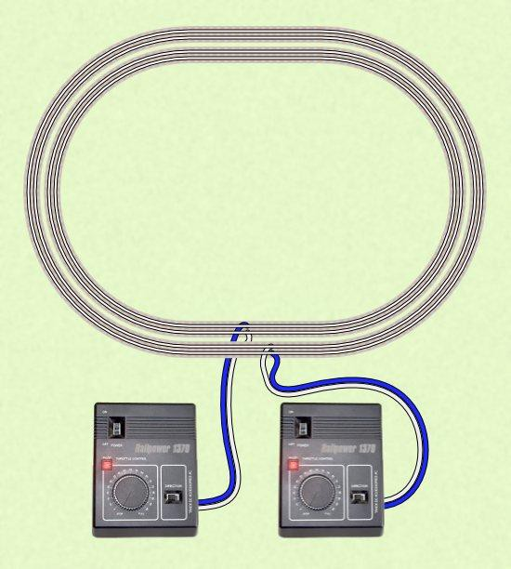
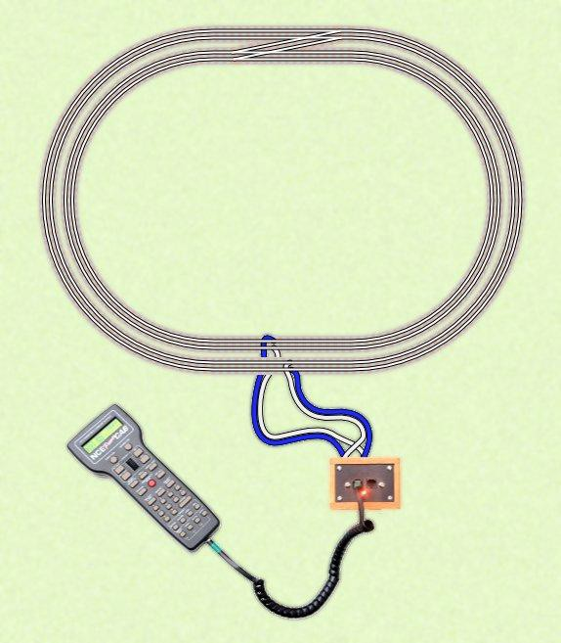
ELECTRICAL
From “Wiring for T-Trak” by Jeff Faust
  http://ttrak.wikidot.com/wiring-for-t-trak
DC DCC
Note the pattern of blue & white wires!

Slide 16
ELECTRICAL (CONT’D)
One powered module every 4-6, minimum
DC Power: Tracks wired opposite
  Opposing direction running
  Wires: Blue-White-White-Blue
DCC: Must reverse wires at the Booster
  Modules should be wired to DC standard with opposite-wired tracks.
Large layouts: use bus structure, larger wires
  Implementation varies by club
  Several good standards available
  Current standards can be found on
  http://t-trak.org/standards.html

Slide 17
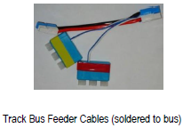
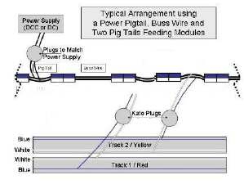
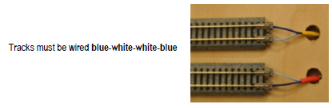
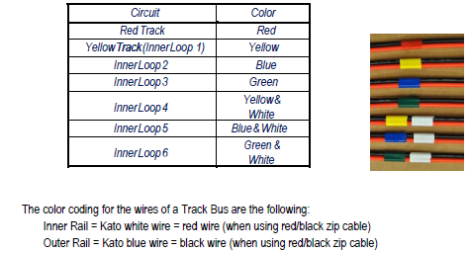
ELECTRICAL (CONT’D)

Slide 18
Recommended Feeder Wiring Harness at Module
This video can be found on YouTube: https://youtu.be/4RIAIacD0bc

Slide 19
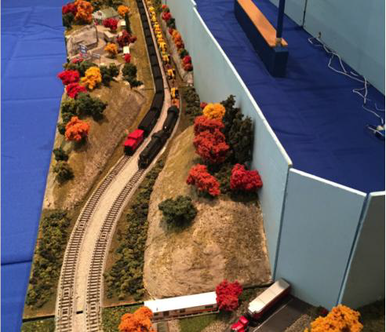
VARIATIONS
Unitrack is only required at endpoints
Sets of modules can have non-standard internal
joints
Fascia may extend beyond the standard depth
S-Curve module can be used to move tracks to the background
Photo by Craig Sonnen, MMR

Slide 20
OTHER SCALES – NOT JUST N
Scale: | Z | N | HO | S | O
Module Length | 328mm (12- 15/16”) | 308mm (12-1/8”) | 486mm (19-1/8”) | 29-7/8” | 39-7/8”
Max Depth | 11-1/4” | 14” | 28” | 24” | 24”
Corner Radius | 195mm / 220mm | 282 mm / 315 mm | 550 mm / 610 mm | 20” / 25” | 18” / 24”
 | 7.7” / 8.7” | 11.1” / 12.4” | 21.6” / 24”
Track Standard | Micro Trains | Unitrack | Unitrack | MTH S- Trax | Lionel Fastrack

Slide 21
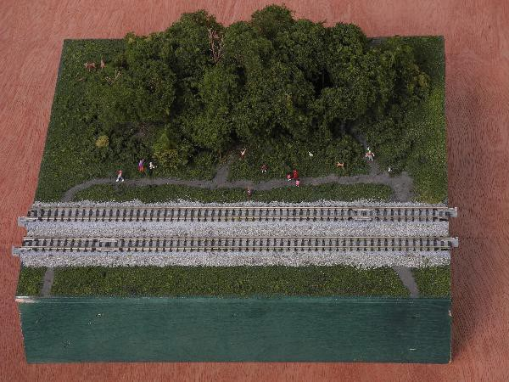
SINGLE MODULE: “DOG PARK”
Design & Photo: Walt P. http://ttrak.wikidot.com/dog-park

Slide 22
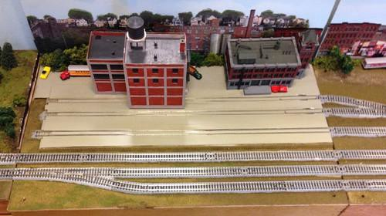
DOUBLE MODULE: “INDUSTRIAL AREA”
Design & Photo: Mark W. Smith. http://ttrak.wikidot.com/industrial-area One of two-module set

Slide 23
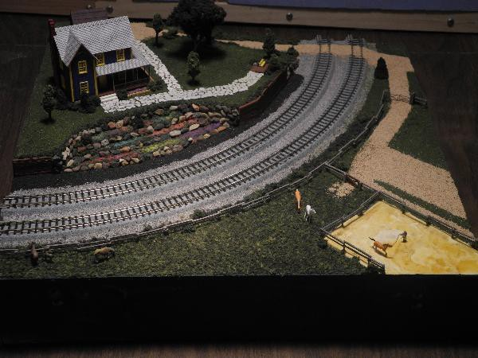
CORNER MODULE: “EQUESTRIAN CORNER”
Design & Photo: Walt P. http://ttrak.wikidot.com/equestrian-corner

Slide 24
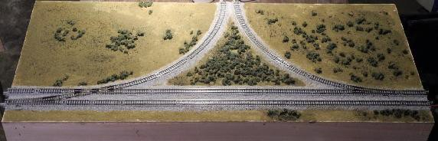
TRIPLE JUNCTION MODULE
Design & Photo: Walt P. http://ttrak.wikidot.com/crossover-junction-1

Slide 25
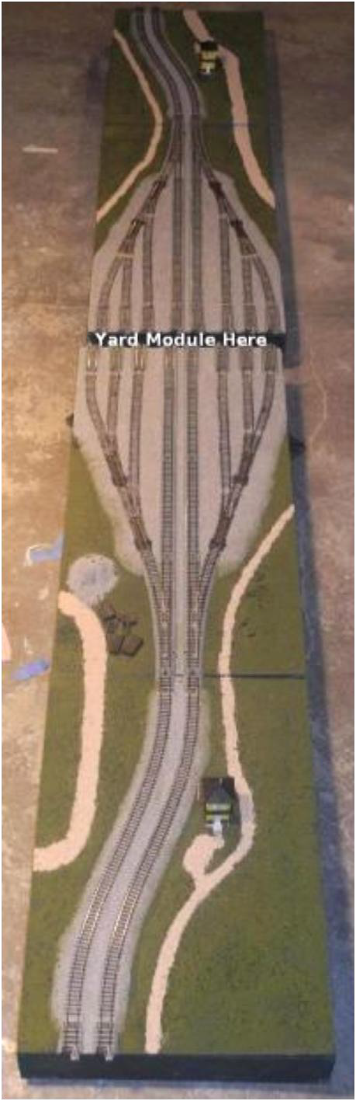
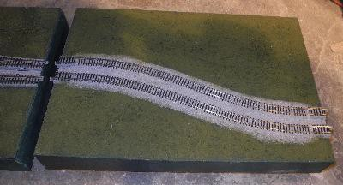
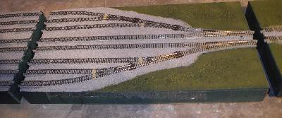
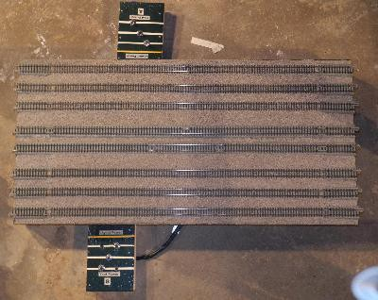
EXAMPLE YARD MODULE
2x Transitions 18” each
2x Ladders 24” each
Yard Modules (any #)
24” each
Design & Photos: Walt P. http://ttrak.wikidot.com/yard-double-sided

Slide 26
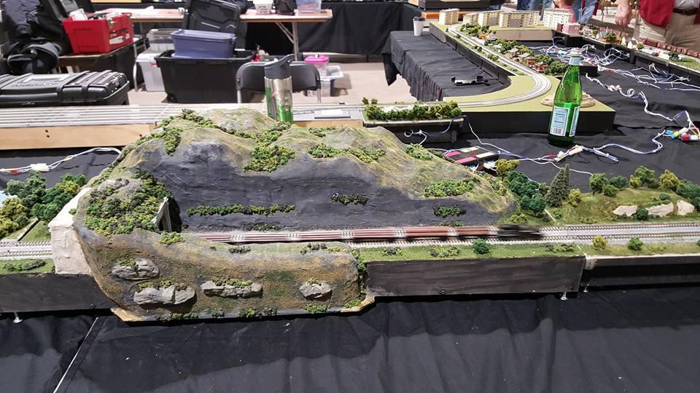
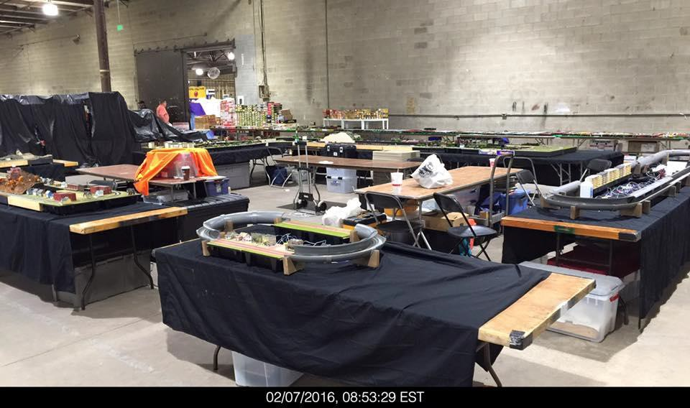
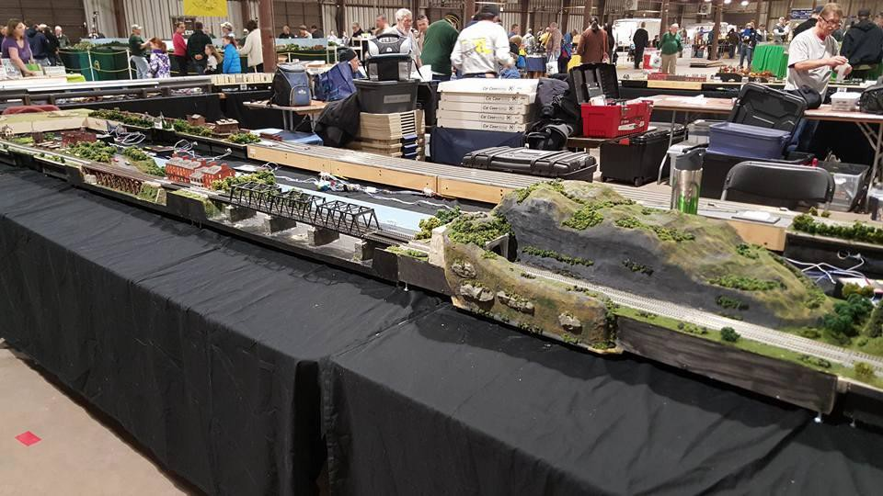
PHOTO GALLERY
Photo: David N. Clyde, Jr.
Photo: Cliff Enz
Photo: David N. Clyde, Jr.

Slide 27
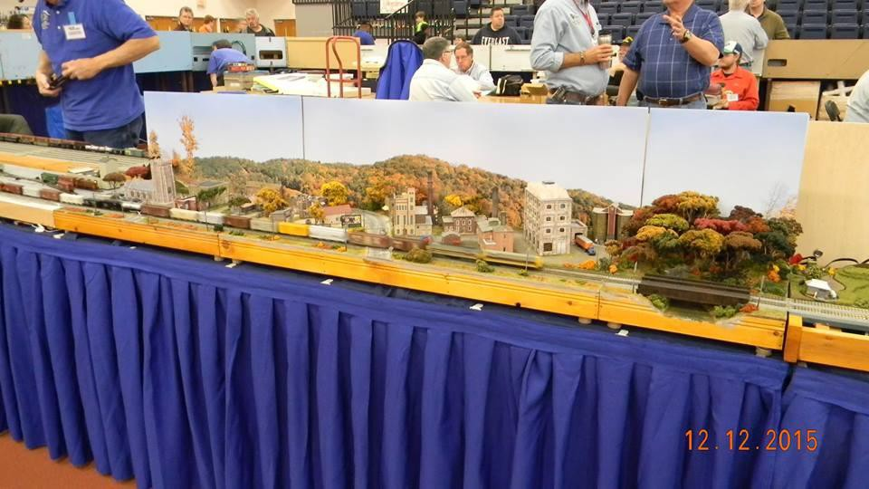
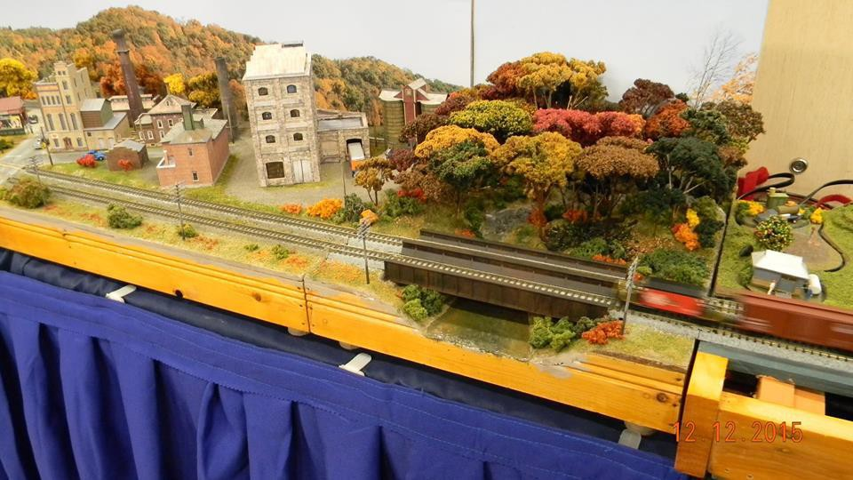
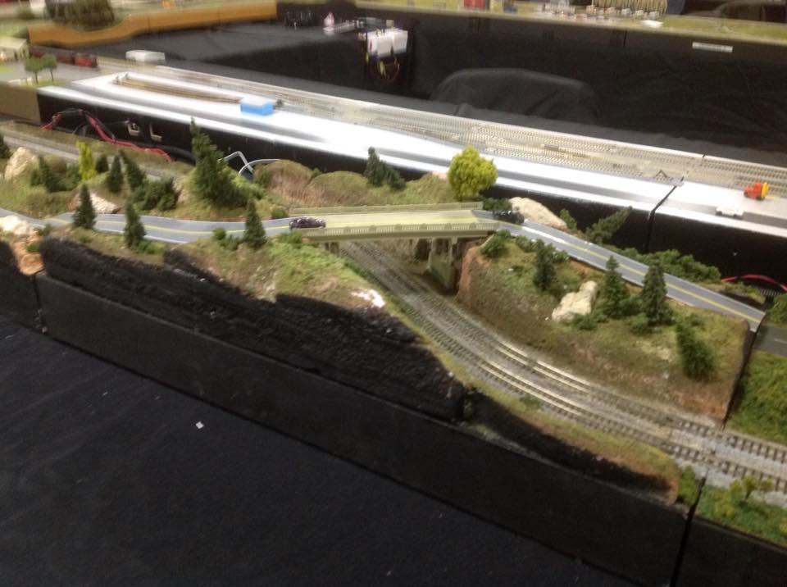
PHOTO GALLERY
Photo: David Rarig
Photo: David Rarig
Photo: Michael Maloney

Slide 28
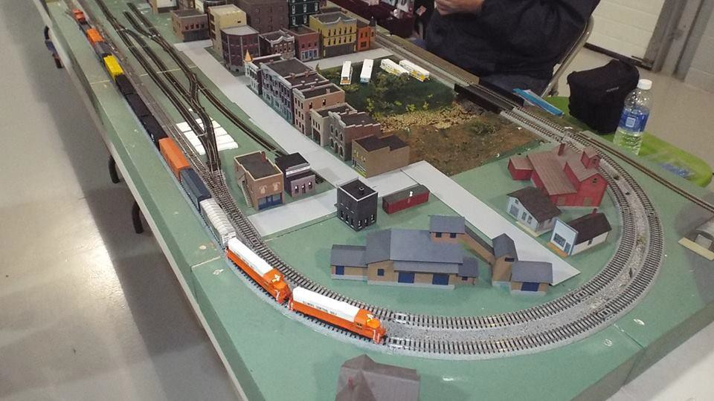


PHOTO GALLERY
Photo: Joseph Martin
Photo: Rob Zatta
Photo: Model Railroader Magazine

Slide 29





PHOTO GALLERY
Modules: Middle Tennessee T-Trak
Photos: Stew Winstandley

Slide 30
VIDEO: WORLD RECORD T-TRAK
Video: https://www.youtube.com/watch?v=fCY7e_39cKU
The final statistics, on the World Record breaking T-TRAK layout are in! The mainline run was an astounding 28.4 scale miles!!!
  340 modules, of all sizes, participated, which, measured as equivalent singles, would be a total of 732 single modules!!!!
  The mainline run bent around a few legs, to also traverse yellow track on those legs...if one wanted to only count the outside run, while only traversing each module only once, the run was 22.18 scale miles.

Slide 31

QUESTIONS?

Slide 32
LINKS AND CREDITS
Official Site: http://t-trak.org/
Unofficial Handbook: http://t-trakhandbook.com/
T-Trak Wiki: http://ttrak.wikidot.com/
Commercial Kit Vendors:
  CMR Products: http://www.cmrproducts.com/
  Masterpiece Modules: http://www.masterpiecemodules.com/
  Woodland Scenics/Kato: Available through your local hobby shop
  Osborn Model Kits: http://www.osbornmodelkits.com/t-track-modules

