Slide 1
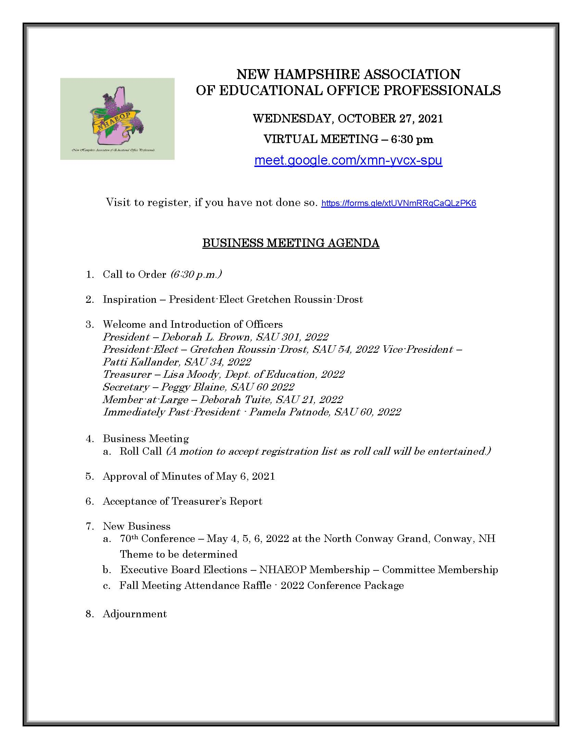

Slide 3
2020-2022 NHAEOP Executive Board
Deborah Brown, President – SAU 301
Gretchen Roussin-Drost, President-Elect – SAU 54
Patti Kallander, Vice-President – SAU 34
Lisa Moody, Treasurer - Dept. of Education
Peggy Blaine, Secretary – SAU 60
Deborah Tuite, Member-at-Large – SAU 21

Slide 4
Business Meeting:
Approval of Minutes of May 6, 2021
Acceptance of Treasurer’s Report
New Business:
70th Annual NHAEOP Edith E. Hammond Conference May 4-6, 2022, North Conway Grand Hotel, Conway, NH ~ theme to be determined
Executive Board Elections
NHAEOP Membership
Committee Membership
Fall Meeting Attendance Raffle – 2022 Conference Package (valued at $436)

Slide 5
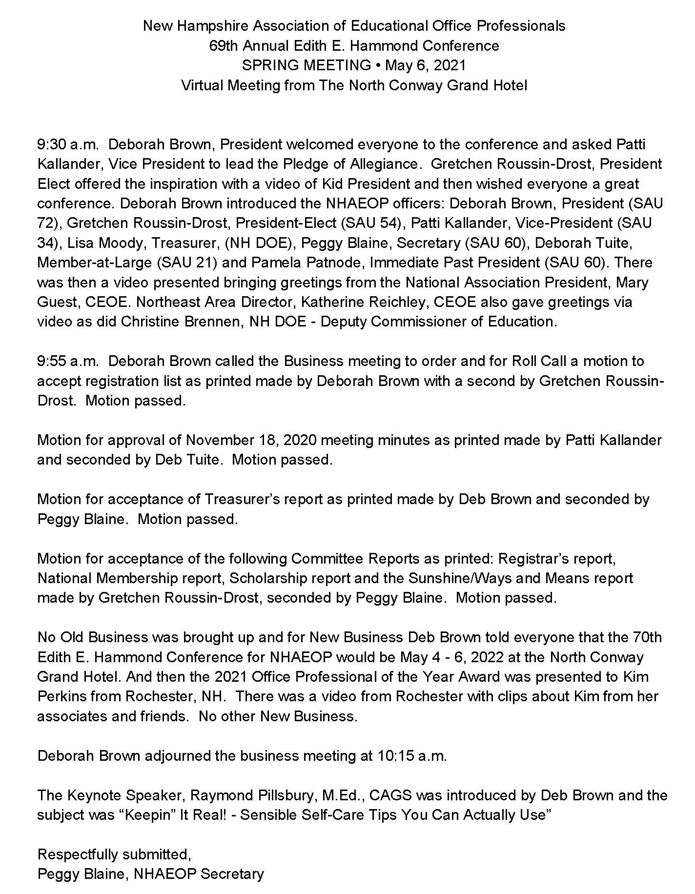

Slide 6
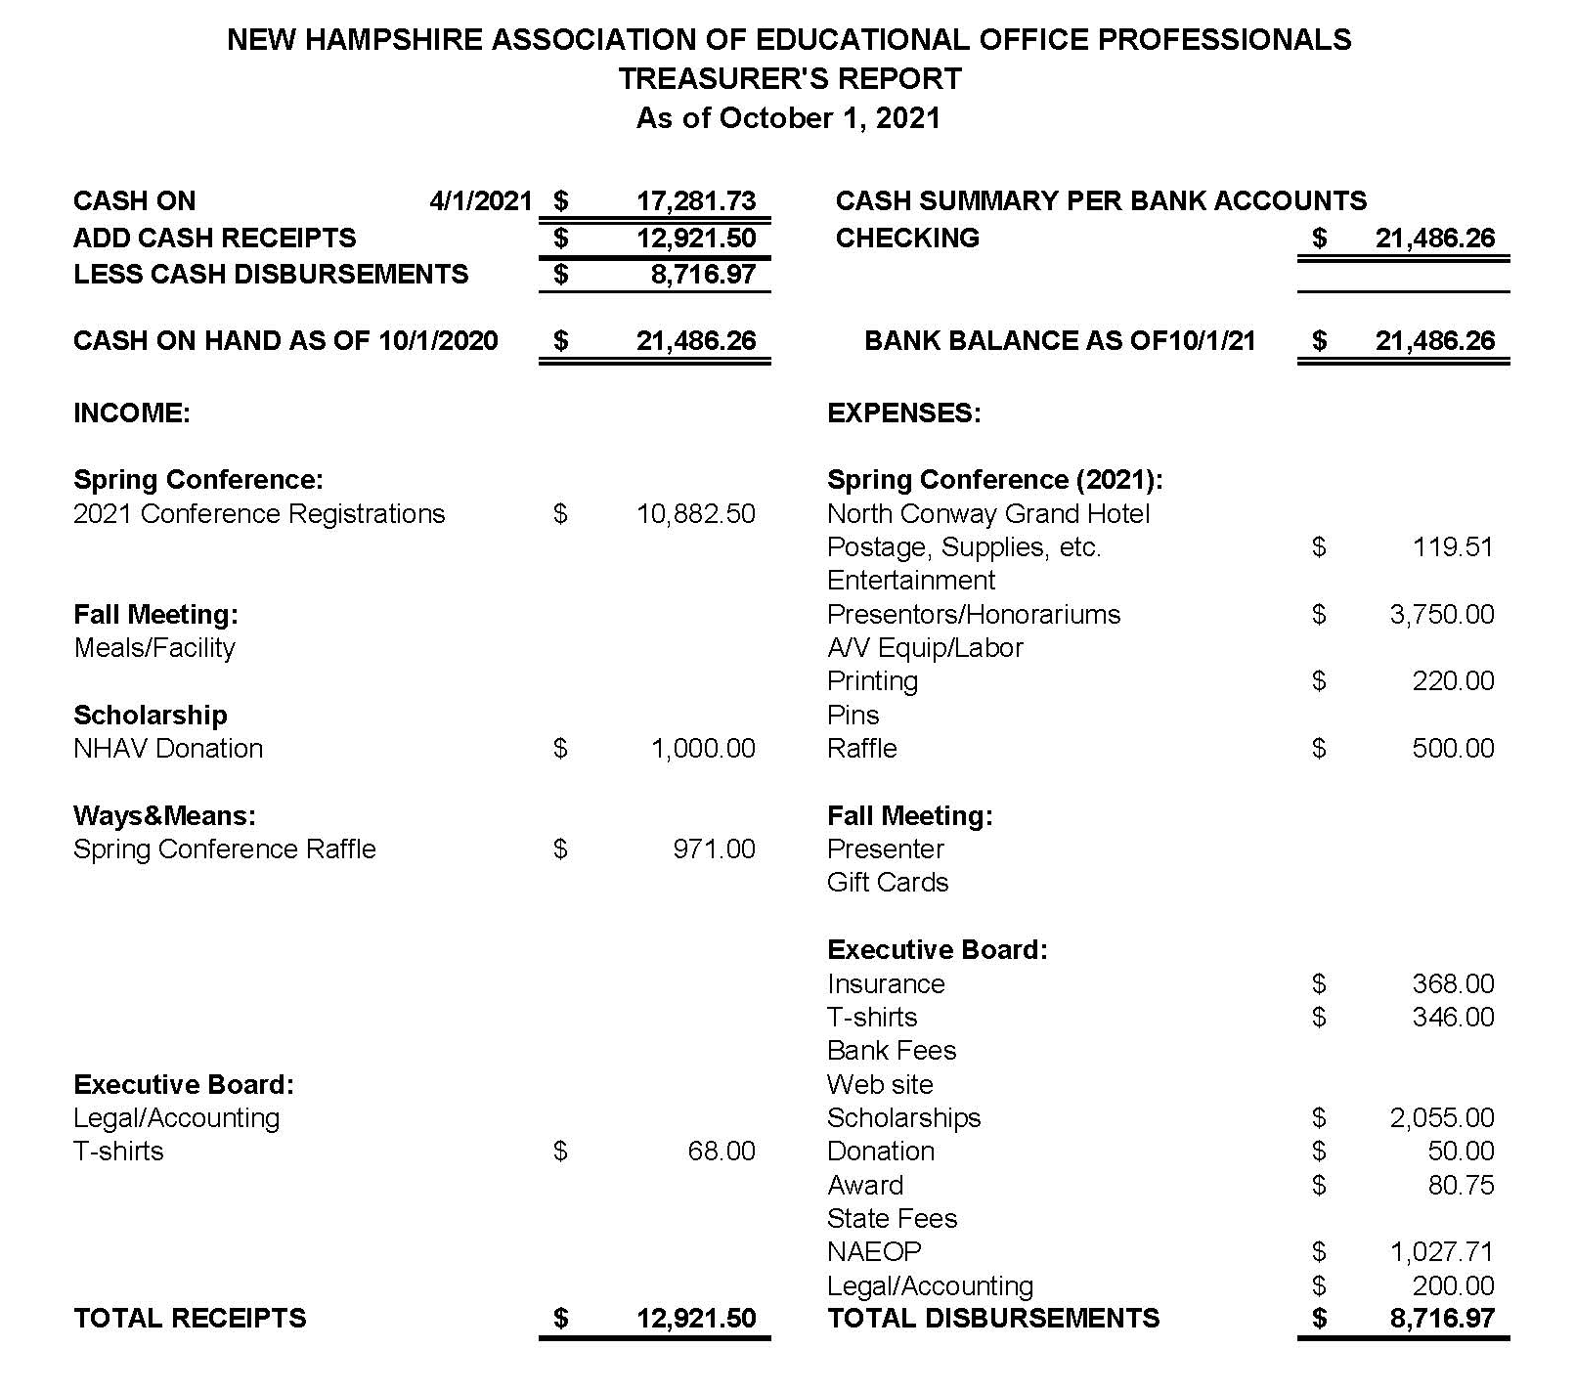

Slide 7
NHAEOP
Edith E. Hammond Conference Package
(valued at $436.00)
May 4-6, 2022
North Conway Grand Hotel, North Conway, NH

Slide 8
Adjournment:
For attending the 2021 NHAEOP Fall Business Meeting. Enjoy the rest of your evening!

