Slide 1
Annual Meeting
2020 / 2021
October 6, 2021
Clarkston United Methodist Church
7:000 PM

Slide 2

Agenda
Call to Order
Introduction of Board
Presidents Report - Financial overview
Expenditures / Improvements 2022
Expense / Savings
Old Business
Road Repaving project
Restoration of detention pond
New Business
New Website/ FB page
Volunteers for Fall planting/ Holiday Decorations
Golf Carts
Entrance to Oakland County Park
Vote for 3 open positions on Architectural committee
Proposed changes to Articles/Bylaws
Suggestions for 2023
General Q&A

Slide 3
Current Directors / Board Members
Directors
HOA Board
Teresa Ottman President
Mark Gadley Treasurer
Manoel Goncalves Vice President
Christina Schneider Secretary
Russ Jones Member at Large
Teresa Ottman
Manoel Goncalves
Christina Schneider
Mark Gadley

Slide 4
2022 Financial Overview
ANNUAL FINANCIAL REPORT
Statement of Financial Position (Balance Sheet)
· Assets = $76,644
· Liabilities = $0
· Equity = $76,644
Statement of Activity (Income Statement)
· Revenue = $93,206
· Expenditures = $70,522 (as of 9/30)
· Other (Inc.)/Exp.= $560
· Net Income = $22,124 (as of 9/30)
Top 3 Expenses for 2022
Rubbish Removal $21,825
Landscaping $15,836
Snow Removal/ Salt $12,240
Account Receivables – Aging Summary ***as of 09/30/22
· Outstanding Dues (1) - $600

Slide 5
2022 Improvements
Lamp and street sign post painted
Removal / treatment of diseased trees
Replaced/repaired 3 mailbox kiosks
Road repair

Slide 6
2022 Savings
Change in Trash Service – Switch made from Waste Management to TNR, with a 3-yr agreement, expiring in 2025. | $23,706
Maintenance of vacant Lots (2014) | $1,350
M-15 Entrance – evenly split with DWII | $10,000
Snowplow and salt contract – headed into year 2 of 3-year agreement

Slide 7
Old Business
Road Repaving– After the extremely high quote from the RCOC to repave the roads, the online vote of the HOA was in favor to continue to patch as needed. The vote was 82% in favor of patching and 42% in favor of evaluating an independent contractor. Roads were patch in May. At this time, roads will continue to be patched as needed
Restoration of Detention Pond
Topographical Study complete
3 bids received
Next Steps

Slide 8
HOA common area, located on Morning Mist, between Morning Mist Court and Hunters Creek contains a DETENTION pond, designed to handle the runoff from 63.5 acres. This was originally engineered by Zeimet/Wozniak as a sediment basin in 1992. In 1993, the plans were revised to a DETENTION basin. Normal water level per original design had an elevation of 1,106.6’. The storm outlet in was set at 1,107’ The stand pipe at the rim of the wetland was set at 1,109’ allowing for a maximum storm surge capacity of 1,111’. A berm was put in place at 1,112’
Standpipe was blocked at some point with cement, creating a RETENTION POND. This created an expanded pond surface area and actual water level of 1,111’ , pushing pond circumference onto into residents' property and causing further erosion. The retained water eliminated the 4.5’ of necessary storm surge capacity and 1’ additional buffer of the berm. Consequently, the berm was breached causing storm water to flow directly into the protected wetland area. With a change from DETENTION to RETENTION, the pond no longer could handle the storm run off as it was designed and also caused flooding on Deer Cross and Hunters Creek.

Slide 9
DETENTION POND / BERM EXPENSE
$6,600 paid in 2012 / 2013 to shore up berm
$12,500 paid in 2021 to restore basin to original intent of DETENTION BASIN, which included removal and replacement of blocked pipes, replacing riprap, removing “sediment island” and shoring up berm.
Bids range from $40,000 to $140,000 for the removal of sediment
Alternate – Put grates on Drainpipe and let the area continue to heal - $1,500.00

Slide 10

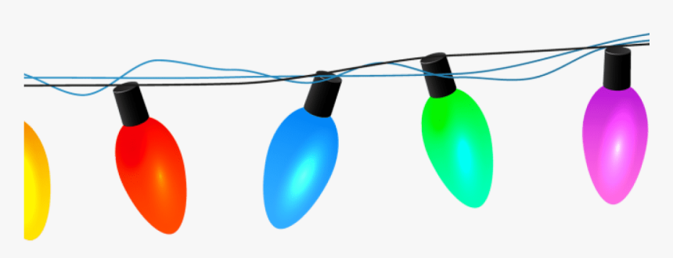

Community Building!
Looking for Volunteers! We are starting 3 committees to spearhead some community development initiatives!
Holiday Decorating Committee!
*Looking for 3-4 neighbors to make The Manors ‘Festive’ throughout the year!
Make an annual calendar of holidays/seasons;
Meet quarterly to plan ahead;
Develop plan and budget and submit to HOA for approval;
Responsible for putting up and taking down decorations!
Christmas lights will continue to be professionally hung ~
Christmas, Halloween, Easter, Memorial Day, Fourth of July, Spring, Fall, etc!!
Social Fun Committee!
*Looking for 4-6 neighbors to come up with fun events and ideas, and coordinate & promote positive engagement among neighbors!
Neighbor Meet & Greet;
Annual Picnic
Food Trucks; Popsicle Day; Margarita Night
Holiday Cookie Exchange
Random Act of Kindness Day
Easter Egg Hunt
Scavenger Hunt
Garage Sale
Poker Night / Dinner Parties / Wine Exchange
Welcome Committee – for new neighbors
Bike / Golf Cart Parade
Garden Club
Fall Planting
October 16- Looking for volunteers to help plant spring bulbs at all entrances. Cyndi Brower and Carolyn Bielak are the Spring Champions

Slide 11
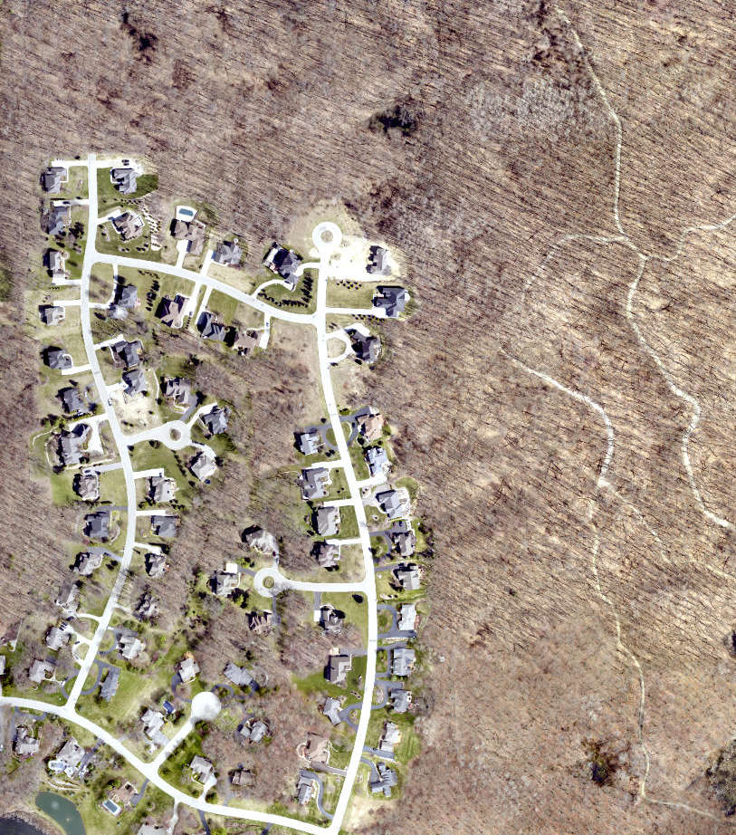
Possible Park Entrance
Thank you, Mike Metz

Slide 12
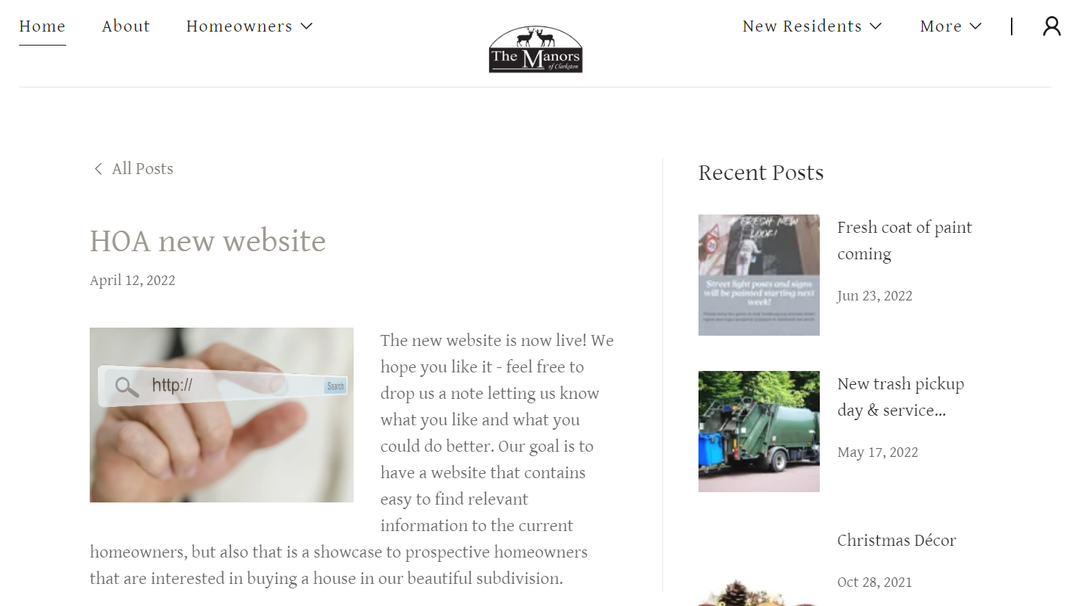
www.themanorsofclarkston.com
New Website!

Slide 13


These items do not pertain to any bylaws or HOA responsibilities, just a friendly reminder
Golf carts and electric dirt bikes have become a growing trend in our neighborhood. Like our Neighboring communities (Oakhurst, Deer Lake, Springfield) this is a fun way to get around and explore the beauty of our tree lined, hilly roads! Here are some friendly rules to ensure the safety of everyone:
Although these electric recreation vehicles are much slower than automobiles, the same road rules apply. (stop, yield, right of way, etc.)
Be considerate, please pull to the side of the road if cars are approaching from behind.
Remind any drivers that we live in a peaceful community, and disrespecting behavior will be reported. Please contact the board for corrective action!
Stop at Buses, and be on the look out for walkers, bike riders, etc.!! Safety first!
All golf carts and dirt bikes must be insured. Any damages or injuries will reflect to the homeowner.
Please do not leave your golf carts or dirt bikes parked in a driveway overnight.
With these rules we can ensure the safety and peace of our neighborhood! Have fun, be safe!

Slide 14
Architectural Board Election Bill Klage Mike Metz Ralf Woods Dave Boersma Mohsin Tarar

Slide 15
Proposed Amendments - Vote
Section 4.8 – Max of 5 vehicles parked in driveway, on a continuous basis, owned by the resident
Article IV – Trash containers to be stored in garage or location nonvisible from the street
New Section 5.2C Reducing mandatory quorum from 35% to 20% in attendance of HOA meetings
Amend section 5.4 – “Dues Fund”. Requires approval of HOA to increase dues
Amend Section 6.7 – Notices may be sent by electronic mail for HOA communication
Amend Article VI with addition of section 6.8 – Recovery of costs and attorney’s fee
Amend Article VI and add new section 6.9 Assessment of fines due to violations

Slide 16
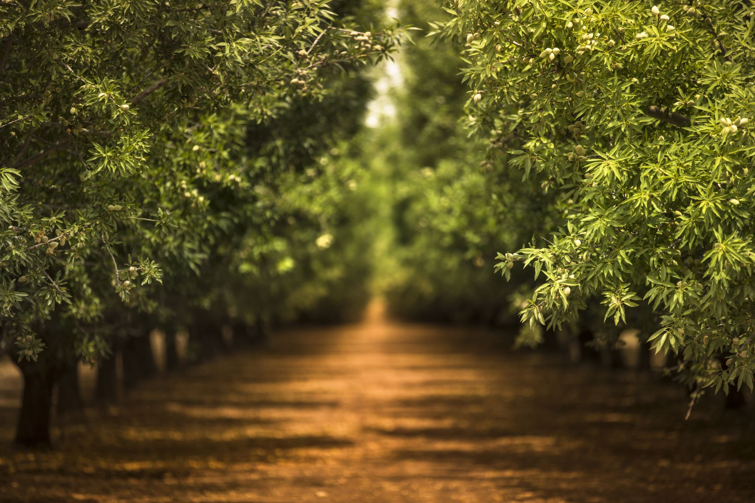
2023 Initiatives
Investigating entrance to Independence Oaks from Deerwood, for resident use. To be gated, locked or use with a key card.
Suggestions

Slide 17


The Manors of Clarkston **New** Facebook Page
Facebook.com/groups/themanorsofclarkston
“There is no power for change greater than a community discovering what it cares about.” – Margaret J. Wheatley
Welcoming Neighborly Feel within our community: Your participation is encouraged and valued!!
Lost dogs, Lemonade Stand Announcements, Support our youth community commitments: Boy Scout/Girl Scout, Youth Sport Fundraisers (mum, or spring flower sales, bottle return drives, pizza kits, etc), Garage Sales, Beautification Updates, And more…
Keep Neighbors informed of Upcoming Events specific to The Manors Community:
A safe environment to discuss inform about Pond / Wetland updates, upcoming projects (road, common areas, park entrance), Changes to bylaws, and resource links, Trash Pick up changes, flags for Memorial & Independence Day, Links to websites…
Hosting / Polling / Announcing Community Events to bring neighbors together and make new friendships:
Food Trucks, Chili Cookoffs, Cookie Exchanges, Holiday Events, Gage interest in community events through polls!
Updates from the HOA and requests specific to The Manors
We have 1 annual meeting a year, keep up to date on what’s up and coming and put in suggestions of what would you like to see?
Highlight services of our neighbors, and referral section!
Section to highlight some of the services our neighbors provide – A lot of neighbors either own or work for cool businesses that could be of value to our homeowners! A non-solicitation area letting our neighbors aware of some services that may be useful to them (Real-estate, Scentsy, Landscaping, Roden&Fields, restaurants, insurance services, marketing businesses, cleaning crews, renovations, etc.)
Create Groups within our community!
Looking for a walking group? How about a book club among neighbors? The Manors Golf Club? Euchre or Game Club? By keeping this within our community we can manage the size of the groups!
Post Annual Meeting Notes, Quarterly Newsletters, Calendar of Events, Welcome New Neighbors!

Slide 18

To Find On Facebook:
Facebook.com/groups/themanorsofclarkston/
Or search:
The Manors of Clarkston

Slide 19
General Q & A
Adjournment

