Slide 1
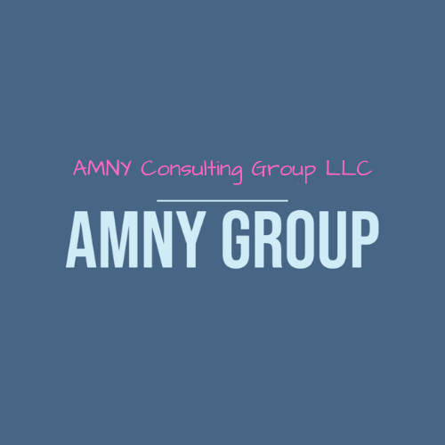
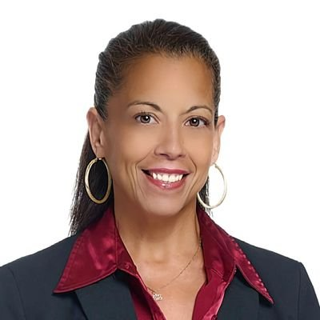

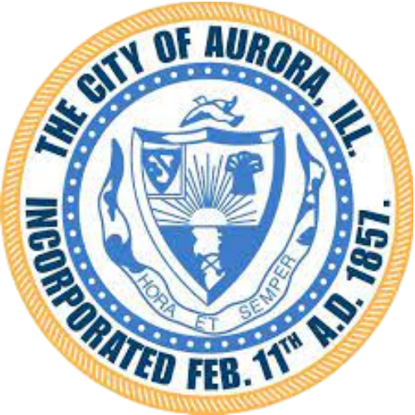




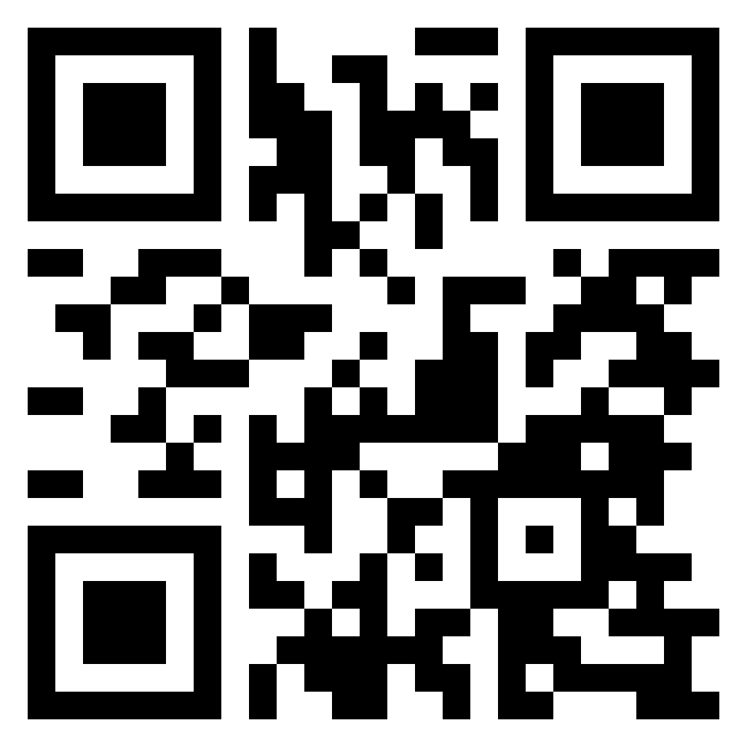






AMNY Consulting Group empowers changemakers across the social impact ecosystem providing a customized suite of services designed to strengthen organizations, amplify impact, and create lasting change in the communities our clients serve.
Adrienne Holloway, Ph.D. Founder/CEO
aholloway@amnygroup.com
832.553.0714
INDUSTRIES
Nonprofit Corporations
Public Sector Agencies
Philanthropic Organizations
Social Impact Corporations
Higher Education
Services
Program Development Strategic Planning
Fund Development Government Compliance
Community Engagement
DIFFERENTIATORS
Assemble dedicated, multifaceted teams tailored to project's specific needs.
Unwavering commitment to personalized service.
Understand the intricate dynamics of community-driven initiatives.
Dedicated to crafting innovative solutions that empower communities.
Experienced in conducting robust research and evaluations.
Experience creating and executing programs across sectors.
By-the-Numbers
$2M
Funds Raised 2020-2023
REFERENCES
Greater Houston Community Foundation
Nadia Valliani, Director
nvalliani@ghcf.org
City of Aurora
Richard Irvin, Mayor
rirvinlaw@gmail.com
Edison Arts Foundation
Charity Carter, President
CharityCarter@edisonartsfoundation.org
CLIENTS
NAICS
541611 - Management Consulting
813200 - Grantmaking
541820 - Public Relations
NIGP
918-27- Community Development
918-90 - Strategic Planning
918-63 - Housing Consulting
500%
Increase in Client Base
Insurance Coverage
$1M General Liability
$1M Professional Liability
Certification
NMSBC– MBE
WBNEC– WBE, WOSB
Texas HUB-Pending
SBA 8(a)-in process
DUNS #
118980340
Tax ID#
92-2461557
UEI
H2HDWPV54569
WWW.AMNYGROUP.COM

