Slide 1


Rescue Swimmer Training and Safety
Module 2

Slide 2

Learning Objectives
Rescue Swimmers will demonstrate knowledge and understanding of:
  Five phases of Rescue Swimmer (RS) Deployment
  Task organization and Preparation of the RS
  Three scenarios in which an RS is deployed
  The importance of conducting an After-Action Review
  Key elements that differentiate a Rescue Swimmer COB briefing from a traditional one
  How to create a safety ethos on a vessel
  Aspects of the Constant Briefing technique
  Impact of water temperature to the PIW
  The role of the navigator in a COB
  The use a PAN PAN or a MAYDAY Radio Call

Slide 3
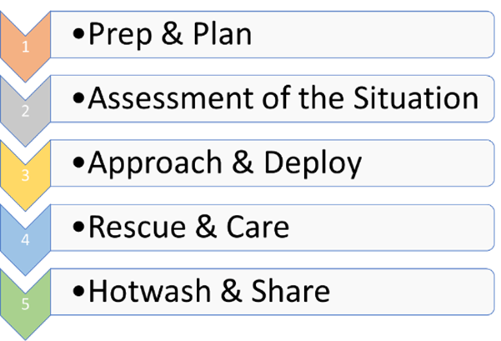
The Five Phases of Rescue Swimmer Deployment
Notes:
Deploying the Rescue Swimmer involves much more than suiting up, hooking up and splashing the swimmer. Once there in a COB situation, a Certified Rescue Swimmer will control the risk be using a systematic approach to ensure the roles and responsibilities of the entire crew are clear. By identifying tasks, sequences and phases the Rescue Swimmer trains up a boats rescue performance. It is important to understand the sequence of each phase, and how it provides a positive safety ethos for the crew, with the end goal of preventing the COB situation all together. The crew should thoroughly understand the five phases and use them while training

Slide 4
Phase One - Preparation and Planning Deployment
Skipper/Watch Captain direct safety preparation prior to leaving the dock.
Task Organization/Preparation
Establish Constant Communications with RS.
Identify the ‘Ready Halyards’.
  Rig the rescue line fastest winch (be prepared to attach the recovery line to the RS)
  Prep team off watch (Who).
  First Aid/Warming (Who).
  Radio/DSC Positions (Who and How).
  Who is in Charge of Communications .
  Navigation (Who).
Helm Prep and Nav Plan? What is the rescue plan? Make sure it is communicated!
CREW OVERBOARD – Deploy the RS is a Skipper decision (Input with WC and RS).
With any COB, the RS begins suiting up when feasible.

Slide 5
Phase Two - Rapid Assessment
Assess the PIW
- well-being?
- Personal Protection Equipment (PPE)?
- Conditions and Scenario
Scenario
- Conscious, No PPE. (First Chance Last Chance?)
- Conscious with PPE.
- Unconscious with PPE (or injured) and or Incapacitated/Unconscious.
PIW with PPE: It is important that each crew has the exact same PPE set up. Each PFD should be identical and the equipment for each should also be similar. (Note - Procedures in the following segments.)
What is the approach of the helmsman, strategy, and RS deployment plan?
Understand that the conditions which may dictate that the situation may be a first chance/last chance. (IDR Drowning)
Notes:
No matter the condition of the PIW, RS/Team should be prepared to recover an incapacitated or unconscious PIW. Once a person enters the water their condition will continue to deteriorate. This needs to be in the forefront of the minds of the teams on the boat.

Slide 6
Phase Three - Approach & Deploy
The Rescue Swimmer will make recommendations how to position the vessel as close as possible to affect a positive outcome.
The Skipper, Watch Captain and Rescue Swimmer will then communicate the strategy to deploy the Rescue Swimmer.
Notes:
Pay attention to the approximate distance the RS needs and how much Rescue Line is availible.

Slide 7
Phase Four - Rescue and Aftercare
The final hoist retrieving both sailors.
Assessment
Hypothermia:
Uncontrolled shivering.
Mental confusion.
Slurring words.
Lack of coordination.
(extreme cold, a loss of the ability to shiver)
Organize Medical Evacuation as needed

Slide 8
Phase Five - Hot Wash AAR
Immediate - After the situation is normalized, the resident expert (RS/Skipper) will conduct a review of the incident to ensure the situation(s) that caused the COB are communicated and controlled so that a repetitive incident does not end with the same result.
Post Incident - Once ashore, a more thorough Hotwash/AAR can take place with a full team review. (Samples provided in the back of the handbook).

Slide 9
Creating a Safety Ethos
Mastery of Crew and Boat Readiness requires constant communication. A resounding echo or a continuous mantra needs to be expressed throughout the sail.
Safety must be constantly monitored and briefed as situations change. This only occurs if this is part of a job description (the Rescue Swimmer/Safety Officer).
Constant Briefing - Continual verbal commands and readiness cues lead by the Skipper, Watch Captain and Rescue Swimmer to ensure that the team understands maintaining safety and which tools are availible if needed.
Halyards are critical tools to be used in rescue operations –
Each peel, tack, jibe and sail re-configuration should be followed by reminders of the free halyard and clutch to be used in the event of an emergency.

Slide 10
Water Temperature Impact
Notes:
Use this chart as a reference for safety Briefings. It will be important to understand in 70 degrees(f) of water, a person may not be able to help themselves after three hours of exposure. The body’s core temperature drops very quickly when it is submerged. The Navigator will be able to prompt Watch Captains as water temperature changes in distance racing. WCs and RSs will then keep the crew updated of maintaining a safety ethos while racing. (Michigan State University)

Slide 11
The Navigator Plays a Critical Role
HIT COB Button!!!
It can take up to a 30 minutes to control a vessel to make the recovery turn .
The Navigator will:
Determine the course.
Search pattern.
and Communicate on availible Radio and Sat Com.
Record the COB lat/long position (on a piece of white tape) and mark it as COB position.
Upon hearing any PAN-PAN or May-Day, the Navigator will need to capture the important information, mark boat’s position (for ‘Redress’), and ensure the team is briefed on the situation if a position to assist.

Slide 12
COB - PAN PAN or a MAYDAY Radio Call?
When the COB is visible hail “PAN PAN” and trigger COB and the DSC. It is critical to understand that the GPS of a boat is integrated into the DSC.
Use a MAYDAY call when the PIW the COB is not visible.
Notes:
It is critical to understand that the GPS of a boat is integrated into the DSC in many radios. With a COB DSC, other vessels with DSC radios will automatically receive the location of the COB. Additionally, each crew member must understand the correct use of the DSC button and the proper way to call for assistance.
The last thing the skipper needs is a dozen well-meaning good Samaritans in fast boats with powerful engines applying full power, throwing big wakes and racing at break-neck speed to the position broadcast. The ensuing radio calls after a MAYDAY can often become unmanageable for verification of position could make the channel unusable. By using the PAN- PAN, reporting the position of the PIW sets greater expectations for those listening to the distress call.

Slide 13
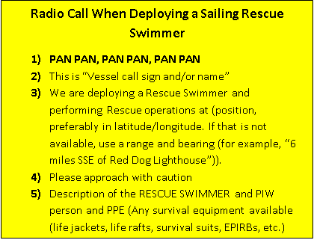
Radio Call while Deploying a Rescue Swimmer
Notes:
Remember you need to protect the swimmer from other boats

