Slide 1
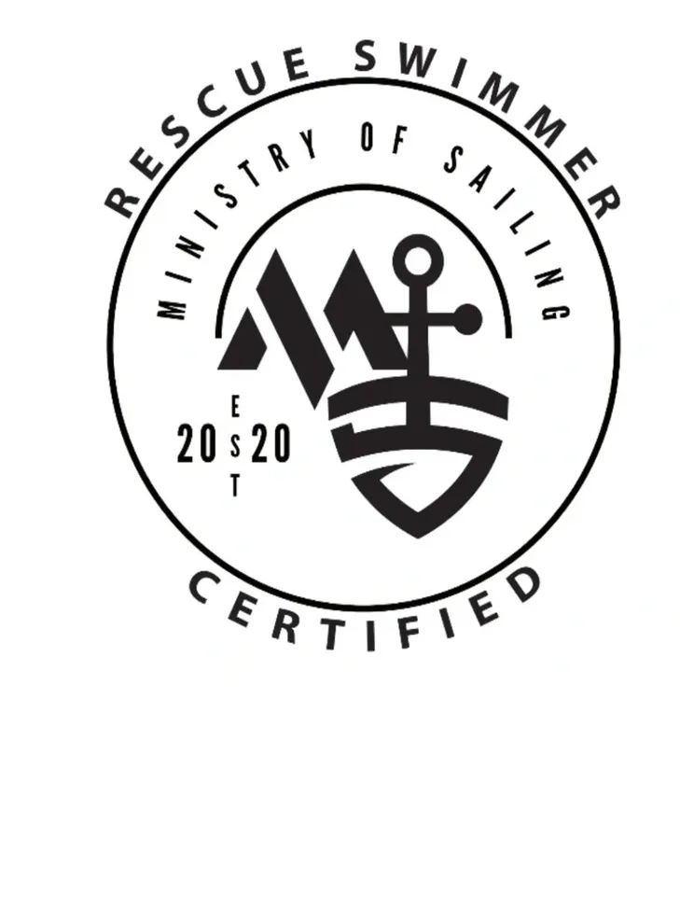
Rescue Swimmer Introduction
Module 1

Slide 2
Learning Objective
The Rescue Swimmers/Principal Race Officers will be able to:
Demonstrate knowledge and understanding of:
The differences between a Rescue Swimmer and a Surface Swimmer
Terminology of crew and boat readiness
Methods that maintain the crew readiness
The need for the use of a Sailing Rescue Swimmer
The qualification and certification process to become a RS
Importance of certification
The roles and responsibilities of the rescue swimmer
Reasons sailors should refrain from employing unproven methods
Ways a rescue swimmer can mitigate the urge to take short cuts in safety situations.

Slide 3
The differences between a Rescue Swimmer and a Surface Swimmer
Sailing Rescue Swimmer: is a designation given to a technical expert trained to leave a vessel - while attached to a rescue line - and swim away from the boat to retrieve a Person in the Water.
Sailing Surface Swimmer: is the designated crew member that is using a technique to give aid when a person is lowered from the deck near to or into the water. The intent is a ‘longer reach’ to assist a PIW.
IMPORTANT The definitions of Rescue Swimmers and a Surface Swimmers are recognized industry terms used by Rescue, Military and Security Forces around the world.

Slide 4
Terminology of crew and boat readiness
Crew Readiness is when the crew has mastered:
Rescue operations
Safety communications
Teamwork
Managing of resources and personnel training in preparation for responding to emergencies.
Boat Readiness refers to the operational conditions of:
PPE and functional equipment
The boat is equipped with all the kit needed to prevent COBs
Ocean Racing mandates that time is always of the essence in emergencies, especially when lives are in jeopardy. It is the Rescue Swimmers purpose to lead the crew to maintain a constant state of readiness.

Slide 5
Risks from using unproven methods
There will be risk.
Sending a second sailor into the water increases the risk to an already difficult situation.
This training program provides training to control the risks.
The Sailing Rescue Swimmer, in combination with a trained team, are game changers. The certification program provides the training, procedures, and equipment needed to mitigate the additional risk associated by sending a second soul into the water.
By using the training procedures and protective equipment, sending in a second soul to rescue a PIW is now a viable option while controlling the risk.
DO NOT SEND A PERSON INTO THE WATER, TO SAVE ANOTHER WITHOUT PRACTICED PROCEDURES, PPE AND A TRAINED RESCUE PERSON

Slide 6
The need for Sailing Rescue Swimmers
Modern sailboat performance characteristics have evolved to a point that enable far more effective rescue techniques than current standard practices if experiencing Crew Overboard (COB) situations.
Sailing Rescue Swimmers, in combination with a trained crew, are the game changers which will add more options for rescuing a sailors who are in the water.
Enhanced performance boats increase the distance separating the Person in the Water from the boat.
Crews do and will continue to lose sight of the Person in the Water (PIW).

Slide 7
The need for Sailing Rescue Swimmers (2)
Controlling a vessel at high speeds with two or even three headsails deployed can take up to 20 minutes (or more). In 2014, during the Clipper Race in 2014, it took thirty minutes to find the PIW - and when they did, the PIW was unable to help themselves due to hypothermia. Sometimes, it may be impossible to rescue or even recover a PIW without the utilization of a Surface or Rescue Swimmer.
Without practice, training and specialized equipment, sending a second person into the water may increase risk in a way that cannot be controlled. Some even suggest the risk is being doubled. However, through training, expert advice, procedures, certification, proven methods, and equipment the additional risk can be controlled.

Slide 8
The need for Sailing Rescue Swimmers (3)
The Sailing Rescue Swimmer certification creates the highest trained safety professional aboard a boat.
It provides a commitment to safety leadership coincides with the certification, no matter which vessel you sail.
It is expected each Rescue Swimmer will lead the way to safety on every boat they sail on.
The Rescue Swimmer is a certified, deployable team member, responsible for the rescue readiness of the boat, crew and in the execution of rescuing activities.

Slide 9
What the Sailing Rescue Swimmer Certification provides.
Professional certifications provide:
Standardized processes, equipment and training.
A framework for controlling the risk through training, procedures, and equipment rather than controlling the risk through avoidance alone.
Techniques that are vetted and tested by professionals, are used by professional teams, and that provide a consensus of acceptable practices.

Slide 10
Qualifications to become a Rescue Swimmer
1) CPR and First Aid Qualified*
2) Safety at Sea Certificate*
3) Life-Guard Certification or evidence provided of strong swimming skills in open water (the ability to swim 400 meters, and the ability to tread water for 20 minutes).
4) A recommendation from a World Sailing, Group Three Professional or Team Captain/Owner providing evidence of experience.
5) Sailing experience not less than 150 nautical miles, or a passage not less than 24 hours.
(* as recognized by World Sailing)

Slide 11
Roles and responsibilities of the Rescue Swimmer
Under the command of the Skipper, it is the Rescue Swimmer who is responsible for readiness in Person in Water (PIW) situations.
Deployment, training, administration, personnel management, and logistics in all matters relating to PIW situations.
Planning, training, making timely decisions, organizing and assigning tasks, and supervising the safety related activities.
Keeps the team informed of latest information and review incident of COB situations.
Plan COB drills and other safety training.

Slide 12
Roles and responsibilities of the Rescue Swimmer (2)
Stays abreast of sailing objectives through close coordination with Watch Captains and Team Leadership.
Directs, trains, and assists the planning and coordinating the team’s medical and emergency plans, reviews sailing instructions and safety requirements, ensure comprehension, and team implementation.
Ensures that all-round safety maintenance is operational and up to date, provides task organization and corrects unsatisfactory actions.
Positions oneself where they can influence the most critical tasks for mission safety.

