Slide 1
Heavy Weather Sailing

Slide 2
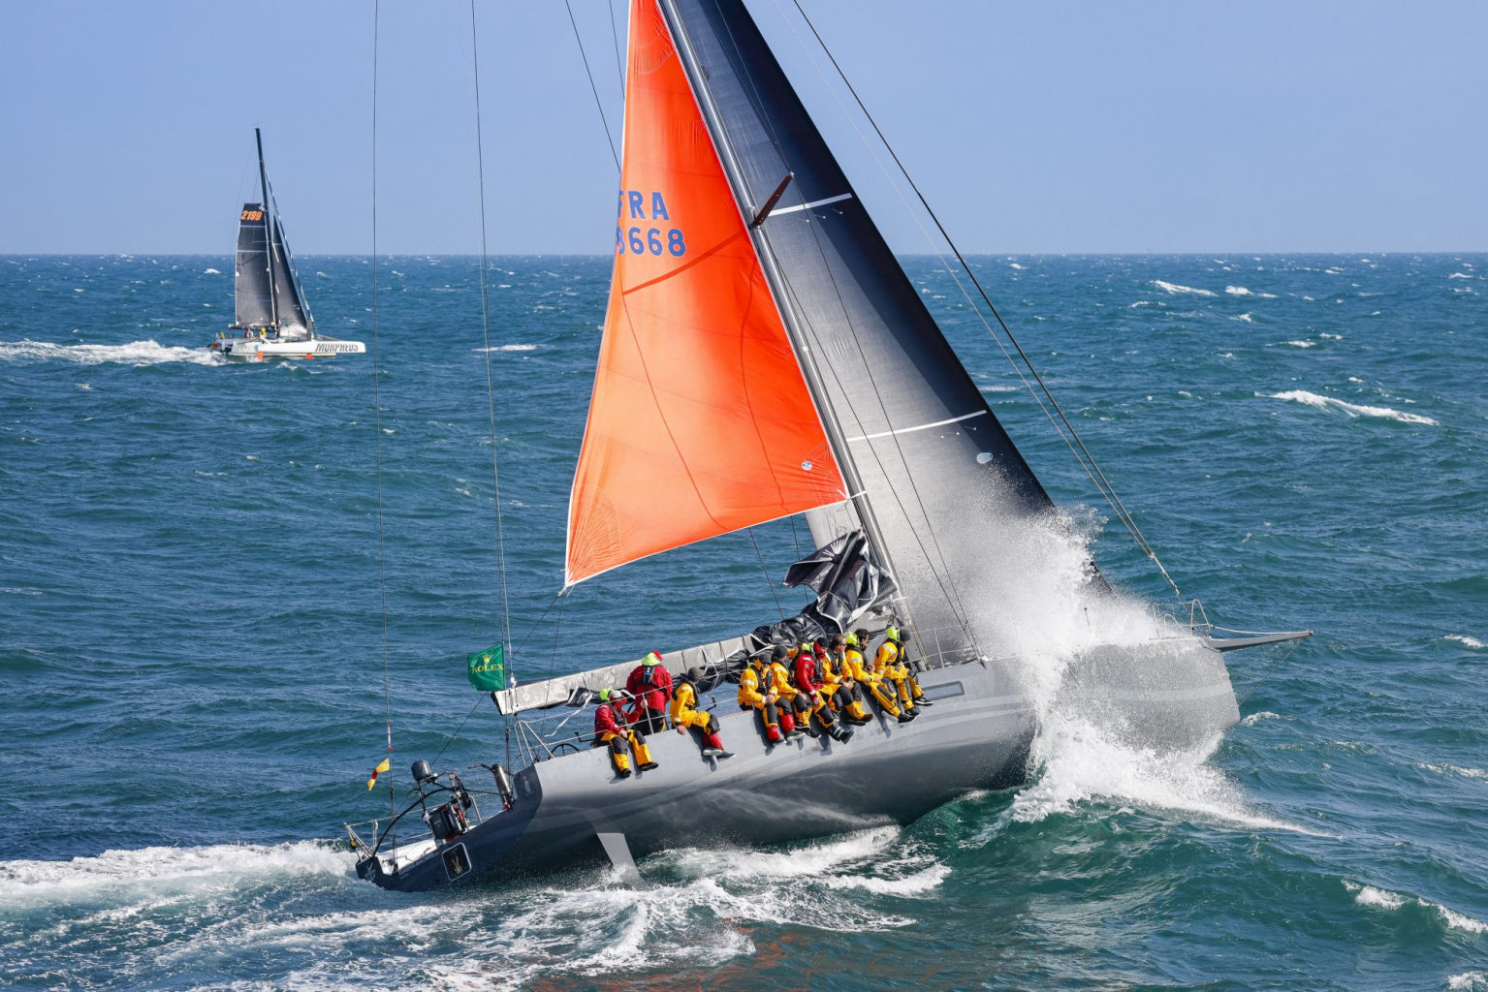
Take Home
The first time you put up a Tri Sail or a Storm Sail, should not be in a storm.
If you need one, have one!
Notes:
Training must include what the Person in the Water will experience.

Slide 3
Take Home
Risk Controls
How Storm Sails should be setup
The De-powering Sequence
Tips: Getting them up and down
Keeping them in one piece
Heavy Air Strategy and Tactics
Notes:
Training must include what the Person in the Water will experience.

Slide 4
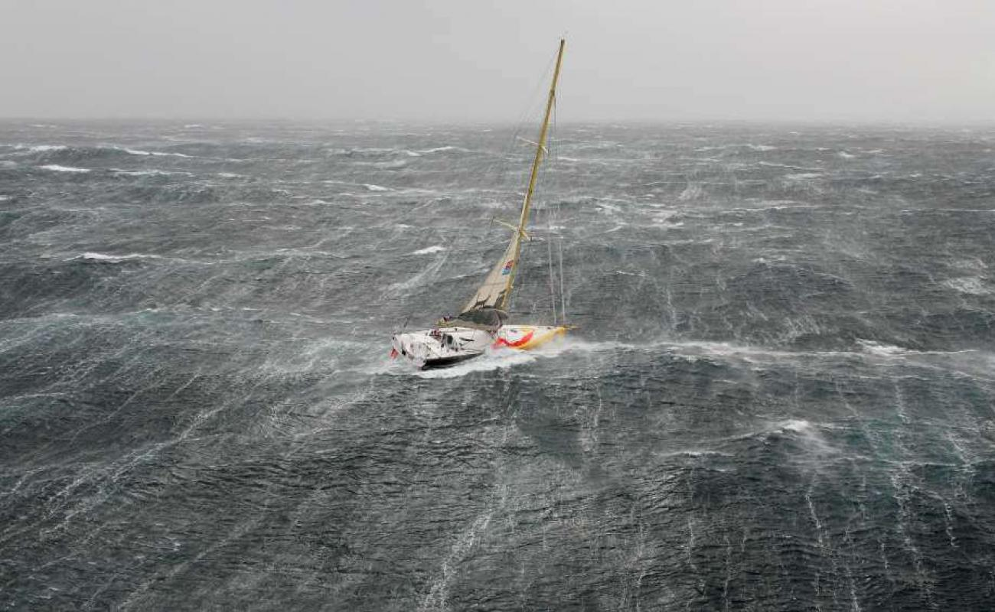
What is Heavy Weather?
10 Knots
20 Knots
30 Knots
45 Knots
Opti
Catalina 22
Volvo 65
Notes:
Experience and

Slide 5
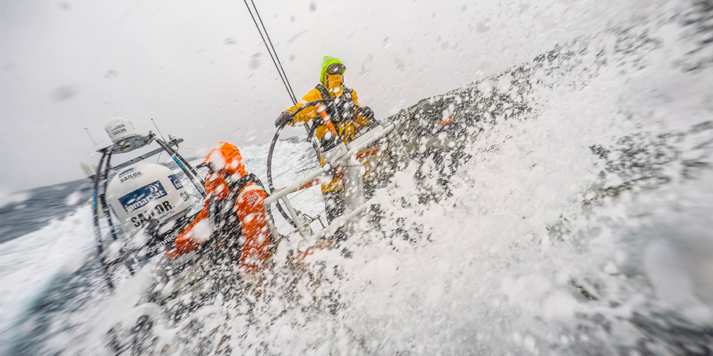
EXPECT DAMAGE!
Avoidance
Reduce Impact
Reduce Likelihood
Risk Controls
Notes:
Your mindset cannot be it will never happen to me. The greatest enemy!!!

Slide 6
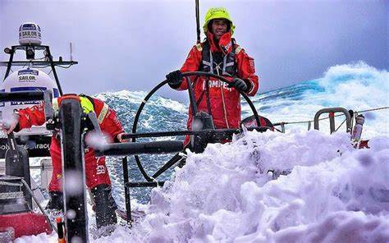
Risk Controls
Training
Procedures
Policy
S@S - Practice
Task Mastery and Cross Training
Reefs, Night, PFDs

Slide 7
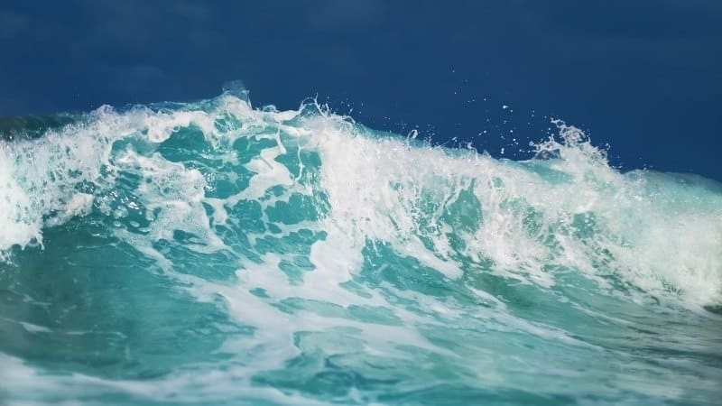
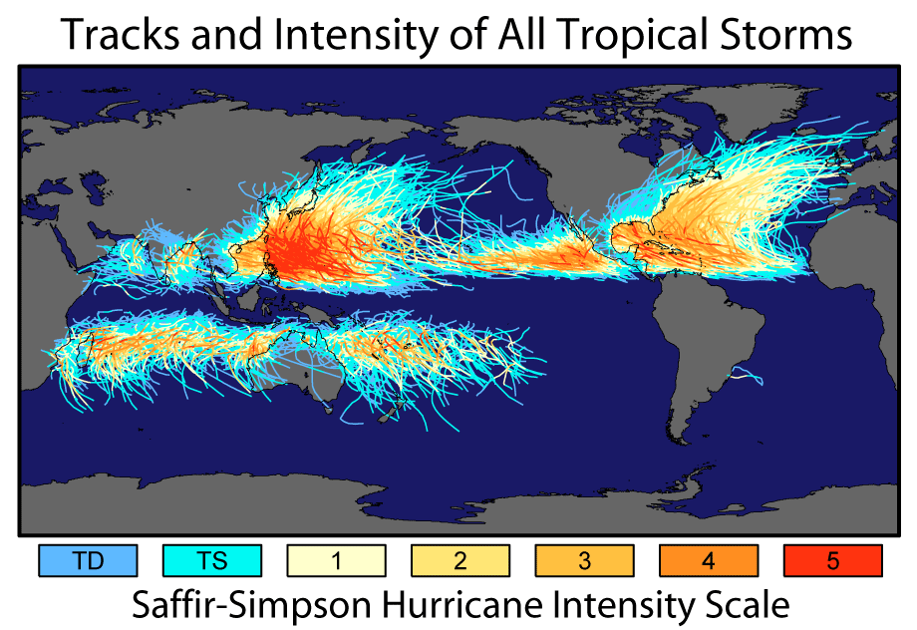
Know your limitations and the Risk
Notes:
Training must include what the Person in the Water will experience.

Slide 8
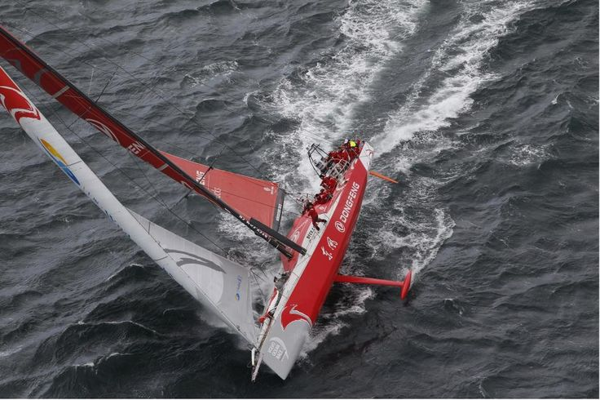
Opinion vs Standard
World Sailing Offshore Special Regulations (OSR) governs the rules for boats taking part in recognized offshore races.
- Based on best practice
- Updated at least every two years
- Reflect the latest knowledge in offshore safety
- Includes learnings from incidents at sea
World Sailing - Offshore Special Regulations
Fastnet Force 10 & Safety at Sea Guide
Notes:
World Sailing Offshore Special Regulations (OSR) governs the rules for boats taking part in recognised offshore races, including the storm sails they must carry. While there is no such rule for cruising boats, the information provided in the OSR is based on best practice and is updated at least every two years to reflect the latest knowledge in offshore safety including learnings from incidents at sea.
OSR 4.27 Storm & Heavy Weather Sail Specifications includes the requirement for 'highly-visible' colours and the ability to hoist a jib 'independent of a luff groove'. The maximum sail areas are also stipulated as follows which can be a useful guide for non-racers:
Storm jib
Area of 13.5% height of the foretriangle squared For Cat 2 races this reduces to area of 5% height of the foretriangle squared with a maximum luff length of 65% of height of foretriangle
For example a typical 35ft Yacht with 14m foretriangle height: Max. storm jib area = (5 / 100) x 142 = 9.8 m2
Storm trysail
Area not greater than 17.5% mainsail hoist (P) x mainsail foot length (E) For sails made after 2011: The storm trysail area calculated as (0.5 x leech length x shortest distance between tack point and leech)
READ THE FULL OSR HERE
Summary
Storm sails can be invaluable for surviving heavy weather and for the minimal extra weight / storage space required it is a no-brainer to carry them. The exact rigging setup should be carefully planned to be as simple and robust as possible. The OSR states the rules around storm sails for racers but also provides useful guidance and best practices for cruisers.
Just like all safety equipment, it's absolutely essential to familiarise yourself with how to set your storm sails, before heading out on a longer passage where they might be needed.

Slide 9
World Sailing Offshore Special Regulations (OSR)
What’s wrong?
Who is in Command of Safety?
WS OSR Cat 3 ORC WORLDS (no liferaft) 5.pdf
Notes:
World Sailing Offshore Special Regulations (OSR) governs the rules for boats taking part in recognised offshore races, including the storm sails they must carry. While there is no such rule for cruising boats, the information provided in the OSR is based on best practice and is updated at least every two years to reflect the latest knowledge in offshore safety including learnings from incidents at sea.
OSR 4.27 Storm & Heavy Weather Sail Specifications includes the requirement for 'highly-visible' colours and the ability to hoist a jib 'independent of a luff groove'. The maximum sail areas are also stipulated as follows which can be a useful guide for non-racers:
Storm jib
Area of 13.5% height of the foretriangle squared For Cat 2 races this reduces to area of 5% height of the foretriangle squared with a maximum luff length of 65% of height of foretriangle
For example a typical 35ft Yacht with 14m foretriangle height: Max. storm jib area = (5 / 100) x 142 = 9.8 m2
Storm trysail
Area not greater than 17.5% mainsail hoist (P) x mainsail foot length (E) For sails made after 2011: The storm trysail area calculated as (0.5 x leech length x shortest distance between tack point and leech)
READ THE FULL OSR HERE
Summary
Storm sails can be invaluable for surviving heavy weather and for the minimal extra weight / storage space required it is a no-brainer to carry them. The exact rigging setup should be carefully planned to be as simple and robust as possible. The OSR states the rules around storm sails for racers but also provides useful guidance and best practices for cruisers.
Just like all safety equipment, it's absolutely essential to familiarise yourself with how to set your storm sails, before heading out on a longer passage where they might be needed.

Slide 10
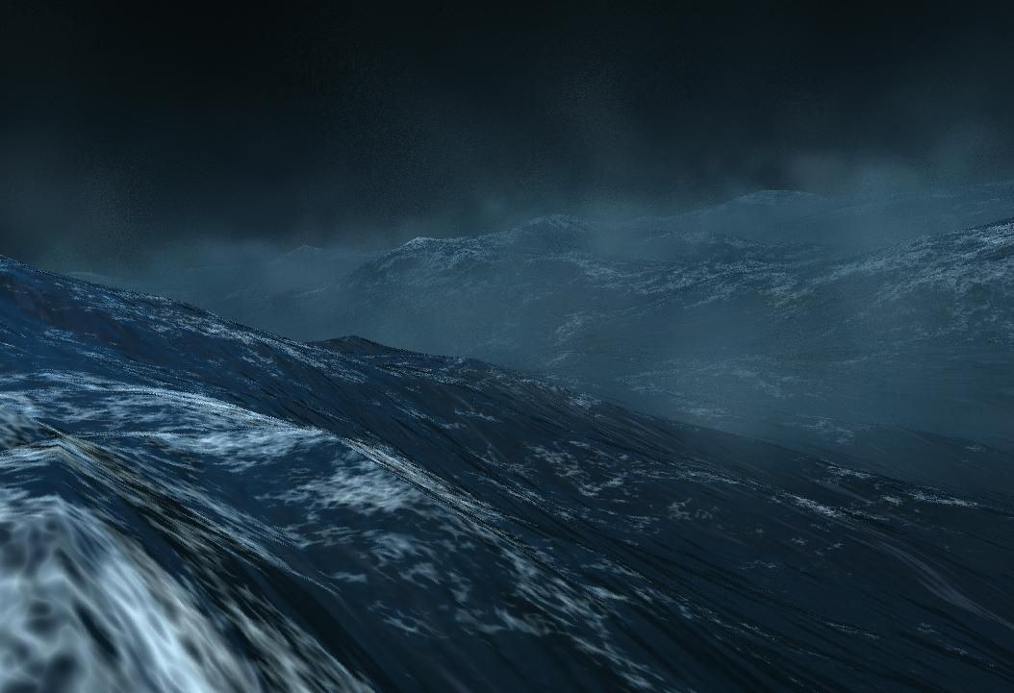
Sails
Heavy Air Sails:
The ORC #4
No Larger than 13.5% of I2
Storm Jib
5% of I2
Notes:
I' is the distance from the highest spinnaker halyard to the deck, Did you know that the fasnt net Rock Race the Check in musyt have the starm sails up displaying the numbers? HEAVY WEATHER JIB OSR reference 4.26.2 a) With area of 13.5% of height of the foretriangle squared, independent of a luff groove to attach to the stay.

Slide 11
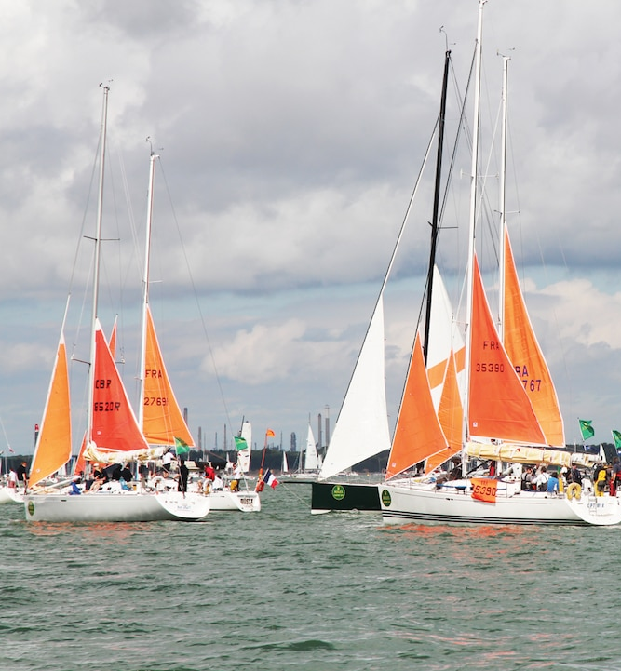
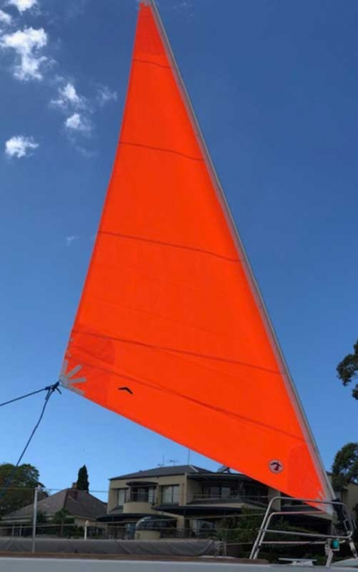
The RORC Fastnet Race Requires all boats to check in with both Tri-Sail and Storm Jib rigged.
Notes:
Risk Controls, when do you move these sails from the bottom of the

Slide 12
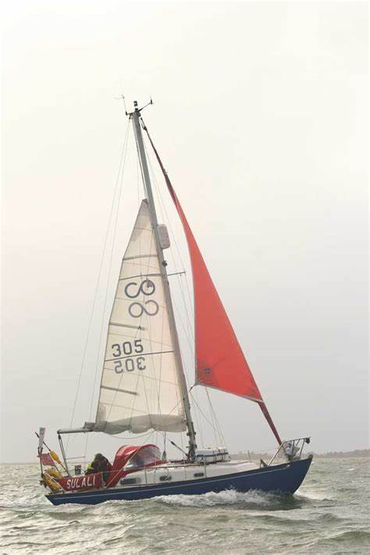
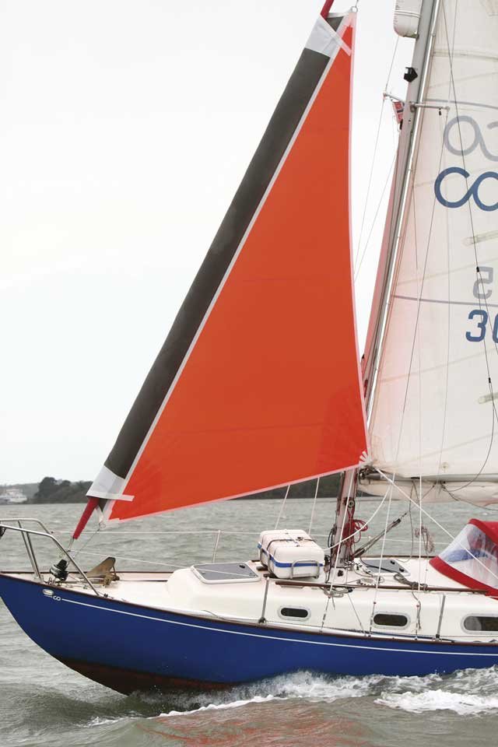
Storm Jib 5% of I
The Gale Rider clips over a roller furled sail to prevent it from unfurling.
Notes:
The Gale Sail
Here's what Tom Burden has to say about it:
"The safest and easiest way to hoist a storm jib in heavy conditions. Simply furl the genoa sheets down to the deck and yank the Gale Sail over the furled headsail, attach its sheets and hoist it with a spare halyard or the spinnaker halyard. The reinforced Dacron pouch easily slides up and down over the furled sail and prevents any accidental unfurling of the genoa.
Eliminates the need for a removable headstay. No need to unfurl, lower and pack the genoa to hoist the storm jib. The Gale Sail is a heavy-duty storm jib that can be flown either by itself, or in combination with the reefed mainsail or trysail. The Gale Sail is typically a 50% headsail, when in doubt, go for the larger size.“ Also note that it is designed to lessen the impact of water from waves knocking down the boat.

Slide 13
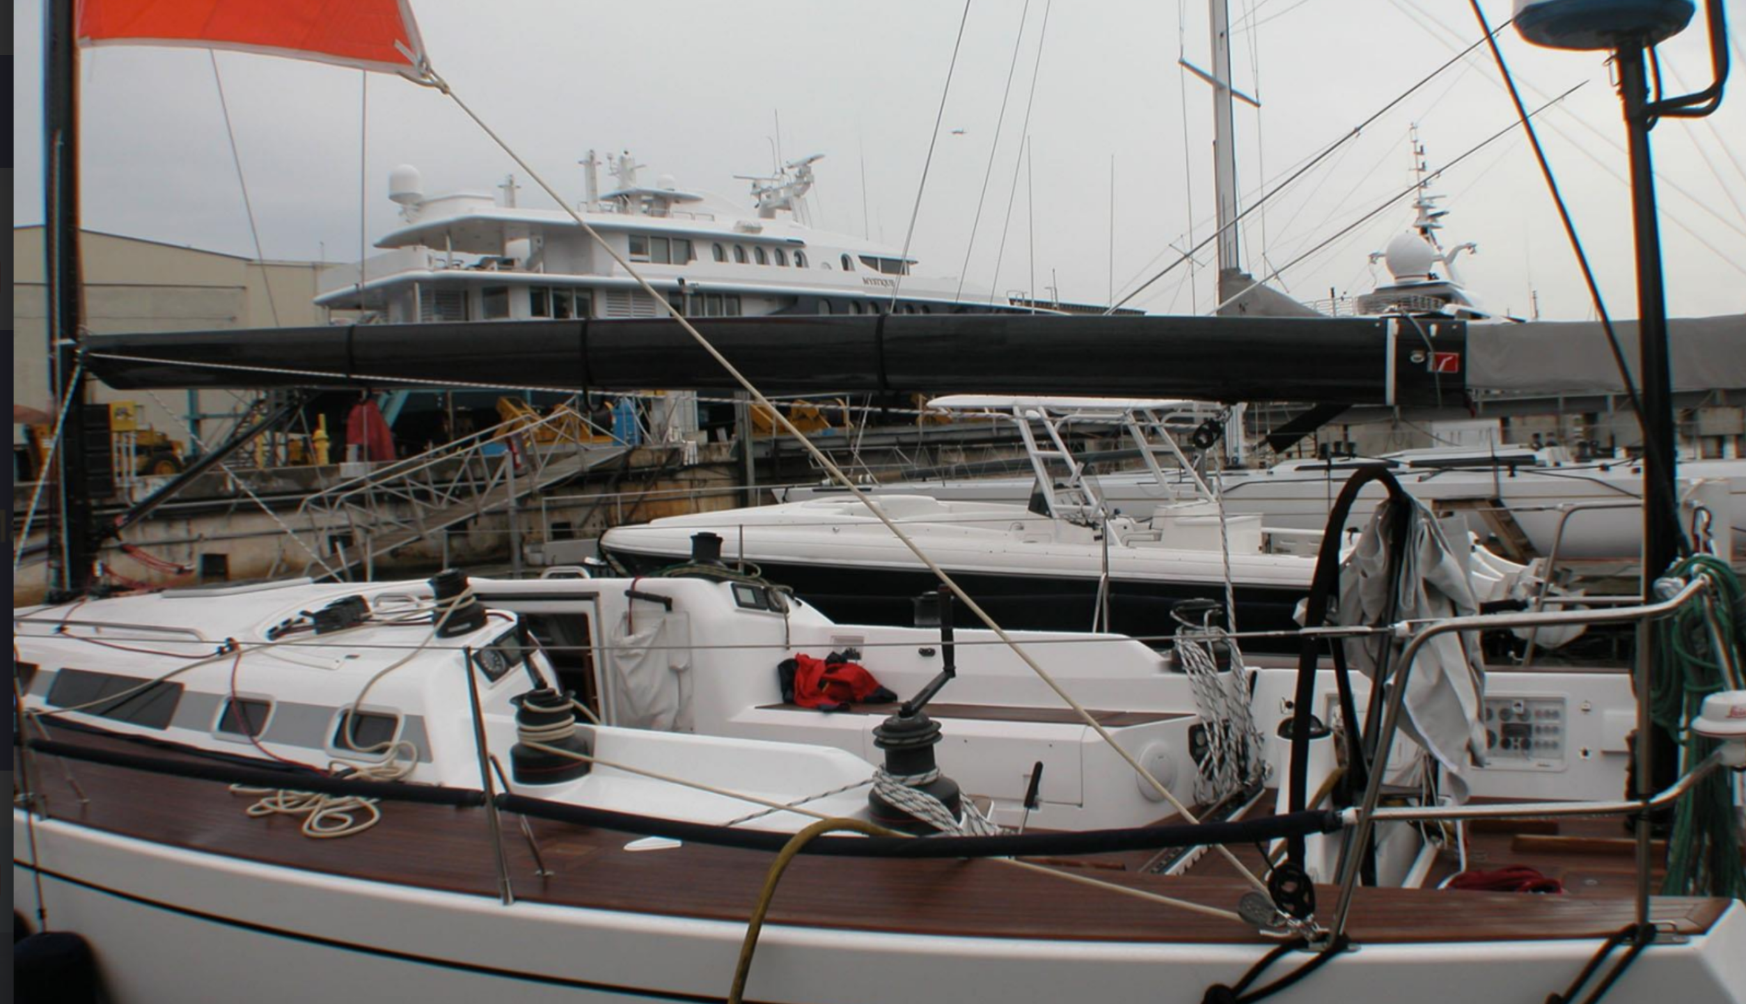
Notes:
The TRI Sail Rigging follow the sheets!!!

Slide 14
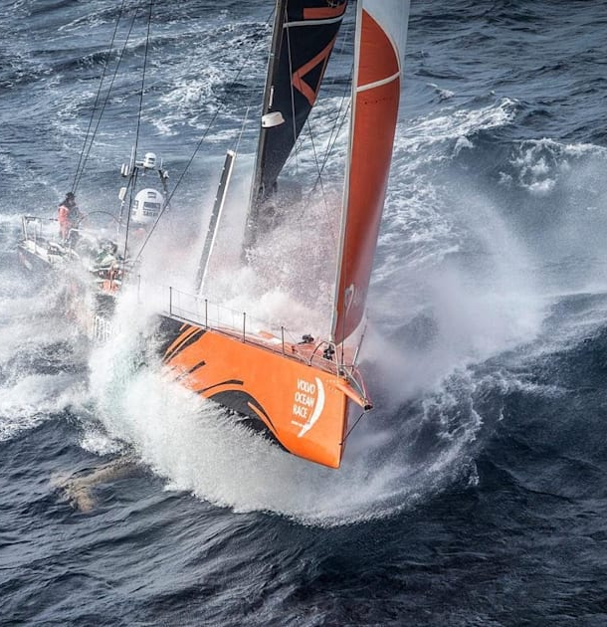
Cross-Overs
Notes:
Policy is a control of risk. Ensure that while your team trains, the crossovers (Sail Plan) are posted. This plan determines the sails to be used under each condition.

Slide 15
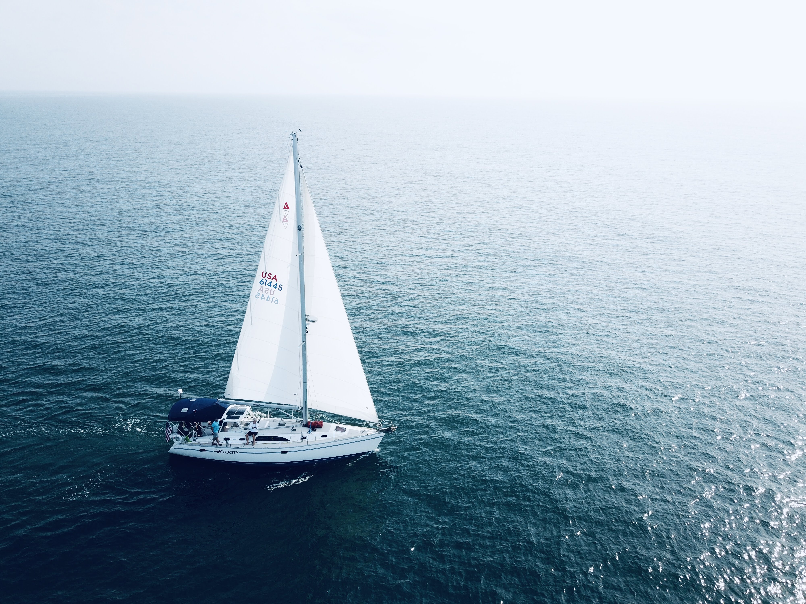
The De-powering Sequence Race
Full Main / Light #1 0-8
Full Main / Medium #1 8-14
Full Main / #2 or Heavy Jib 14-20
Full Main / #3 or H+ Jib 19-25
Full Main / #4 ORC Jib 24-28
Reef Main / #4 28-32
Reef Main / #5 32-36
Double Reef / #5 36-40
Three Reefs or Trysail / SJ40+

Slide 16
The De-powering Sequence Cruise
Full Main / Full Genoa 0-12
Reef Main / Full Genoa 12-20
Full Main / Partially furled Genoa 14-20
Reef Main / Working Jib 19-25
Double Reef Main / Working Jib 24-35
Three Reefs or Trysail
– / SJ/Staysail 35+
Notes:
Training must include what the Person in the Water will experience.

Slide 17
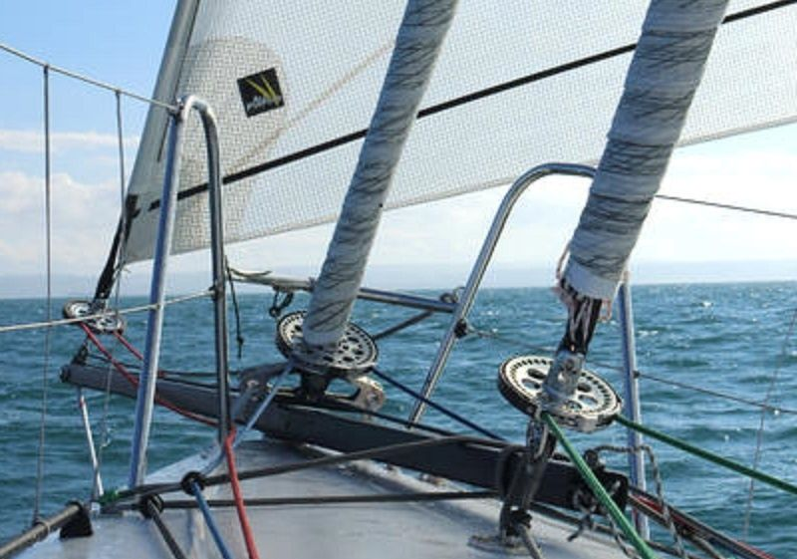
Cruiser Tips
Roller Furler Reefing
Count the wraps
Notes:
Upwind or down wind roll ups?

Slide 18
KEEPING THEM IN ONE PIECE
Spreader/stanchion/pulpit patches
Batten pockets against rig
Sew or tie in battens (carry spares)
Minimize flogging
Watch what you are pulling on
Notes:
Upwind or down wind roll ups?

Slide 19
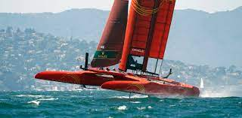
Strategy Tip Know when to say No
For a trip less than 5 days, given the availability of modern weather forecasting, you will probably never have to experience extreme conditions
If possible, stay in port until bad weather passes
If underway, find a safe port or anchorage
Know your team and their limitations... Once you are committed, there is no turning back
Notes:
Upwind or down wind roll ups?

Slide 20
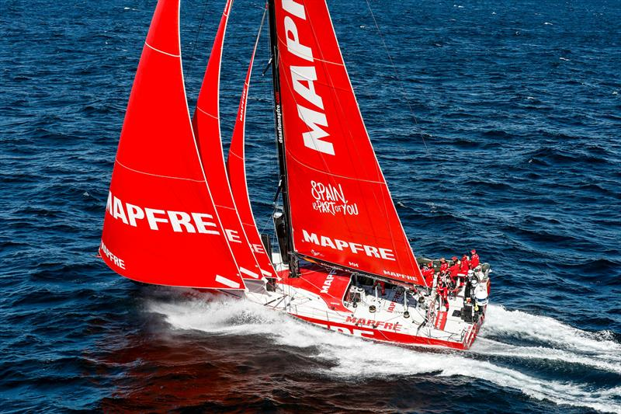
Are there intermediate ports to use in the event that weather threatens?
How difficult are the entrances? Can they be negotiated in foul weather, with a sea running, or at night? Do you have the right charts?
Will you be on a lee shore?
How seaworthy is the boat? How fast can she travel under power
(including range) and under sail? The wind often dies in the approach path of a major storm system.
Notes:
Upwind or down wind roll ups?

Slide 21
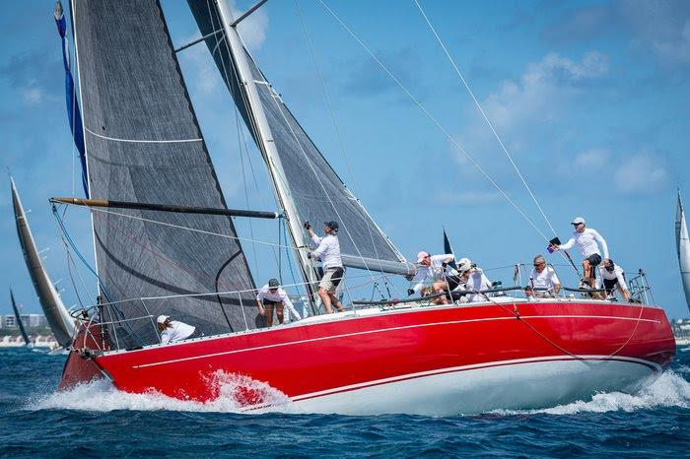
Steering is the key to sailing in heavy weather
Your pool of helmsmen is critical
Ideally everyone can steer
Let your inexperienced crew steer during the day when visibility is good and conditions are reasonable
Save your best helmsmen for nighttime, when visibility is poor and when squalls build up
Strategic Tip #2
It’s All About the Team
Notes:
Upwind or down wind roll ups?

Slide 22
Deck Preparation
Jack Lines Rigged
Remove all extra cockpit canvas and dodgers
Hatches secured and taped
Reef lines led
Coil and secure all lines and halyards
Rig inner forestay and backstays
Preposition all storm and heavy weather sails
Hatch boards in and secured
Cockpit lockers secured
Rubber Flap over Engine Exhaust
Strategic Tip #3
PANIC EARLY... AVOID THE RUSH
Notes:
Upwind or down wind roll ups?

Slide 23
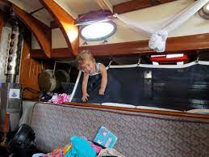
Secure all heavy objects batteries, floorboards, books etc.
Lock gimbaled stove and reefer doors
Stow sails in proper order heavy on top
Test pumps (lanyards on pump handles)
Close all unnecessary thru hulls
Call in position
Charge batteries
Install or have ready ventilator caps
Preposition buckets below
Have a grab (ditch) bag at the ready
Stow all galley equipment (pots Pans)
Pre prepare thermos of hot soups make sandwiches and put out snacks and energy bars Freeze dried food
Get rigging cutters out with a lanyard attached
Rig lee cloths on the bunks
Pro Tip
Use Synthetic materials, they don’t absorb H2O
Notes:
Upwind or down wind roll ups?

Slide 24
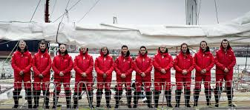
Eat when you can; bring all your clothes
Keep the bunks dry
Have headlight, knife, personal AIS
Have reliable routines and timely watch relief
You are going to be cold, wet, exhausted and miserable... embrace it
The Crew
Notes:
Upwind or down wind roll ups?

Slide 25
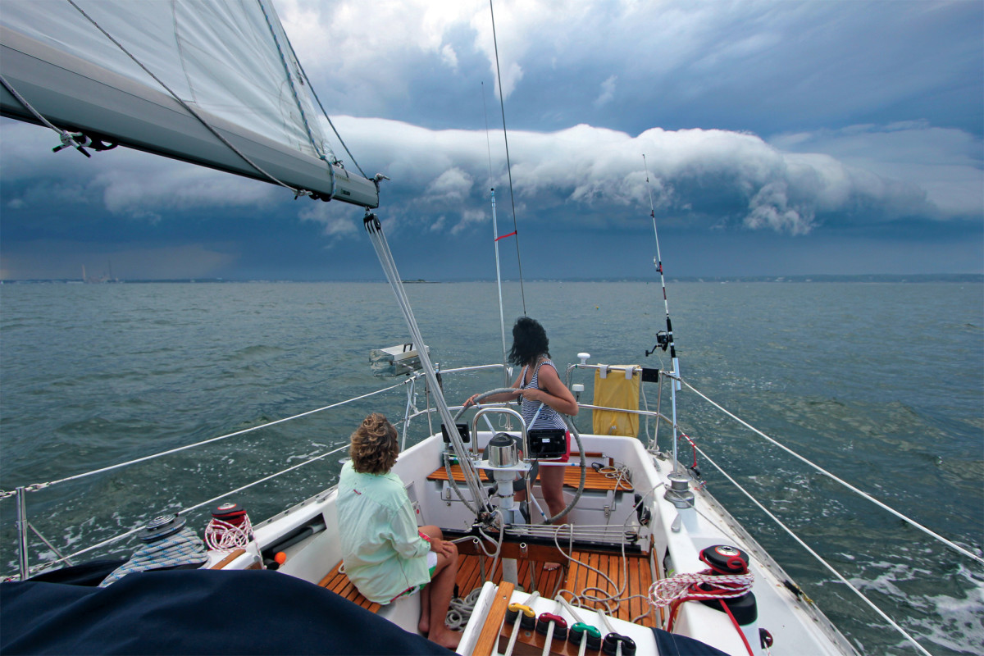
Get it down
All hands on deck; battle stations
Mainsail halyard ready to run
Sail ties ready
GPS dialed in
The Squall
Notes:
Upwind or down wind roll ups?

Slide 26
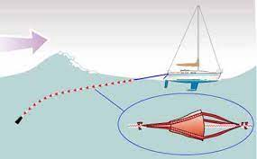
Anything towed from the stern to slow the boat down
Ideally it should be deployed two waves back, so when the boat is on the face of the wave, the drogue is on the back of the second wave
You need strong attachment points and chafe free lead for the rode. A bridle works best
Leading the rode to a winch will help retrieve the drogue or warp and make it easier to control
Slowing Down... warps and rogues
Notes:
Upwind or down wind roll ups?

Slide 27
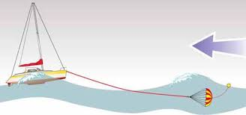
A tool to be used when normal seamanship techniques are inadequate. It is deployed off the bow, where a drogue is deployed off the stern
Can be used to:
Stop the boat off a lee shore
To make repairs in comfortable, quiet conditions
To jury rig after a broken rudder or mast
To allow a boat overwhelmed by heavy weather a break to rest crew and put the boat back in order
Sea Anchor
Notes:
Upwind or down wind roll ups?

Slide 28
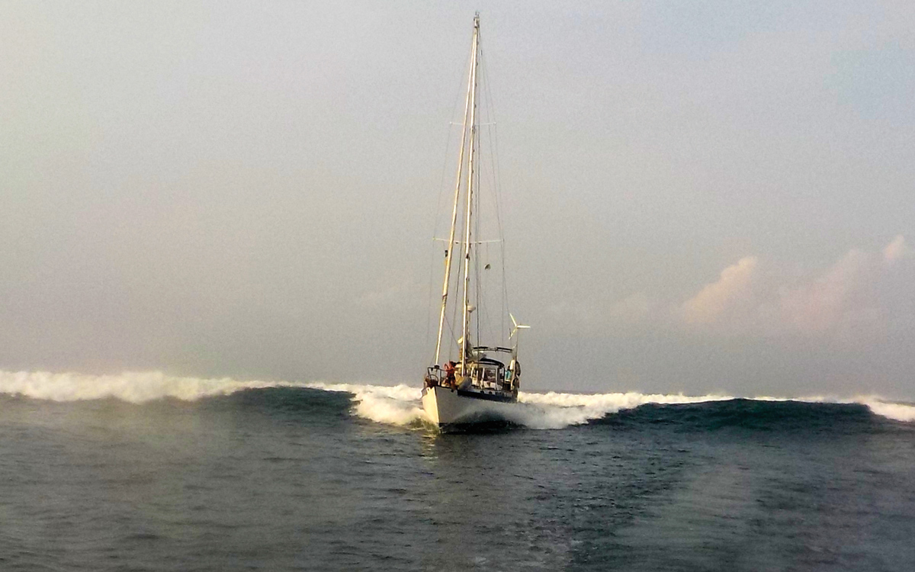
Breaking waves occur at 1.3 times the wave height at shoals
10 Foot Wave Breaks in 13.3 of Water
Be Ware of Lee Shore
Notes:
Upwind or down wind roll ups?

Slide 29
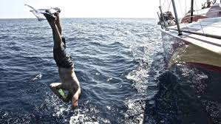
Control Risk
Prepare your boat
Prepare your crew
Practice when it is windy
Have a positive attitude
Enjoy it, don’t fear it
Big Wind + Controlled Risk = Big Fun
Notes:
Upwind or down wind roll ups?

