Slide 1

THE COLONY YOUTH SOCCER ASSOCIATION
General
Meeting
January 24, 2018

Slide 2

TSS Photography
Joan Hollander
1647 Witt Road
Suite 104
Frisco, TX
(p) 972-394-1010
Email: joan.hollander@tssphotography.com
PICTURE DAY – March 3

Slide 3
Board Members
Executive Committee – 2017-2018 Soccer Year
Volunteer Opportunities

Slide 4
TCYSA Executive Committee
Name | Position Held | Email Address
Joe Hedrington | President | president@tcysa.net
Melvin Tramell | 1st Vice-President | firstvp@tcysa.net
Lee Wise | 2nd Vice-President (Referee Assignor) (Scheduler) | secondvp@tcysa.net referee@tcysa.net scheduler@tcysa.net
Lisa Tramell | Secretary / Registrar | registrar@tcysa.net
Jenny Hundt | Treasurer | treasurer@tcysa.net
Jeremy Doss | Field Manager | field.manager@tcysa.net
Raina Horner | U4-U6 Boys Director | u6b.director@tcysa.net
Ruth Huerta | U4-U6 Girls Director | u6g.director@tcysa.net
Michael Hundt | U7-U8 Director | u8.director@tcysa.net
Cobey Reynolds | U9-U10 Director | u10.director@tcysa.net
Nicole Perry | U11 and Up Director | u11.director@tcysa.net

Slide 5
Things to Know
Rules of the Game
Fees
Fields
Web Resources
Got Soccer
Tentative Dates

Slide 6
Rules of the Game
North Texas Bylaws (rules of the game) North Texas website, www.ntxsoccer.org,
  under the Administrative tab, then NTSSA Bylaws and Rules.
TCYSA Bylaws, Constitution and Rules, www.tcysa.net
**Each recreational player, when present at a game, shall play a minimum of 50% of the time.

Slide 7
Calendar Age Groups Spring 2017-2018
U4 | 2014
U5 | 2013
U6 | 2012
U7 | 2011
U8 | 2010
U9 | 2009
U10 | 2008
U11 | 2007
U12 | 2006
U13 | 2005
U14 | 2004
U15 | 2003
Playing Group =
2018 – Birth Year

Slide 8
Fields
Turner:
Lights: The lights are scheduled to come on 30 minutes before sunset. If the lights do not turn on, call the Rec Center immediately at 972-625-1106 x. 0.
Do not wait until the next day to report a problem!
Restrooms: The code for the bathroom is 6575. If you unlock them, you are responsible to lock them. If found unlocked, PARD may change the code. There are Solar Powered Lights in the restrooms (paper on your own)
Five Star:
Contact a Board Member or Field Marshall to report any issues.

Slide 9
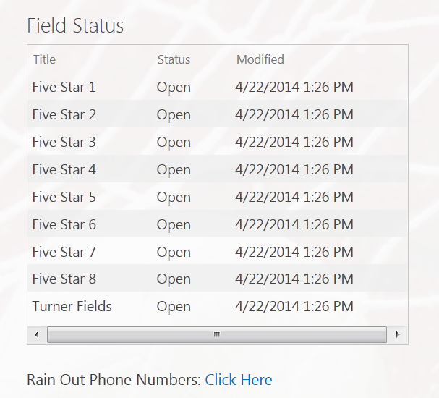
Rain Out Information
Turner / Five Star:
Facebook / Twitter
Website – www.tcysa.net
Call-in Line – 682-777-GOAL (4625)
Other Associations:
Use Rain Out Number / Websites for Other Member Associations

Slide 10
Web Resources
Important Websites
The Colony Youth Soccer Association
www.tcysa.net
Got Soccer
www.gotsoccer.com
North Texas Soccer
www.ntxsoccer.org
Greater Lewisville Area Soccer Association (GLASA)
http://www.glasasoccer.org
Northern Mid Cities Soccer League (NMCSL)
http://www.nmcsl.com

Slide 11
Miscellaneous
How to find your schedule
We provide a link to all schedules on our website http://www.tcysa.net/schedules;
you can also visit www.glasasoccer.org (GLASA) or http://nmcsl.com/schedules.php (NMCSL)
Game Day Report
These are required at every game, U9 and older. Players’ names and jersey numbers must be on the report.
Calling in Scores (U9 and older)
The phone number, event and pin number will be on the bottom of the
Game Day Report. You will be prompted to put in the game number
(found on your schedule) and the score. The Home team should call in
the score within 24 hours. Do not abuse the calling in of scores.

Slide 12
DOs and DON’Ts
DO
Play each player 50% of each game they attend (50% of the time they are there).
Have your coach badge and roster at each game
Have your team pick up their trash after practices and games.
Set up nets and flags if you are the first Home team to play.
Take down nets and flags if you are the last Home team to play.
Practice at Turner at your scheduled time and field.
Have parents/spectators sit on the side of the field opposite your bench.

Slide 13
DOs and DON’Ts
DON’T
DON’T bring pets to the practice fields or games. Pets are welcome along the walking trails. This is a city ordinance and also a safety concern.
DON’T park on side streets and Cul de sacs at Turner Fields.
DON’T practice at Five Star.
DON’T yell at the Referees, especially the younger ones. This goes for parents and other spectators too.

Slide 14
Heading Rule
No Heading U4 - U12. Deliberate heading will be an indirect free kick for the other team. No practicing until U13.
Any Head injury needs to be brought to the attention of a Board Member. If the Referee believes a Player has sustained a concussion, the player will be required to sit out all games and practices until a Doctor has provided a note saying it is safe for the player to return. Referee’s decision at the fields is FINAL.
Other Fields may have a Trainer on-site that can clear a player to continue playing. TCYSA is NOT employing a Medical Trainer.

Slide 15
Dates
January 29 Start of Practices
February 17 Opening Day (TCYSA/GLASA)
March 3 TSS Picture Day
March 10 First weekend of Spring Break, GAMES WILL PLAY!!
March 17 Second weekend of Spring Break, NO GAMES
March 31 Easter Weekend, GAMES WILL PLAY!!
April 21 Games at Five Star will start at 12:00PM (Noon)
May 12 End of Regular Season
GLASA will not honor any game reschedule requests for March 10 or March 31!!
TCYSA will make the decision based on Field Availability, if playing a GLASA Team the game will not be rescheduled.

Slide 16
Age Group Information
All age groups are playing with either Greater Lewisville Area Soccer Association (GLASA) or Northern Mid-Cities Soccer League (NMCSL)

Slide 17
Next Steps
Practice Schedule Requests
Black Out Dates
Uniforms
Rosters

Slide 18
Practice Schedule Requests
If you have not scheduled your practice times yet please see Lisa
Practices at Turner fields are in one hour time slots
  6:00 – 7:00
  7:00 – 8:00
  8:00 – 9:00
Please provide any relevant notes /
requests. Do not assume our scheduler
knows you are coaching multiple teams
or that you can’t practice on a
particular night.
You can practice at other facilities, but
please let us know where you are.

Slide 19
Game Schedules
Please send your team’s black out dates to scheduler@tcysa.net ASAP.
We hope to have schedules available at least one week prior to the first games on February 17th.
You may see a preliminary schedule on the various websites, but do not assume it is the final schedule until you receive notice from us that schedules really are live!
Throughout the season, make it a habit to recheck the schedule to ensure no changes have been made without you being notified.

Slide 20
Game Reschedules
(School and Civic Events ONLY)
Please arrange for an assistant coach to cover for you when games cannot be rescheduled. Any adult in charge of players must pass a background check! Generally the Head Coach, Assistant Coach, Team Mom/Manager
Game reschedule requests need to come from the head coach!
We are working with GLASA and other area associations, so the more notice you provide of conflicts, the better chance we have of accommodating a reschedule request. At least 1 week in advance.
Understand that a Saturday game will almost always be rescheduled to a weeknight and there comes a point in the season when reschedules just aren’t an option.
If you do not receive feedback on a reschedule request within a day or two, please follow up using the scheduler@tcysa.net email address.

Slide 21
Game Schedule Etiquette
If you know your team will NOT be playing in a scheduled game, e-mail your director and scheduler@tcysa.net as soon as you know, so the other team, the referee assignor, and other interested parties can be notified.
This applies even if you learn of the issue at 9:00 a.m. on a Saturday and your game is set for 9:30 a.m.!
Forfeited games are NOT rescheduled. The sooner you notify us of a conflict, the better chance we have of rescheduling for another day, so your team can still play all of its games.

Slide 22
Uniforms
Coaches/teams are responsible for choosing and obtaining uniforms.
Choose colors wisely. Home teams must have pinnies to wear in the event of uniform color conflict with the Away team.
Team jerseys must be a matching color and each jersey must have a unique number on the back.
  Jersey numbers should be approximately 6" - 8" in size, and contrast with the color of the jersey (black OR white are the most common colors).
  Goal Keeper jerseys shall be a different color from the rest of the team.
  We don’t prohibit placing player names on the jerseys, but suggest keeping in mind safety concerns before doing so.
Teams may obtain uniform sponsors to help offset out-of-pocket costs for families.
  A sponsor’s logo may be attached to the uniform, provided they do NOT contain explicit or adult-oriented content – NO ALCOHOL or TABACCO SPONSORS

Slide 23
Where can I order uniforms?
Score has supplied uniforms for many of our Teams for several years. Please feel free to pick up a catalog. Discounts available.
Challenger Team Wear
  1.866.588.3468
  Challengerteamwear.com
FW Custom Ink – local company that also offers Jerseys and printing at competitive pricing.
    FWCustomink.com
    Contact: Chris Bowman ( cbowman@fwpromo.com) for special pricing and discounts
    817-231-8040 x2018

Slide 24
Rosters
Current rosters are available tonight.
Please expect changes if your roster is not full at this time. We are continuing to register players, possibly until 2nd or 3rd Game.
Please keep the roster information in confidence. We do not want a child’s information to end up in the wrong hands. For this reason, please do not share your team Got Soccer login information with non-background checked people either.
If you have a parent who would like to act as team manager, they will need to register and complete a background check.

Slide 25
The Colony Youth Soccer Association
Coaches,
Without you, hundreds of children wouldn’t be able to play soccer. We appreciate the time and efforts that you give to TCYSA.
THANK YOU!!!!

