Slide 1
THE COLONY YOUTH SOCCER ASSOCIATION
General
Meeting
January 23, 2019

Slide 2
TSS Photography
Joan Hollander Carrollton, TX (p) 972-394-1010 Email: joan.hollander@tssphotography.com
PICTURE DAY – MARCH 2

Slide 3
Board Members
Executive Committee – 2018-2019 Spring Soccer
Volunteer Opportunities

Slide 4
TCYSA Executive Committee (red text means position is up for election in May)
Name | Position Held | Email Address
Joe Hedrington | President | president@tcysa.net
Melvin Tramell | 1st Vice-President | firstvp@tcysa.net
Lee Wise | 2nd Vice-President | secondvp@tcysa.net referee@tcysa.net scheduler@tcysa.net
Lisa Tramell | Secretary / Registrar | registrar@tcysa.net
Jenny Hundt | Treasurer | treasurer@tcysa.net
Jeremy Doss | Field Manager | field.manager@tcysa.net
Raina Horner | U4-U6 Boys Director | u6b.director@tcysa.net
Ruth Huerta | U4-U6 Girls Director | u6g.director@tcysa.net
Michael Hundt | U7-U8 Director | u8.director@tcysa.net
Cobey Reynolds | U9-U10 Director | u10.director@tcysa.net
Kendal Garner | U11 and Up Director | u11.director@tcysa.net

Slide 5
Things to Know
Rules of the Game
Fees
Fields
Web Resources
Got Soccer
Tentative Dates

Slide 6
Rules of the Game
North Texas Bylaws (rules of the game) North Texas website, www.ntxsoccer.org,
under the Administrative tab, then NTSSA Bylaws and Rules.
TCYSA Bylaws, Constitution and Rules, www.tcysa.net
Play modified FIFA Rules
**Each recreational player, when present at a game, shall play a minimum of 50% of the time.

Slide 7
Coaches Badges
Print out the Background Check Card from your Coach GotSoccer Account
Carry this card and your ID (Driver’s License) to all games, especially if playing away from Five Star
TSS Badges should be honored, but GLASA has been asking for the GotSoccer Background Check Card and ID

Slide 8
Fields
Turner (Practice, can practice elsewhere):
Lights: The lights are scheduled to come on 30 minutes before sunset. If the lights do not turn on, call the Rec Center immediately at 972-625-1106 x. 0.
Do not wait until the next day to report a problem!
Restrooms: The code for the bathroom is 6575. If you unlock them, you are responsible to lock them. If found unlocked, PARD may change the code. There are Solar Powered Lights in the restrooms (paper on your own)
Five Star:
Contact a Board Member or Field Marshall to report any issues.

Slide 9
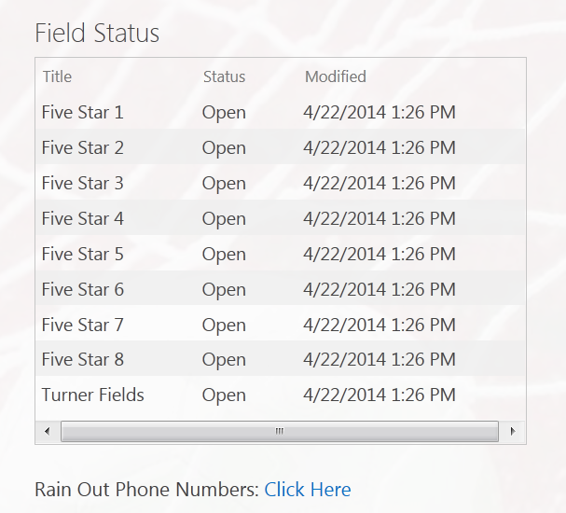
Rain Out Information
Turner / Five Star:
Facebook / Twitter
Website – www.tcysa.net
Call-in Line – 682-777-GOAL (4625)
Other Associations:
Use Rain Out Number / Websites for Other Member Associations

Slide 10
Miscellaneous
How to find your schedule
We provide a link to all schedules on our website http://www.tcysa.net/schedules; you can also visit www.glasasoccer.org (GLASA) or http://nmcsl.com/schedules.php (NMCSL)
Game Day Report: Required U9 and older, filled out with Names and Jersey #
Photo Player Cards or Roster: U13 and Older have them in case asked
Calling in Scores (U9 and older)
The phone number, event and pin number will be on the bottom of the Game Day Report. You will be prompted to put in the game number (found on your schedule) and the score. The Home team should call in the score within 24 hours. Do not abuse the calling in of scores.

Slide 11
Five Star Setup and Teardown
Set up nets and flags if you are the first Home team to play.
Take down nets and flags if you are the last Home team to play.
Both Teams sit on the same side of the field.
Have parents/spectators sit on the side of the field opposite your bench.
Have your team pick up their trash after practices and games.

Slide 12
Season Dates
February 4 Start of Practices (maybe January 28)
February 16 Opening Day (TCYSA/GLASA)
March 2 TSS Picture Day
March 9 First weekend of Spring Break, GAMES WILL PLAY!!
March 16 Second weekend of Spring Break, NO GAMES
April 13 Games at Five Star will start at 12:00PM (Noon) Kid’s Chase Day
April 20 Easter Weekend, GAMES WILL PLAY!!
May 12 End of Regular Season
GLASA and TCYSA will not honor any game reschedule requests for March 9 or April 20!!

Slide 13
Age Group Information
U4 will be COED and stay local
U5-U6 Boys will play Local
U5-U6 Girls will play GLASA.
U7-U8 are discussing with Coaches and will have a decision after the meeting.
U9 and older age groups are playing with either Greater Lewisville Area Soccer Association (GLASA) or Northern Mid-Cities Soccer League (NMCSL)
Probably all GLASA, but U15/16 may have to go NMCSL

Slide 14
Next Steps
Practice Schedule Requests
Black Out Dates
Uniforms
Rosters

Slide 15
Practice Schedule Requests
If you have not sent in your requests for practice times yet please see Lisa. Will try to honor at least 1 request day/time
Practices at Turner fields are in one hour time slots
6:00 – 7:00
7:00 – 8:00
8:00 – 9:00
Please provide any relevant notes /requests.
Do not assume our scheduler knows you are coaching multiple teams or that you can’t practice on a particular night.
You can practice at other facilities, but please let us know where you will be (contact your Director).

Slide 16
Game Schedules
Please send your team’s black out dates to scheduler@tcysa.net ASAP.
We hope to have schedules available at least one week prior to the first games on February 16th.
You may see a preliminary schedule on the various websites, but do not assume it is the final schedule until you receive notice from us that schedules really are live!
Throughout the season, make it a habit to recheck the schedule to ensure no changes have been made without you being notified.

Slide 17
Game Reschedules (School and Civic Events ONLY)
Please arrange for an assistant coach to cover for you when games cannot be rescheduled. Any adult in charge of players must pass a background check! Generally the Head Coach, Assistant Coach, Team Mom/Manager
Game reschedule requests need to come from the head coach!
At least 1 week notice to reschedule, the more time the better
If you do not receive feedback on a reschedule request within a day or two, please follow up using the scheduler@tcysa.net email address.

Slide 18
Uniforms
Coaches/teams are responsible for choosing and obtaining uniforms.
Choose colors wisely. Home teams must have pinnies to wear in the event of uniform color conflict with the Away team.
Team jerseys must be a matching color and each jersey must have a unique number on the back.
Jersey numbers should be approximately 6" - 8" in size, and contrast with the color of the jersey (black OR white are the most common colors).
Goal Keeper jerseys shall be a different color from the rest of the team.
We don’t prohibit placing player names on the jerseys, but suggest keeping in mind safety concerns before doing so.
Teams may obtain uniform sponsors to help offset out-of-pocket costs for families.
A sponsor’s logo may be attached to the uniform, provided they do NOT contain explicit or adult-oriented content – NO ALCOHOL or TABACCO SPONSORS

Slide 19
Where can I order uniforms?
Score has supplied uniforms for many of our Teams for several years. Please feel free to pick up a catalog. Discounts available.
Challenger Team Wear
1.866.588.3468
Challengerteamwear.com
FW Custom Ink – local company that also offers Jerseys and printing at competitive pricing.
FWCustomink.com
Contact: Chris Bowman ( cbowman@fwpromo.com) for special pricing and discounts
817-231-8040 x2018

Slide 20
Rosters
Please keep the roster information in confidence. We do not want a child’s information to end up in the wrong hands. For this reason, please do not share your team Got Soccer login information with non-background checked people either.
If you have a parent who would like to act as team manager, they will need to register and complete a background check.
ONLY Rostered Players and Adults allowed on the Team Sideline.

Slide 21
TCHS Boys Soccer
Monday February 18. Fundraiser at Heritage Pizza. Please mention TCHS Boys Soccer Team when ordering. A percentage of sales will be donated to the soccer team. Good for Dine-in, Delivery, or Carry-out but must mention the team.

Slide 22
Friday March 1: The Boys Varsity soccer team will conduct a FREE 40 minute soccer clinic for youth players in the Cougar indoor field from 6:00pm-6:40pm.
After the clinic, youth players will escort a varsity player onto the field during the pregame player introduction; and at halftime, the youth players will play a 3v3 mini soccer game.
ALL TCYSA players that wear their team jersey will get in free. (parents will have to pay regular admission)
All TCYSA coaches that wear their badges will get in free.
RSVP to Kim Peña 972-489-5965 or at kj_pena@yahoo.com by 2/27 4pm.

Slide 23
The Colony Youth Soccer Association
Coaches,
Without you, hundreds of children wouldn’t be able to play soccer. We appreciate the time and efforts that you give to TCYSA.
THANK YOU!!!!

