Slide 1

THE COLONY YOUTH SOCCER ASSOCIATION
General
Meeting
Aug 11, 2021

Slide 2

TSS Photography
Joan Hollander
Carrollton, TX
(p) 972-394-1010
Email: joan.hollander@tssphotography.com
PICTURE DAY – October 02, 2021

Slide 3
TCYSA Executive Committee
Name | Position Held | Email Address
Melissa Zieglar | President | Melissa.Zieglar@tcysa.net
Melvin Tramell | 1st Vice-President | firstvp@tcysa.net
Joe Hedrington | 2nd Vice-President | secondvp@tcysa.net referee@tcysa.net scheduler@tcysa.net
Lisa Tramell | Secretary / Registrar | registrar@tcysa.net
Sheri Coates | Treasurer | treasurer@tcysa.net
Jeremy Doss | Field Manager | field.manager@tcysa.net
Steven Peters | U4-U6 Boys Director | u6b.director@tcysa.net
Steven Peters | U4-U6 Girls Director | u6g.director@tcysa.net
Chantel Bennett | U7-U8 Director | u8.director@tcysa.net
 | U9-U10 Director | u10.director@tcysa.net
Ken Zieglar | U11 and Up Director | u11.director@tcysa.net

Slide 4
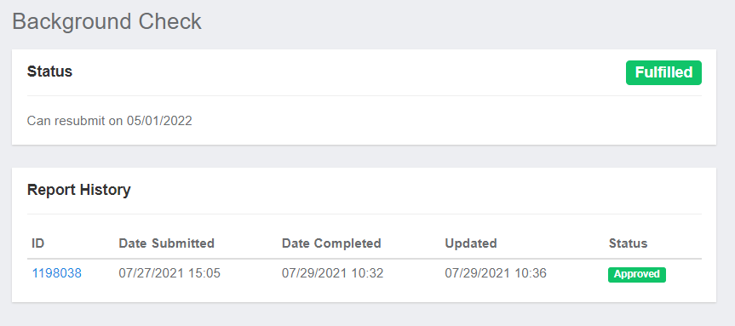
Coaches Badges
Print out the R/M Background Check Card from your Coach GotSport Account
Carry this card and your ID (ex: Driver’s License) to all games, especially if playing away from Five Star

Slide 5
Fields
Turner (TCYSA Rents for Practice):
Lights: The lights are scheduled to come on 30 minutes before sunset. If the lights do not turn on, call the Rec Center at 972-625-1106 ext. 0.
Do not wait until the next day to report a problem!
Restrooms: The code for the bathroom is 6575. If you unlock them, you are responsible to lock them. If found unlocked, PARD may change the code. There are Solar Powered Lights in the restrooms (TP and Towels on your own)
Five Star (TCYSA Rents for Games:
Contact a Board Member or Field Marshall to report any issues.

Slide 6
Season Dates
Aug 9 Possible Start of Practices (have to get PARD approval)
Aug 28 Opening Day (TCYSA/GLASA)
Sep 4 Labor Day Weekend. NO GAMES!!
Oct 2 TSS Picture Day
Oct 30 End of Regular Season (Five Star Closed on weekends)
TOC is December 3-5 for ages U9 – U18 (2004 – 2012 Birth years)
Teams must Qualify for TOC. TCYSA will invite your team to play and pay Fees. If you cannot play, do not accept as NTX Soccer will penalize team for no shows.

Slide 7
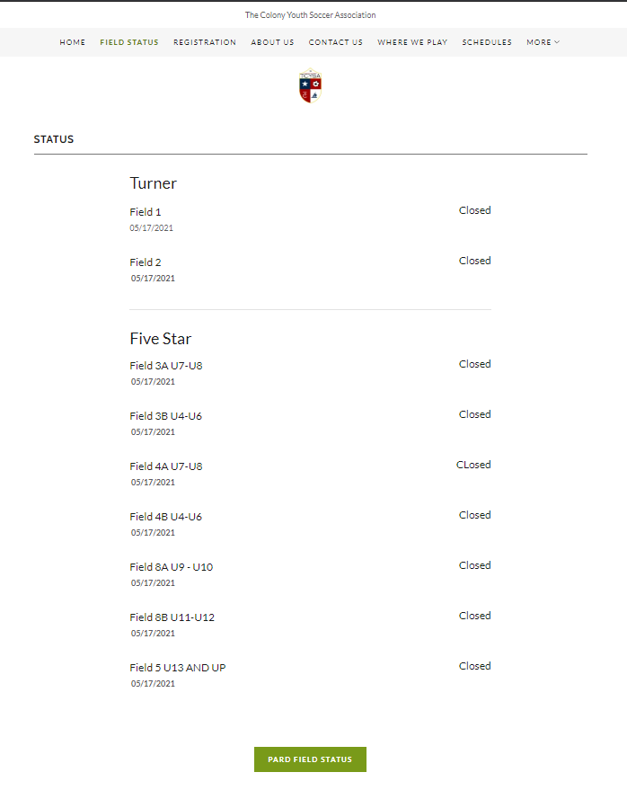
Rain Out Information
Turner / Five Star:
Facebook / Twitter / Instagram
Website – https://tcysa.net/field-status
Call-in Line – 682-777-GOAL (4625)
Other Associations:
Use Rain Out Number / Websites for Other Member Associations

Slide 8
Five Star Setup and Teardown
Set up nets and flags if you are the first Home team to play.
Take down nets and flags if you are the last Home team to play.
Both Teams sit on the same side of the field.
Have parents/spectators sit on the side of the field opposite your bench.
Have your team pick up their trash after practices and games.

Slide 9
SCHEDULES
How to find your schedule
We provide a link to all schedules on our website http://www.tcysa.net/schedules
Game Day Report: Required U9 and older, filled out with Names and Jersey #
Photo Player Cards or Roster: U13 and Older MUST have them in case asked
Calling in Scores (U9 and older)
The phone number, event and pin number will be on the bottom of the
Game Day Report. You will be prompted to put in the game number
(found on your schedule) and the score. The Home team should call in
the score within 24 hours. Do not abuse the calling in of scores.

Slide 10
Game Schedules
Please send your team’s black out dates to scheduler@tcysa.net ASAP.
We hope to have schedules available at least one week prior to the first games on August 17th.
Throughout the season, make it a habit to recheck the schedule to ensure no changes have been made without you being notified.

Slide 11
Game Reschedules
(School and Civic Events ONLY)
Please arrange for an assistant coach to cover for you when games cannot be rescheduled. Any adult in charge of players must pass a background check! Generally the Head Coach, Assistant Coach, Team Mom/Manager
Game reschedule requests need to come from the head coach!
At least 1 week notice to reschedule, the more time the better
If you do not receive feedback on a reschedule request within a day or two, please follow up using the scheduler@tcysa.net email address.

Slide 12
Rosters
Please keep the roster information in confidence. We do not want a child’s information to end up in the wrong hands. For this reason, please do not share your team’s Got Soccer login information with non-background checked persons.
If you have a parent who would like to act as team manager, they will need to register and complete a background check and Safe Sport.
ONLY Rostered Players and Adults allowed on the Team Sideline.

Slide 13
Uniforms
Coaches/teams are responsible for choosing and obtaining uniforms.
Choose colors wisely. Home teams must have pinnies to wear in the event of uniform color conflict with the Away team.
Team jerseys must be a matching color and each jersey must have a unique number on the back.
  Jersey numbers should be approximately 6" - 8" in size, and contrast with the color of the jersey (black OR white are the most common colors).
  Goal Keeper jerseys shall be a different color from the rest of the team.
  We don’t prohibit placing player names on the jerseys, but suggest keeping in mind safety concerns before doing so.
Teams may obtain uniform sponsors to help offset out-of-pocket costs for families.
  A sponsor’s logo may be attached to the uniform, provided they do NOT contain explicit or adult-oriented content – NO ALCOHOL or TABACCO SPONSORS

Slide 14
Where can I order uniforms?
Score has supplied uniforms for many of our Teams for several years. www.texas.scoresports.com
Challenger Team Wear
  1.866.588.3468
  Challengerteamwear.com
FW Custom Ink – local company that also offers Jerseys and printing at competitive pricing.
    FWCustomink.com
    Contact: Chris Bowman ( cbowman@fwpromo.com) for special pricing and discounts
    817-231-8040 x2018

Slide 15
Rules of the Game
**Each recreational player, when present at a game, shall play a minimum of 50% of the time.
Coaches/Managers can be shown Yellow/Red Card.
Goal Kicks and kicks from within Penalty Area: Is live when kicked and moves.
Hand Ball Defined…Accidental will now be called if advantage gained
Defensive Wall on Free Kicks. 3 or more Defenders, Attackers cannot be in the wall. Must be 1 yard away.
Coin Toss. Team winning toss can now Choose to Kickoff or Choose which end they want to defend first.
Pass Back to Keeper

Slide 16
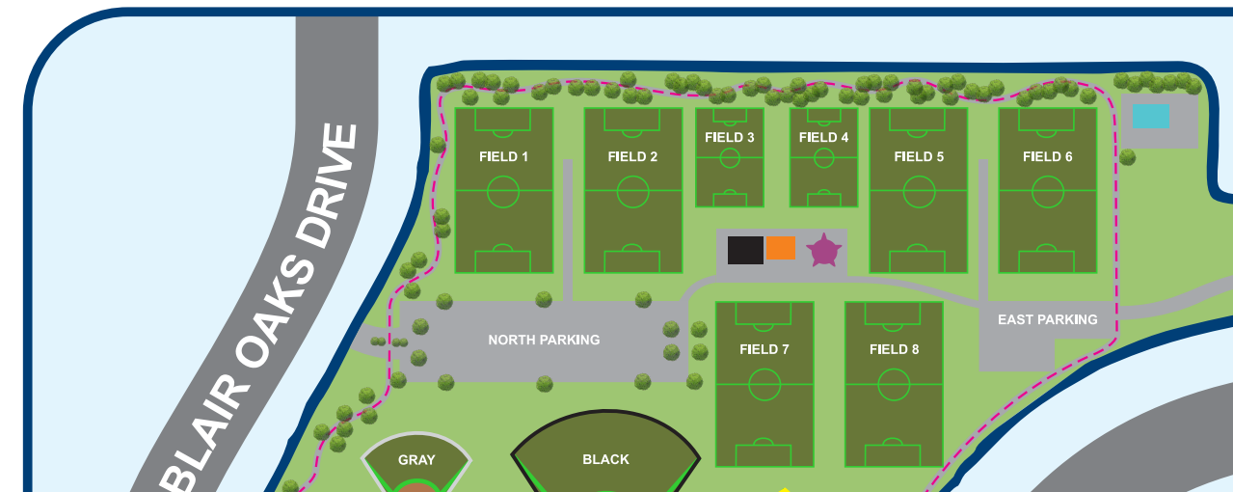
Five Star Complex Fields

Slide 17
The Colony Youth Soccer Association
Coaches,
Without you, hundreds of children wouldn’t be able to play soccer. We appreciate the time and efforts that you give to TCYSA.
THANK YOU!!!!

