Slide 1

THE COLONY YOUTH SOCCER ASSOCIATION
General
Meeting
January 29, 2020

Slide 2

TSS Photography
Joan Hollander
(p) 972-394-1010
Email: joan.hollander@tssphotography.com
PICTURE DAY – March 14

Slide 3
Board Members
Executive Committee – 2019-2020 Soccer Year
Volunteer Opportunities

Slide 4
TCYSA Executive Committee
Name | Position Held Election |  | Email Address
Joe Hedrington | President Odd Year |  | president@tcysa.net
Melvin Tramell | 1st Vice-President Even Year |  | firstvp@tcysa.net
Lee Wise | 2nd Vice-President (Referee Assignor) (Scheduler) | Odd Year | secondvp@tcysa.net referee@tcysa.net scheduler@tcysa.net
Lisa Tramell | Secretary / Registrar Even Year |  | registrar@tcysa.net
Sheri Coates | Treasurer Odd Year |  | treasurer@tcysa.net
Jeremy Doss | Field Manager Even Year |  | field.manager@tcysa.net
Melissa Zieglar | U4-U6 Boys Director Even Year |  | u6b.director@tcysa.net
Ruth Huerta | U4-U6 Girls Director Odd Year |  | u6g.director@tcysa.net
Eric Umanzor | U7-U8 Director Odd Year |  | u8.director@tcysa.net
Nate Eltzholtz | U9-U10 Director Even Year |  | u10.director@tcysa.net
Timothy Tischler | U11 and Up Director Even Year |  | u11.director@tcysa.net
Even year Election.
Need for volunteers/nominations for
Each position showing Even Year in chart
Election at May Meeting, end of Season

Slide 5
Things to Know

Slide 6
Rules of the Game
North Texas Bylaws (rules of the game) North Texas website, www.ntxsoccer.org,
  under the Administrative tab, then NTSSA Bylaws and Rules.
TCYSA Bylaws, Constitution and Rules, www.tcysa.net
**Each recreational player, when present at a game, shall play a minimum of 50% of the time.

Slide 7
Fields
Turner:
Lights: The lights are scheduled to come on 30 minutes before sunset. If the lights do not turn on, call the Rec Center immediately at 972-625-1106 ext. 0.
Do not wait until the next day to report a problem!
Restrooms: The code for the bathroom is 6575. If you unlock them, you are responsible to lock them. If found unlocked, PARD may change the code. There are Solar Powered Lights in the restrooms (paper on your own)
Five Star:
Contact a Board Member or Field Marshall to report any issues.
CONCESSIONS: Not sure if there will be concessions

Slide 8
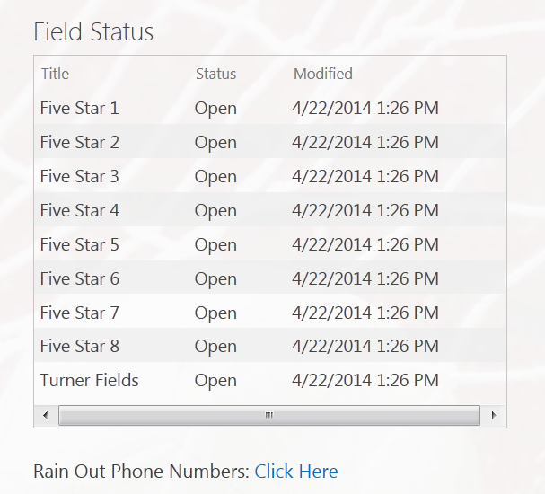
Rain Out Information
Turner / Five Star:
Facebook / Twitter / Instagram
Website – www.tcysa.net
Call-in Line – 682-777-GOAL (4625)
Other Associations:
Use Rain Out Number / Websites for Other Member Associations

Slide 9
Miscellaneous
Game Day Report
These are required at every game, U9 and older. Players’ names and jersey numbers must be on the report.
Calling in Scores (U9 and older)
The phone number, event and pin number will be on the bottom of the
Game Day Report. You will be prompted to put in the game number
(found on your schedule) and the score. The Home team should call in
the score within 24 hours.

Slide 10
DOs and DON’Ts
DO
Play each player 50% of each game they attend (50% of the time they are there).
Have your (coach badge or R/M Card) and roster at each game.
Set up nets and flags if you are the first Home team to play.
Take down nets and flags if you are the last Home team to play.
Practice at Turner at your scheduled time and field.
Have parents/spectators on the side of the field opposite your bench.

Slide 11
DOs and DON’Ts
DON’T
DON’T bring pets to the practice fields or games. Pets are welcome along the walking trails. This is a city ordinance and also a safety concern.
DON’T park on side streets and Cul de sacs at Turner Fields.
DON’T practice at Five Star.
DON’T make negative remarks to the Referees, especially the younger ones. This goes for parents and other spectators too.

Slide 12
Heading Rule
No Heading U4 - U12. Deliberate heading will be an indirect free kick for the other team. No practicing of heading until U13.
Any Head injury needs to be brought to the attention of a Board Member. If the Referee believes a Player has sustained a concussion, the player will be required to sit out all games and practices until a Doctor has provided a note saying it is safe for the player to return. Referee’s decision at the fields is FINAL.
Other Fields may have a Trainer on-site that can clear a player to continue playing. TCYSA is NOT employing a Medical Trainer.

Slide 13
Dates
February 3 Start of Practices
February 22 Opening Day (TCYSA/GLASA)
March 14 TSS Picture Day
March 14 First weekend of Spring Break, GAMES WILL PLAY!!
March 21 Second weekend of Spring Break, NO GAMES
April 11 Easter Weekend, GAMES WILL PLAY on Saturday!!
April 25 Games at Five Star will start at 11:00AM
May 2 End of Regular Season, Rainout day
GLASA will not honor any game reschedule requests for March 14 or April 11!!
TCYSA will make the decision based on Field Availability, if playing a GLASA Team the game will not be rescheduled.

Slide 14
Next Steps
Practice Schedule Requests
Black Out Dates
Uniforms
Rosters

Slide 15
Practice Schedule Requests
If you have not scheduled your practice times yet please see Lisa
Practices at Turner fields are in one hour time slots
  6:00 – 7:00
  7:00 – 8:00
  8:00 – 9:00
Please provide any relevant notes / requests. Do not assume our scheduler knows you are coaching multiple teams or that you can’t practice on a particular night.
You can practice at other parks, but please let us know where you are.

Slide 16
Game Schedules
Please send your team’s black out dates to scheduler@tcysa.net ASAP.
We hope to have schedules available at least one week prior to the first games on February 16th.
You may see a preliminary schedule on the various websites, but do not assume it is the final schedule until you receive notice from us that schedules really are live!
Throughout the season, make it a habit to recheck the schedule to ensure no changes have been made without you being notified.

Slide 17
Game Schedule Etiquette
If you know your team will NOT be playing in a scheduled game, e-mail your director and scheduler@tcysa.net as soon as you know, so the other team, the referee assignor, and other interested parties can be notified.
This applies even if you learn of the issue at 9:00 a.m. on a Saturday and your game is set for 9:30 a.m.!
Forfeited games are NOT rescheduled. The sooner you notify us of a conflict, the better chance we have of rescheduling for another date.

Slide 18
Uniforms
Coaches/teams are responsible for choosing and obtaining uniforms.
Choose colors wisely. Home teams must have pinnies to wear in the event of uniform color conflict with the Away team.
Team jerseys must be a matching color and each jersey must have a unique number on the back.
  Jersey numbers should be approximately 6" - 8" in size, and contrast with the color of the jersey (black OR white are the most common colors).
  Goal Keeper jerseys shall be a different color from the rest of the team.
Teams may obtain uniform sponsors to help offset out-of-pocket costs for families.
  A sponsor’s logo may be attached to the uniform, provided they do NOT contain explicit or adult-oriented content – NO ALCOHOL or TABACCO SPONSORS

Slide 19
Where can I order uniforms?
Score has supplied uniforms for many of our Teams for several years. Please feel free to pick up a catalog. Discounts available.
Challenger Team Wear
  1.866.588.3468
  Challengerteamwear.com
FW Custom Ink – local company that also offers Jerseys and printing at competitive pricing.
    FWCustomink.com
    Contact: Chris Bowman ( cbowman@fwpromo.com) for special pricing and discounts
    817-231-8040 x2018

Slide 20
TCHS Boys Soccer FREE Clinic
file://localhost/Users/josephhedrington/Downloads/2020_Flyer.docx

Slide 21
The Colony Youth Soccer Association
Coaches,
Without you, hundreds of children wouldn’t be able to play soccer. We appreciate the time and efforts that you give to TCYSA.
THANK YOU!!!!

